Slide 1
Retail Demand Forecasting
BIG DATA ANALYTICS CAPSTONE PROJECT
HDFS
1
Hive
2
Spark / PySpark
3
Big Data Analytics Pipeline
Spark MLlib
4
Final Technical Documentation
HBase
MSc Data Science and Analytics | Jain (Deemed-to-be) University
5
Aisha Rasifa PS · Abina A · Akhila Vaidya · Anuska Misra · Divyanshi Mishra

Slide 2
Team and Responsibilities
Aisha Rasifa PS
Data ingestion + HDFS storage architecture
1
Abina A
Hive data modelling, schema + SQL analytics
2
Akhila Vaidya
PySpark processing + MLlib demand forecasting
3
Anuska Misra
Advanced integration – HBase NoSQL lookup layer
4
Divyanshi Mishra
System integration, validation + documentation
5

Slide 3
Business Problem and Objectives
Stock-outs
PIPELINE OBJECTIVES
Lost revenue and unhappy customers
1
Distributed ingestion into HDFS
2
SQL modelling with Hive external tables
Excess inventory
Holding costs, depreciation, obsolescence
Scalable cleaning + features in PySpark
3
Managers need data-driven demand forecasts across categories, regions, promotions, discounts and shocks such as epidemics.
4
Demand forecasting with Spark MLlib
5
Low-latency lookups via HBase

Slide 4
Dataset Snapshot
76,000
16
100
760
records
attributes
store-product series
days of history
TARGET: DEMAND (UNITS)
COVERAGE
4
104.32
430
5 stores (S001–S005)
20 products (P0001–P0020)
5 categories, 4 regions
Min
Mean
Max

Slide 5
Big Data Architecture
SOURCE: retail_demand.csv (76,000 rows × 16 columns)
1
2
3
4
5
HDFS
Hive
PySpark
MLlib
HBase
Raw storage at /data/retail/raw
External table retail_demand
Quality audit, lags, analytics
Linear Regression vs Random Forest
Store summary key-value lookups
Logical integration
Stages ran in separate environments (local HDFS, Docker Hadoop/Hive, PySpark in Colab) but shared one schema, definitions and the same 76,000 rows.

Slide 6
HDFS: Data Ingestion
EXECUTION EVIDENCE
/data/retail/
├── raw/
│ └── retail_demand.csv
├── processed/
└── results/
✓
Hadoop 3.3.6 initialized
✓
NameNode active and healthy
✓
DataNode active (port 9866)
✓
CSV uploaded, 76,000 records verified
hdfs dfs -mkdir -p \
/data/retail/raw
hdfs dfs -put retail_demand.csv \
/data/retail/raw/
hdfs dfs -du -h /data/retail/raw/

Slide 7
Hive: Data Modelling
CREATE DATABASE retail_analytics;
CREATE EXTERNAL TABLE retail_demand (
`date` STRING, store_id STRING,
category STRING, region STRING,
price DOUBLE, discount DOUBLE,
... 16 columns ...,
demand INT )
ROW FORMAT DELIMITED
FIELDS TERMINATED BY ','
STORED AS TEXTFILE
LOCATION '/data/retail/raw'
TBLPROPERTIES
('skip.header.line.count'='1');
76,000
rows from SELECT COUNT(*)
External table: data stays in HDFS, Hive adds the schema
CSV header skipped via table property

Slide 8
Query 1: Demand by Category
46.4%
Groceries share of 7.93M units
120.98
Groceries avg demand per record
~18 units
avg unfilled demand, Groceries + Clothing

Slide 9
Query 2: Region and Seasonality
3.15M
North total demand, ~1.9× any other region
Winter
peak season in all 4 regions; Spring is lowest
~9%
avg discount everywhere; West priciest at ~$77

Slide 10
Query 3: Weather and Promotion
+30%
promotion lift in every weather type
136.44
best: sunny with promotion
85.25
lowest: snowy, no promotion

Slide 11
Key Findings from Hive Analytics
46%
40%
of all demand comes from Groceries, with the highest average per record
of total demand sits in the North region
Winter
+30%
is the demand peak in every region, ~19–24% above Spring
demand lift from promotions, consistent across all weather types

Slide 12
PySpark: Reading and Quality Audit
EXECUTION EVIDENCE
spark = (SparkSession.builder
.appName("RetailDemandForecasting")
.getOrCreate())
raw = (spark.read
.option("header", True)
.schema(schema) # explicit types
.csv("/content/retail_demand.csv"))
df.count() # 76000
df.rdd.getNumPartitions() # 2
✓
PySpark 4.0.4 in local[*] mode (Colab)
✓
76,000 rows × 16 columns, 2 partitions
✓
0 nulls, 0 duplicate rows or keys
✓
2022-01-01 to 2024-01-30 (760 days)
Explicit schema avoids an extra inferSchema pass and guarantees correct types.
✓
100 series: 5 stores × 20 products
12

Slide 13
PySpark: Feature Engineering
Feature | Definition | Purpose
Calendar fields | year, quarter, month, day of week, week | Time patterns
demand_gap | demand − units_sold | Unmet demand
price_vs_competitor | price − competitor_pricing | Price position
effective_price | price × (1 − discount / 100) | Price paid
demand_lag_1, _7 | Demand 1 and 7 days earlier | Recent history
demand_roll7 / 28 | Average of previous 7 / 28 days | Demand level
w = Window.partitionBy(
"store_id", "product_id"
).orderBy("date")
F.lag("demand", 1).over(w)
F.avg("demand").over(
w.rowsBetween(-7, -1))
No leakage: windows end at the previous row, so a day never predicts itself.
13

Slide 14
Analytics: Promotion Lift by Category
+29–31%
promotion lift in every category
+30.6%
highest lift: Electronics (88.6 → 115.7)
142.76
best: Groceries with promotion
14

Slide 15
Analytics: Epidemic and Discount
−38%
demand in epidemic records (70.16 vs 112.86)
15%
discount level where gains flatten out
Descriptive patterns, not proof of cause and effect.
15

Slide 16
MLlib: Forecasting Design
1
2
3
4
StringIndexer
→
OneHotEncoder
→
VectorAssembler
→
Regressor
categories to indices
indices to vectors
one feature vector
Linear Regression or Random Forest
Target and features
Leakage removed
Time-based split
Demand per store-product-day, from category, region, weather, price, discount, promotion, epidemic, calendar and past demand.
units_sold, units_ordered and inventory_level are recorded on the same day as demand, so they are excluded.
Train: Jan 2022 – Sep 2023 (63,100 rows). Test: Oct 2023 – Jan 2024 (12,200 rows). No shuffling.
16

Slide 17
MLlib: Model Results
Random Forest (50 trees, depth 8) RMSE 31.93 · MAE 24.72 · R² 0.495 · 38% lower RMSE than baseline
17

Slide 18
HBase: NoSQL Lookup Layer
ADVANCED TECHNOLOGY
HBase 1.2.6
1
Store summary
2
HDFS result
3
HBase table
4
Lookup
→
→
→
Spark A1 output
store-level demand
TSV stored under
/data/retail/results/hbase
retail_store_summary
family: demand
Row key: STORE#id
key-based access
Why HBase
Table Design
Row-Key Access
Selected store summaries are useful for quick lookup. HBase adds a NoSQL layer keyed by store ID.
Table: retail_store_summary
Column family: demand
region · records · total_demand · avg_demand · avg_demand_gap
Each store uses STORE#<store_id> as its row key, so a known store can be retrieved directly.

Slide 19
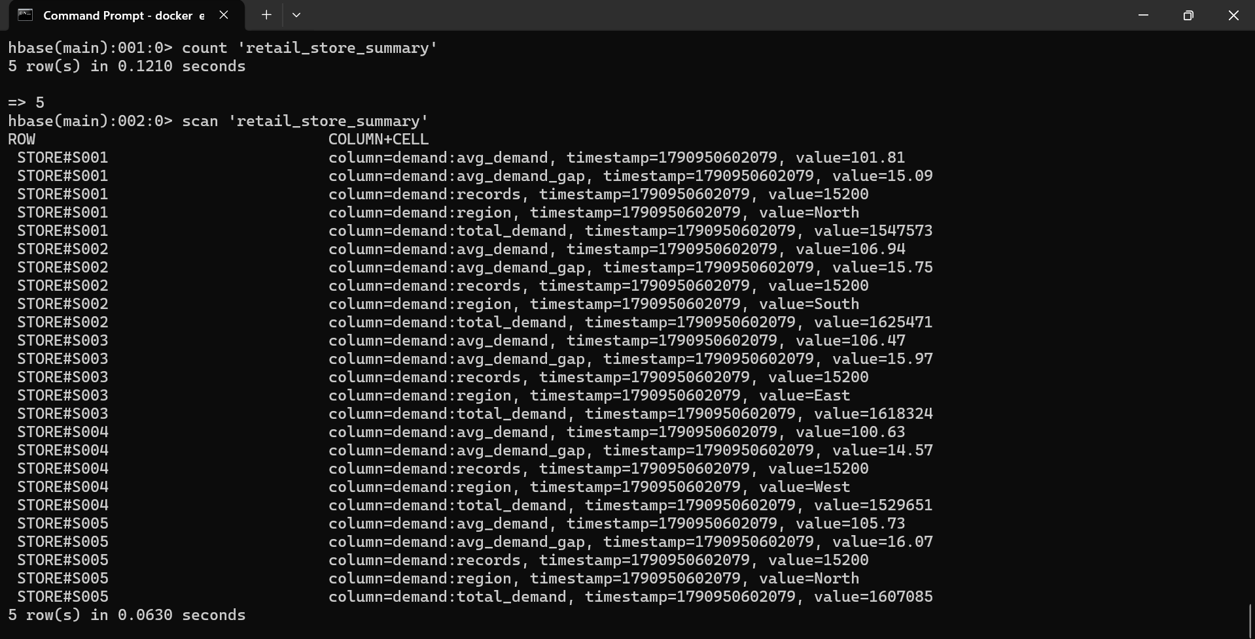
Hbase: Implementation and Verification
EXECUTION EVIDENCE
5
ROWS
validated by count
S001–S005
store row keys visible in scan
VALIDATION
count 'retail_store_summary'
scan 'retail_store_summary'
HBase count + scan: five store-summary rows loaded
Actual project demand summaries stored in HBase.

Slide 20
Key Findings and Hand-off
+30%
−38%
HAND-OFF TO STUDENT 4 AND 5
Cleaned data with features (Parquet)
Seven analysis tables and model metrics (CSV)
Random Forest predictions and feature importance
Summary tables suit HBase key-value lookups
demand lift from promotions, consistent across all five categories
lower average demand during epidemic periods
15%
0.495
discount level beyond which extra demand levels off
R² of the Random Forest on the held-out test period
18

Slide 21
Integration & Documentation
CSV
HDFS
Hive
Spark / PySpark
HBase
Final Results
Consolidated outputs from HDFS, Hive, Spark/PySpark and HBase into one project workflow
1
Documented the end-to-end flow: CSV → HDFS → Hive → Spark/PySpark → HBase → Final Results
2
Reviewed outputs from each team member and organized them into the final project structure
3
Prepared the README, project documentation and final results for reproducibility
4
Documented limitations, execution environments and individual contributions
5
19

Slide 22
Final Results & Validation
31.931
24.715
0.495
RMSE · Random Forest
MAE · Random Forest
R² · Random Forest
76,000
S002
5/5
retail records
5 stores · 16 attributes
1,625,471 units
highest total demand
stores matched (Spark vs HBase)
30/30 field-level values matched
Reviewed for consistency, correctness and completeness
20

Slide 23
Thank You
BIG DATA ANALYTICS CAPSTONE PROJECT
HDFS
1
Hive
2
Spark / PySpark
3
Spark MLlib
4
Retail Demand Forecasting · Big Data Analytics Pipeline
HBase
MSc Data Science and Analytics | Jain (Deemed-to-be) University
5
Aisha Rasifa PS · Abina A · Akhila Vaidya · Anuska Misra · Divyanshi Mishra

