Slide 1

XGBoost An Optimized Boosting Algorithm
Presented by Divyanshi, Arif Elshafea and Rabiya Malik
Course: Machine Learning (RNA) Instructor: Caryn Geady
July 24, 2025
Notes:
Speaker Notes: Good [morning/afternoon], everyone.
Today, our group—Divyanshi, Arif Elshafea, and Rabiya Malik—will be presenting our Capstone Project on XGBoost, a highly optimized and scalable boosting algorithm.
XGBoost is widely used in both academia and industry because of its speed, accuracy, and versatility, especially when working with structured or tabular data.
This project is part of the Machine Learning (RNA) course, under the guidance of our instructor, Caryn Geady.

Slide 2
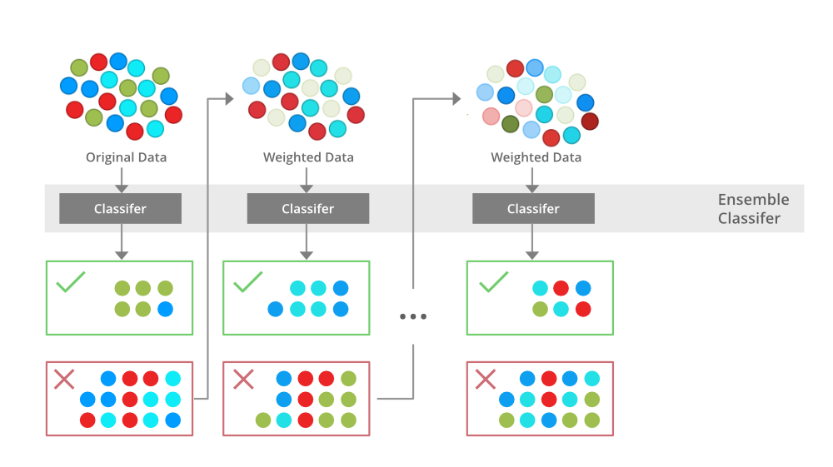
What is XGBoost?
XGBoost = Extreme Gradient Boosting
Ensemble method: Builds trees sequentially to correct past errors
Designed for:
High accuracy
Speed (parallel processing)
Scalability (big data, sparse data)
Widely used in:
Kaggle competitions
Fraud detection, ad click-through rate, bioinformatics, etc.
https://medium.com/@techynilesh/xgboost-algorithm-explained-in-less-than-5-minutes-b561dcc1ccee
Notes:
Speaker Notes: So, what exactly is XGBoost?
XGBoost stands for Extreme Gradient Boosting. It is an ensemble learning method—specifically, a boosting technique.
Unlike bagging methods that train models independently and average the results, boosting builds models sequentially, where each new model tries to correct the errors made by the previous ones.
XGBoost also adds performance improvements such as regularization, parallelization, and tree pruning, which make it not only accurate but also efficient.
It’s especially powerful for classification and regression problems involving structured datasets.

Slide 3
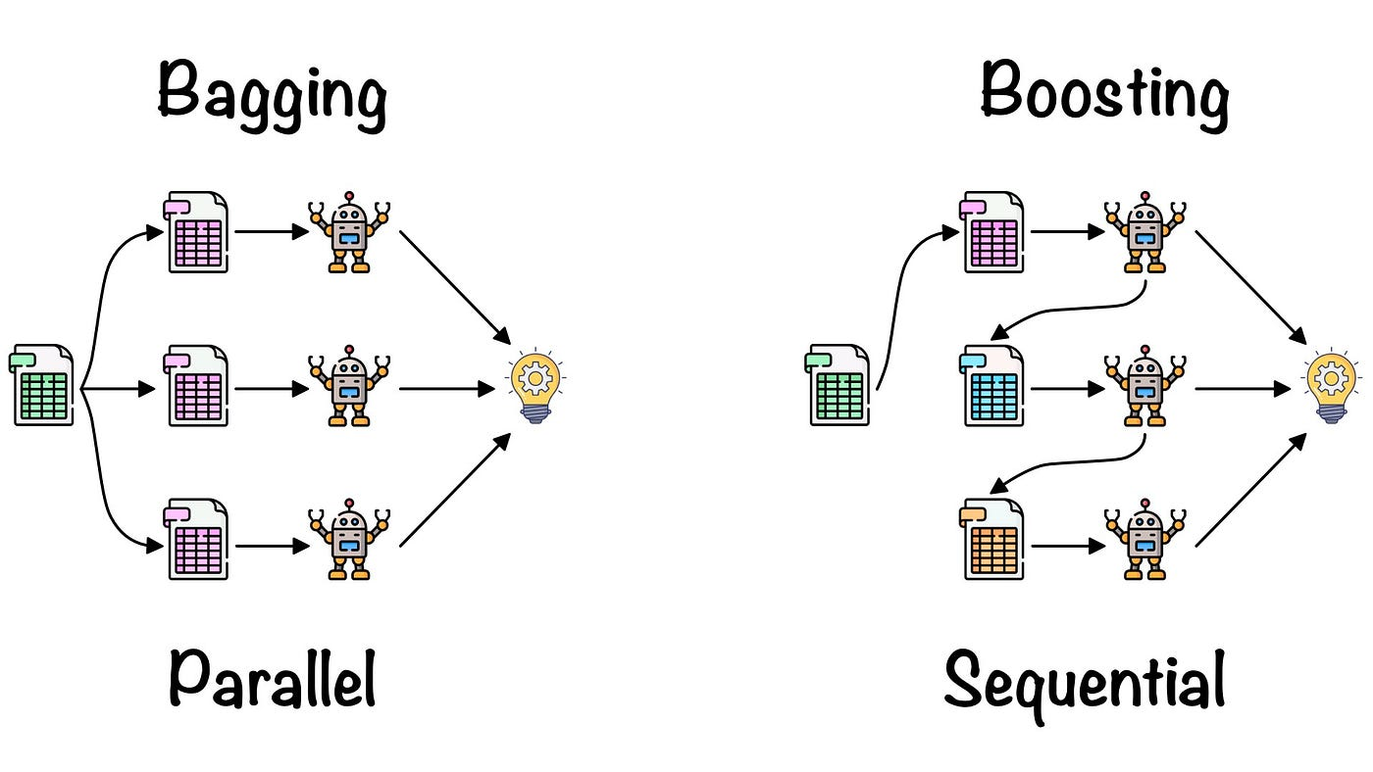
Boosting vs. Bagging
Visual Comparison 🟦 Bagging (Random Forest)
Trains trees in parallel
Reduces variance
Each tree has equal vote
🟥 Boosting (XGBoost)
Trains trees sequentially
Reduces bias
Later trees correct previous mistakes
Weighted vote
📌 Boosting = Sequential + Weighted + Lower Bias
https://medium.com/almabetter/xgboost-a-boosting-ensemble-b273a71de7a8
Notes:
Speaker Notes: This slide compares two ensemble methods: Bagging and Boosting.
On the left, we have Bagging, with Random Forest as a popular example. Bagging builds many trees in parallel and averages their predictions. It reduces variance and helps avoid overfitting.
On the right, Boosting—and specifically XGBoost—builds trees sequentially, with each tree learning from the mistakes of the previous one. This reduces bias and often leads to better generalization.
Also, unlike bagging where all trees vote equally, in boosting the trees are weighted based on their performance.
That’s why boosting is often better when you need strong performance from relatively simple base learners.

Slide 4

How XGBoost Works – Part 1
Gradient Boosting Recap
Trees trained iteratively
At each step, new tree fits residuals (errors)
Objective = Loss Function + Regularization
XGBoost Additions:
Regularized loss = better generalization
Tree pruning for efficiency
Shrinkage = learning rate
Notes:
Let's dive into how XGBoost works.
First, a quick recap of gradient boosting: it trains models iteratively, each time fitting to the residuals, or errors, from the previous model.
The goal is to minimize a loss function—such as log loss or mean squared error—plus a regularization term.
What makes XGBoost different is that it improves this process in several ways:
It adds regularized loss, which improves generalization and reduces overfitting.
It uses tree pruning to remove splits that don't improve performance, making it more efficient.
It also introduces shrinkage, also known as the learning rate, which slows down the training to prevent overfitting and improve accuracy.

Slide 5
How XGBoost Works – Part 2
Feature | Purpose
💡 L1 & L2 Regularization | Prevents overfitting
⚡ Parallel Tree Building | Speeds up training
🔍 Sparsity Aware | Handles missing values
📊 Quantile Sketch | Fast split finding
🛑 Early Stopping | Prevents unnecessary trees
XGBoost Innovations
Notes:
Building on the previous slide, here we highlight XGBoost’s unique innovations.
One of the biggest is its ability to handle sparse data efficiently using a sparsity-aware algorithm.
It also supports parallel computation, making it very fast—especially important when working with large datasets.
XGBoost also uses cache-aware access patterns and hardware optimization, which speed up model training.
Another important feature is regularization, which isn’t found in some earlier gradient boosting frameworks. This penalizes complex models to reduce overfitting.
Overall, these innovations make XGBoost both faster and more accurate than traditional gradient boosting methods.

Slide 6
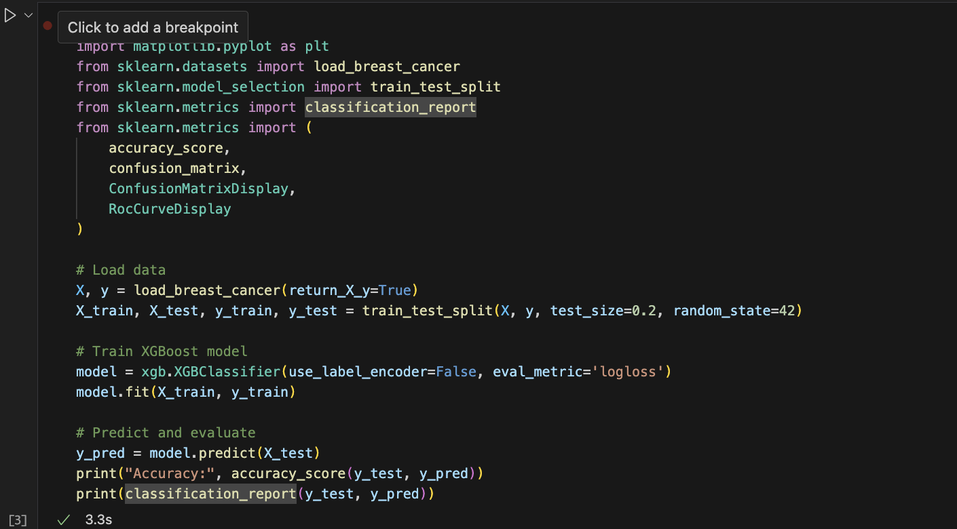
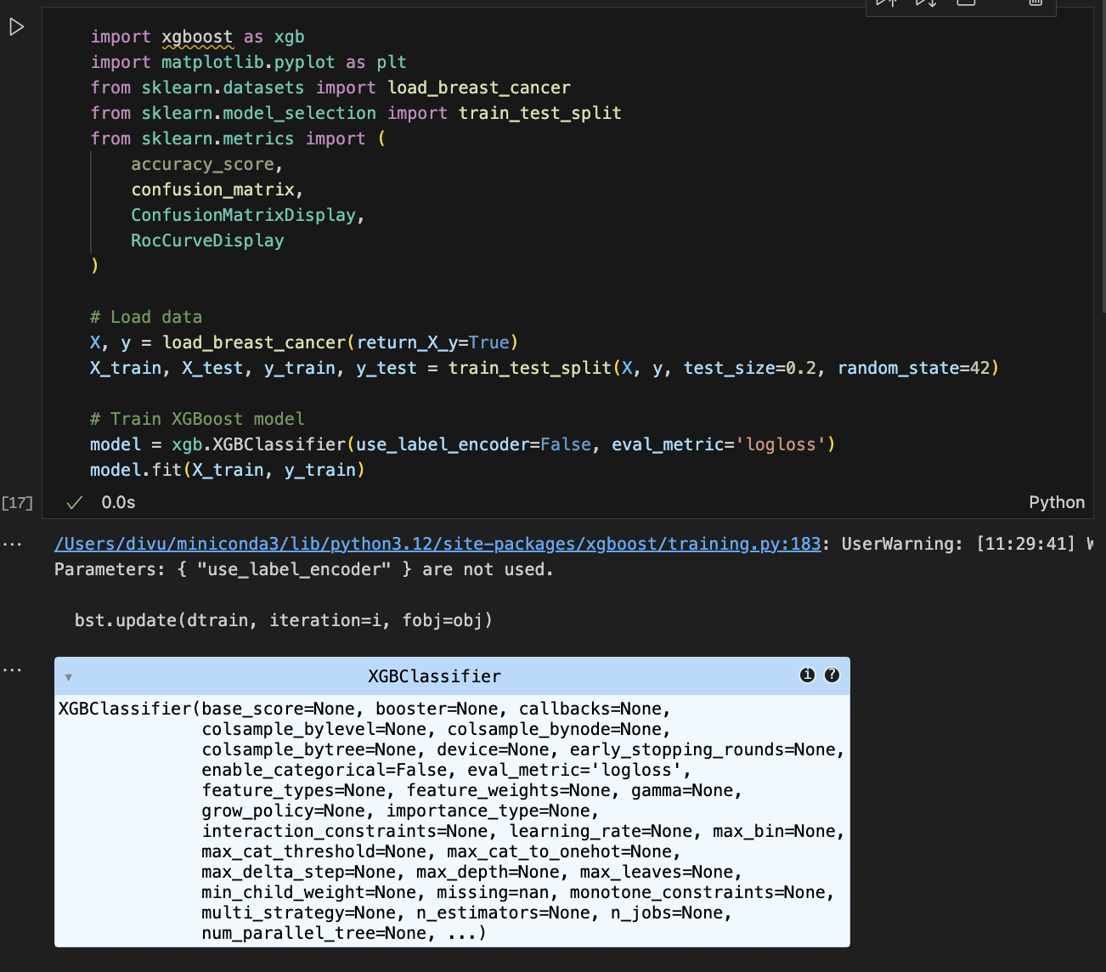
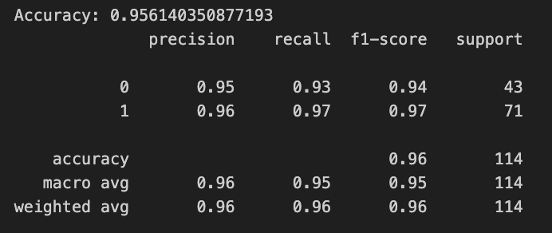
Python Code Walkthrough

Slide 7
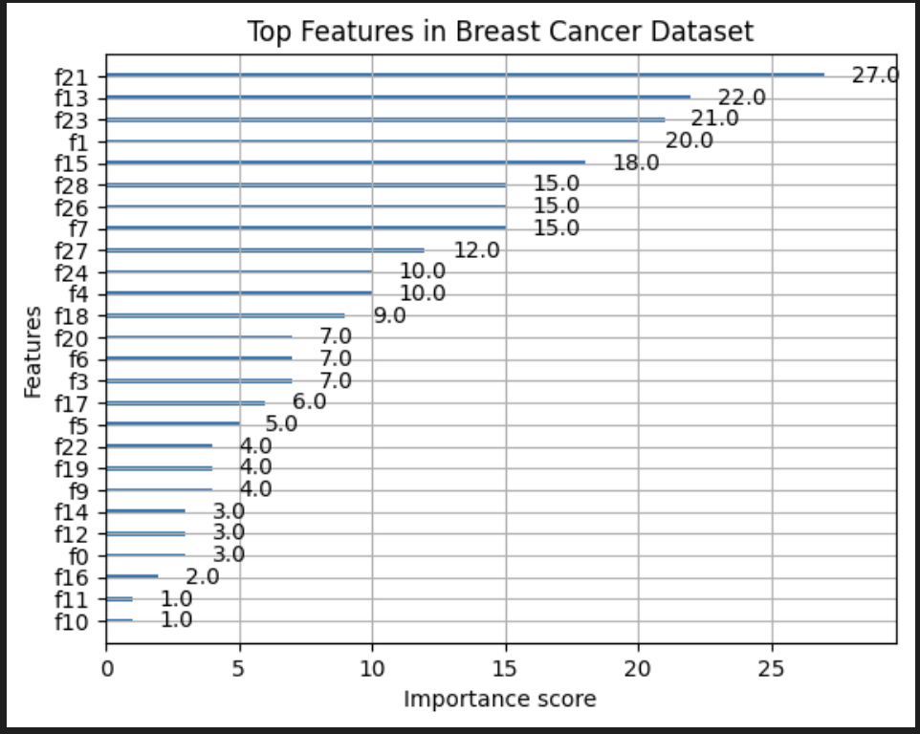
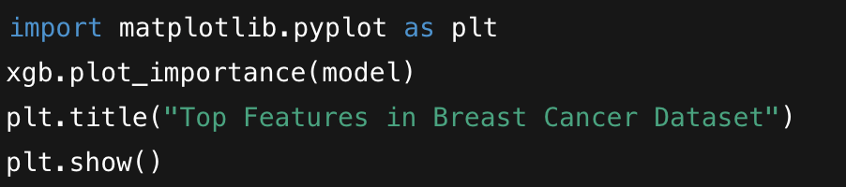
Feature Importance & Output Interpretation
📊 Helps explain which features drive the predictions (e.g., mean radius, texture)

Slide 8
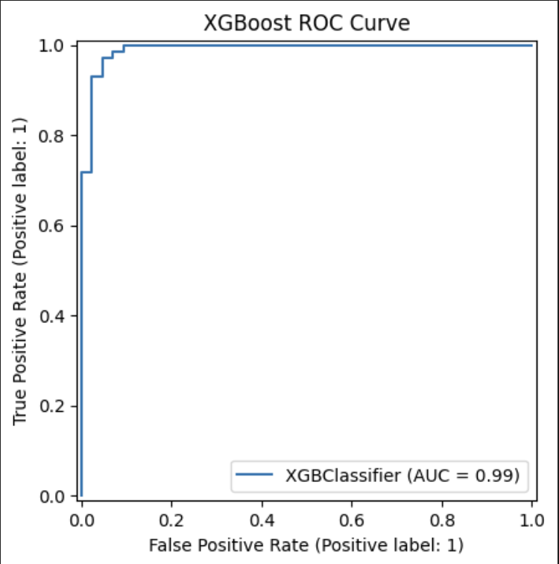
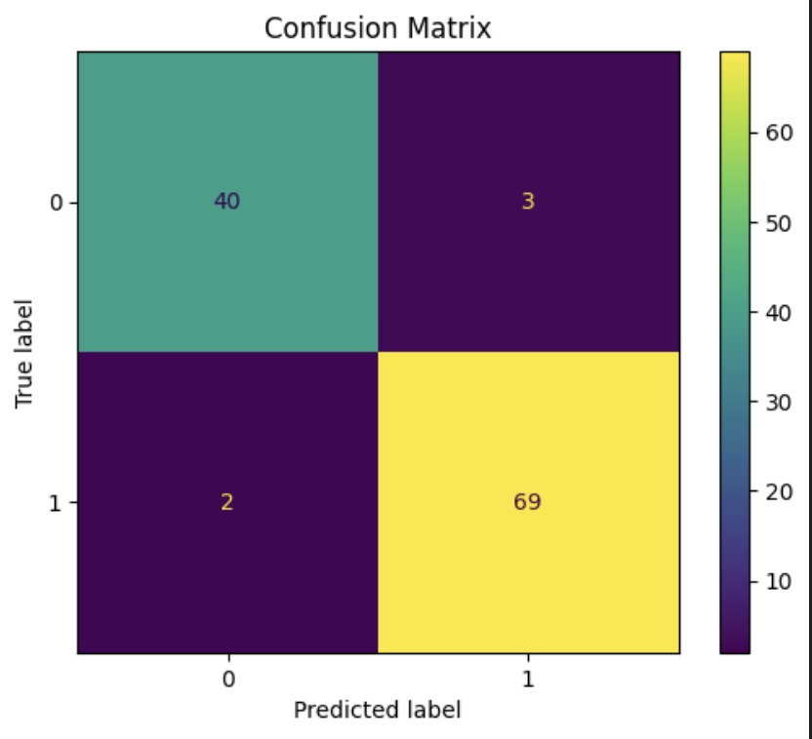
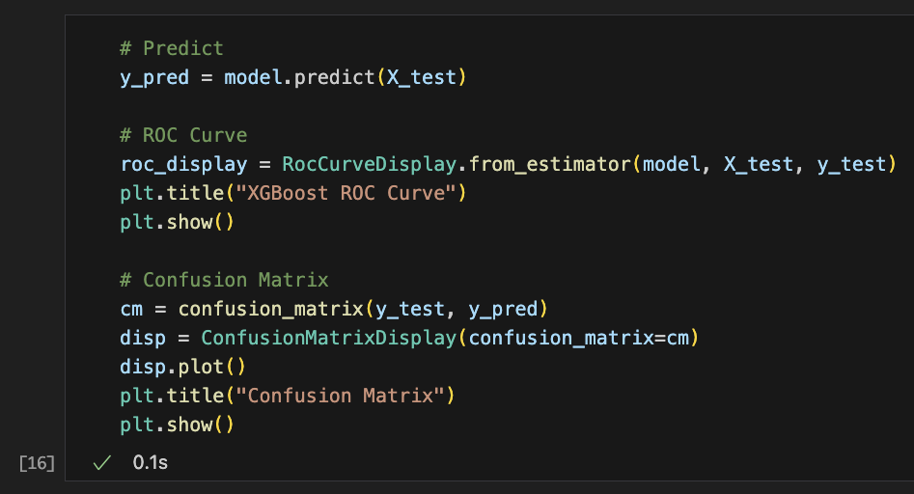
Model Performance Visualizations
ROC Curve: Model achieves high AUC, indicating strong discrimination power.
Confusion Matrix: Only 2 false negatives; sensitivity is high.

Slide 9
XGBoost vs Random Forest
Metric | XGBoost | Random Forest
Accuracy | 96.5% | 94.1%
Training Time | Faster | Slower
Overfitting | Less prone | More likely
Feature Importance | Built-in | Built-in
Visual Comparison:
Include ROC curves side by side
Use same train/test split for fairness
Key Insight: XGBoost offers higher accuracy + better generalization on this dataset.

Slide 10
Assumptions & Transformations
🧪 Dataset: sklearn.datasets.load_breast_cancer
✅ Balanced binary classification
✅ No missing values (XGBoost handles if there are)
No scaling needed
Default train/test split (80/20)
Evaluation: Accuracy + F1 + ROC-AUC
🔧 Transformations:

Slide 11
Summary & Takeaways
✅ XGBoost is:
Fast, scalable, and regularized
Works well on structured/tabular data
Less prone to overfitting than traditional decision trees
⚖️ Limitations:
Hyperparameter tuning can be compute-heavy
Interpretability lower than simpler models
🌐 Real-world use: Used in bioinformatics, customer churn, anomaly detection

Slide 12

Q&A
🤖 “If your data is tabular, use XGBoost.” Questions?

