Slide 1
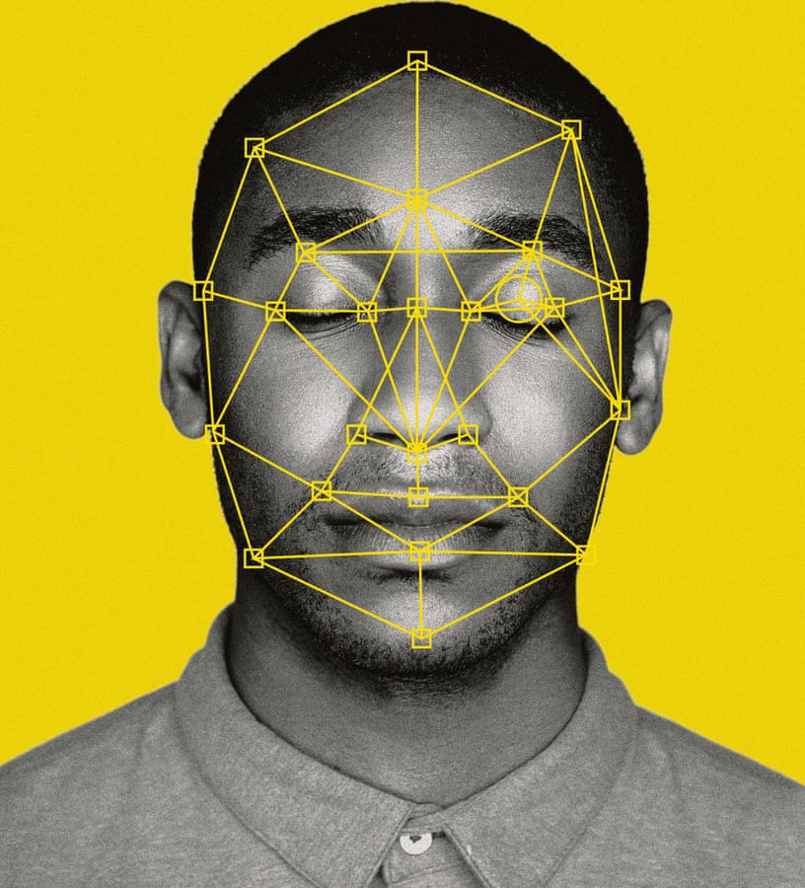
AI HACKATHON
Analytics Club & EarlySalary’s
Submission by:
Team Featuristic
Approach Used
Final Results
Future scope and Discussions

Slide 2
APPROACH USED
Feature Extraction
PCA
Cosine Similarity
Google FaceNet
After Experimentation
& Hyperparameter tuning
Optimal Approach
Step I. MTCNN
Step II. Google FaceNet
Step III. Random Forest Classifier
2
1
3
Face
Detection
Haar cascade
MTCNN
Feature Classification
SVM
XGBoost
ANN
Random Forest

Slide 3
FINAL RESULTS
Future Scope
& Discussions
Around 1% of the data wasn’t identified as facial images. Further work can be explored to produce better results on them
State-of-the-art Neural Network architectures can be explored for feature classification
Computationally better efficient methods can be explored for feature extraction
Over Train-Validation split of 16%
 | PRECISION | RECALL | F1-SCORE
0 | 0.89 | 0.98 | 0.94
1 | 0.96 | 0.79 | 0.87
MACRO AVG | 0.93 | 0.88 | 0.90
WEIGHTED AVG | 0.92 | 0.91 | 0.91
VALIDATION
ACCURACY
91%

