Slide 1

welcome

Slide 2

Operators and Set Operators in SQL
What are SQL Operators
Types
Parameters
Syntax
Working

Slide 3

What are Operators?
A special word
or character
Used to perform tasks.

Slide 4

Types of operators
Arithmetic Operators
Bitwise Operators
Comparison Operators
Compound Operators
Logical Operators
Set Operators

Slide 5

Arithmetic Operators
+ Add
- Subtract
* Multiply
/ Divide
% Modulo

Slide 6
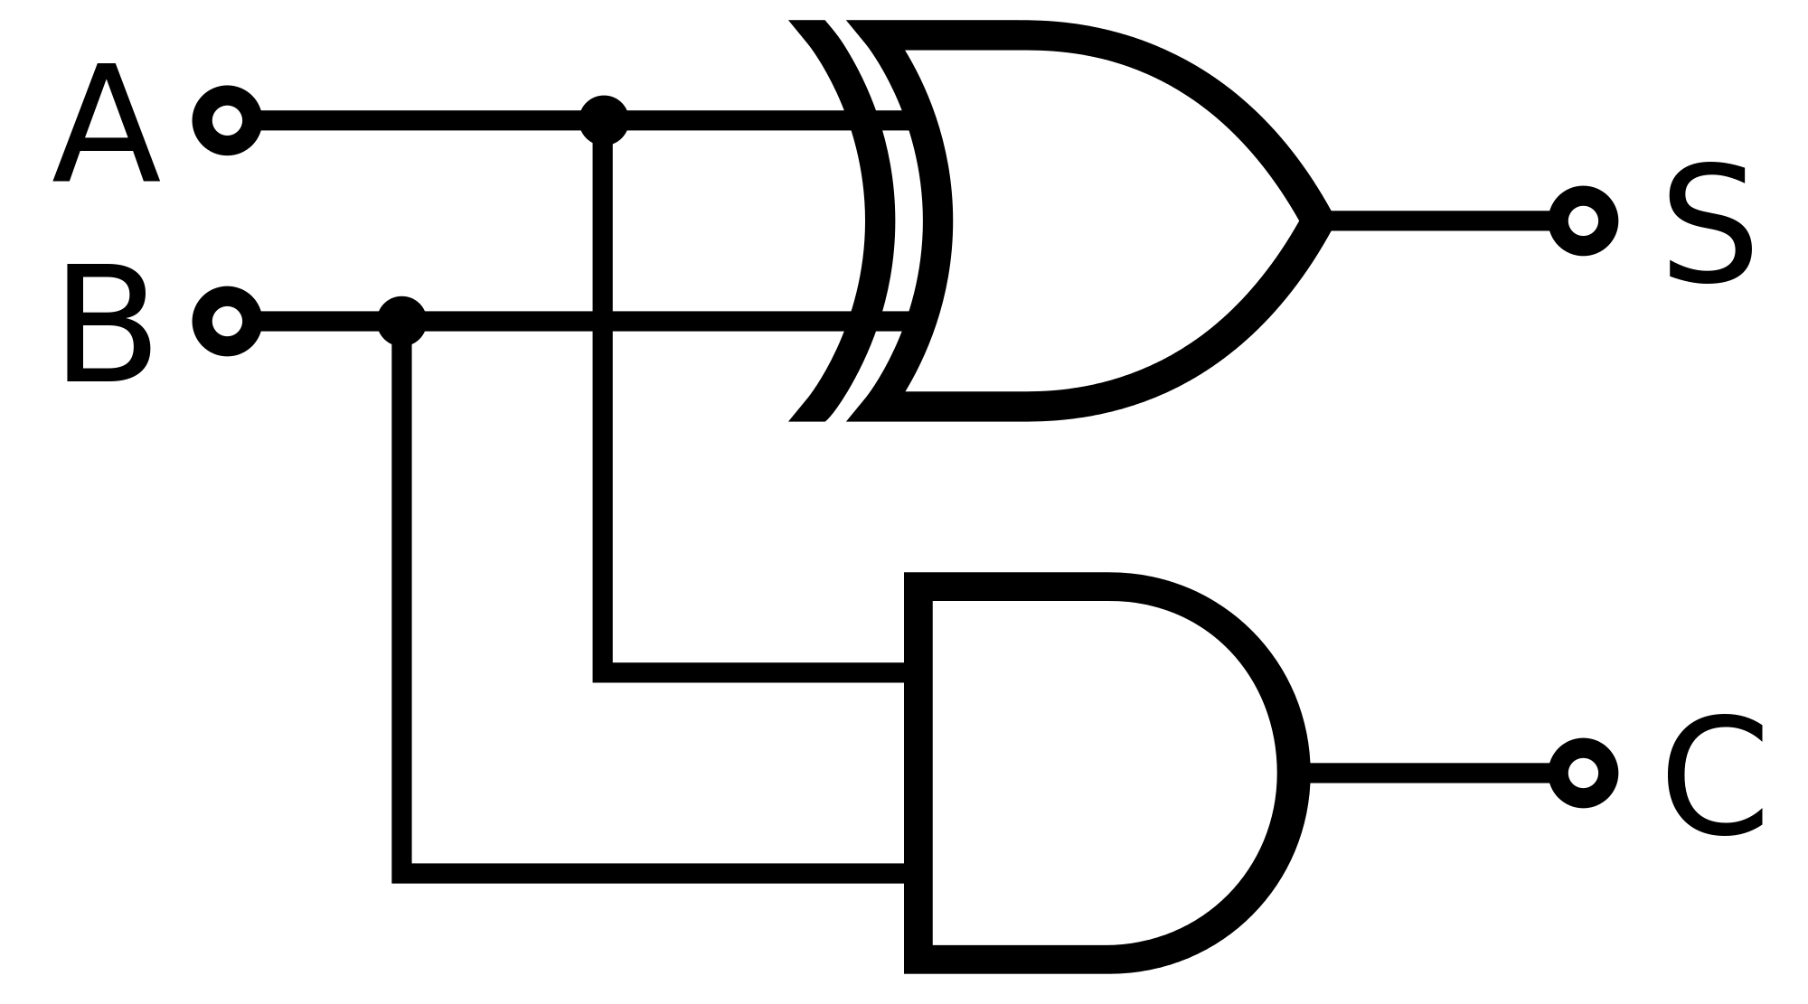
Bitwise Operators
& Bitwise AND
| Bitwise OR
^ Bitwise exclusive OR

Slide 7

Comparison Operators
= Equal to
> Greater than
< Less than
>= Greater than or equal to
<= Less than or equal to
<> Not equal to

Slide 8

Compound Operators
+= Add equals
-= Subtract equals
*= Multiply equals
/= Divide equals
%= Modulo equals
&= Bitwise AND equals
^-= Bitwise exclusive equals
|*= Bitwise OR equals

Slide 9


Logical Operators
ALL TRUE if all of the subquery values meet the condition
AND TRUE if all the conditions separated by AND is TRUE
ANY TRUE if any of the subquery values meet the condition
BETWEEN TRUE if the operand is within the range of comparisons
EXISTS TRUE if the subquery returns one or more records
IN TRUE if the operand is equal to one of a list of expressions
LIKE TRUE if the operand matches a pattern
NOT Displays a record if the condition(s) is NOT TRUE
OR TRUE if any of the conditions separated by OR is TRUE
SOME TRUE if any of the subquery values meet the condition

Slide 10

What are Set Operators?
Used to combine results

Slide 11
Types of Set Operators
Union
Union all
Intersect
Minus

Slide 12

Parameters
SET OPERATOR
column_name
FROM table_name_1
FROM table_name_2
May use:
WHERE GROUP BY
HAVING

Slide 13

Syntax
UNION
SELECT column_name FROM table_name_1 UNION
SELECT column_name FROM table_name_2;

Slide 14
Syntax
UNION ALL
SELECT column_name FROM table_name_1
UNION ALL
SELECT column_name FROM table_name_2;

Slide 15
Syntax
INTERSECT
SELECT column_name FROM table_name_1
INTERSECT
SELECT column_name FROM table_name_2;

Slide 16
Syntax
MINUS
SELECT column_name FROM table_name_1
MINUS
SELECT column_name FROM table_name_2;

Slide 17

Working
Some points to keep in mind
No. of columns must be same
Columns must have same data type
Must have same order

Slide 18

You have learnt
Types of set operators
Syntax
Working

Slide 19

The end

