Slide 1
Normalization

Slide 2
Partial Dependency
Y→A is a Partial Dependency ((Y is a proper subset of Candidate key X) AND(A is a
Non Prime Attribute))
Y→A is a Full Dependency ((Y is not a proper subset of Candidate key X) OR (A is a
Prime Attribute))
PD
NOTE: A relation will not be in 2NF iff a partial dependency exists
A
Y
X

Slide 3
Example 1:
A relation R(a,b,c,d) with candidate key {ab} with {a,b} as prime attributes and {c,d} as non prime attributes have a FD: a→cd. We can clearly say that this given FD:a→cd is a partial dependency as attribute a is a proper subset of Candidate key ab and cd are Non prime attributes. This violates both part of the statement
Y→A is a Partial Dependency ((Y is a proper subset of Candidate key X) AND(A is a
Non Prime Attribute))
Let us examine another FD:b→ac
This FD has a prime and non prime attributes on RHS therefore we shall break it into 2 FDs first as shown below:
FD1: b→a
FD2:b→c
Now we can see that FD1 is Full Functional Dependency as a is a prime attribute on RHS that satisfy the second part of the statement
Y→A is a Full Dependency ((Y is not a proper subset of Candidate key X) OR (A is a
Prime Attribute))
But FD2 is a partial dependency as b is a proper subset of Candidate key and also c is a non prime attribute

Slide 4
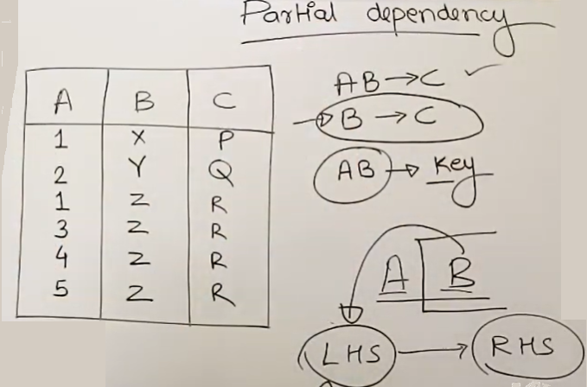
B→C is a partial dependency as B is a proper subset of AB and C is a non prime attribute. This dependency leads to redundancy as shown in red rounded rectangle

Slide 5
A relation Schema R is in 2NF if and only if relation is in 1NF and it does not contain any partial dependency.
OR
A relation Schema R is in 2NF if every Non Prime Attribute X in R is not partially dependent on any key of R

Slide 6
SOME FACTS ABOUT 2NF
A relation with all candidate keys as simple and atomic will be in 2NF as there cannot exist any partial dependency. Partial dependency may exist when we have 2 or more attributes in candidate keys but if a candidate key has only one attribute then LHS of any FD cannot become a proper subset of candidate key. Further we can say that 1 of the possibilities can exist.
Y
FFD
FFD
A
X=y
A
X
Y is not a proper subset of X and is rather equal to x
Y is not a subset of X

Slide 7
SOME FACTS ABOUT 2NF
A relation with all attributes as prime attributes will only have Full Functional dependencies and hence such a relation will be in 2NF.

Slide 8
An Example on 2NF
Ex: Normalize the relation R(a,b,c,d,e) to 2NF . R has following FDs {ab→c, c→d, b→e}
Soln:
We start by assuming that the relation already satisfies definition of 1NF as no explicit information about multi-valued attribute is given.
Next we need to find out all candidate keys and prime attributes in order to proceed further.
Look for attribute(s) that does not exists on the RHS of any FD.
We found a, b the only attributes that does not exists on RHS of any FD and hence will surely exists as either a part of a candidate key or will themselves form a candidate key. Let us therefore find out the closure of ab i.e. ab⁺
ab⁺ |abcde --closure has all attributes of R
Candidate Key={ab}
Prime Attributes={a,b}
Non-Prime Attributes={c,d,e}

Slide 9
ab⁺ |abcde --closure has all attributes of R
Candidate Key={ab}
Prime Attributes={a,b}
Non-Prime Attributes={c,d,e}
Now lets us find out whether any FD is a Partial Dependency or not.
We start with ab→c, this is a full functional dependency as ab is not a proper subset of candidate key{ab}.
Next c→d is also a full functional dependency as c is not a proper subset of candidate key{ab}(this violates first part of the statement
Next b→e is a partial dependency as b is proper subset of candidate key{ab} and also e is a non prime attribute. This satisfies following definition of partial dependency.
Y→A is a Full Dependency ((Y is not a proper subset of Candidate key X) OR (A is a
Prime Attribute))
Y→A is a Partial Dependency ((Y is a proper subset of Candidate key X) AND(A is a
Non Prime Attribute))

Slide 10
b→e
a | b | c | d | E
a1 | b1 |  |  | e1
a1 | b2 |  |  | e5
a2 | b1 |  |  | e1
a2 | b2 |  |  | e5
a3 | b1 |  |  | e1
REDUNDANCY
NOTE: Relation R is not in 2NF due to partial dependency b→e
We need to decompose relation R into 2 relations in such a way that the decomposition is:
A lossless decomposition
A dependency preserving decomposition
Let us create two relations first one as R1(a,b,c,d) and by pushing the violating FD and its attributes into (second )separate relation R2(b,e).
Here as we can see that attribute b is common between R1 and R2 it is lossless decomposition.
Also as ab→c and c→d exists in R1 and b→e exists in R2, the decomposition is also dependency preserving in nature.

Slide 11
R(abcde)
R1(abcd)
R2(be)
R1 and R2 are in 2NF
ab→c and c→d are full functional dependencies
b→e is a full functional dependency
a | b | c | d
a1 | b1 | c1 | d1
a1 | b2 | c1 | d1
a2 | b1 | c1 | d1
a2 | b2 | c2 | d2
a3 | b1 | c2 | d2
b | e
b1 | e1
b2 | e2
REDUNDANCY
R2(be)
R1(abcd)
Note: Redundancy due to FDs has reduced in 2NF and will further reduce in 3NF and will be 0% in BCNF

Slide 12
R is in 3NF ⟺∀FD^{NT}(X→Y)[(X is SK)∪(Y:PA)]
OR
A relation Schema R is in 3NF if and only if relation is in 2NF and no non prime attribute of R is transitively dependent on the Primary Key.
⇨ R is not on 3NF if ∃ a Transitive Dependency (X→Y)
This means--
(X→Y) is a transitive dependency ⟺[(X is not a SK)∩(Y: NPA)]

Slide 13
R is in 3NF ⟺∀FD^{NT}(X→A)[(X is SK)∪(A:PA)]
OR
A relation Schema R is in 3NF if whenever a non trivial FD x→A holds in R then either of the following is true:
X is the Super key of R
A is a prime attribute
∃

Slide 14
MEANING OF TRANSITIVE DEPENDENCY
(X→Y) is a transitive dependency ⟺[(X is not a SK)∩(Y: NPA)]
QUES: Let R (abcdef) be a relation with candidate keys{ab,cd} and prime attributes{abcd} check whether abe→f ,a→e and a→be are a transitive dependency or not.
Sol: Here abe is a super key as (abe) is a superset of candidate key(ab). This makes LHS of above condition false and therefore abe→f is not a transitive dependency.
Now for a→e a is not a super key and also e is a NPA, therefore a→e is a transitive dependency as it satisfies the above condition.
Further a→be is a special FD as its RHS is a combination of PA & NPA. We shall decompose it into 2FDs as a→b and a→e. a→e is already examined and was a transitive dependency. a→b is not a transitive dependency as a is a super key and b is PA thus violating both conditions .

Slide 15
Example on 3NF

Slide 16
R(abcde)
R1(abcd)
R2(be)
R1 and R2 are in 2NF
ab→c and c→d are full functional dependencies
b→e is a full functional dependency
b—e> is not a transitive dependency and therefore R2 is in 3NF
a | b | c | d
a1 | b1 | c1 | d1
a1 | b2 | c1 | d1
a2 | b1 | c1 | d1
a2 | b2 | c2 | d2
a3 | b1 | c2 | d2
b | e
b1 | e1
b2 | e2
REDUNDANCY
R2(be)
R1(abcd)

Slide 17
a | b | c | d
a1 | b1 | c1 | d1
a1 | b2 | c1 | d1
a2 | b1 | c1 | d1
a2 | b2 | c2 | d2
a3 | b1 | c2 | d2
R1(a,b,c,d) has FDs:
ab→c and c→d
Candidate Key={ab}
Prime Attributes={a,b}
Non-Prime Attributes={c,d}
REDUNDANCY
R1(abcd)
Here ab is a super key. This makes LHS of above condition false and therefore ab→c is not a transitive dependency.
Now for c→d c is not a super key and also d is a NPA, therefore c→d is a transitive dependency as it satisfies the above condition.
Hence relation R1(a,b,c,d) is not in 3NF due to FD c→d. Now let us decompose R1 into R11(a, b, c) and R12(c, d)

Slide 18
R1(abcd)
R11(abc)
R12(cd)
R11 and R12 are in 3NF
ab→c is not a transitive dependency
c→d is not a transitive dependency
NO REDUNDANCY
a | b | c
a1 | b1 | c1
a1 | b2 | c1
a2 | b1 | c1
a2 | b2 | c2
a3 | b1 | c2
c | d
c1 | d1
c2 | d2
REDUCED REDUNDANCY
Also it is not due to any FD
R12(cd)
R11(abc)

