Slide 1

Slide 18- <number>

Slide 2
Chapter 18
Concurrency Control Techniques
Copyright © 2007 Ramez Elmasri and Shamkant B. Navathe

Slide 3
Chapter 18 Outline
Databases Concurrency Control
  Purpose of Concurrency Control
  Two-Phase locking
  Limitations of CCMs
  Index Locking
  Lock Compatibility Matrix
  Lock Granularity
Slide 18- <number>

Slide 4
Database Concurrency Control
1 Purpose of Concurrency Control
  To enforce Isolation (through mutual exclusion) among conflicting transactions.
  To preserve database consistency through consistency preserving execution of transactions.
  To resolve read-write and write-write conflicts.
Example:
  In concurrent execution environment if T1 conflicts with T2 over a data item A, then the existing concurrency control decides if T1 or T2 should get the A and if the other transaction is rolled-back or waits.
Slide 18- <number>

Slide 5
Database Concurrency Control
Two-Phase Locking Techniques
  Locking is an operation which secures
    (a) permission to Read
    (b) permission to Write a data item for a transaction.
  Example:
    Lock (X). Data item X is locked in behalf of the requesting transaction.
  Unlocking is an operation which removes these permissions from the data item.
  Example:
    Unlock (X): Data item X is made available to all other transactions.
  Lock and Unlock are Atomic operations.
Slide 18- <number>

Slide 6
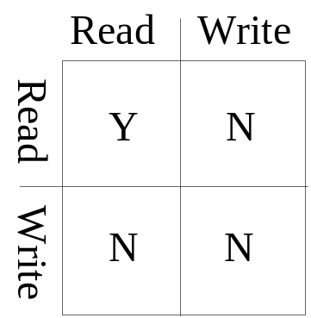
Database Concurrency Control
Two-Phase Locking Techniques: Essential components
  Two locks modes:
    (a) shared (read) (b) exclusive (write).
  Shared mode: shared lock (X)
    More than one transaction can apply share lock on X for reading its value but no write lock can be applied on X by any other transaction.
  Exclusive mode: Write lock (X)
    Only one write lock on X can exist at any time and no shared lock can be applied by any other transaction on X.
  Conflict matrix
Slide 18- <number>

Slide 7
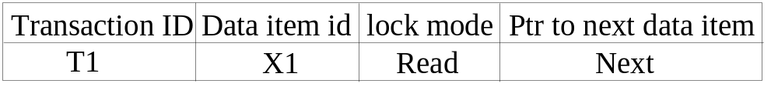
Database Concurrency Control
Two-Phase Locking Techniques: Essential components
  Lock Manager:
    Managing locks on data items.
  Lock table:
    Lock manager uses it to store the identify of transaction locking a data item, the data item, lock mode and pointer to the next data item locked. One simple way to implement a lock table is through linked list.
Slide 18- <number>

Slide 8
Database Concurrency Control
Two-Phase Locking Techniques: Essential components
  Database requires that all transactions should be well-formed. A transaction is well-formed if:
    It must lock the data item before it reads or writes to it.
    It must not lock an already locked data items and it must not try to unlock a free data item.
Slide 18- <number>

Slide 9
Database Concurrency Control
Two-Phase Locking Techniques: Essential components
  The following code performs the lock operation:
  B: if LOCK (X) = 0 (*item is unlocked*)
  then LOCK (X) ← 1 (*lock the item*)
  else begin
  wait (until lock (X) = 0) and
  the lock manager wakes up the transaction);
  goto B
  end;
Slide 18- <number>

Slide 10
Database Concurrency Control
Two-Phase Locking Techniques: Essential components
  The following code performs the unlock operation:
  LOCK (X) ← 0 (*unlock the item*)
  if any transactions are waiting then
  wake up one of the waiting the transactions;
Slide 18- <number>

Slide 11
Database Concurrency Control
Two-Phase Locking Techniques: Essential components
  The following code performs the read operation:
B: if LOCK (X) = “unlocked” then
  begin LOCK (X) ← “read-locked”;
  no_of_reads (X) ← 1;
  end
  else if LOCK (X) ← “read-locked” then
  no_of_reads (X) ← no_of_reads (X) +1
  else begin wait (until LOCK (X) = “unlocked” and
  the lock manager wakes up the transaction);
  go to B
  end;
Slide 18- <number>

Slide 12
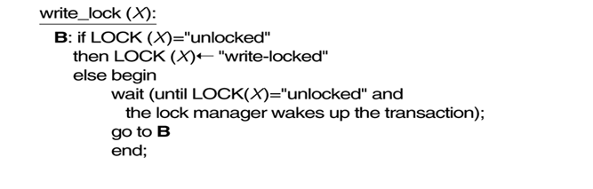
Database Concurrency Control
Two-Phase Locking Techniques: Essential components
  The following code performs the write lock operation:
Slide 18- <number>

Slide 13
Database Concurrency Control
Two-Phase Locking Techniques: Essential components
  The following code performs the unlock operation:
if LOCK (X) = “write-locked” then
  begin LOCK (X) ← “unlocked”;
  wakes up one of the transactions, if any
  end
  else if LOCK (X) ← “read-locked” then
  begin
  no_of_reads (X) ← no_of_reads (X) -1
  if no_of_reads (X) = 0 then
  begin
  LOCK (X) = “unlocked”;
  wake up one of the transactions, if any
  end
  end;
Slide 18- <number>

Slide 14
Database Concurrency Control
Two-Phase Locking Techniques: Essential components
Lock conversion
  Lock upgrade: existing read lock to write lock
if Ti has a read-lock (X) and Tj has no read-lock (X) (i ≠ j) then
  convert read-lock (X) to write-lock (X)
  else
  force Ti to wait until Tj unlocks X
  Lock downgrade: existing write lock to read lock
  Ti has a write-lock (X) (*no transaction can have any lock on X*)
  convert write-lock (X) to read-lock (X)
Slide 18- <number>

Slide 15
Database Concurrency Control
Two-Phase Locking Techniques: The algorithm
Two Phases:
  (a) Locking (Growing)
  (b) Unlocking (Shrinking).
Locking (Growing) Phase:
  A transaction applies locks (read or write) on desired data items one at a time.
Unlocking (Shrinking) Phase:
  A transaction unlocks its locked data items one at a time.
Requirement:
  For a transaction these two phases must be mutually exclusively, that is, during locking phase unlocking phase must not start and during unlocking phase locking phase must not begin.
Slide 18- <number>

Slide 16
Database Concurrency Control
Two-Phase Locking Techniques: The algorithm
T1 T2 Result
read_lock (Y); read_lock (X); Initial values: X=20; Y=30
read_item (Y); read_item (X); Result of serial execution
unlock (Y); unlock (X); T1 followed by T2
write_lock (X); Write_lock (Y); X=50, Y=80.
read_item (X); read_item (Y); Result of serial execution
X:=X+Y; Y:=X+Y; T2 followed by T1
write_item (X); write_item (Y); X=70, Y=50
unlock (X); unlock (Y);
Transactions T1 and T2 do not follow the two-phase locking protocol. This is because the write_lock(X) operation follows the unlock(Y) operation in T1, and similarly the write_lock(Y) operation follows the unlock(X) operation in T2•
Slide 18- <number>

Slide 17
Database Concurrency Control
Result of 2 possible serial schedules:
Initial values: X=20; Y=30
Result of serial execution T1 followed by T2
X=50, Y=80.
Result of serial execution T2 followed by T1
X=70, Y=50
Slide 18- <number>

Slide 18
Database Concurrency Control
Nonserializable Schedule
T1 T2 Result
read_lock (Y); X=50; Y=50
read_item (Y); Nonserializable because it.
unlock (Y); violated two-phase policy.
read_lock (X);
read_item (X);
unlock (X);
write_lock (Y);
read_item (Y);
Y:=X+Y;
write_item (Y);
unlock (Y);
write_lock (X);
read_item (X);
X:=X+Y;
write_item (X);
unlock (X);
Time
Slide 18- <number>

Slide 19
Database Concurrency Control
Schedule that follow Two-Phase Locking Techniques
T’1 T’2
read_lock (Y); read_lock (X); T1 and T2 follow two-phase
read_item (Y); read_item (X); policy but they are subject to
write_lock (X); Write_lock (Y); deadlock, which must be
unlock (Y); unlock (X); dealt with.
read_item (X); read_item (Y);
X:=X+Y; Y:=X+Y;
write_item (X); write_item (Y);
unlock (X); unlock (Y);
Slide 18- <number>

Slide 20
Limitation of 2PL
Two-phase locking may limit the amount of concurrency that can occur in a schedule.
This is because a transaction T may not be able to release an item X after it is through using it if T must lock an additional item Y later on;
or conversely, T must lock the additional item Y before it needs it so that it can release X. Hence, X must remain locked by T until all items that the transaction needs to read or write have been locked; only then can X be released by T.
Meanwhile, another transaction seeking to access X may be forced to wait, even though T is done with X; conversely, if Y is locked earlier than it is needed, another transaction seeking to access Y is forced to wait even though T is not using Y yet. This is the price for guaranteeing serializability of all schedules without having to check the schedules themselves.
Slide 18- <number>

Slide 21
Database Concurrency Control
Types of Two-Phase Locking Techniques:
Basic:
  Transaction locks data items incrementally. This may cause deadlock which is dealt with.
Conservative:
Prevents deadlock by locking all desired data items before transaction begins execution, by pre declaring its read-set and write-set. the read-set of a transaction is the set of all items that the transaction reads, and the write-set is the set of all items that it writes. If any of the pre declared items needed cannot be locked, the transaction does not lock any item; instead, it waits until all the items are available for locking. Conservative 2PL is a deadlock-free protocol, However, it is difficult to use in practice because of the need to pre declare the read-set and write-set, which is not possible in most situations.
Slide 18- <number>

Slide 22
Database Concurrency Control
Strict 2PL:
The most popular variation of 2PL is strict 2PL, which guarantees strict schedules. In this variation, a transaction T does not release any of its exclusive (write) locks until after it commits or aborts. Hence, no other transaction can read or write an item that is written by T unless T has committed, leading to a strict schedule for recoverability. Strict 2PL is not deadlock-free.
Rigorous 2PL:
A more restrictive variation of strict 2PL is rigorous 2PL, which also guarantees strict schedules. In this variation, a transaction T does not release any of its locks (exclusive or shared) until after it commits or aborts, and so it is easier to implement than strict 2pL.
Slide 18- <number>

Slide 23
Database Concurrency Control
Dealing with Deadlock and Starvation
  Deadlock
T’1 T’2
read_lock (Y); T1 and T2 did follow two-phase
read_item (Y); policy but they are deadlock
read_lock (X);
read_item (Y);
write_lock (X);
(waits for X) write_lock (Y);
(waits for Y)
  Deadlock (T’1 and T’2)
Slide 18- <number>

Slide 24
Database Concurrency Control
Dealing with Deadlock and Starvation
Deadlock prevention
  A transaction locks all data items it refers to before it begins execution.
  This way of locking prevents deadlock since a transaction never waits for a data item.
  The conservative two-phase locking uses this approach.
Slide 18- <number>

Slide 25
Database Concurrency Control
Dealing with Deadlock and Starvation
Deadlock detection and resolution
  In this approach, deadlocks are allowed to happen. The scheduler maintains a wait-for-graph for detecting cycle. If a cycle exists, then one transaction involved in the cycle is selected (victim) and rolled-back.
  A wait-for-graph is created using the lock table. As soon as a transaction is blocked, it is added to the graph. When a chain like: Ti waits for Tj waits for Tk waits for Ti or Tj occurs, then this creates a cycle. One of the transaction is aborted
Slide 18- <number>

Slide 26
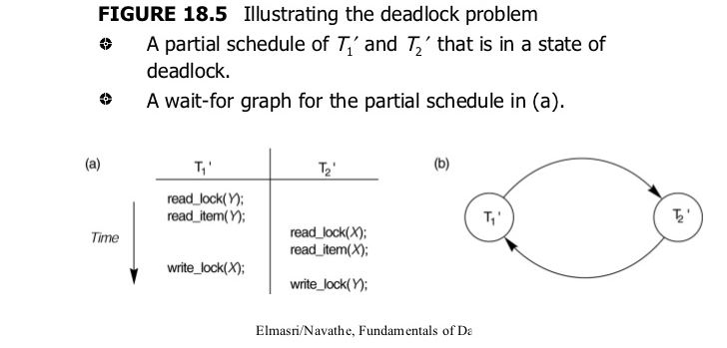
Slide 18- <number>

Slide 27
Database Concurrency Control
Dealing with Deadlock and Starvation
Deadlock avoidance
  There are many variations of two-phase locking algorithm.
  Some avoid deadlock by not letting the cycle to complete.
  That is as soon as the algorithm discovers that blocking a transaction is likely to create a cycle, it rolls back the transaction.
  Wound-Wait and Wait-Die algorithms use timestamps to avoid deadlocks by rolling-back victim.
Slide 18- <number>

Slide 28
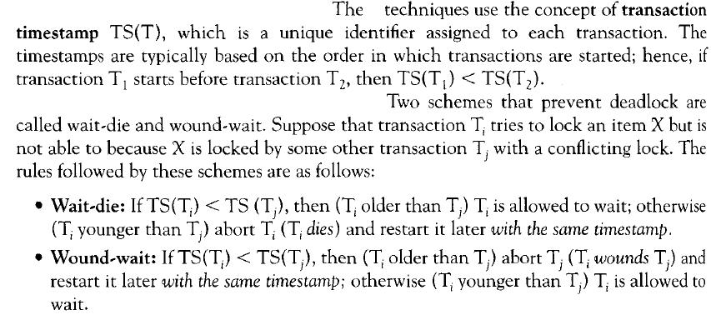
Deadlock Prevention Techniques
Slide 18- <number>

Slide 29
In wait-die, an older transaction is allowed to wait on a younger transaction, whereas a younger transaction requesting an item held by an older transaction is aborted and
restarted. The wound-wait approach does the opposite: A younger transaction is allowed to wait on an older one, whereas an older transaction requesting an item held by a
younger transaction preempts the younger transaction by aborting it. Both schemes end up aborting the younger of the two transactions that may be involved in a deadlock. It can be
shown that these two techniques are deadlock-free, since in wait-die, transactions only wait on younger transactions so no cycle is created. Similarly, in wound-wait, transactions only wait on older transactions so no cycle is created. However, both techniques may cause some transactions to be aborted and restarted needlessly, even though those transactions may never actually cause a deadlock.
Slide 18- <number>

Slide 30
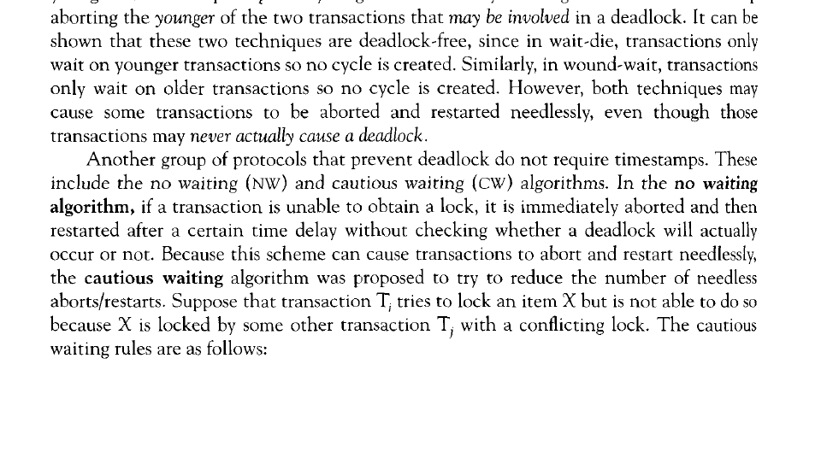
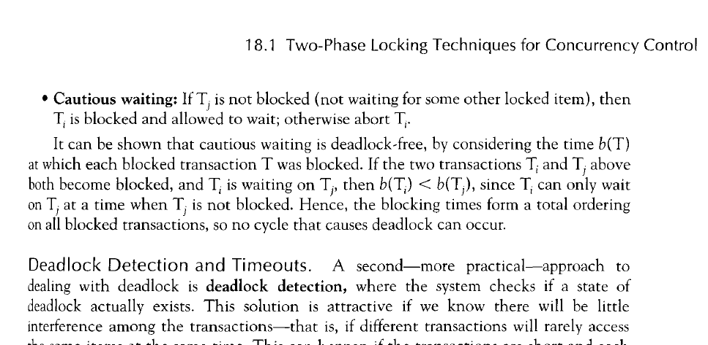
Slide 18- <number>

Slide 31
Database Concurrency Control
Dealing with Deadlock and Starvation
Starvation
  Starvation occurs when a particular transaction consistently waits or restarted and never gets a chance to proceed further.
  In a deadlock resolution it is possible that the same transaction may consistently be selected as victim and rolled-back.
  This limitation is inherent in all priority based scheduling mechanisms.
  In Wound-Wait scheme a younger transaction may always be wounded (aborted) by a long running older transaction which may create starvation.
Slide 18- <number>

Slide 32
This may occur if the waiting scheme for locked items is unfair, giving priority to some transactions over others. One solution for starvation is to have a fair waiting scheme, such as using a first-come-first-served queue; transactions are enabled to lock an item in the order in which they originally requested the lock.
Another scheme allows some transactions to have priority over others but increases the priority of a transaction the longer it waits, until it eventually gets the highest priority and proceeds. Starvation can also occur because of victim selection if the algorithm selects the same transaction as victim repeatedly, thus causing it to abort and never finish execution. The algorithm can use higher priorities for transactions that have been aborted multiple times to avoid this problem.
Slide 18- <number>

Slide 33
Database Concurrency Control
Timestamp based concurrency control algorithm
Timestamp
  A monotonically increasing variable (integer) indicating the age of an operation or a transaction. A larger timestamp value indicates a more recent event or operation.
  Timestamp based algorithm uses timestamp to serialize the execution of concurrent transactions.
Slide 18- <number>

Slide 34
Database Concurrency Control
Timestamp based concurrency control algorithm
Basic Timestamp Ordering
  1. Transaction T issues a write_item(X) operation:
    If read_TS(X) > TS(T) or if write_TS(X) > TS(T), then an younger transaction has already read the data item so abort and roll-back T and reject the operation.
    If the condition in part (a) does not exist, then execute write_item(X) of T and set write_TS(X) to TS(T).
  2. Transaction T issues a read_item(X) operation:
    If write_TS(X) > TS(T), then an younger transaction has already written to the data item so abort and roll-back T and reject the operation.
    If write_TS(X) ≤ TS(T), then execute read_item(X) of T and set read_TS(X) to the larger of TS(T) and the current read_TS(X).
Slide 18- <number>

Slide 35
Slide 18- <number>

Slide 36
Database Concurrency Control
Timestamp based concurrency control algorithm
Strict Timestamp Ordering
  1. Transaction T issues a write_item(X) operation:
    If TS(T) > read_TS(X), then delay T until the transaction T’ that wrote or read X has terminated (committed or aborted).
  2. Transaction T issues a read_item(X) operation:
    If TS(T) > write_TS(X), then delay T until the transaction T’ that wrote or read X has terminated (committed or aborted).
Slide 18- <number>

Slide 37
Database Concurrency Control
Timestamp based concurrency control algorithm
Thomas’s Write Rule
  If read_TS(X) > TS(T) then abort and roll-back T and reject the operation.
  If write_TS(X) > TS(T), then just ignore the write operation and continue execution. This is because the most recent writes counts in case of two consecutive writes.
  If the conditions given in 1 and 2 above do not occur, then execute write_item(X) of T and set write_TS(X) to TS(T).
Slide 18- <number>

