Slide 1
User Defined Functions

Slide 2
PHP Functions
Defining a Function
Calling A function
Variable Scope(Global variable& Static Variables)

Slide 3
What is a function?
A function takes some arguments (inputs) and does something with them (echo, for example, outputs the text input to the user).
As well as the inbuilt PHP functions, we can define our own functions..

Slide 4
Definition vs. Calling
There are two distinct aspects to functions:
Definition: Before using a function, that function must be defined – i.e. what inputs does it need, and what does it do with them?
Calling: When you call a function, you actually execute the code in the function.

Slide 5
Function Definition
A function accepts any number of input arguments, and returns a SINGLE value.
The function name can start with a letter or underscore (not a number)
A function will be executed by a call to the function.
You may call a function from anywhere within a page
function myfunction($arg1,$arg2,…,$argN)
{
statements;
return $return_value;
}

Slide 6
Example
Function to join first and last names together with a space..
function make_name($first,$last)
{
$fullname = $first.’ ‘.$last;
return $fullname;
}

Slide 7
Function Example: Factorial
function fact($n)
{
if ($n <= 1) return 1;
return ($n * fact($n-1));
}
print(fact(5)); // Outputs 120

Slide 8
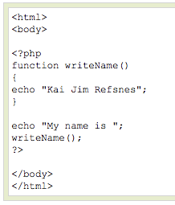
PHP Functions
A simple function that writes a name when it is called:

Slide 9
PHP Functions - Parameters
Adding parameters...
> To add more functionality to a function, we can add parameters. A parameter is just like a variable.
> Parameters are specified after the function name, inside the parentheses.

Slide 10
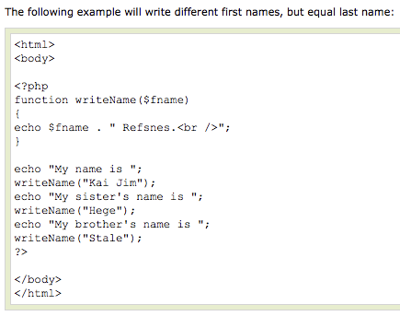
PHP Functions - Parameters

Slide 11

PHP Functions - Parameters

Slide 12
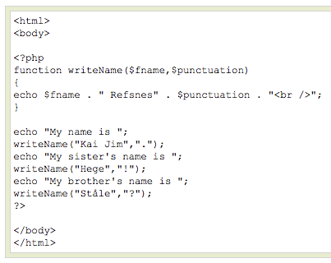
PHP Functions - Parameters
This example adds different punctuation.

Slide 13

PHP Functions - Parameters

Slide 14
Scoping
Variables defined in a function are local to that function only and by default variables are pass by value
function foo($x,$y)
{
$z=1;
$x=$y + $z;
print($x); // Outputs 21
}
$x=10;
$y=20;
foo($x,$y);
print(“$x $y<p>”); // Outputs 10 20

Slide 15
Scope
Variables declared outside of functions, classes are global to the script, outside of function blocks
Unlike C! Global variables are not automatically available to functions
Example:
$a = 1; /* global scope */
function Test()
{
echo $a; /* reference to local scope variable */
}
Test();

Slide 16
Variable Scope
Access to global variables inside functions
Explicitly declare variable as global
global $a, $b;
Use the $GLOBALS array
$foo = $GLOBALS[“a”]

