Slide 1
UNIT IV (WBP)

Slide 2
Overview of Unit –IV
Overview of MYSQL database
Using PHP to Access a Database
phpMyAdmin
Relational Databases and SQL
PHP Data Objects (PDO)
MySQLi Object Interface
SQLite
MongoDB
Introduction to MySQL
Creating Database and other operations on database
Querying a MySQL Databases with PHP
Connecting to a Database
Parsing of the Query Results
Checking Data Errors

Slide 3
Overview of MYSQL database
MySQL is a popular open-source database management system
MySQL is a database system used on the web
MySQL is a database system that runs on a server
MySQL is ideal for both small and large applications
MySQL is very fast, reliable, and easy to use
MySQL uses standard SQL
MySQL compiles on a number of platforms

Slide 4
Overview of MYSQL database
MySQL is free to download and use
MySQL is developed, distributed, and supported by Oracle Corporation
MySQL is named after co-founder Monty Widenius's daughter: My
MySQL is an SQL (Structured Query Language) based relational database management system (DBMS)
MySQL is compatible with standard SQL
MySQL is frequently used by PHP and Perl

Slide 5
Using PHP to Access a Database
The steps required to access data from a table in a database provided by MYSQL can be summarized as follows:
Establish or open a connection to the MYSQL server.
Select a database.
Execute the query against the database.
Process the result returned by the server.
Close the connection

Slide 6
phpMyAdmin
phpMyAdmin is a free software tool written in PHP, intended to handle the administration of MySQL over the Web.
phpMyAdmin supports a wide range of operations on MySQL and MariaDB.
Frequently used operations (managing databases, tables, columns, relations, indexes, users, permissions, etc) can be performed via the user interface, while you still have the ability to directly execute any SQL statement.

Slide 7
Features of phpMyAdmin
Intuitive web interface
Support for most MySQL features:
browse and drop databases, tables, views, fields and indexes
create, copy, drop, rename and alter databases, tables, fields and indexes
manage MySQL user accounts and privileges
manage stored procedures and triggers

Slide 8
Features of phpMyAdmin
Import data from CSV and SQL
Export data to various formats: CSV, SQL, XML, PDF, ISO/IEC 26300 - OpenDocument Text and Spreadsheet, Word, L^{A}T_{E}X and others
Creating graphics of your database layout in various formats
Searching globally in a database or a subset of it
Transforming stored data into any format using a set of predefined functions, like displaying BLOB-data as image or download-link

Slide 9
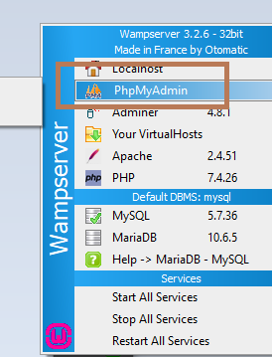
Using phpMyAdmin
Start Wampserver and click on phpMyAdmin in the menu.

Slide 10
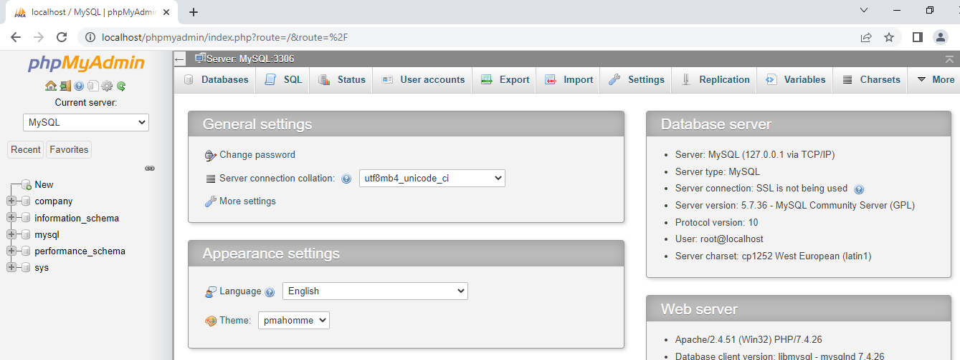
We get the following interface that contains the options to perform different tasks on the database. As can be seen below, on the left pane, there is a list of existing databases.

Slide 11
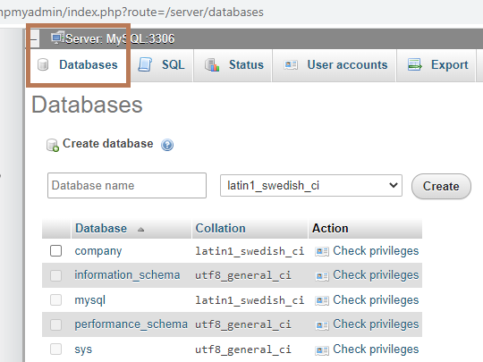

In order to create a database, click on the Database option. So, you get the list of existing databases as well as provision to create a new database.

Slide 12

After that enter the name of the database and click on the Create button.

Slide 13
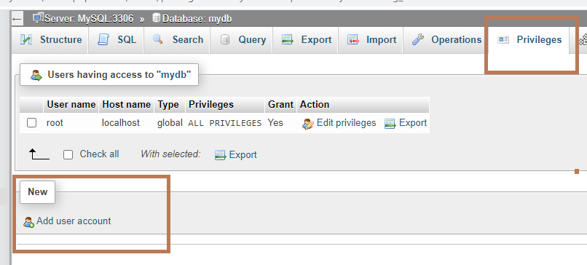
In order to create the database users, click on the Privileges option. click on the Add user account.

Slide 14
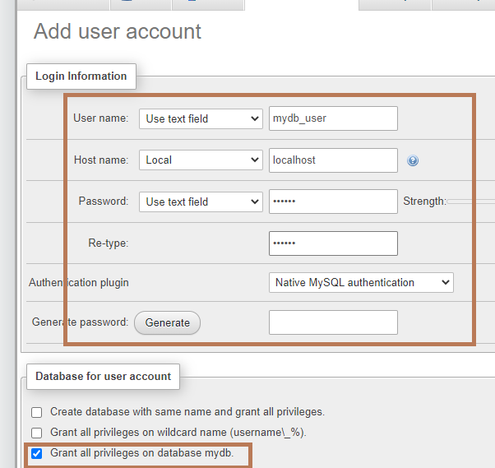
Now enter the username and password and check on the option for granting all privileges.

Slide 15
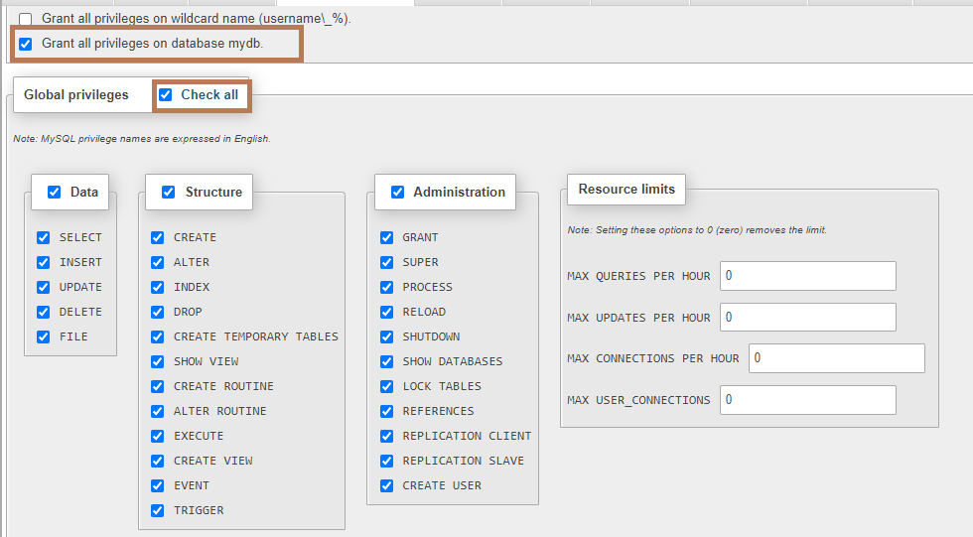
Also, click on the Check All button. It will assign the global privileges.

Slide 16
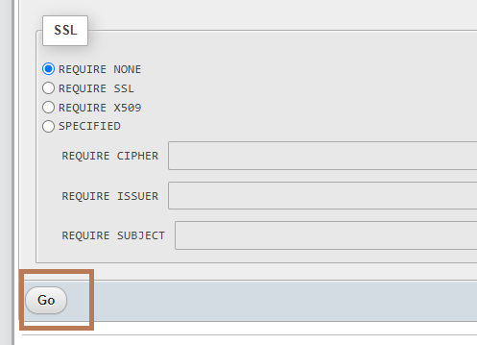
you can also set the option for accessing the database using SSL. For now, leave it as default option of REQUIRE NONE.

Slide 17
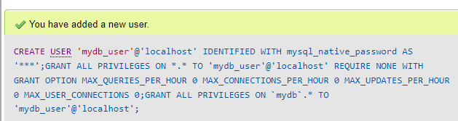
After That, click on the Go button. It will execute the Create User SQL command.

Slide 18
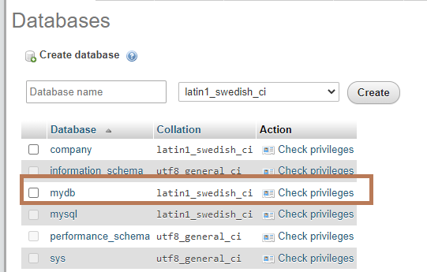
Again click on the Databases tab. You will find the name of your newly created database in the list. In order to find the database user and privileges, click on the Check privileges link.

Slide 19
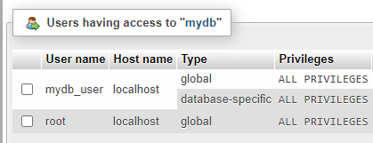
As can be seen below, the database mydb has two users mydb_user and root. Both of these users have all privileges.

Slide 20
Relational Databases and SQL
SQL is a programming language that is used by most relational database management systems (RDBMS) to manage data stored in tabular form (i.e. tables).
A relational database consists of multiple tables that relate to each other.

Slide 21
Some of The Most Important SQL Commands
SELECT - extracts data from a database
UPDATE - updates data in a database
DELETE - deletes data from a database
INSERT INTO - inserts new data into a database
CREATE DATABASE - creates a new database
ALTER DATABASE - modifies a database
CREATE TABLE - creates a new table
ALTER TABLE - modifies a table
DROP TABLE - deletes a table
CREATE INDEX - creates an index (search key)
DROP INDEX - deletes an index

Slide 22
MySQL Data Types
Type | Size | Description
int tinyint,smallint,mediumint,bigint | 4 bytes 1,2,3 and 8 bytes | 2^32 values
float double | 4 bytes 8 bytes
Date | 3 bytes | In the format of YYYY-MM-DD
Time | 3 bytes | In the format of HH:MM:SS
char[length] varchar[length] | fi String length + 1 byte | Fixed length string Variable length from 0 to 255 characters long

Slide 23
CREATE DATABASE
An SQL relation is defined using the CREATE DATABASE command:
create database [database name]
Example
create database mydatabase

Slide 24
DROP and ALTER TABLE
The DROP TABLE command deletes all information about the dropped relation from the database
The ALTER TABLE command is used to add attributes to or remove attributes from an existing relation (table):
alter table tablename actions
where actions can be one of following actions:
ADD Attribute
DROP Attribute
ADD PRIMARY KEY (Attribute_name₁,…)
DROP PRIMARY KEY

Slide 25
Modifying the database
3 basic cases:
Add a tuple | INSERT INTO table_name VALUES (Val₁, Val₂, … , Val_{n})
Change tuples | UPDATE table_name SET A₁=val₁, A₂=val₂, …, A_{n}=val_{n} WHERE tuple_selection_predicate
Remove tuples | DELETE FROM table_name WHERE tuple_selection_predicate

Slide 26
INSERTION
Add a new tuple to student
insert into student
values(‘999999999’,’Mike’,18,’computer science’)
or equivalently
insert into student(flashlineID,name,age,department)
values(‘999999999’,’Mike’,18,’computer science’)
Add a new tuple to student with age set to null
insert into student
values(‘999999999’,’Mike’,null,’computer science’)

Slide 27
UPDATE
Set all department to ‘computer science’
update student
set department=‘computer science’
In table account(account_number, balance, branch_name, branch_city), increase the balances of all accounts by 6%
update account
set balance=balance*1.06

Slide 28
DELETION
Delete records of all students in the university
delete from student
Delete the students who study computer science
delete from student
where department=‘computer science’

Slide 29
Basic Query Structure
A typical SQL query has the form:
select A₁, A₂, …, A_{n}
from table₁, table₂, …, table_{m}
where P
A_{i} represents an attribute
table_{i} represents a table
P is a constraints (condition)
This query is equivalent to the relational algebra expression:
Example
Select flashlineID, name from student
Where department=‘computer science’

Slide 30
The SELECT Clause – Duplicate tuples
Unlike pure relational algebra, SQL does not automatically remove duplicate tuples from relations or query results
To eliminate duplicates, insert the keyword distinct after select.
Example: Find the names of all students in the university, and remove duplicates
select distinct name
from student

Slide 31
The WHERE Clause
The WHERE clause specifies the conditions (constraints) results satisfy
Corresponds to the selection predicate σ
Comparisons and Booleans are as follows:
Comparison operator: <, <=, >,>=, =, <>
Logical operators: and, or, not
Example
Find names of all students in computer science department with age smaller than 18
select names
from student
where department=‘computer science’ and age<18

Slide 32
Aggregate Functions
Aggregate functions operate on the multiset of values of a attribute and return a value
avg(attribute): average value
min(attribute): minimum value
max(attribute): maximum value
sum(attribute): sum of values
count(attribute): number of values
To obtain the value when duplicates are removed, insert the keyword distinct before attribute name:
avg(distinct attribute)

Slide 33
Aggregation: GROUP BY clause
GROUP BY attribute operate in this sequence
Groups the attribute set’s members into subsets by value
Performs the aggregate separately on each subset
Produces a result value for each subset
Example: list each department and its number of students
select department, count(distinct name) as number
from student
group by department
Note: if a select clause contains any aggregate functions, then all non-aggregated terms in the select clause must be used in a group by clause. Ex: department is not aggregated, so it must be in the group by clause.

Slide 34
Null Values and Aggregate
The youngest student in the university
select *
from student
where age=min(age)
Above statement ignores null amounts
Result is null if there is no non-null amount
All aggregate operations except count(*) ignore tuples with null values on the aggregated attributes.

