Slide 1
Introduction
(Website Development)
Static Website
Dynamic Website

Slide 2


Static Websites
Static Websites

Slide 3
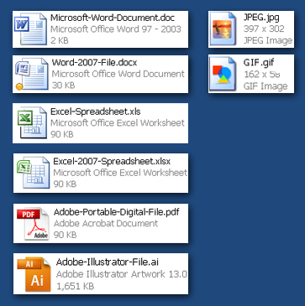

Static Websites - Pages
Web Pages exist as individual files
Some file types that may be familiar
  MS WORD DOC .doc, .docx
  MS EXCEL .xls, xlsx
  ADOBE FILES: .pdf, .psd, .ai.
  Digital Camera Files .jpg, .tiff
Examples of typical static web page files
  .htm
  .html
Notes:
Joint Photographic Experts Group
Graphic Interchange Format

Slide 4

Static Websites - Pages (continued)
Pages typically contain text,
hyper links, photos, and graphics
Pages may also contain animated or interactive media such as:
  Movie Clips (YouTube etc.)
  Adobe Flash Presentations
  Microsoft Silverlight
  Other media types
Pages are called Static
because text, photos, and other content will not change unless the
actual web page file itself is edited.

Slide 5
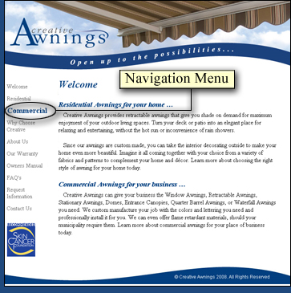
Static Website Navigation
Pages are associated with each other by a menu of links or “Navigation Menu”
Changes to the main Navigation Menu will require an edit to every web page that contains this menu.
Web development software can automate Navigation Menu maintenance, but pages will still need to be re-published for changes to take effect.
footer

Slide 6
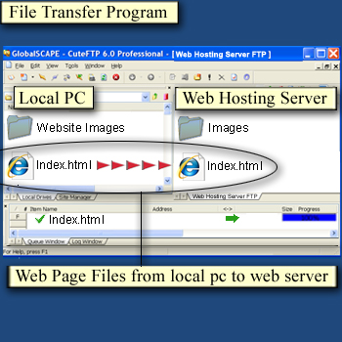
Static Websites - Publishing
Pages are published by uploading files to a Web Hosting Computer
  Directly from within the development software
  By transferring individual or groups of files with a File Transfer program.
  Maintaining a networked folder with the Web Hosting Server
Static Web Page Files are
published by physical transfer from the development PC to a Web Hosting Computer

Slide 7

Dynamic Websites
Dynamic Websites

Slide 8
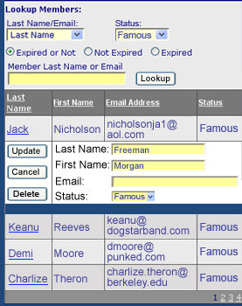
Dynamic Websites
Employ Dynamic pages that exist as files with extensions based on the type of programming used.
  .jsp , .cfm, .pl, .php, .asp, .aspx
Pages are Dynamic in that they can draw ever changing Content from external information sources
Pages can provide Create, Retrieve, Update, and Delete functions for company records
Pages may not require
republishing

Slide 9
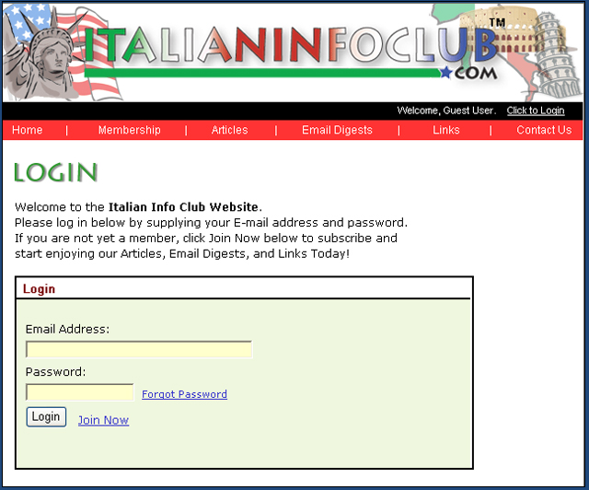
Dynamic Websites - Features
Your basic “CRUD”
Pages are capable of providing interactivity such as:
  Forms to request information or submit sales leads
  Internal searches within your site
  Registration and Login, personal profile maintenance, and authenticated/secure access to protected or premium content

Slide 10
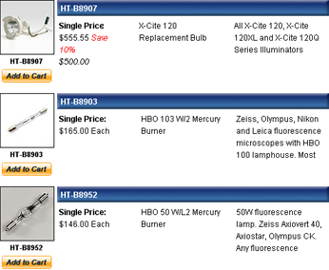
Dynamic Websites - Features (continued)
  Dynamic Product Catalogs and online sales (Ecommerce)
Information that is already maintained within company I.T. Systems such as Databases, Spreadsheets, and text files can be leveraged as Web Content.
Access can be granted to allow customers to maintain their own information.

