Slide 1
exit() and die() in PHP

Slide 2
exit() Function in PHP
In PHP, the exit() function prints a message and exits the application.
It’s often used to print a different message in the event of a mistake.
Use exit() when there is not an error and have to stop the execution.

Slide 3
Syntax of exit() Function
exit("Message goes here");
or
exit();

Slide 4
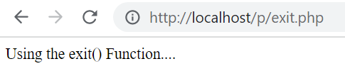
Example
<?php
exit('Using the exit() Function....');
echo "<br>It will not Print....";
?>

Slide 5
die() Function in PHP
In PHP, die() is the same as exit().
A program’s result will be an empty screen.
Use die() when there is an error and have to stop the execution.

Slide 6
Syntax
die("Message goes here");
or
die();

Slide 7

Example
<?php
die('Some error occured....');
echo "<br>It will not Print....";
?>

Slide 8
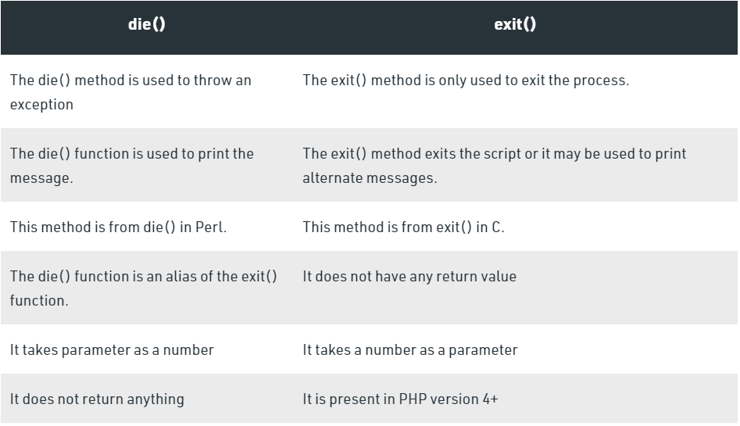
Difference Between die() and exit() Functions

