Slide 1
Bachelor of Science (Honours) in Data Science and Artificial Intelligence
DA 104, C programming

Slide 2
Week 1: Learning Objectives
01
Understanding the basic terminologies and concepts of computer systems
02
Basic structure of C program
03
Compile debug and run a C program

Slide 3
Computer System Fundamentals

Slide 4
Computer Systems:
Users​
Application Software​
​
Operating Systems​
​
Hardware

Slide 5
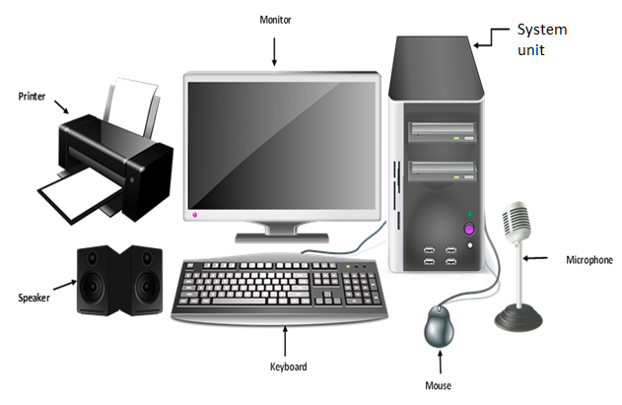
Hardware

Slide 6
Inside system unit​
All computers more or less based on the same basic design, the Von Neumann Architecture!
All computers more or less based on the same basic design, the Von Neumann Architecture!
Source: 3.3. Personal Computer Tour – Information Systems for Business and Beyond (pressbooks.pub)

Slide 7
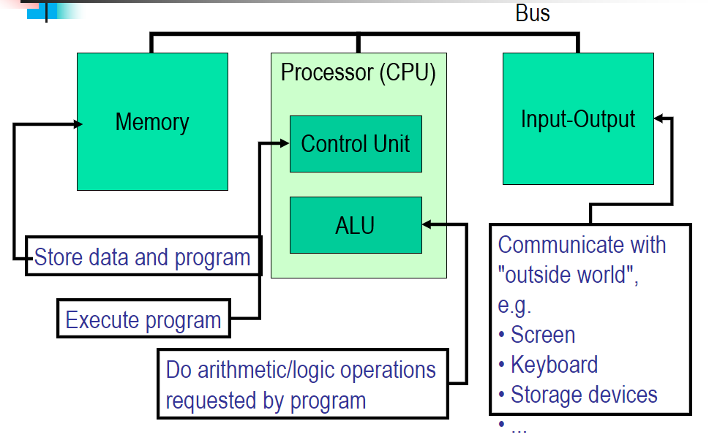
The Von Neumann Architecture

Slide 8
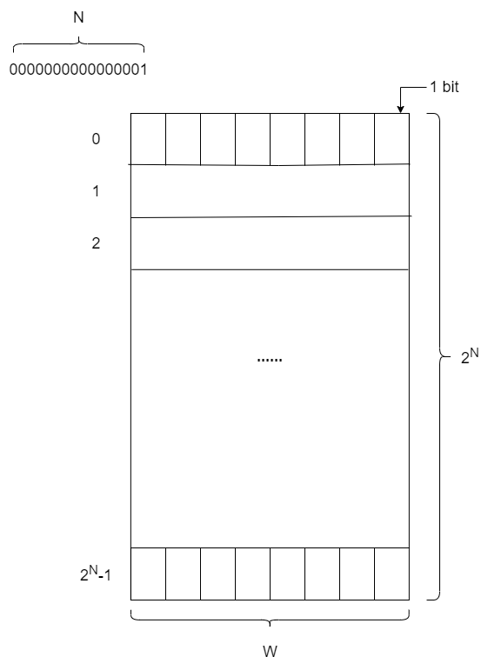
Random Access Memory​
Memory

Slide 9
Memory Size / Speed​​
Typical memory in a personal computer (PC):​
in Gigabytes​
Memory sizes:​
Kilobyte (KB) = 2¹⁰ = 1,024 bytes ~ 1 thousand​
Megabyte(MB) = 2²⁰ = 1,048,576 bytes ~ 1 million​
Gigabyte (GB) = 2³⁰ = 1,073,741,824 bytes ~ 1 billion​
Terabyte (TB) = 2⁴⁰ = 1,099,511,627,776 bytes ~ 1 trillion​
Memory Access Time (read from/ write to memory)​
50-75 nanoseconds (1 nsec. = 0.000000001 sec.)​
RAM is​
volatile (can only store when power is on)​
relatively expensive​

Slide 10
Computer Systems:
Users​
Application Software​​
Operating Systems​
​
Hardware​

Slide 11
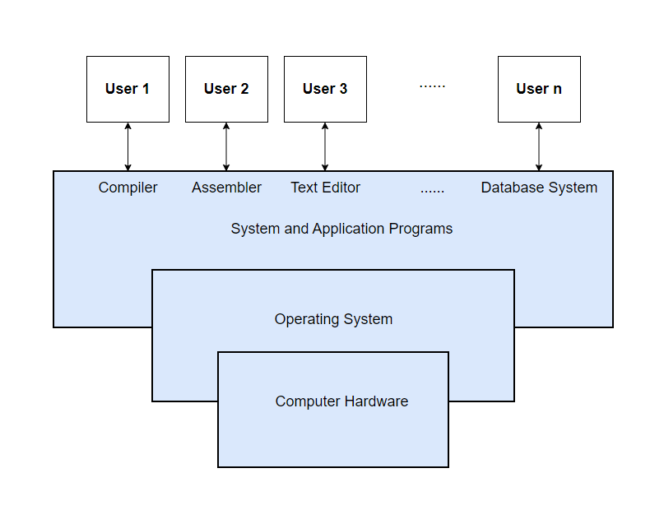
Four Components of a Computer System​
Application SW​
OS​
H/W​

Slide 12
What is an Operating System?​​
Layer between applications and hardware​
Operating system goals:​
Provides abstractions for applications​
Manages and hides details of h/w​
Accesses hardware through low/level​ interfaces unavailable to applications
Use the computer hardware in an efficient manner.​
Provides protection

Slide 13
Four Components of a Computer System​
Application SW​
OS​
H/W​

Slide 14
Machine language​
Machine language, aka machine code, is the lowest-level programming language that a computer can understand​
a low-level language.​
made up of 0s and 1s instructions.​
difficult for humans to read and write.​
​
​
​​
Opcode (8 bits)​
Address 1 (16 bits)
Address 2 (16 bits)
00001001​
0000000001100011​
0000000001100100​

Slide 15
High level language​​
HLLs are simple languages that use English like keywords and mathematical symbols like +, -, %, / etc. for its program construction, eg. C, Fortran, Java etc.​
Easy to learn and use ​
Need to be converted to machine language for the computer to understand ​
Compiler is a program that translates the instruction of a higher level language to machine language
​

Slide 16
Computer System Fundamentals Algorithms and Flowchart

Slide 17
Steps to solve a programming task
Two phases:
Problem-solving phase
Algorithm
Flowchart
Implementation phase
implement the program in some programming language

Slide 18
Steps to print the largest of two values
Input VALUE1, VALUE2
if (VALUE1 > VALUE2) then
MAX ← VALUE1
else
MAX ← VALUE2
endif
Print “Largest value is”, MAX

Slide 19
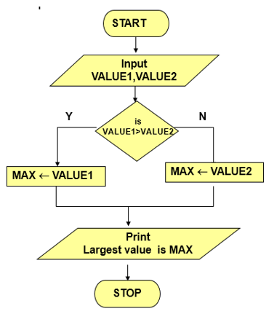
Steps to print the largest of two values
Input VALUE1, VALUE2
if (VALUE1 > VALUE2) then
MAX ← VALUE1
else
MAX ← VALUE2
endif
Print “Largest value is”, MAX

Slide 20
Starting with C Your first program, Hello World!

Slide 21
Your First C Program​
Open a text editor and type the following​:
#include<stdio.h>​
int main(void)​
{​
printf(“Hello World\n”);​
return 0;​
}​
Save the file as hello.c​

Slide 22
Compile & run a C program
gcc hello.c –o hello​
./hello​
Compiling Options​
gcc –help​

Slide 23
Anatomy of “Hello World” Program​
1. #include<stdio.h>​
2. int main(void)​
3. {​
4. printf(“Hello World\n”);​
5. return 0;​
6. }​
Lines that begin with # is a pre-processing ​directive. Contains the standard IO routines​

Slide 24
Anatomy of “Hello World” Program​
1. #include<stdio.h>​
2. int main(void)​
3. {​
4. printf(“Hello World\n”);​
5. return 0;​
6. }​
main() is the first function called when a ​program starts. int means it will return an ​integer. void means the function has no ​arguments​​

Slide 25
Anatomy of “Hello World” Program​
1. #include<stdio.h>​
2. int main(void)​
3. {​
4. printf(“Hello World\n”);​
5. return 0;​
6. }​
braces {} denote the start and end of the​ function body. The left and right braces​ must match.

Slide 26
Anatomy of “Hello World” Program​
1. #include<stdio.h>​
2. int main(void)​
3. {​
4. printf(“Hello World\n”);​
5. return 0;​
6. }​
printf() is a standard library function.​ \n means newline.​

Slide 27
Anatomy of “Hello World” Program​
1. #include<stdio.h>​
2. int main(void)​
3. {​
4. printf(“Hello World\n”);​
5. return 0;​
6. }​
As promised at the beginning of the function​ it returns an integer.​​

Slide 28
Starting with C Algorithm to Code

Slide 29
Print the largest of two values (Review)
Recall the algorithm to print the largest of two values
Input VALUE1, VALUE2
if (VALUE1 > VALUE2) then
MAX ← VALUE1
else
MAX ← VALUE2
endif
Print “Largest value is”, MAX

Slide 30
Print the largest of two values (Review)
Recall the algorithm to print the largest of two values
#include<stdio.h>
int main(void) {
int val1, val2, max;
scanf("%d %d",&val1, &val2);
if (val1 > val2)
max = val1;
else
max = val2;
printf(“Largest value is %d\n",max);
}
Input VALUE1, VALUE2
if (VALUE1 > VALUE2) then
MAX ← VALUE1
else
MAX ← VALUE2
endif
Print “Largest value is”, MAX

Slide 31
Starting with C Compiling a C program

Slide 32
Steps in compiling
Preprocessing: handles preprocessing directives and macros
Expands them and generates a clean source code​
Compilation: Translates the preprocessed source code into assembly/machine code specific to target architecture​
Linking: Resolve references between different object code files and libraries​​
Links these files to create an object code​

Slide 33
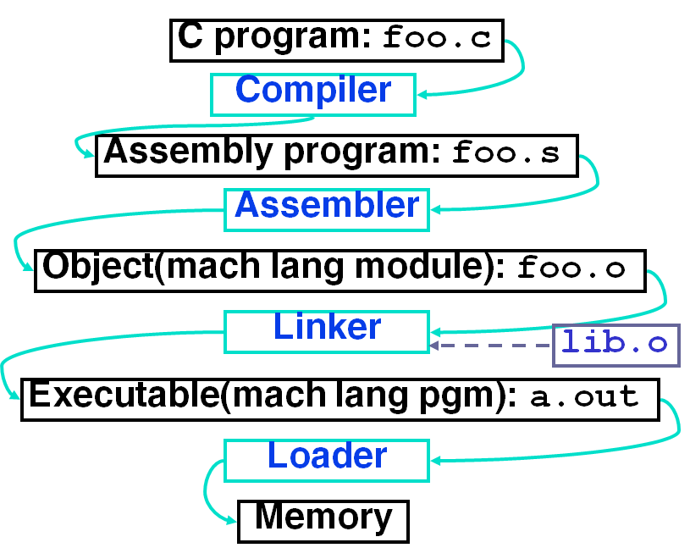
Steps to execute a program

Slide 34
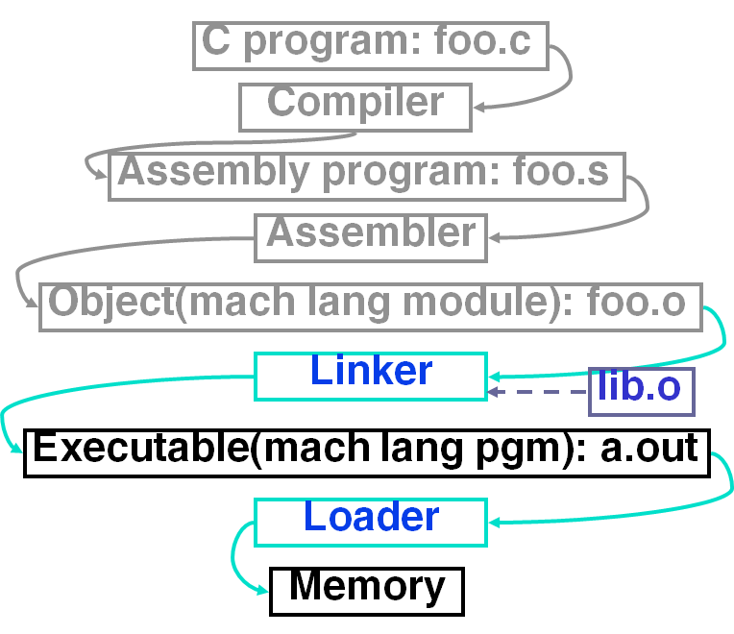
​​
Linker combines several object (.o) files into a single executable (“linking”) ​
Executable files are stored on disk. When one is run, loader’s job is to load it into memory and start it running.​
​

Slide 35
Compile & run a C program
gcc hello.c –o hello​
./hello​
Compiling Options​
gcc –help​
Why do we need to prefix ./ while running a program?​

Slide 36
Environment Variables​
Dynamic variables that are accessed by processes and it can affect the output of a process​
Setting env. variables in .profile file​
PATH=$PATH:.​
Setting Env. Variables using script​
Edit the file .bash_profile​
export PATH=$PATH:.​

