Slide 1
Bachelor of Science (Honours) in Data Science and Artificial Intelligence
DA 104, C programming

Slide 2
Lexical elements

Slide 3
Tokens
Types of tokens

Slide 4
Compilation process
Groups character into tokens
Source Code
Tokens
Object Code
Translate tokens into object code

Slide 5
Tokens
Syntactic units of the language
Six kind of tokens
  Keywords
  Punctuators
  Identifiers
  Constants
  String constants
  Operators

Slide 6
Tokens
Keywords

Slide 7
Keywords
Reserved words have a strict meaning
Cannot be redefined.
Keywords
auto | double | int | struct
break | else | long | switch
case | enum | register | typedef
char | extern | return | union
const | float | short | unsigned
continue | for | signed | void
default | goto | sizeof | volatile
do | if | static | while

Slide 8
Categorizing Keywords: related to data types
keywords related to data types of variables/functions
Keywords
auto | double | int | struct
break | else | long | switch
case | enum | register | typedef
char | extern | return | union
const | float | short | unsigned
continue | for | signed | void
default | goto | sizeof | volatile
do | if | static | while

Slide 9
Categorizing Keywords: related to control statements
keywords related to control statements
Keywords
auto | double | int | struct
break | else | long | switch
case | enum | register | typedef
char | extern | return | union
const | float | short | unsigned
continue | for | signed | void
default | goto | sizeof | volatile
do | if | static | while

Slide 10
Ex: Area of a circle
#include <stdio.h>
/* Compute area of a circle */
int main(void) {
int radius;
float area, pi;
radius = 5;
pi = 3.14;
area = pi * radius * radius;
printf(“\n Area is %f.\n\n”, area);
return 0;
}
Notes:
.

Slide 11
Comments
Anything written between /* … */ is a comment and is ignored by the compiler
Lines starting with // are also comments and ignored by the compiler.

Slide 12
Ex: Area of a circle
#include <stdio.h>
/* Compute area of a circle */
int main(void) {
int radius;
float area, pi;
radius = 5;
pi = 3.14;
area = pi * radius * radius;
printf(“\n Area is %f.\n\n”, area);
return 0;
}

Slide 13
Tokens
Punctuators

Slide 14
Punctuators
A symbol that has a semantic significance but does not specify an operation to be performed.
  braces {} - indicate start and end of a compound statement

Slide 15
Punctuators
A symbol that has a semantic significance but does not specify an operation to be performed.
  braces {} - indicate start and end of a compound statement
  semicolon ; - terminate statements

Slide 16
Punctuators
A symbol that has a semantic significance but does not specify an operation to be performed.
  braces {} - indicate start and end of a compound statement
  semicolon ; - terminate statements
  comma , - separate expression or variables

Slide 17
Punctuators
A symbol that has a semantic significance but does not specify an operation to be performed.
  braces {} - indicate start and end of a compound statement
  semicolon ; - terminate statements
  comma , - separate expression or variables
  colon : - used in conditional statements, labelled statements

Slide 18
Punctuators
A symbol that has a semantic significance but does not specify an operation to be performed.
  braces {} - indicate start and end of a compound statement
  semicolon ; - terminate statements
  comma , - separate expression or variables
  colon : - used in conditional statements, labelled statements
  hash #: preprocessing directive

Slide 19
Punctuators
A symbol that has a semantic significance but does not specify an operation to be performed.
  braces {} - indicate start and end of a compound statement
  semicolon ; - terminate statements
  comma , - separate expression or variables
  colon : - used in conditional statements, labelled statements
  hash #: preprocessing directive
  Angle brackets <>: used to include files

Slide 20
Punctuators
A symbol that has a semantic significance but does not specify an operation to be performed.
  braces {} - indicate start and end of a compound statement
  semicolon ; - terminate statements
  comma , - separate expression or variables
  colon : - used in conditional statements, labelled statements
  hash #: preprocessing directive
  Angle brackets <>: used to include files
  parenthesis () : group expression, specify function parameters

Slide 21
Not Punctuators
Not punctuators but operators.
  braces {} – used to initialize arrays
  comma , - can also be used as an operator
  question mark ? : – ternary operator
  square brackets [] – subscript operator
  period . – used to access the member of a structure/union
  arrow -> - used to access the member of a structure/union

Slide 22
Ex: Area of a circle
#include <stdio.h>
/* Compute area of a circle */
int main(void) {
int radius;
float area, pi;
radius = 5;
pi = 3.14;
area = pi * radius * radius;
printf(“\n Area is %f.\n\n”, area);
return 0;
}

Slide 23
Tokens
Identifiers

Slide 24
Identifiers
Give unique names to objects in a program.
Composed of sequence of letters, digits and the special character _
Letter or _ should be the first character.

Slide 25
Ex: Area of a circle
#include <stdio.h>
/* Compute area of a circle */
int main(void) {
int radius;
float area, pi;
radius = 5;
pi = 3.14;
area = pi * radius * radius;
printf(“\n Area is %f.\n\n”, area);
return 0;
}

Slide 26
Programming Tip
Choose name of the identifiers that are meaningful to enhance readability and documentation of the program.

Slide 27
Tokens
Constants and String constants

Slide 28
Constants
Several types of constants
  Integer Constant: represents whole numbers. Can be written with different bases
  Floating point constant:
  Character constants:

Slide 29
String Constants
Sequence of characters enclosed in a pair of double quotes.
Example
  “” (Null String)
  “A String Constant”
  “a = b + c”
  “abc” “def” equivalent to “abcdef”
  “The boy said \”Hello\””

Slide 30
Ex: Area of a circle
#include <stdio.h>
/* Compute area of a circle */
int main(void) {
int radius;
float area, pi;
radius = 5;
pi = 3.14;
area = pi * radius * radius;
printf(“\n Area is %f.\n\n”, area);
return 0;
}

Slide 31
Token
Operators

Slide 32
Operators
An operator is a token representing operations that can be performed on operands
Operands are expression or constants
  unary operator: single operand
  binary operator: two operands

Slide 33
Ex: Area of a circle
#include <stdio.h>
/* Compute area of a circle */
int main(void) {
int radius;
float area, pi;
radius = 5;
pi = 3.14;
area = pi * radius * radius;
printf(“\n Area is %f.\n\n”, area);
return 0;
}

Slide 34
Summary: Area of a circle example
Preprocessing directive
#include <stdio.h>
/* Compute area of a circle */
int main(void) {
int radius;
float area, pi;
radius = 5;
pi = 3.14;
area = pi * radius * radius;
printf(“\n Area is %f.\n\n”, area);
return 0;
}
Comment
Color | Token
 | keywords
 | Punctuators
 | Identifiers
 | Constants
 | Operators

Slide 35
Tokens
Unary and arithmetic operators

Slide 36
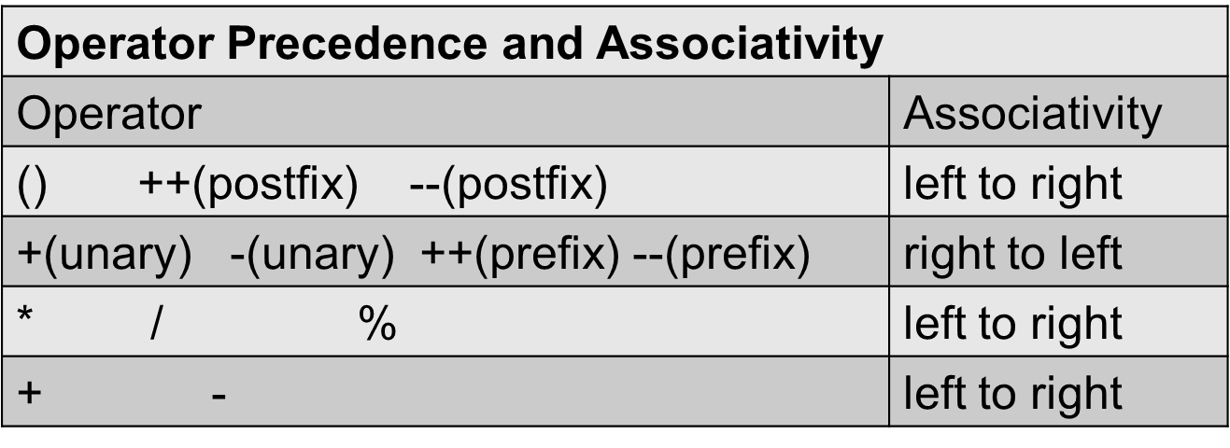
Unary and arithmetic operators
Courtesy: A book on C, AI Kelly, Ira Pohl

Slide 37
Unary and arithmetic operators
Courtesy: A book on C, AI Kelly, Ira Pohl

Slide 38
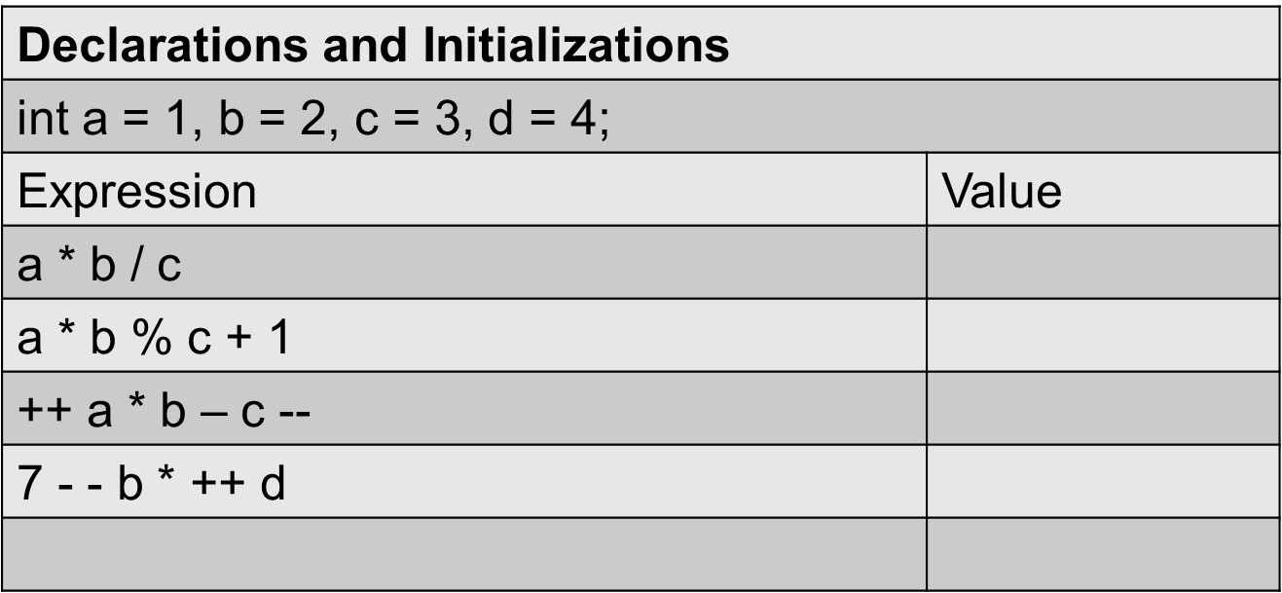
Ex: Unary and arithmetic operators
Courtesy: A book on C, AI Kelly, Ira Pohl

Slide 39
Token
Assignment operator

Slide 40
Assignment Operators
C treats = as an operator
variable = Right_Hand_Side
Associativity right to left
Other assignment operators
  variable op (expression)
  +=, -=, *=, /=, %=, >>=, <<=, &=, ^= and |=

Slide 41
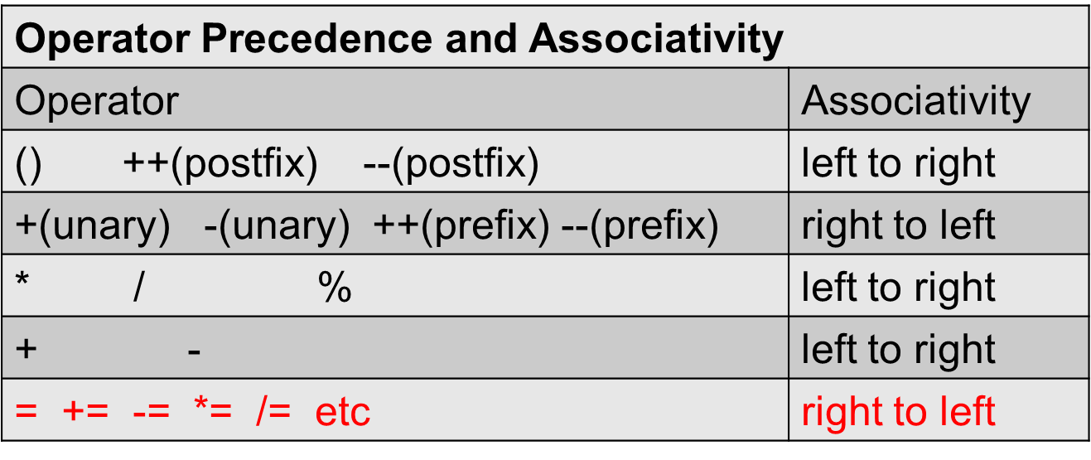
Assignment operators
Courtesy: A book on C, AI Kelly, Ira Pohl

Slide 42
Token
Relational operator

Slide 43
Relational Operators
Used to compare values
Associativity left to right
Relational operators
  <, <=, > and >=

Slide 44
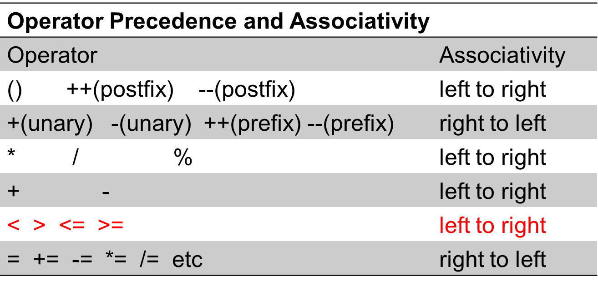
Relational operators
Courtesy: A book on C, AI Kelly, Ira Pohl

Slide 45
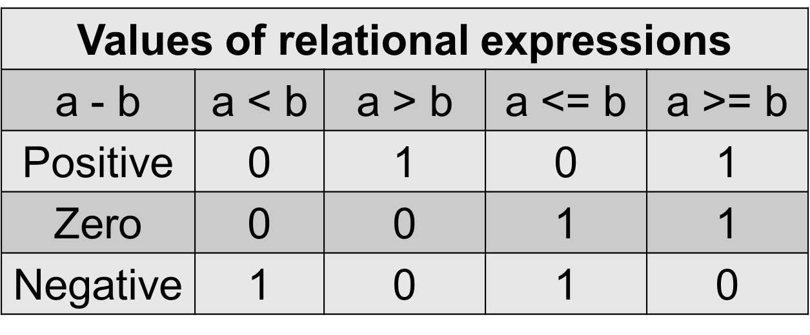
Ex: Relational Expressions
Courtesy: A book on C, AI Kelly, Ira Pohl

Slide 46
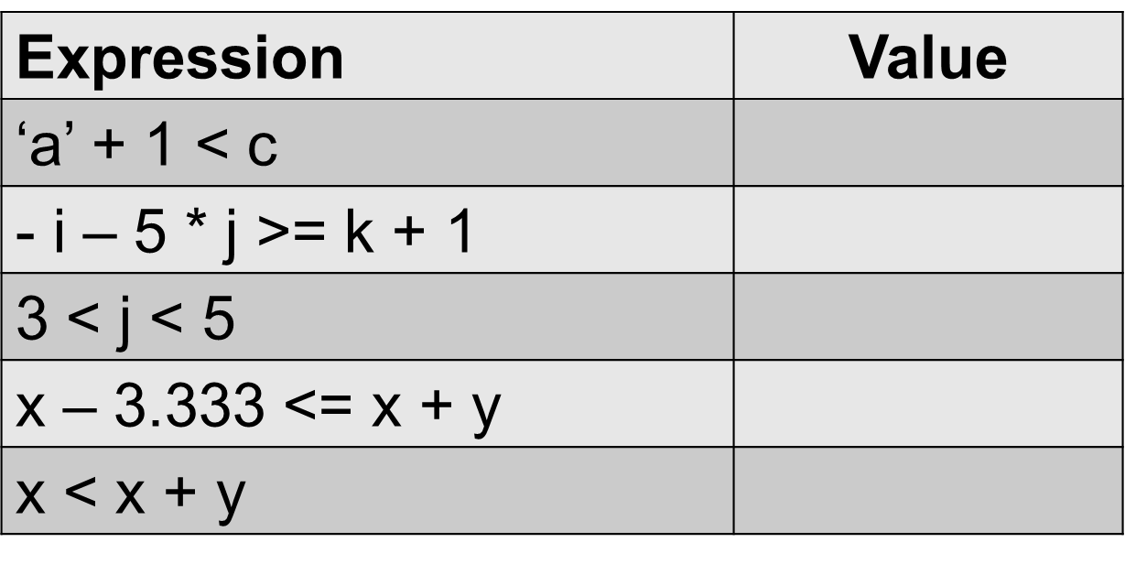
Ex: Relational Expressions (2)
char c = ‘w’; int i = 1, j = 2, k = -7;
x = 7e+33, y = .001;

Slide 47
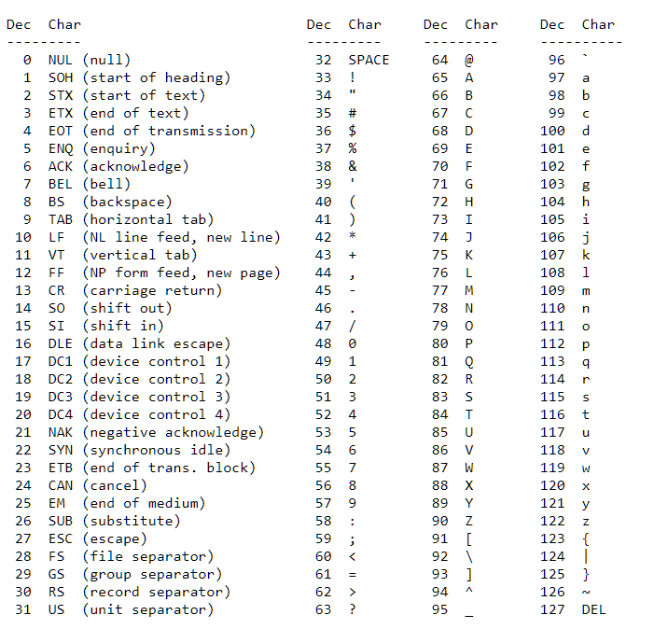
ASCII values
American Standard Code for Information Interchange is a character encoding for communication

Slide 48
Ex: Relational Expressions (2)
char c = ‘w’; int i = 1, j = 2, k = -7;
x = 7e+33, y = .001;

Slide 49
Tokens
Equality and Logical operators

Slide 50
Equality Operators and Expressions
== and !=
Lower precedence than relational operators and left to right associativity
Binary operators
Yield either 1 (TRUE) or 0 (FALSE).
What is the output of this equality expression?
  i + j + k == -2 * -k where i = 1, j = 2, k = 3;

Slide 51
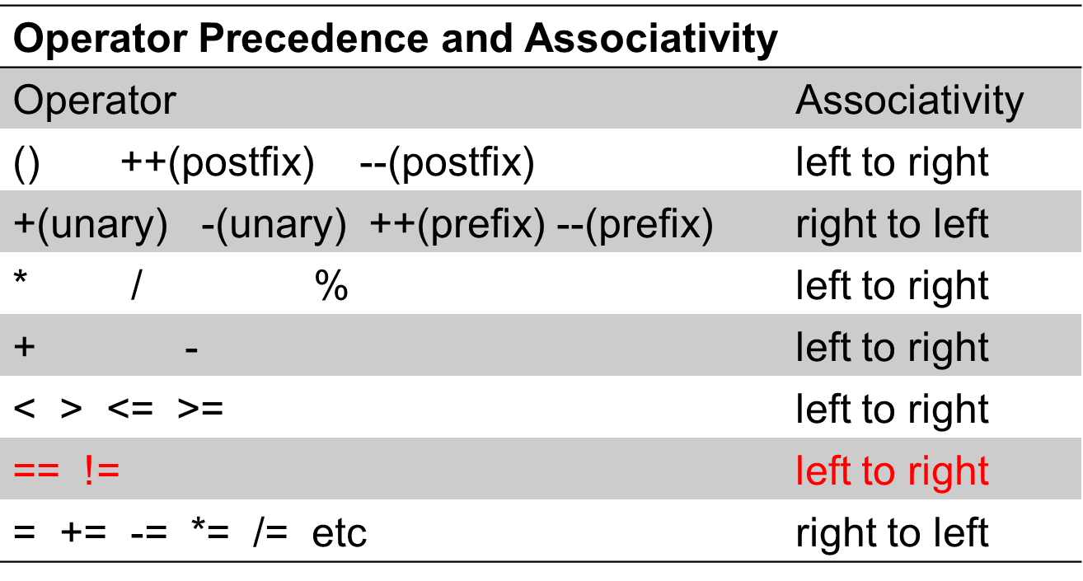
Equality operators

Slide 52
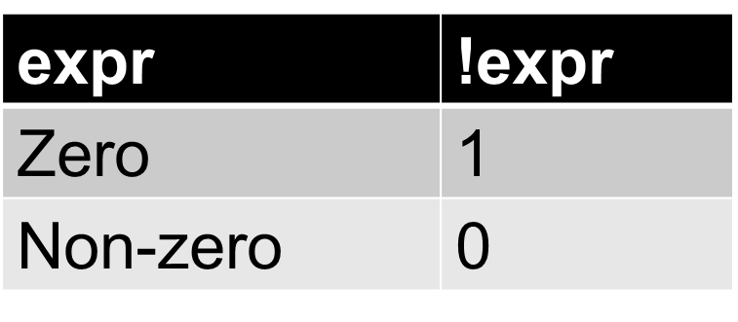
Logical Operators and Expressions
! (not) is unary, && (and) and || (or) are binary
&& has higher precedence than ||
! has same precedence as other unary operators.
Semantics of the ! operator

Slide 53
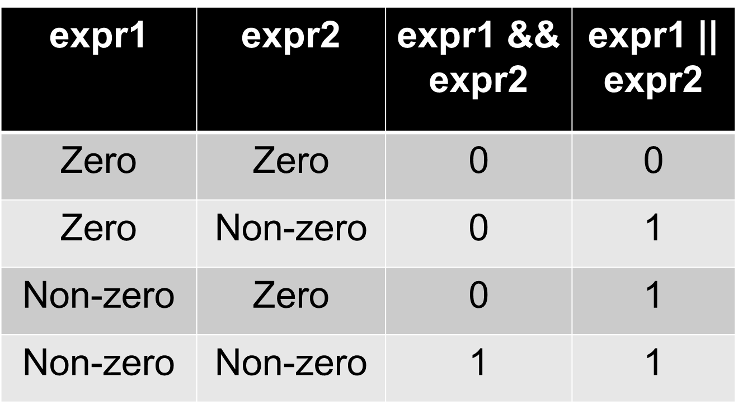
Semantics of && and || operator

Slide 54
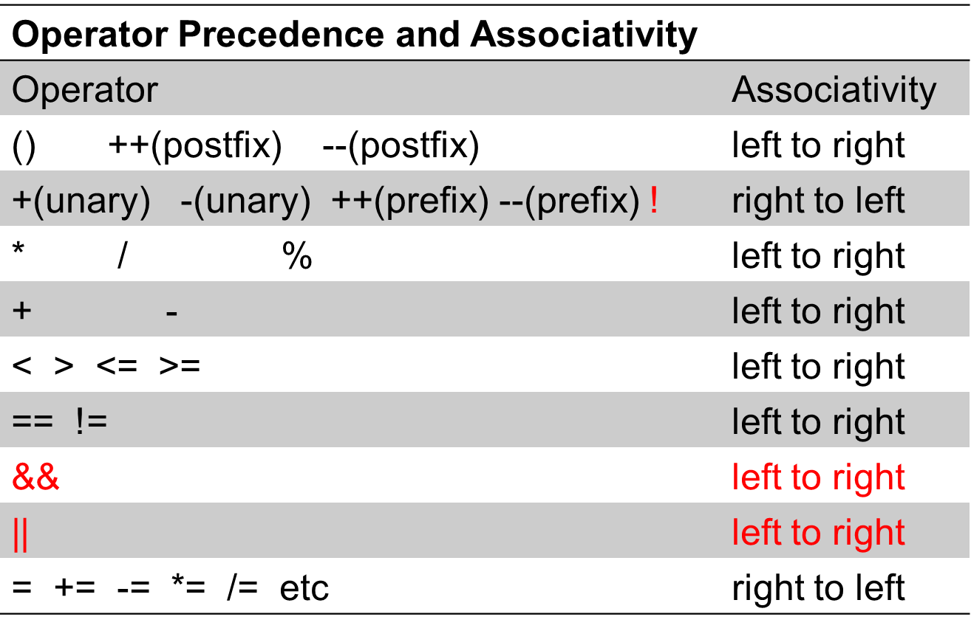
Operators (5)

Slide 55
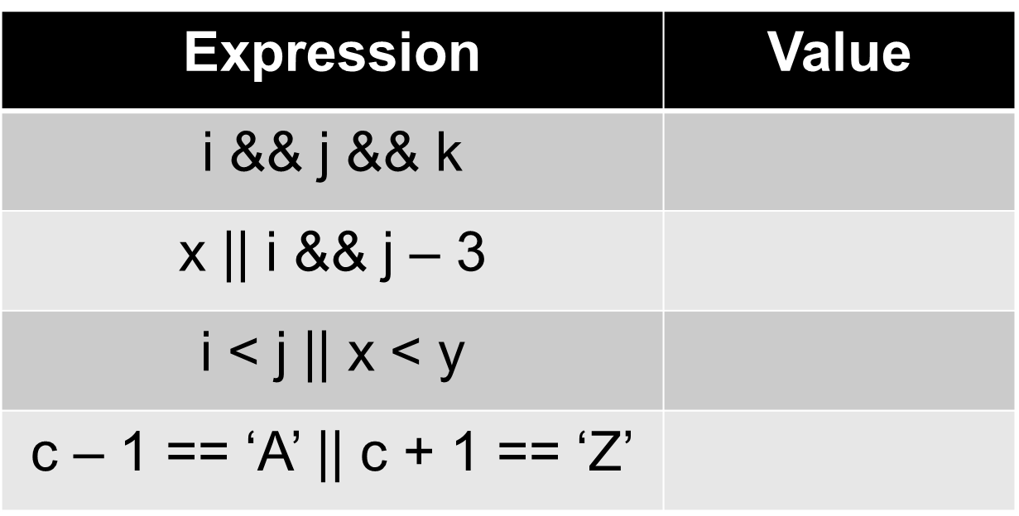
Examples of Logical Operators
char c = ‘B’; int i = 3, j = 3, k = 3;
double x = 0.0, y = 2.3;

Slide 56
Tokens
Application of operators

Slide 57
Ex 1
What will be the output of the following C program
#include<stdio.h>
int main(void) {
int a, b = 0, c = 0;
a = ++b + ++c;
printf("%d %d %d\n", a, b,c);
a = b++ + c++;
printf("%d %d %d\n", a, b,c);
a = ++b + c++;
printf("%d %d %d\n", a, b,c);
a = b-- + --c;
printf("%d %d %d\n", a, b,c);
}

Slide 58
Ex 2
What will be the output of the following C program
#include<stdio.h>
int main()
{
int a = 1, b = 2, c = 3;
a +=b +=c +=7;
printf("a=%d,\t b=%d,\t c=%d\n", a, b, c);
}

