Slide 1
Bachelor of Science (Honours) in Data Science and Artificial Intelligence
DA 104, C programming

Slide 2
Control Statements

Slide 3
Looping statements while and do-while
Notes:
Lesson Name

Slide 4
Flow Control – while and do-while
while (expr)
stmt1
do
stmt1
while (expr)

Slide 5
Ex: Print numbers(revisited)
// Print numbers from 1 to n
#include <stdio.h>
int main() {
int n;
scanf(“%d”,&n);
while (n >0 && n <= 5) {
printf("%d\n", n);
++n;
}
return 0;
}

Slide 6
Example: do-while
#include<stdio.h>
int main() {
int number;
do {
printf("Enter a number: ");
scanf("%d", &number);
} while (number < 0);
printf("You entered: a positive number\n");
return 0;
}

Slide 7
Looping statements
For loop
Notes:
Lesson Name

Slide 8
Flow Control – for (example)
Program to print all odd numbers between 1 and n
for(i = 1; i <= n; i += 2)
printf(“%d\n”, i);

Slide 9
Flow Control – for
for (<initialize>;<boolean_expr>;<update>)
    statement
If boolean expression evaluates to TRUE execute statement, followed by update statement
Any or all expression statements (exprs) can be missing.

Slide 10
Which loops?
for loops are more natural when we know how many iterations we need (definite or counting loops).
  Example: Print even numbers, etc.
while and do loops are more natural when we want to keep looping until some outcome (indefinite or result controlled loops).

Slide 11
Jump statements break and continue statement

Slide 12
break Statement
break statement causes to exit from the innermost enclosing loop or switch statement.
while (1) {
  scanf(“%d”, &counter);
  if (counter < 0 ) {
  printf(“I am not positive\n”);
  break;
  else
  printf(“I am positive\n”);
  }

Slide 13
continue Statement
while (1) {
scanf(“%d”, &counter);
if (counter < 0 ) {
continue;
else
printf(“I am positive\n”);
}

Slide 14
continue Statement
May occur only inside for, while and do loops.
Causes to skip the remaining statement of the loop and continues with the next iteration of the loop.

Slide 15
Jump statements goto statement

Slide 16
Ex: using goto
while (1) {
scanf(“%d”, &counter);
if (counter < 0 ) {
continue;
else
printf(“I am positive\n”);
}
Causes unconditional jump to a labeled statement.

Slide 17
Why goto stmt should not be used?
Makes code difficult to read and understand
  Code tends to be unstructured and lacks clear flow control
Use structured alternatives
  Instead, use structured flow constructs such as loops and conditional statements

Slide 18
Flow control – using switch case (example)
Write a program that takes as input a day value from the user and prints Sunday if day=0, Monday if day=1 and so on.
For any other input, it should print “invalid input”

Slide 19
Multiple selection with if
(continued)
if (day == 4) {
printf (“Thursday”) ;
}
if (day == 5) {
printf (“Friday”) ;
}
if (day == 6) {
printf (“Saturday”) ;
}
if ((day < 0) || (day > 6)) {
printf(“Error - invalid day.\n”) ;
}
if (day == 0 ) {
printf (“Sunday”) ;
}
if (day == 1 ) {
printf (“Monday”) ;
}
if (day == 2) {
printf (“Tuesday”) ;
}
if (day == 3) {
printf (“Wednesday”) ;
}

Slide 20
Multiple selection with if - else
Which structure is more efficient if or if-else?
(continued)
} else if (day == 4) {
printf (“Thursday”) ;
} else if (day == 5) {
printf (“Friday”) ;
} else if (day = 6) {
printf (“Saturday”) ;
} else {
printf (“Error - invalid day.\n”) ;
}
if (day == 0 ) {
printf (“Sunday”) ;
} else if (day == 1 ) {
printf (“Monday”) ;
} else if (day == 2) {
printf (“Tuesday”) ;
} else if (day == 3) {
printf (“Wednesday”) ;

Slide 21
Multiple selection with switch
Which structure is more efficient if-else or switch?
(continued)
case 4: printf (“Thursday\n”) ;
break ;
case 5: printf (“Friday\n”) ;
break ;
case 6: printf (“Saturday\n”) ;
break ;
default: printf (“Error -- invalid day.\n”) ;
break ;
}
switch ( day )
{
case 0: printf (“Sunday\n”) ;
break ;
case 1: printf (“Monday\n”) ;
break ;
case 2: printf (“Tuesday\n”) ;
break ;
case 3: printf (“Wednesday\n”) ;
break ;

Slide 22
Flow Control: switch - case
Which structure is more efficient if-else or switch?
switch ( expression ){
case value1 :
statement-list1
break;
case value2 :
statement-list2
break;
case value3 :
statement-list3
break;
case ...
}
Evaluates expression and attempts to exactly match the result to one of several possible cases
Each case contains a value and a list of statements
Can have an optional default case

Slide 23
Conditional Operator (?:)
Syntax: bool_expr1 ? expr2 : expr3
Precedence just above assignment ops.
Right to left associated.
if (y < z )
x = y;
else
x = z;
x = (y < z) ? y : z

Slide 24
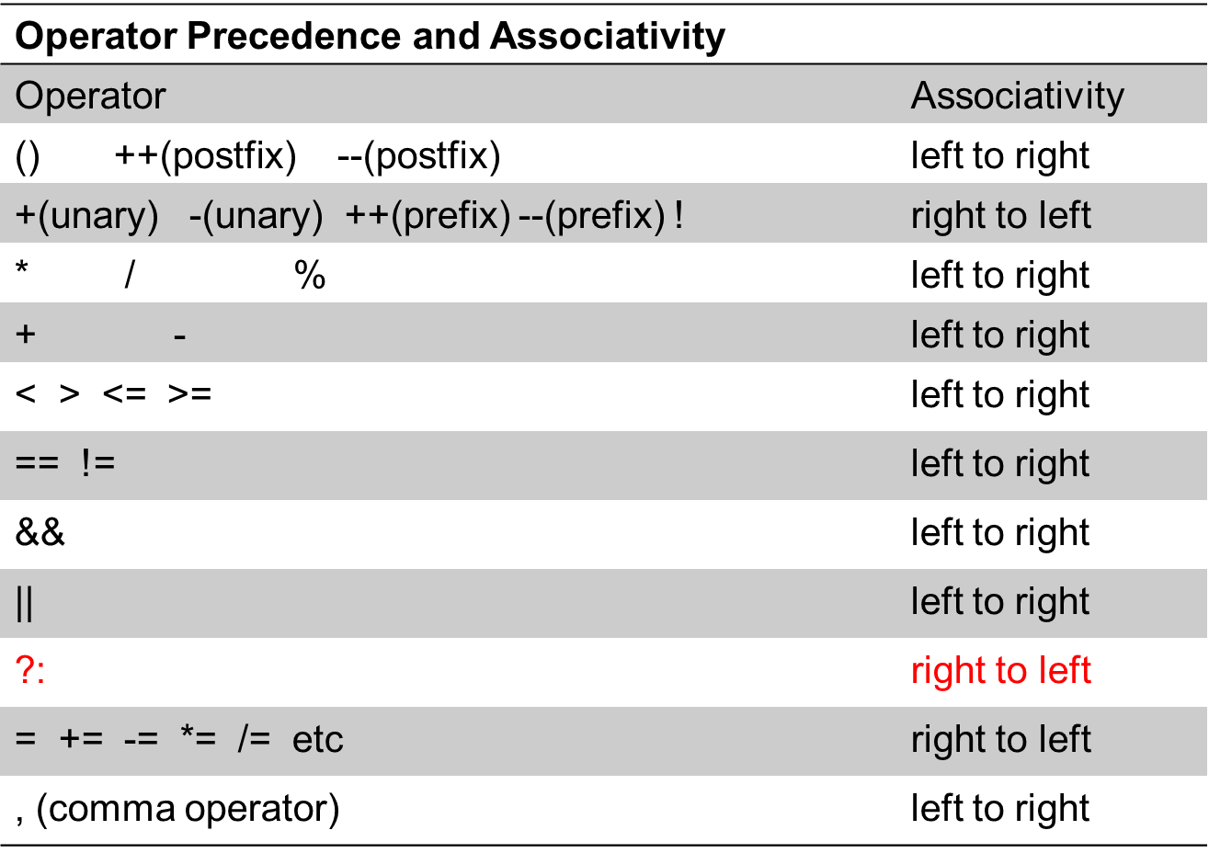
Operators (7)

Slide 25
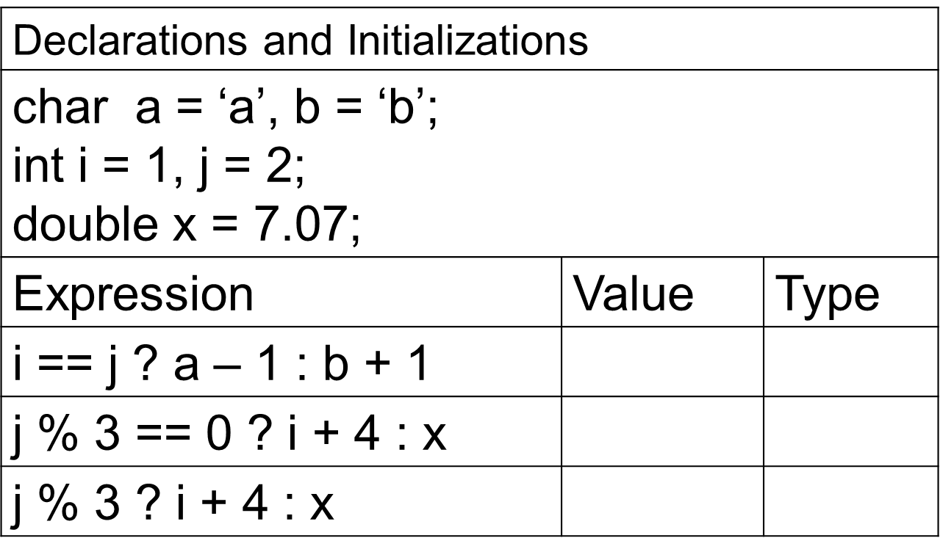
Example ?:
99
int
7.07
double
5.0
double

Slide 26
Conditional Statement
IF statement

Slide 27
Flow Control - if
if (boolean_expr)
stmt
  The statement stmt may be one statement or a compound statement
  Usually expr will be a relational, equality or logical expression

Slide 28
Example: IF statement
#include <stdio.h>
int main() {
int age;
printf("Enter your age: ");
scanf("%d", &age);
if (age >= 18) {
printf("You are eligible to vote.\n");
}
return 0;
}

Slide 29
Flow Control – if … else
if (expr)
stmt1
else
stmt2
If expr is nonzero than stmt1 is executed and stmt2 is skipped else stmt2 is executed and stmt1 is skipped
Let the flowchart for the if – else statement

Slide 30
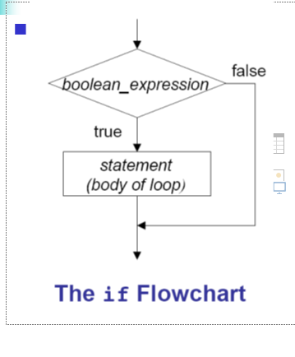
Flowchart: IF - ELSE

Slide 31
Conditional Statement
Switch statement

Slide 32
Flow control – using switch case (example)
Write a program that takes as input a day value from the user and prints Sunday if day=0, Monday if day=1 and so on.
For any other input, it should print “invalid input”

Slide 33
Multiple selection with if
(continued)
if (day == 4) {
printf (“Thursday”) ;
}
if (day == 5) {
printf (“Friday”) ;
}
if (day == 6) {
printf (“Saturday”) ;
}
if ((day < 0) || (day > 6)) {
printf(“Error - invalid day.\n”) ;
}
if (day == 0 ) {
printf (“Sunday”) ;
}
if (day == 1 ) {
printf (“Monday”) ;
}
if (day == 2) {
printf (“Tuesday”) ;
}
if (day == 3) {
printf (“Wednesday”) ;
}

Slide 34
Multiple selection with if - else
Which structure is more efficient if or if-else?
(continued)
} else if (day == 4) {
printf (“Thursday”) ;
} else if (day == 5) {
printf (“Friday”) ;
} else if (day = 6) {
printf (“Saturday”) ;
} else {
printf (“Error - invalid day.\n”) ;
}
if (day == 0 ) {
printf (“Sunday”) ;
} else if (day == 1 ) {
printf (“Monday”) ;
} else if (day == 2) {
printf (“Tuesday”) ;
} else if (day == 3) {
printf (“Wednesday”) ;

Slide 35
Multiple selection with switch
Which structure is more efficient if-else or switch?
(continued)
case 4: printf (“Thursday\n”) ;
break ;
case 5: printf (“Friday\n”) ;
break ;
case 6: printf (“Saturday\n”) ;
break ;
default: printf (“Error -- invalid day.\n”) ;
break ;
}
switch ( day )
{
case 0: printf (“Sunday\n”) ;
break ;
case 1: printf (“Monday\n”) ;
break ;
case 2: printf (“Tuesday\n”) ;
break ;
case 3: printf (“Wednesday\n”) ;
break ;

Slide 36
Flow Control: switch - case
Which structure is more efficient if-else or switch?
switch ( expression ){
case value1 :
statement-list1
break;
case value2 :
statement-list2
break;
case value3 :
statement-list3
break;
case ...
}
Evaluates expression and attempts to exactly match the result to one of several possible cases
Each case contains a value and a list of statements
Can have an optional default case

Slide 37
Conditional statement conditional operator

Slide 38
Conditional Operator (?:)
Syntax: bool_expr1 ? expr2 : expr3
Precedence just above assignment ops.
Right to left associated.
if (y < z )
x = y;
else
x = z;
x = (y < z) ? y : z

Slide 39
Operators (7)

Slide 40
Example ?:

