Slide 1
Bachelor of Science (Honours) in Data Science and Artificial Intelligence
DA 104, C programming

Slide 2
Data types and Macros

Slide 3
Fundamental data types
Functionality of data types

Slide 4
Data Types
Data type of an identifier defines
  Space occupied in memory
  How bit pattern is stored
  Operations allowed
Data types can be broadly divided into two
  Fundamental data type
    char, int, float, double
  User-defined data type

Slide 5
Data types by functionality
Fundamental data types
Integral data type |  | Floating data type
char | char(1), unsigned char(1), signed char (1) | Single precision | float(4)
short | short(2), unsigned short(2) | double precision | double(8)
int | int(4), unsigned(4) | enhanced precision | long double(16)
long | long(80), unsigned long(8)

Slide 6
Fundamental data types
Characters

Slide 7
Character
Includes lower and upper case letters, digits, punctuation and special characters.
Size of a character is 1 byte.
There are no character constants, all character constants are integers.

Slide 8
Input/Output statement (Review)
Used to provide input to the program and receive output from it
Input statements: scanf(), fscanf(), getchar() and gets()
Output statements: printf(), fprintf(), putchar() and puts()
Need to include <stdio.h>

Slide 9
Read/write character
Read a single character
  char c;
  c = getchar();
Write a single character
  putchar(c);
Their return types are int
Notes:
.

Slide 10
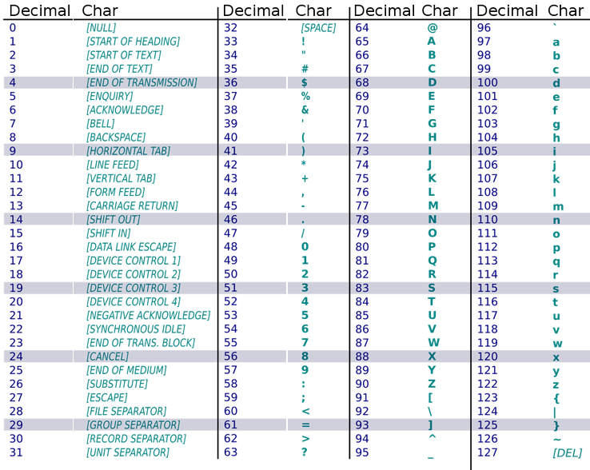
ASCII Table

Slide 11
Summary: Different ways to say the same
while ((c=getchar())!=EOF)
putchar(c);
for (c=getchar(); c!=EOF; c=getchar())
putchar(c);
for (;;) {
c = getchar();
if (c == EOF)
break;
putchar(c);
}
c = getchar();
while (c!=EOF) {
putchar(c);
c = getchar();
}

Slide 12
Fundamental data types
Integers and floating points

Slide 13
Integers (int)
Size of an integer is dependent on the machine but usually 4 bytes.
Integer overflow occurs when assigned value greater than space provided.
We can also have octal and hexadecimal integers

Slide 14
Integral Types
short, unsigned short : provides less storage, usually 2 bytes
int, unsigned : provide more storage than short, 4 bytes
long, unsigned long
  provides more storage (than int but not necessary), usually 8 bytes.

Slide 15
float vs double vs long double
#include<stdio.h>
int main(){
float pi_f= 3.14159265358979323846f;
double pi_F = 3.14159265358979323846;
long double pi_Lf = 3.14159265358979323846L;
printf("Float PI=%.15f\n", pi_f);
printf("Double PI=%.15lf\n", pi_F);
printf("Long double PI=%.15Lf\n", pi_Lf);
}

Slide 16

float vs double vs long double
#include<stdio.h>
int main(){
float pi_f= 3.14159265358979323846f;
double pi_F = 3.14159265358979323846;
long double pi_Lf = 3.14159265358979323846L;
printf("Float PI=%.15f\n", pi_f);
printf("Double PI=%.15lf\n", pi_F);
printf("Long double PI=%.15Lf\n", pi_Lf);
}

Slide 17
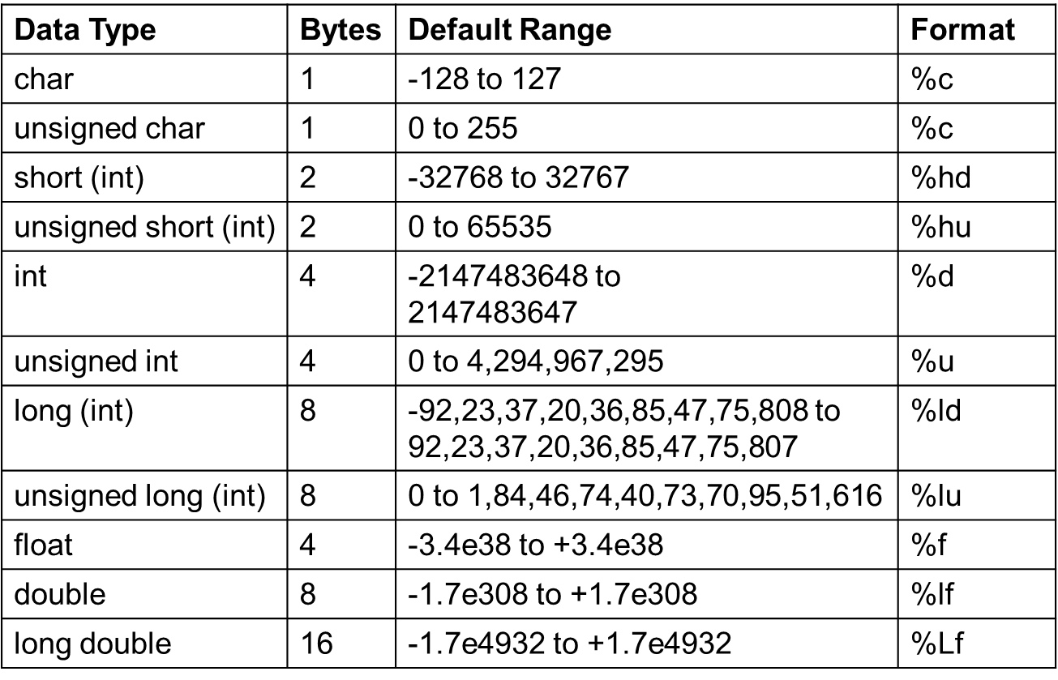
Data types, size, format

Slide 18
Fundamental data types
Keywords typedef and sizeof

Slide 19
typedef
Explicitly associate a type with an identifier
  typedef int integer;
  typedef unsigned long size_t;
Allows abbreviating long declarations, provide meaningful type names

Slide 20
sizeof Operator
Syntax: sizeof(object)
  object can be type (int, float etc) or an expression (a+b)
Returns the number of bytes needed to store an object (unsigned long)
printf(“char: %lu\n”, sizeof(char));
printf(“Int: %lu\n”, sizeof(int));
printf(“char: %lu\n”, sizeof(a+b));

Slide 21
Type conversion coercion

Slide 22
Conversion types
Implicit type conversion also known as coercion is done by the compiler
Explicit type conversion is explicitly defined within a program called casting or casts

Slide 23
Implicit: Integral promotion
In an expression
  if all the values of the original type can be represented by an int, then the value is converted to an int. Example:
  char c = ‘A’;
  Otherwise it is converted to an unsigned int.

Slide 24
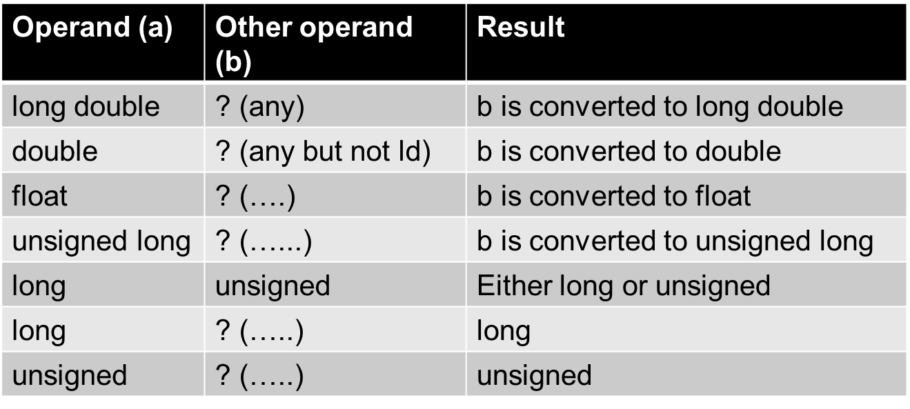
Arithmetic Conversion Rules
The rules are applied in the following order

Slide 25
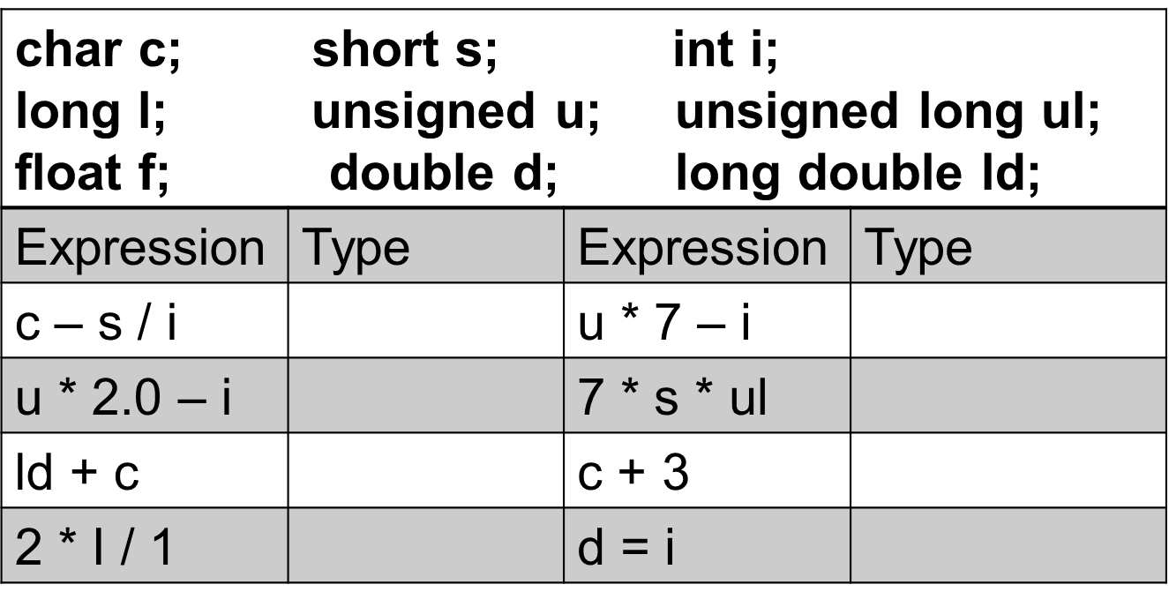
Conversion Example
Courtesy: A book on C, AI Kelly, Ira Pohl

Slide 26
Type conversion casting

Slide 27
Why casting?
What is the output of this arithmetic expression?
int num1 = 10, num2 = 4;
double num3 = num1 / num2;

Slide 28
Casts
Explicit conversion is called casting
  Manually convert from one type to another temporarily
Syntax: (type) identifier
Examples
  (double) i;
  f = (float) ((int) d + 1);

Slide 29
Why casting?
What is the output of this arithmetic expression?
int num1 = 10, num2 = 4;
double num3 = num1 / num2;
How can we change the expression to get the correct result?

Slide 30
Widening versus Narrowing Conversions
Widening conversion – convert lower-ranked data type to higher-ranked types
  No loss of information
Narrowing conversion – convert higher-ranked data type to lower ranked types
  May result in loss of information

Slide 31
C preprocessor
Macros

Slide 32
C preprocessor
C Preprocessor is not a part of the compiler
  It is a separate step in the compilation process
  It is just a text substitution tool
  All pre-processor commands begin with a #

Slide 33
Macros
Macro
  # define <macro name> [ (<parameters>) ] <macro text>
  Performs a text substitution – no data type checking

Slide 34
Predefined macro name
The __DATE__ Macro: current date (month dd yyyy)
The __FILE__ Macro: current source file
The __LINE__ Macro: line number in source file containing the macro reference
The __TIME__ Macro: time compilation started (hh:mm:ss)
The __STDC__ Macro: evaluates to integer constant 1, which indicates a conforming implementation

Slide 35
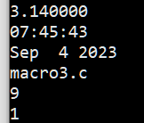
Predefined macro name: putting it together
#include<stdio.h>
#define PI 3.14
int main(){
printf(“%f\n”, PI);
printf("%s\n", __TIME__);
printf("%s\n", __DATE__);
printf("%s\n", __FILE__);
printf("%d\n", __LINE__);
printf("%d\n", __STDC__);
}

Slide 36
C preprocessor
Parameterized Macros

Slide 37
Parameterized macros
Parameterized macros
  # define <macro name> [ (<parameters>) ] <macro text>
  Example:
  #define SQ(x) x * x
  Advantage: code reusability

Slide 38
Using parameterized macros
#include<stdio.h>
#define cir(r) 3.14*r*r
int main(){
int radius;
float area;
scanf("%d",&radius);
area = cir(radius);
printf("Area :%f\n",area);
}

Slide 39
Improper use of macro: an example
#include <stdio.h>
#define sq(x) x*x
int main()
{
int x;
x = 25/sq(5);
printf("%d", x);
return 0;
}

Slide 40
Improper use of macro: Another example
#include <stdio.h>
#define WRITE(i, n) do
{
if (i++ < n)
{
printf(“Hello world\n");
continue;
}
}while(1)
int main()
{
WRITE(0, 3);
return 0;
}

