Slide 1
Traffic Sign Classifier
Divyansh Khandelwal -11840440

Slide 2
What I did Further ??
We worked on improvement of our model accuracy further.
For the task-2 of the project, we implemented a live video capturing feature to our model.
Also we have implemented an traffic sign object detection model using YOLO v3 framework.
Added the audio part also in our app which we did using the streamlit library.

Slide 3
HOW I IMPROVED OUR MODEL ACCURACY
We worked on various model architectures to improve our model accuracy and performance, like by changing filters or varying dense layers or dropouts ,and then observed our model performance .
After working on various model architectures we found that our model was giving good accuracy when we are increasing the dense layer and decreasing the filter sizes.

Slide 4
REASON FOR THE IMPROVEMENT OF OUR MODEL ACCURACY IS :
when we were using the larger kernel size we were losing some details in the smaller features while when we used a 3x3 filter it detected those features and thus resulted in better accuracy .
And also a model with more layers and more hidden units per layer has higher representational capacity i.e it is capable of representing more complicated functions. Thus , increasing the model capacity leads to improving our model performance.

Slide 5
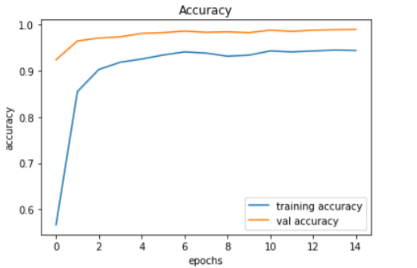
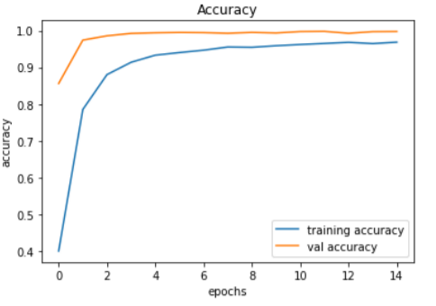
MODEL PERFORMANCE; COMPARISON USING PLOTS :

Slide 6
UPDATED RESULTS :
The testing accuracy on our test Dataset after model improvement is 97.7355 % while before the changes it was 96 % .
After Epoch=15 , Following is the model performance which we have observed : After /Before
Training loss: 0.0892 / 0.1020 Training accuracy: 0.9738 /0.9706
Validation loss: 0.0059/ 0.0097 Validation Accuracy: 0.9985 /0.9976

Slide 7
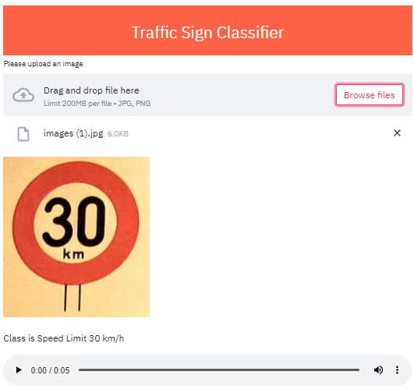
Final Output
In this interface we just need to upload an image and it will predict the class of that image and also generates an audio which will tell us what is the class of the image and from which class it belongs to.

Slide 8
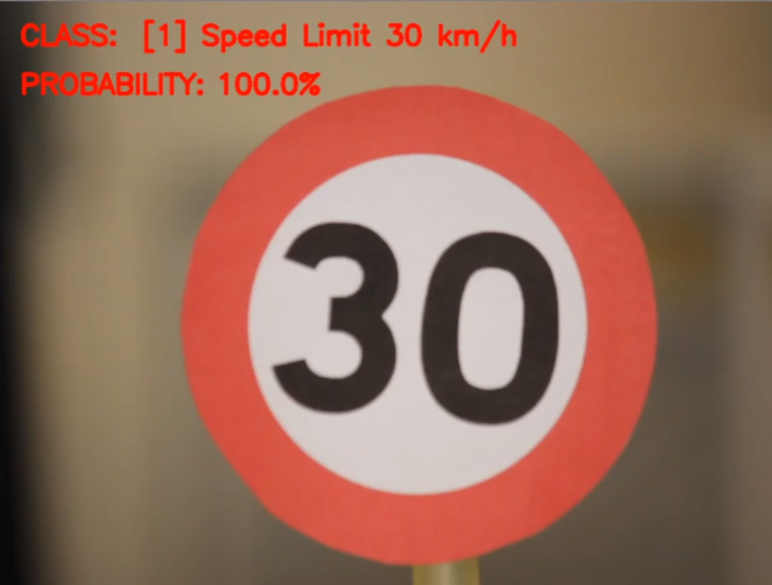
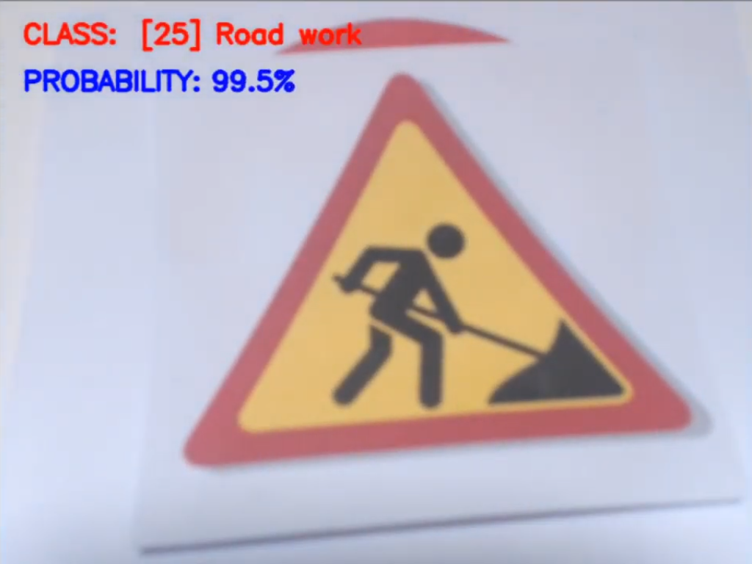
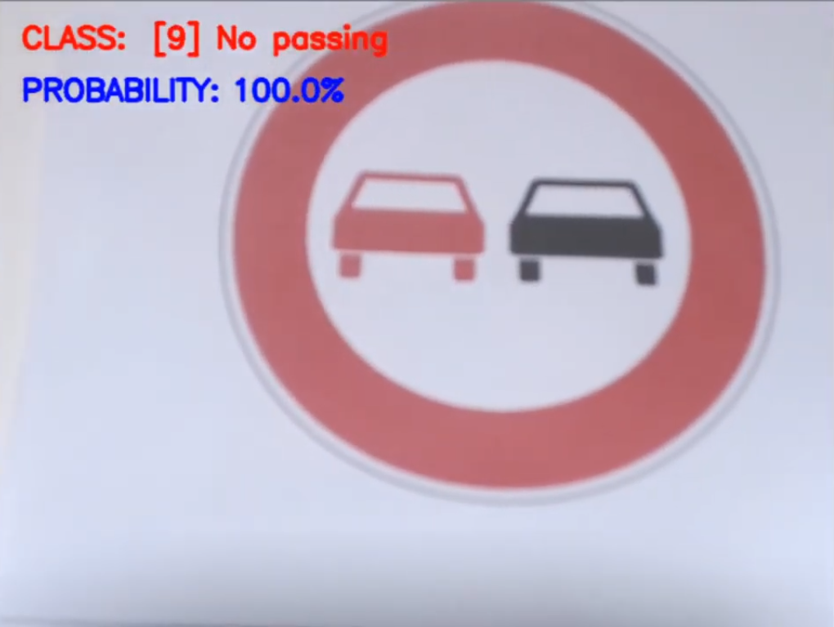
Task-2 Traffic Sign Object Detection
At first, using OpenCV we added a live video capturing feature to our previous image classification model.

Slide 9
Traffic Sign Object Detection
Traffic sign object detection is still a challenging real-world problem of high industrial relevance.
Dataset used-- GTSDB (The German Traffic Sign Detection Benchmark). Contains 900 Images (divided in 600 training images and 300 evaluation images).
Framework used--YOLO v3

Slide 10
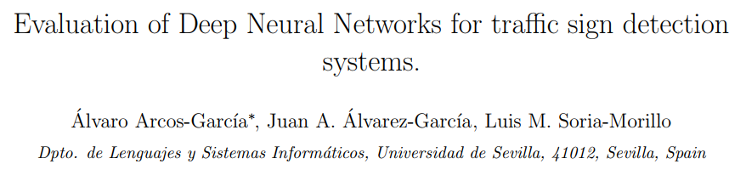
Research Paper Referred
Link to notebook--
https://www.kaggle.com/tanishgupta26/traffic-signs-detection-by-yolo-v3

Slide 11


