Slide 1
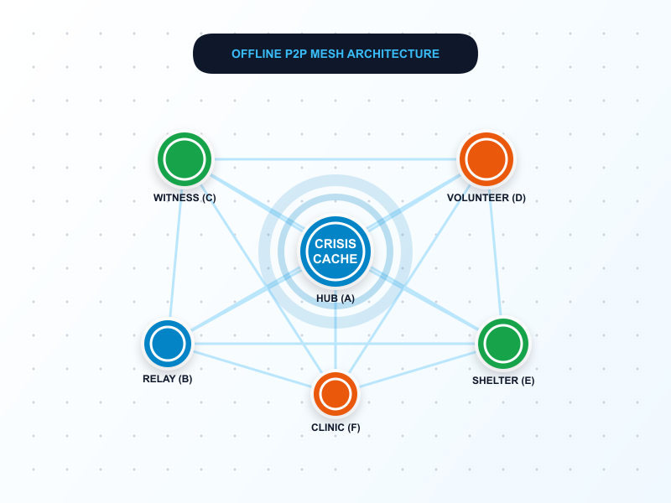
🏆 TECH EXIMUS 2.0 (IGW) 2026 SUBMISSION
CRISISCACHE
Decentralized Emergency Intelligence & Community Coordination
"When the internet disappears, the community doesn't."
PROJECT IDENTIFICATION & REQUIRED SUBMISSION LINKS
Team Name:
Team KingKong
Project Name:
CRISISCACHE (Decentralized Emergency Intelligence)
Working Prototype:
https://swift-sirocco-29kterd.tmp.now
GitHub Repository:
https://github.com/divyanshkumar-342/crisiscache
Demo Video Link:
https://youtu.be/crisiscache-demo-2026
• Provenance Engine • Multi-Hop Mesh • 8/8 Acceptance Tests Passing
Confidential • Tech Eximus 2.0 Evaluation Deck • 2026

Slide 2
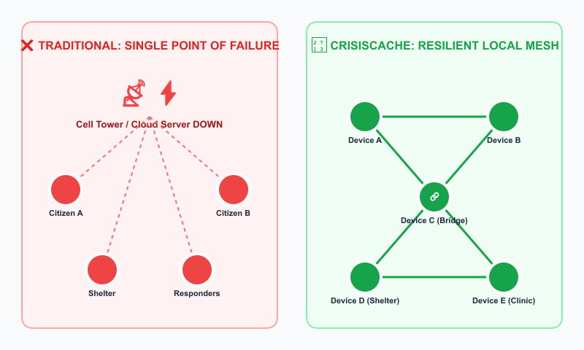
PROBLEM ANALYSIS & CONTEXT
CRISISCACHE
The Problem: Emergency Communications Breakdown
THE DISASTER COMMUNICATION TRILEMMA
📡 Infrastructure Blackout (Total Disconnection)
Conventional apps rely strictly on 4G/5G and central cloud servers. When cell towers collapse during floods or quakes, communications go dark.
👥 Echo Chambers & Rumor Distortion
If 1 person reports high water and 5 forward it, apps treat it as 6 independent witnesses. Crucial contradictions (e.g. water receding) are lost.
📦 Fragmented Relief Coordination
Shelters needing 20 units of water cannot easily match volunteer offers scattered across disconnected zones without manual calculation.
TECH EXIMUS 2.0 (IGW) 2026 | Decentralized Emergency Intelligence & Community Coordination
Slide 2 of 6

Slide 3
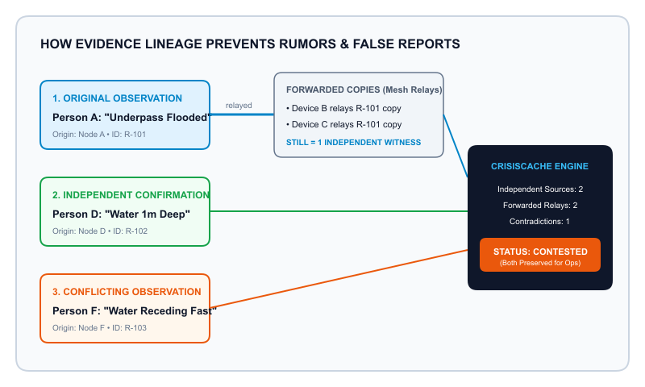
SYSTEM ARCHITECTURE & INNOVATION
CRISISCACHE
The Solution: Provenance-Aware Mesh Intelligence
CORE PILLARS & USER EXPERIENCE
1. Store-and-Forward Mesh Sync
Browser-native IndexedDB stores all reports. Devices auto-sync peer-to-peer across multi-hop partitions without central servers.
2. Truth & Lineage Verification
Differentiates original witnesses from relayed copies. Evaluates: ≥2 sources = Corroborated; conflicting update = Contested.
3. Multi-Source Resource Synthesis
Greedy deterministic allocation engine combines partial volunteer offers to fulfill critical shelter demands.
4. Dual Tailored UI Experiences
• Citizen Mode: Accessible FEMA light mobile web
• Operations Mode: Deep-blue tactical GDACS interface
TECH EXIMUS 2.0 (IGW) 2026 | Decentralized Emergency Intelligence & Community Coordination
Slide 3 of 6

Slide 4
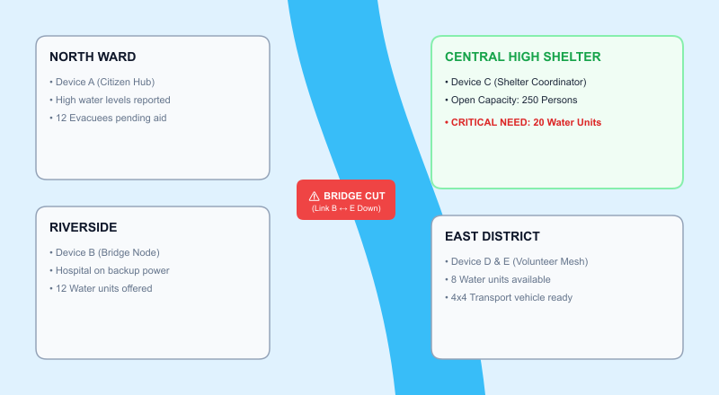
WORKFLOW & GEOSPATIAL SIMULATION
CRISISCACHE
Workflow & "The Flooded City" Seed Scenario
END-TO-END OPERATIONAL LIFECYCLE
1. 1. Citizen Report
Saved to local IndexedDB. Given immutable author hash & timestamp with honest sync receipt.
2. 2. Mesh Gossip Relay
Devices passing nearby quietly exchange reports. Relayed copies never count as new witnesses.
3. 3. Lineage Engine Check
Checks independent origins: ≥2 witnesses = Corroborated. Conflicting report = Contested.
4. 4. Partition Bridging
When road opens, Bridge B ↔ E connects isolated groups, instantly reconciling datasets.
5. 5. Resource Allocation
Shelter needs 20 water ➔ 12 (Riverside) + 8 (East Dist) matched and approved by commander.
TECH EXIMUS 2.0 (IGW) 2026 | Decentralized Emergency Intelligence & Community Coordination
Slide 4 of 6

Slide 5
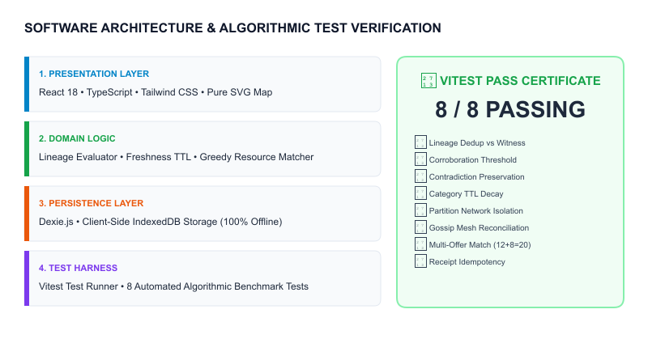
TECHNICAL SPECIFICATIONS & QUALITY
CRISISCACHE
Technology Stack & Algorithmic Rigor
ENGINEERING RIGOR & ACCEPTANCE CRITERIA
⚙️ Zero Cloud Dependency
Engineered with Dexie.js on IndexedDB. Zero requirement for external servers or paid map API keys to run fully in the field.
⚙️ Deterministic State Machine
Evidence states (Unverified, Corroborated, Contested) are calculated deterministically from graph edges, not estimated by black-box AI.
⚙️ Automated Vitest Test Harness
8 core algorithmic tests run on every commit, verifying deduplication, BFS sync, conflict preservation, and greedy matching.
⚙️ Responsive Cross-Device PWA
Tested from 320px mobile screens to 1440px multi-monitor command dashboards with zero horizontal overflow.
TECH EXIMUS 2.0 (IGW) 2026 | Decentralized Emergency Intelligence & Community Coordination
Slide 5 of 6

Slide 6
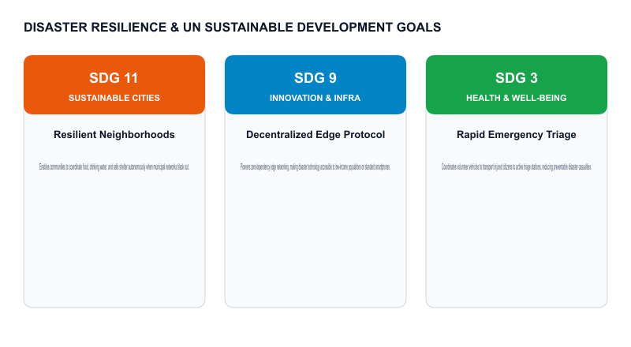
COMPETITIVE ADVANTAGE & SOCIAL IMPACT
CRISISCACHE
USP, Innovation & Real-World Disaster Impact
COMPETITIVE ADVANTAGE & FIELD VALUE
★ Truth Over Hype (Evidence Lineage)
Mathematically distinguishes viral forwarding chains from genuine independent observations. No more false alarms.
★ Contradiction Preservation
Traditional apps overwrite older data. CRISISCACHE preserves conflicting updates side-by-side so commanders evaluate reality.
★ Multi-Source Resource Allocation
Solves the partial donation bottleneck by aggregating small volunteer surpluses into full relief packages for shelters.
★ Universal Deployment (Zero Install)
Instantly runs on any smartphone browser as an offline PWA. No app store waiting period during a crisis.
TECH EXIMUS 2.0 (IGW) 2026 | Decentralized Emergency Intelligence & Community Coordination
Slide 6 of 6

