Slide 1
VIT BHOPAL - SMART CAMPUS NAVIGATION
A campus map & assistance web app for freshers and students
Proposed by: Team Null Syndicate
Abhinav Jain — 25BCE10045
Bhavya Gaurang Vyas — 25BCE10400 Divyansh Mehta — 25BCY10194 Aryan Uday Kansagara — 25BAI11021

Slide 2
The Problem
Every year, new freshers arrive on campus without any clear idea of where things are — academic blocks, hostels, mess halls, medical help, or food outlets.
Campus layouts (AB1, AB2, Blocks 1 to 8, hostel wings, sports areas) are large and confusing for first-time visitors and even some seniors.
Information about mess menus, cafe menus, emergency contacts, and medical services is scattered — students ask around or search social media groups.
There is no single, reliable, always-available source that tells a student where a place is and how to get there.

Slide 3
Proposed Solution
A web app that shows an interactive campus map with every important location pinned and labeled.
Locations covered: Academic Block 1 (AB1) and AB2, Blocks 1–8 (including 8A and 8B), boys' hostel mess halls (Anchor, JMB, Safal, Mayuri), the Special Block food and parcel counter, both campus gates, the MPH sports complex, and Dr. Morphy (campus medical/emergency centre).
Cafes and eateries are marked too — Underbelly near AB1, and Bistro, AB Dakshin, and Mayuri in the Special Block.
Tapping a place opens its description along with a linked PDF (menu, timing, or details) so students don't need to search elsewhere.
Built for freshers on day one, but useful for every student and even visiting parents or guests.

Slide 4
Key Features
Interactive Map
Linked Menus & Info
All blocks, mess halls, cafes, gates, MPH, and Dr. Morphy pinned and labeled clearly.
Tap a place to see a short description; a linked PDF (photographed menus etc.) opens for full details.
Find the Path
Emergency Contacts
Uses the user's live location to calculate and show the best route to any selected place on campus.
One dedicated button for emergency numbers and Dr. Morphy details
— no searching required.
Freshers' Tour
Light / Dark Mode
A guided walkthrough button that introduces new students to the campus, block by block.
A toggle so the map is comfortable to use both indoors and outdoors, day or night.

Slide 5
Target Users & How It Works
Target Users
How a User Moves Through It
Open the website — map loads with all pins visible
Tap a pin (e.g. Underbelly) to see its short info card
Tap the link icon to open the menu/details PDF
Or tap "Find the Path" to get directions from current location
Use quick buttons for Emergency Contacts or the Freshers' Tour anytime
Incoming freshers, on their very first day
Current students who still lose track of new blocks/facilities
Parents and guests visiting during events
Hostel wardens/admin needing quick info to share

Slide 6
Technical Strategy
Technologies / Tools
Frontend:
HTML, CSS, JavaScript (responsive layout for phones, since freshers mostly use mobile)
Map & Location:
Leaflet.js / Google Maps API for the interactive map, browser Geolocation API for "Find the Path"
Backend:
Node.js with Express to serve location data and PDF links
Firebase / MongoDB to store place details, PDF links, and contact numbers so they can be updated easily
Database:
Hosting:
Vercel / Netlify for the website, with PDFs stored on cloud storage (Google Drive or Firebase Storage)

Slide 7
Technical Strategy
Implementation Process
Collect data
→
Build map UI
→
Add routing
→
Add utility buttons
→
Test & launch
Coordinates, photos & menu PDFs for every block, mess, cafe & gate
Place pins on an interactive map with tap-to-view info cards
Connect Geolocation API to a routing service for "Find the Path"
Emergency contacts, Freshers' Tour, light/dark toggle
Test on campus Wi-Fi with real students before go-live

Slide 8
Feasibility and Viability
Feasibility Analysis
Yes — the core pieces (interactive maps, geolocation, and a simple database) are standard web technologies that our team already has working knowledge of.
Resources required: campus location data (coordinates + photos of menus/notices), basic web hosting, and a small amount of cloud storage for PDFs — all low-cost or free tier.
Practical because it doesn't need any new campus infrastructure — it runs entirely as a website accessible from any phone browser.
A first working version covering AB1, AB2, Blocks 1–8, mess halls, and Dr. Morphy can realistically be built and tested within the hackathon timeframe.

Slide 9
Feasibility and Viability
Strategies to Overcome Challenges
Keeping location data accurate: assign one team member to verify and update coordinates and PDFs after physically walking the campus.
GPS accuracy indoors/near buildings: fall back to a simple step-by-step text route when live location isn't precise enough.
Menu/photo files going out of date: store them in a shared cloud folder so they can be swapped without touching the website code.
Low awareness among freshers: tie the website link to orientation day material and hostel WhatsApp groups for the first push.

Slide 10
Impact and Benefits Envisaged
Freshers settle in faster, spending less of their first week lost or asking around for directions.
Reduces load on hostel wardens, seniors, and helpdesks who currently answer the same location questions repeatedly.
Faster access to Dr. Morphy and emergency contacts during genuine emergencies, when time matters most.
Improves accessibility for guests and parents visiting during events without needing a student escort.
Long-term, the same map can be extended with new blocks, new food outlets, or event-specific pins as the campus grows.

Slide 11
Why This Idea May Fail?
Assumes students will actually open and use a new website instead of asking friends or seniors — adoption depends on how well it's promoted during orientation.
Relies on someone keeping the data (menus, contacts, timings) updated; if it goes stale, students will stop trusting it.
Geolocation accuracy can be poor inside buildings or in areas with weak GPS signal, making "Find the Path" less reliable there.
Needs a working internet connection to load the map, which may be an issue in low-connectivity spots on campus.

Slide 12
References
Leaflet.js official documentation — leafletjs.com
MDN Web Docs — Geolocation API
Firebase documentation — firebase.google.com/docs
Campus location photographs and menu references collected by the team on-site
12

Slide 13
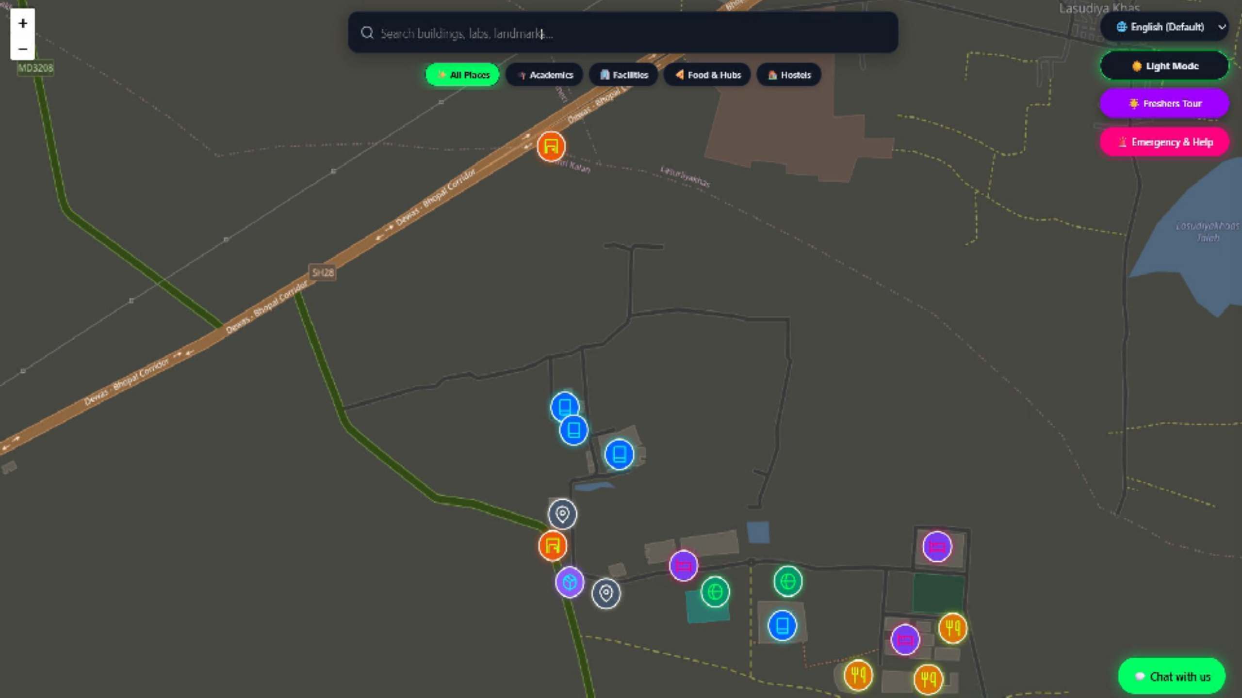

Slide 14
GITHUB LINK:-
https://github.com/divyanshmehta-dev/NullSyndicate-DivyanshMehta
VIDEO LINK:-
https://drive.google.com/file/d/1t79SKB1LbL42Jz_b803I8 1QnUcTowG1j/view?usp=drivesdk
12

Slide 15
Thank You
Questions are welcome
13

