Slide 1

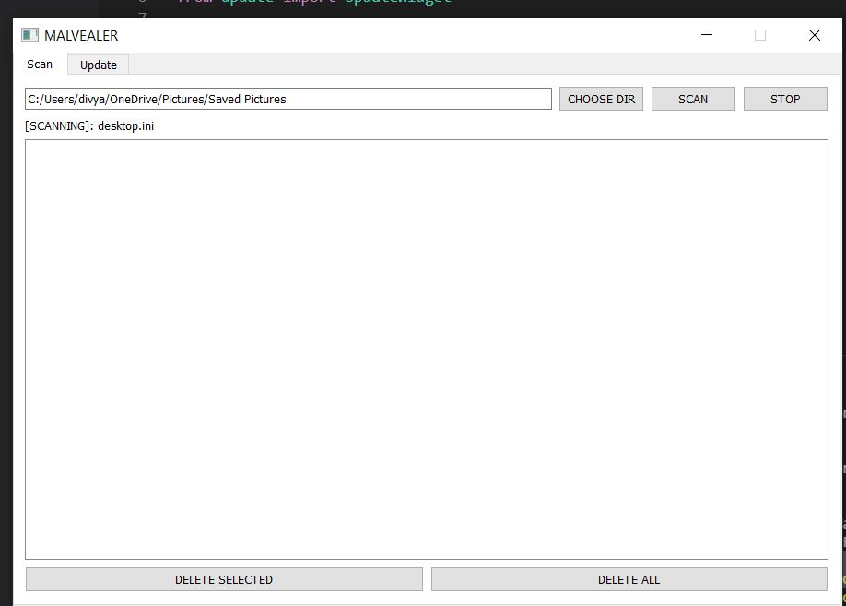
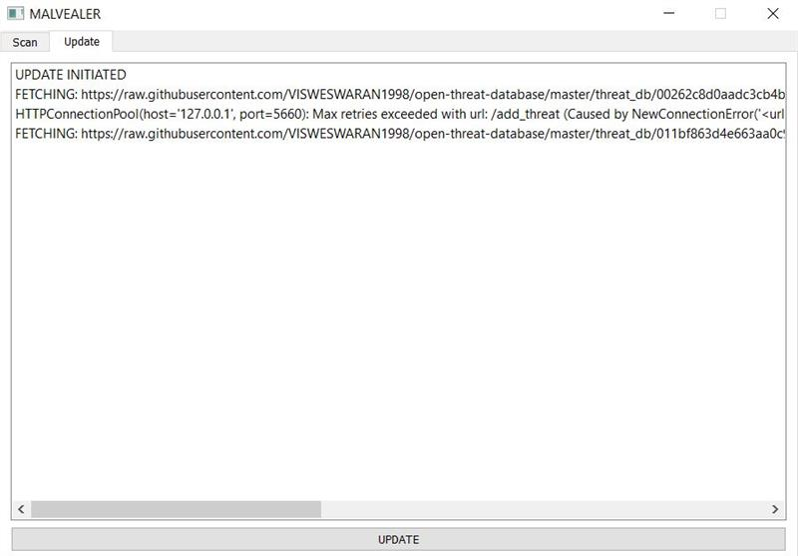
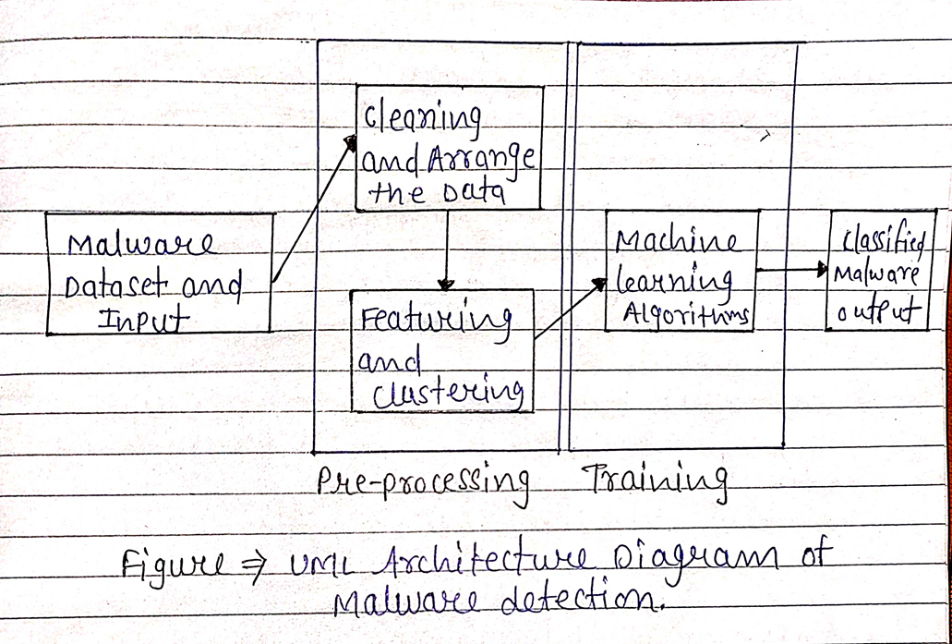
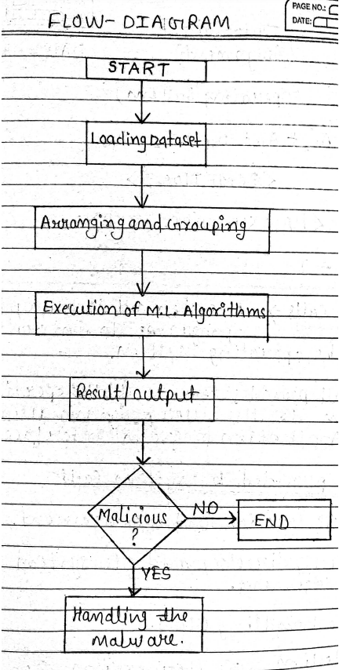
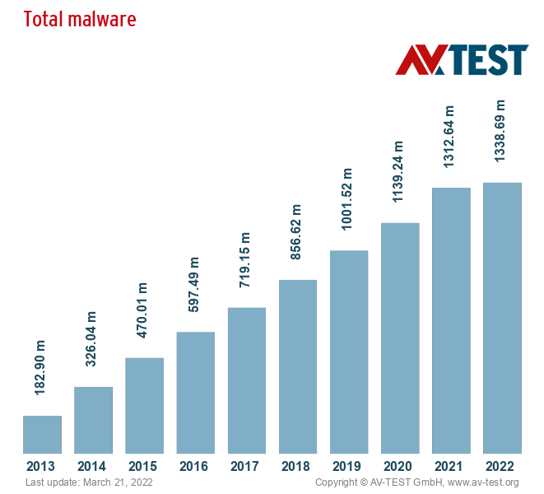
Malvealer – Malware detector
Project Group ID:- 09
<Student names- Harish-Carpenter, Divyansh-Ojha, Akshay-Chouke, Narendra-Kumar-Patel,
Guide name – Dr. Subhash Chandra Patel, affiliate to VIT University
ABSTRACT
INTRODUCTION
RESULTS
DISCUSSION
Malvealer is a Malware Detector tool. It is based on python and machine learning algorithms with GUI. Malvealer detects malware file inside a directory and handles them. We have tested the tool over a dataset. With the help of the Malvealer we can easily detect and handle the malicious filles. In today’s world malware is a very big problem because attacker can use malware and they can access your systems.
The main objective of Malvealer is to able to detect malware or malicious code in the system.
Malvealer – will provide security to the system. It will detect the presence of malware on host system.
Malware is any software intentionally designed to cause disruption to a computer, server, client, or computer network, leak private information, gain unauthorized access to information or systems, deprive users access to information or which unknowingly interferes with the user's computer security and privacy.
The most common types of malware include computer viruses, computer worms, Ransomware, Keyloggers, Trojan horses, spyware and other forms of malicious software. Others include Fileless Malware, Spyware Adware, Rootkits, Bots, RAM scraper, and Mobile Malware.
Hackers use it to steal passwords, delete files and render computers inoperable. A malware infection can cause many problems that affect daily operation and the long-term security of your company.
In future we can add more functionalities to the tool like when a new file is coming in our pc our tool will automatically search for malware in that file.
If Malware found than our tool can easily handle the Malware.
We can use these six steps in our response plan -
Identify: Identify which endpoints have been impacted
by the attack.
Communicate: Once the impact of the attack and the point of entry have been identified, communicate your findings to necessary parties ASAP.
Block: If possible, block any further access from the origin of the malware, such as the originating website, email or IP address.
Restore: Put affected data back in a known-good state where there is no chance of malware remaining. This can be done with reimaging, rebuilding or a combination of the two.
Recover: Recover as much affected data as you can using available backups. This is particularly applicable to ransomware attacks.
Re-examine: Sit back and take a hard look at your current security strategy and what allowed the malware to get through in the first place. By analyzing and sealing these gaps, you protect your organization from a similar attack in the future
MODULES AND METHODS
Modules –
1.Data pre-processing – used to convert the raw data into a clean data set. In other words, whenever the data is gathered from different sources it is collected in raw format which is not feasible for the analysis.
2.Regression – Regression algorithms are used to predict the continuous values such as price, salary, age, etc.
3. Classification - algorithms are used to predict/Classify the discrete values such as Male or Female, True or False, Spam or Not Spam, etc.
4. Clustering - The aim of this is to separate similar categories of data and differentiate them into localized regions.
This way, when a new data point arrives, we can easily identify which group or cluster it belongs to. This is done for unstructured datasets where it is up to the machine to figure out the categories.
Methods -
1.Signature Detection - In this method a unique identifier about the threat is stablished. In virus scan this identifier is Unique code template that attached to a file.
2.Behaviour Detection - It includes “Heuristic Scan”. Heuristic scan uses Algorithms to search for commands that may indicate intent evil.
3.Feature Detection - It is derivation of behaviour-based detection.
This involves monitoring program executions and detecting deviations from the specific and its behaviour,instead of seemingly selecting specific attack patterns.
CONCLUSIONS
As we know malware is trending threat and it is very harmful for the systems. Attackers can use malware and they can access our system. It is very much required to handle the malwares. Malvealer is designed to detect the malware in directory and files.
The aim of this tool is to detect and remove malware from the file.
Figure 1. Overall Architecture.
REFERENCES
RESEARCH ARTICLE | AUTHOR
A state-of-the-art survey of malware detection approaches using data mining techniques | Alireza Souri
Malware Analysis and Vulnerability Detection Using Machine Learning | Farrukh A. Khan
Tools and Techniques for Malware Detection and Analysis | Sajedul Talukder
Techniques of Malware Detection: Research Review | Institute of Electrics and Electronics Engineering
Malware and Malware Detection Techniques: A Survey | Jyoti Landage
https://www.av-test.org/en/statistics/malware/ | AVTEST site report
https://www.researchgate.net/publication/343499527_Project_report_Malware_analysis | Research Gate site report
https://intellipaat.com/community/41644/what-is-the-difference-between-regression-and-clustering
Chart 1 Total. Malware every day.
Figure 2. Flow Diagram.

