Slide 1

Divyansh Patel
8WeekSQLChallenge
CTE
Subquery
Aggregate Function
Rank Function

Slide 2
Introduction
Danny seriously loves Japanese food so in the beginning of 2021, he decides to embark upon a risky venture and opens up a cute little restaurant that sells his 3 Favouritefoods: sushi, curry and ramen.
Danny’s Diner is in need of your assistance to help the restaurant stay afloat - the restaurant has captured some very basic data from their few months of operation but have no idea how to use their data to help them run the business.

Slide 3
Problem Statement
Danny wants to use the data to answer a few simple questions about his customers, especially about their visiting patterns, how much money they’ve spent and also which menu items are their favourite . Having this deeper connection with his customers will help him deliver a better and more personalized experience for his loyal customers.
He plans on using these insights to help him decide whether he should expand the existing customer loyalty program - additionally he needs help to generate some basic datasets so his team can easily inspect the data without needing to use SQL.
Danny has provided you with a sample of his overall customer data due to privacy issues - but he hopes that these examples are enough for you to write fully functioning SQL queries to help him answer his questions!
Danny has shared with you 3 key datasets for this case study:
sales
menu
members

Slide 4
Case Study Questions
Each of the following case study questions can be answered using a single SQL statement:
What is the total amount each customer spent at the restaurant?
How many days has each customer visited the restaurant?
What was the first item from the menu purchased by each customer?
What is the most purchased item on the menu and how many times was it purchased by all customers?
Which item was the most popular for each customer?
Which item was purchased first by the customer after they became a member?
Which item was purchased just before the customer became a member?
What is the total items and amount spent for each member before they became a member?
If each $1 spent equates to 10 points and sushi has a 2x points multiplier - how many points would each customer have?
In the first week after a customer joins the program (including their join date) they earn 2x points on all items, not just sushi - how many points do customer A and B have at the end of January?

Slide 5
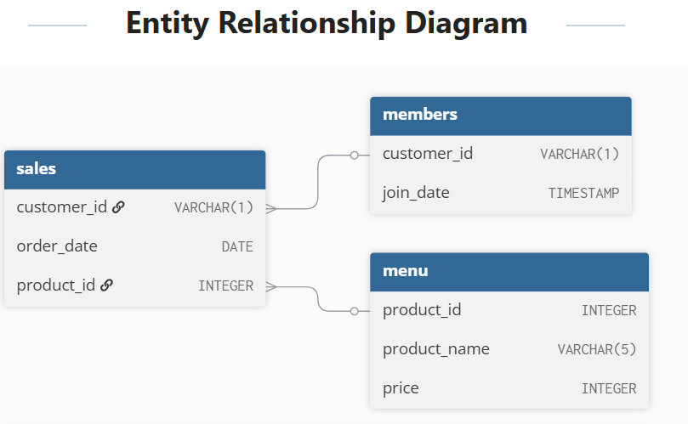
select * from Case_study_1_dannys_diner.sales;
select * from Case_study_1_dannys_diner.menu;
select * from Case_study_1_dannys_diner.members;

Slide 6
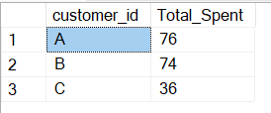
Question 1
1 What is the total amount each customer spent at the restaurant?
select customer_id,SUM(price) as Total_Spent
from Case_study_1_dannys_diner.sales s
left join Case_study_1_dannys_diner.menu m
on s.product_id=m.product_id
group by customer_id
;

Slide 7

Question 2
-- 2.How many days has each customer visited the restaurant?
select customer_id , count(Distinct order_date) as visited_days
from Case_study_1_dannys_diner.sales
group by customer_id;

Slide 8
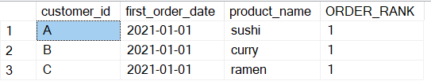
Question 3
-- 3.What was the first item from the menu purchased by each customer?
WITH FIRST_ORDER AS
(
select customer_id,order_date as first_order_date ,product_name,
ROW_NUMBER() OVER(PARTITION BY customer_id ORDER BY order_date ASC) AS ORDER_RANK
from Case_study_1_dannys_diner.sales s
left join Case_study_1_dannys_diner.menu m
on s.product_id=m.product_id
)
SELECT * FROM FIRST_ORDER
WHERE ORDER_RANK =1;

Slide 9
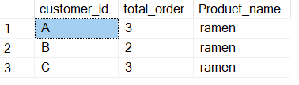
Question 4
4.What is the most purchased item on the menu and how many times was it purchased by all customers?
with top_product as (
select top 1
product_name
from Case_study_1_dannys_diner.sales s
left join Case_study_1_dannys_diner.menu m
on s.product_id=m.product_id
GROUP BY product_name
ORDER BY COUNT(order_date) desc
)
Select
customer_id,count(order_date) as total_order ,
(select product_name from top_product) as Product_name
from Case_study_1_dannys_diner.sales s
left join Case_study_1_dannys_diner.menu m
on s.product_id=m.product_id
join top_product p
on p.product_name=m.product_name
group by customer_id;

Slide 10
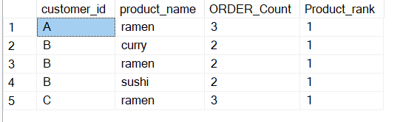
Question 5
-- 5.Which item was the most popular for each customer?
WITH popular AS
(
select customer_id,product_name,
count(order_date) OVER(PARTITION BY customer_id,product_name) AS ORDER_Count
from Case_study_1_dannys_diner.sales s
left join Case_study_1_dannys_diner.menu m
on s.product_id=m.product_id
),
ranks as
(SELECT *,
Dense_rank() OVER(Partition by customer_id ORDER BY ORDER_Count DESC)as Product_rank FROM popular)
select distinct * from ranks
where Product_rank=1;

Slide 11

Question 6
-- 6.Which item was purchased first by the customer after they became a member?
with fis_Meb as (
selects.customer_id,s.product_id,product_name,order_date,join_date,
rank() over(partition by s.customer_id order by order_date asc) as order_rank
from Case_study_1_dannys_diner.sales s
left join Case_study_1_dannys_diner.menu me
on s.product_id=me.product_id
left join Case_study_1_dannys_diner.members m
on s.customer_id=m.customer_id
where S.customer_id =M.customer_id
AND order_date>=join_date)
select * from fis_Meb
where order_rank=1;

Slide 12
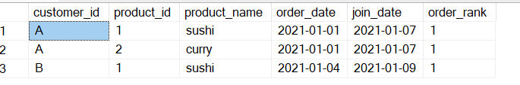
Question 7
-- 7.Which item was purchased just before the customer became a member?
with last_befor_meb as (
selects.customer_id,s.product_id,me.product_name,order_date,join_date,
rank() over(partition by s.customer_id order by order_date desc) as order_rank
from Case_study_1_dannys_diner.sales s
left join Case_study_1_dannys_diner.menu me
on s.product_id=me.product_id
left join Case_study_1_dannys_diner.members m
on s.customer_id=m.customer_id
where S.customer_id =M.customer_id
AND order_date<join_date)
select * from last_befor_meb
where order_rank=1;

Slide 13

Question 8
-- 8.What is the total items and amount spent for each member before they became a member?
with Total_spend_bef_mem as (
select
s.customer_id,s.product_id,me.product_name,
order_date,join_date,price
from Case_study_1_dannys_diner.sales s
left join Case_study_1_dannys_diner.menu me
on s.product_id=me.product_id
left join Case_study_1_dannys_diner.members m
on s.customer_id=m.customer_id
where S.customer_id =M.customer_id
AND order_date<join_date
)
select customer_id,count(product_id) as total_items,sum(price)
as total_spent
from Total_spend_bef_mem
group by customer_id;

Slide 14
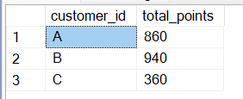
Question 9
-- 9.If each $1 spent equates to 10 points and sushi has a 2x points multiplier - how many points would each customer have?
with cus_poin as (
select
s.customer_id,s.product_id,me.product_name,order_date,price,
case
when me.product_name='sushi' then price*20
else price*10 end as points
from Case_study_1_dannys_diner.sales s
left join Case_study_1_dannys_diner.menu me
on s.product_id=me.product_id
)
select customer_id, sum(points) as total_points
from cus_poin
group by customer_id;

Slide 15

Question 10
-- 10.In the first week after a customer joins the program (including their join date) they earn 2x points on all items, not just sushi - how many points do customer A and B have at the end of January?
with order_week as (
selects.customer_id,s.product_id,me.product_name,price,
order_date,join_date,dateadd(DAY,6,join_date) as week_after_join
from Case_study_1_dannys_diner.sales s
left join Case_study_1_dannys_diner.menu me
on s.product_id=me.product_id
left join Case_study_1_dannys_diner.members m
on s.customer_id=m.customer_id
where S.customer_id =M.customer_id
AND order_date>=join_date
)
select customer_id,sum(price*20) as program_point from order_week
where order_date<='2021-01-31'
and order_date between join_date and week_after_join
group by customer_id;

Slide 16
This project was completed as part of the 8 Week SQL Challenge – Case Study #1: Danny’s Diner,
created by Data With Danny.
📌 Objectives Achieved:
Analyzed real customer behavior using SQL
Answered 10+ business-focused case study questions
Applied concepts like joins, subqueries, CTEs, and window functions
Built a strong foundation in data storytelling through SQL
🎯 Tools Used: SQL SERVER
📂 Full SQL code & project available on: divyanshpatel128/SQL-Case-Study-Danny-s-Diner-8-Week-SQL-Challenge-
🙌 Special Thanks: To (3) Danny Ma | LinkedIn for creating this challenge

