Slide 1
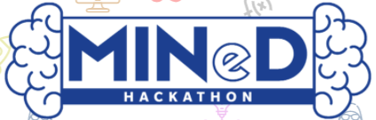
SMART IRRIGATION

Slide 2
Team: Smart EC College: Nirma University
Damini Rathi – 18BEC023@nirmauni.ac.in
Divyansh Rai – 18BEC027@nirmauni.ac.in

Slide 3
Problem Statement
To bring automation in the field of farming. Farmer can control farming activities like irrigation, crop monitoring using an android application.
To build smart farm which guides the farmer about soil parameters like moisture , pH, etc.

Slide 4
Solution
We are making a smart farm blended with sensors and IOT platform that brings the useful data of soil like moisture, humidity, ph, temperature, etc to the cloud(internet) which can be monitored by the farmer anytime on an android application and on that basis of the predicted rainfall, market prices of the crops and obtained soil data through sensors the application itself suggests which crop to be grown to get maximum profit on the basis of present soil conditions.

Slide 5
Solution
Automated smart farm solve the following problems:
problem of irrigation.
Soil watering and irrigation can controlled using mobile phone without visiting farm through Iot.
crop monitoring can done using image processing through drone photography which can be controlled using phone.

Slide 6
Components Required
Atmega16 Microcontroller
Voltage Regulator: IC 7805
1N4007 Rectifier Diode
BC548 npn Transistor
Relay 12V
12V Motor
9V PP3 Battery
12V Battery
Connectors, LEDs, Switch, Resistors, Capacitors.

Slide 7
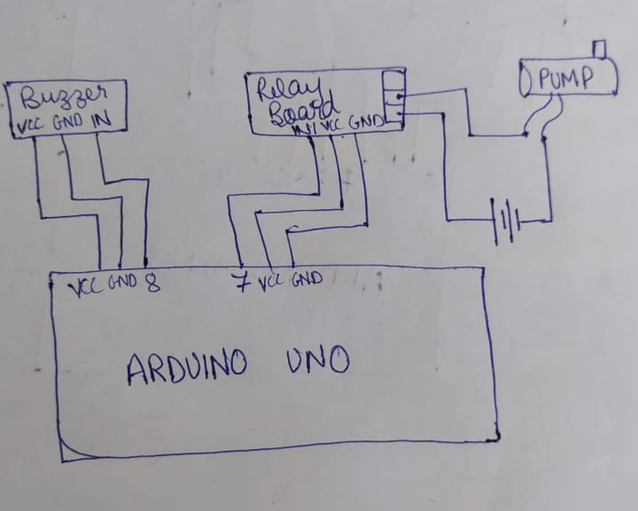
Block Diagram

Slide 8
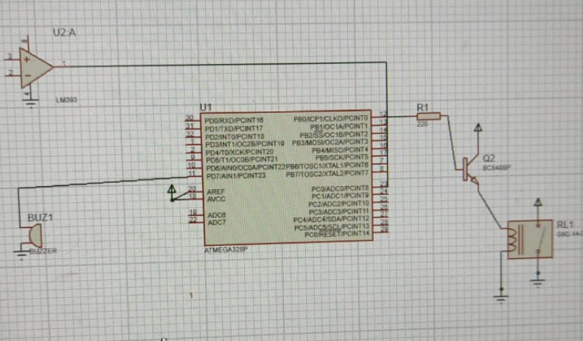
Circuit Diagram

Slide 9
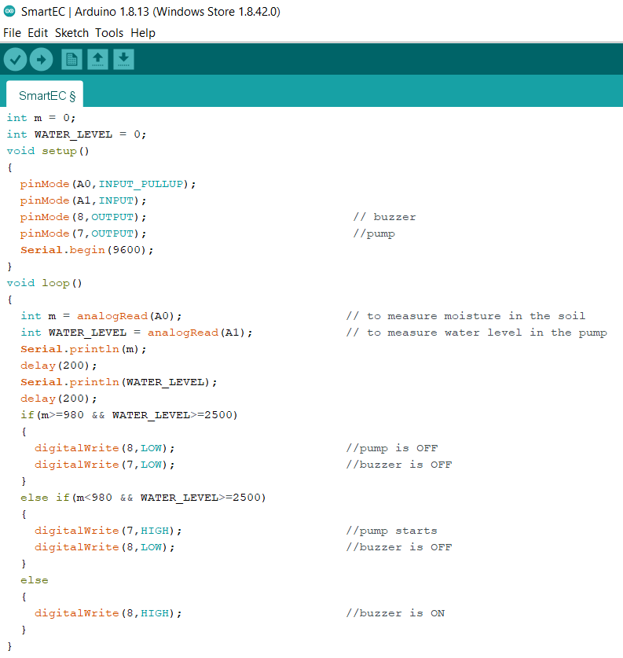
Code:

Slide 10
Future Expansion and Benefits
A digital analysis wing can be made by the government for farming sector analysis and statistics.
Smart decisions regarding farming can be taken by farmers for maximum economic growth.
Automated farming activities(irrigation, fertilization) flexible crop monitoring from phone runtime governmental monitoring system for nation/state wise analysis of agriculture.

Slide 11
References
Automated Plant Watering System-By Ayan Pahwa
Crop Health Monitoring using GSM Technology, Mayuri Grace and Anjaly Mohanan, GRD Journals, May 2019.
Automatic Watering System for My Plants-Project Hub.

Slide 12


