Slide 1


SMART INDIA HACKATHON 2025
Crowdsourced Civic Issue Reporting and Resolution System
Problem Statement ID – 25031
Problem Statement Title- Crowdsourced Civic lssue Reporting and Resolution System
Theme- Clean & Green Technology
PS Category- Software
Team ID- OCT22
Team Name - Nexus

Slide 2


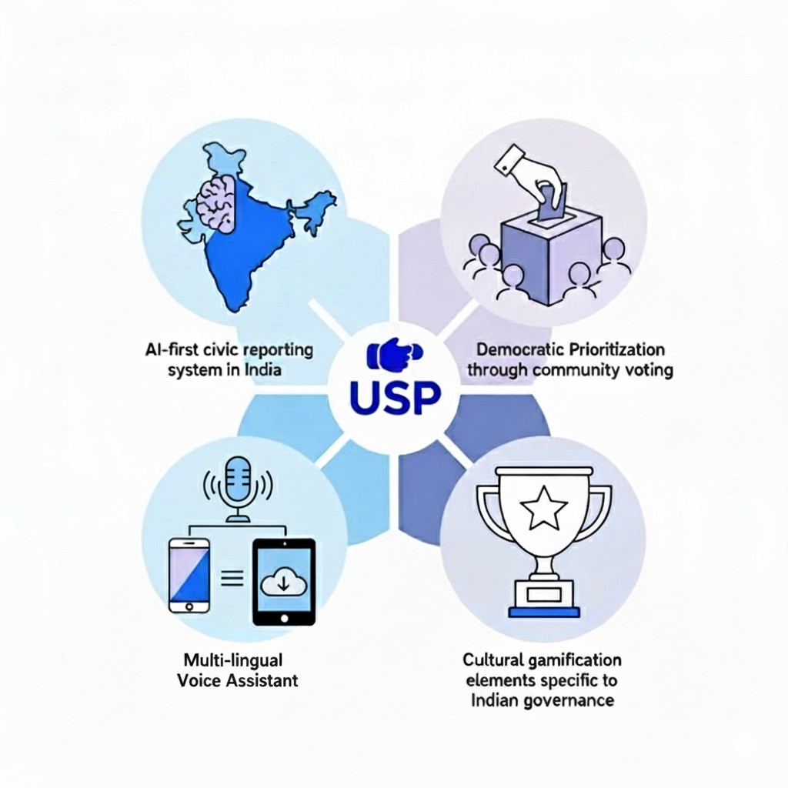
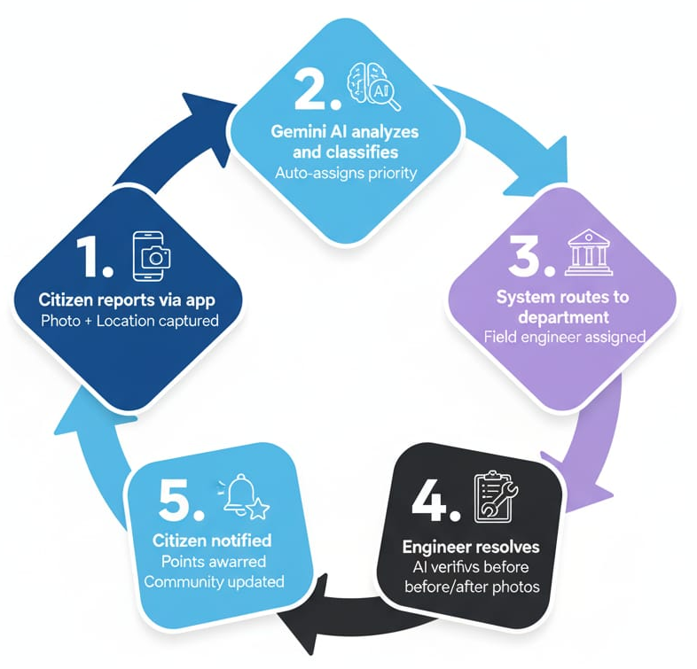

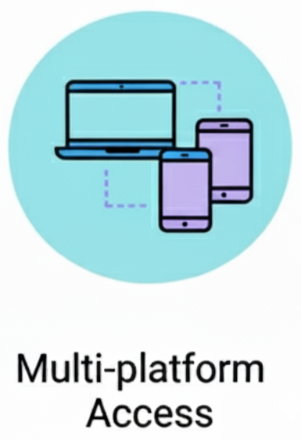
AI Powered Crowdsourced Civic Issue Reporting and Resolution System
How it addresses the problem
Why Our Solution is Unique
Key Features

Slide 3
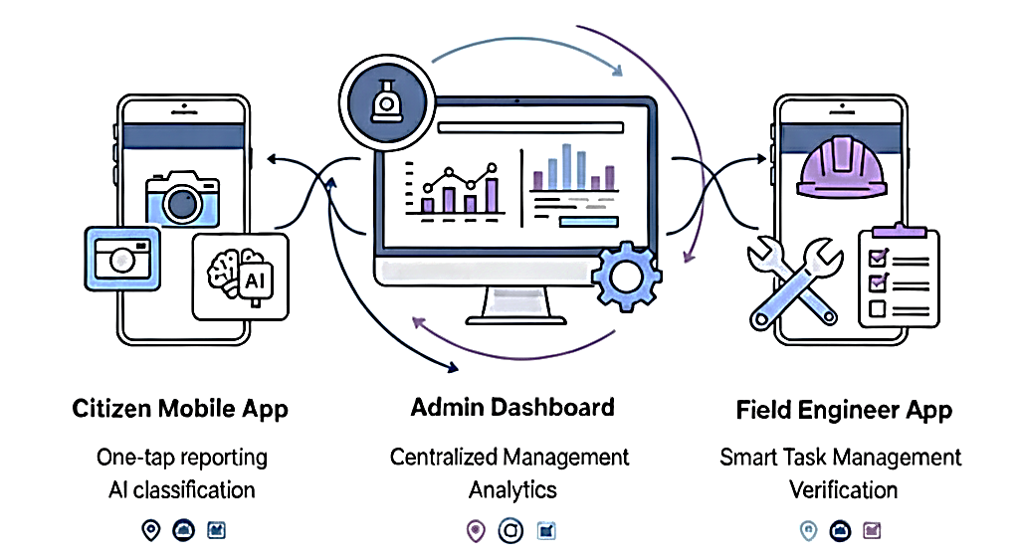
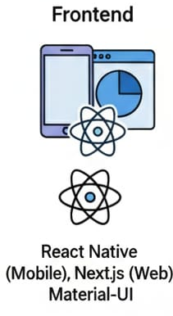


Technical Approach
Node.js , Express,
PostgreSQL

Slide 4
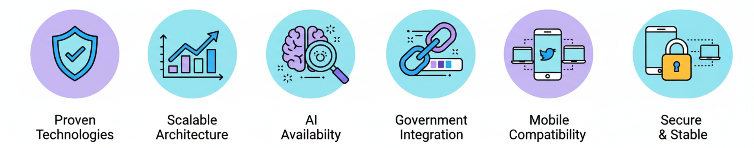
Feasibility and Viability
Analysis of the Feasibility of the Idea
Potential Challenges and Mitigation Strategies
Challenges | Mitigation Strategies
Government Adoption Risk | Pilot program, training, phased rollout
AI Accuracy and Bias | Human oversight, continuous learning, local models
User Engagement | Gamification, community building, frequent updates
Data Privacy and Security | Encryption, GDPR compliance, privacy-first design

Slide 5
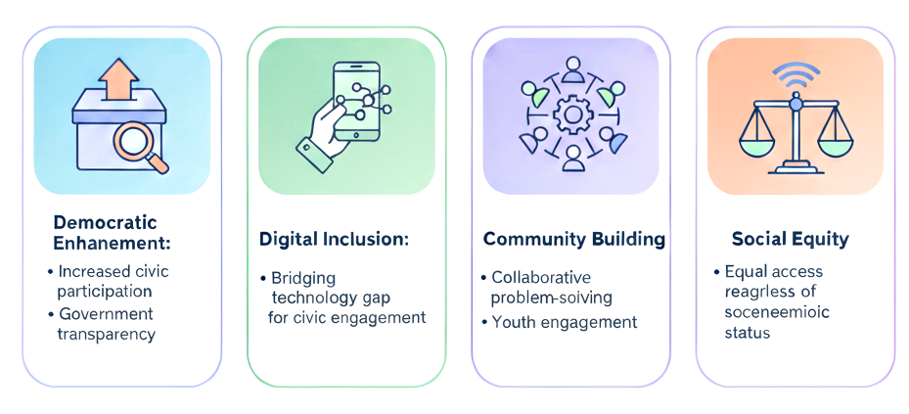
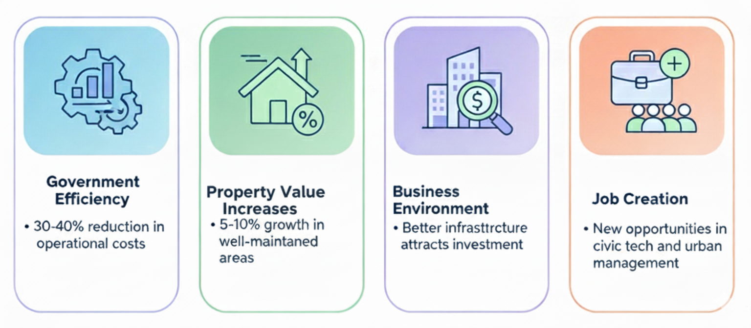
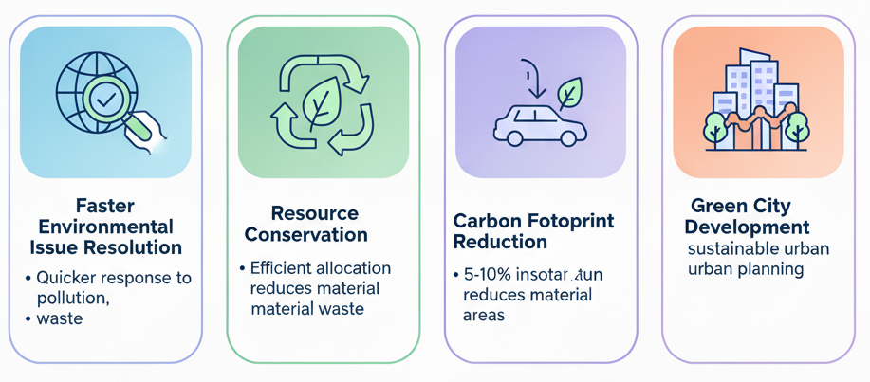

Impact and Benefits
Social Impact
Economical Benefits
Increased civic
participation
Bridging
technology gap
or civic engagement
Collaborative problem Solving
Equal access regardless of socio-economic status
30-40% reduction in
operational costs
5-10% growth in well-maintained areas
Better Infrastructure
attracts investment
New opportunities in
civic tech and urban
management
Government Transparency
Youth engagement
Environmental Impact
Quicker response to pollution, waste
Efficient allocation
reduces material
material waste
Optimized routes reduce emissions
Data supports sustainable urban planning

Slide 6



Research and References
Government Studies
Academic Research
International Case Studies
Ministry of Electronics and IT - Digital India initiatives
"Digital Governance and Citizen Engagement" - IIT Studies
SeeClickFix (USA) - Civic issue reporting platform analysis
Smart Cities Mission implementation reports
"AI in Public Administration" - IISc Research Papers
FixMyStreet (UK) - Community problem-solving model
Urban development challenges in Indian cities
"Gamification in Civic Participation" - Urban Planning Research
Seoul Digital City - Smart governance implementation
Key References and Links
Digital India Programme: https://digitalindia.gov.in/
Smart Cities Mission: https://smartcities.gov.in/
Google Gemini API: https://ai.google.dev/
E-Governance Standards: https://egovstandards.gov.in/

