Slide 1
Methodology Chart
1. Downscaling the Satellite Image using Nearest Neighbour Interpolation and Then Using Otsu Algorithm for Thresholding.
• TIFF format supports geospatial metadata including CRS and transform.
• Used ‘rasterio’ to load the satellite image.
• Code:
import rasterio
image = rasterio.open('image.tif')
• Output: Image object with metadata (bands, resolution, CRS, etc.) Load India's shapefile and filter for Uttarakhand using Geopandas.
• Mask the raster using `rasterio.mask.mask()` with filtered polygon.
• Purpose: Isolate Region of Interest (ROI) for focused processing.
• Reduces computational complexity and ensures accurate analysis.
• Post extraction, background and land regions are normalized to intensity 0.
• Helps in reducing false positives in later classification.
• Non-water areas are removed using logical masking on NumPy arrays.
• This ensures only relevant features (water bodies) are preserved.

Slide 2
In Nearest Neighbour Interpolation It works by assigning the value of the closest pixel from the original image
to the new pixel in the resized image.
When resizing an image:
For each pixel in the new image, find the closest corresponding pixel in the original image.
Then just copy the pixel value from the original image to the new pixel.
Explanation :
For a particular scale value for Downscaling and for a pixel at location (i, j) in the new image ,
The corresponding location in the original image is:
x = Nearest Neighbour of i
y = Nearest Neighbour of j
round() selects the nearest neighbour pixel having integer coordinates based on proximity.
Then Update the new image : new[i][j] = original[x][y]
Pros :
Very fast (no computation - heavy math).
Good for categorical or label images (like masks or segmentation maps).
Easy to implement.
Cons :
Produces blocky, pixelated images.
Poor quality for natural image.

Slide 3
Then Applying Otsu Algorithm for Thresholding , How does Otsu Algorithm work?
Otsu’s Algorithm is a thresholding method used to convert a grayscale image into a binary image. It automatically finds the optimal threshold value (Actually we iterate over all values and finds the optimal value) that best separates the foreground and background pixels.
Main Goal - Choose a threshold that maximizes the separation (contrast) between the foreground and background.
Algorithm :
• Otsu's method determines optimal threshold by maximizing inter-class variance.
• Applied only on non-zero (i.e., water) pixel values.
• Below threshold → Temporary water body
• Above threshold → Permanent water body
• Advantage: No manual threshold selection needed.
Result :
• Successfully extracted Uttarakhand region.
• Enhanced spatial quality of image using interpolation.
• Separated water bodies into temporary and permanent categories.
• Optional visual outputs: histogram of intensities, water mask overlays.

Slide 4
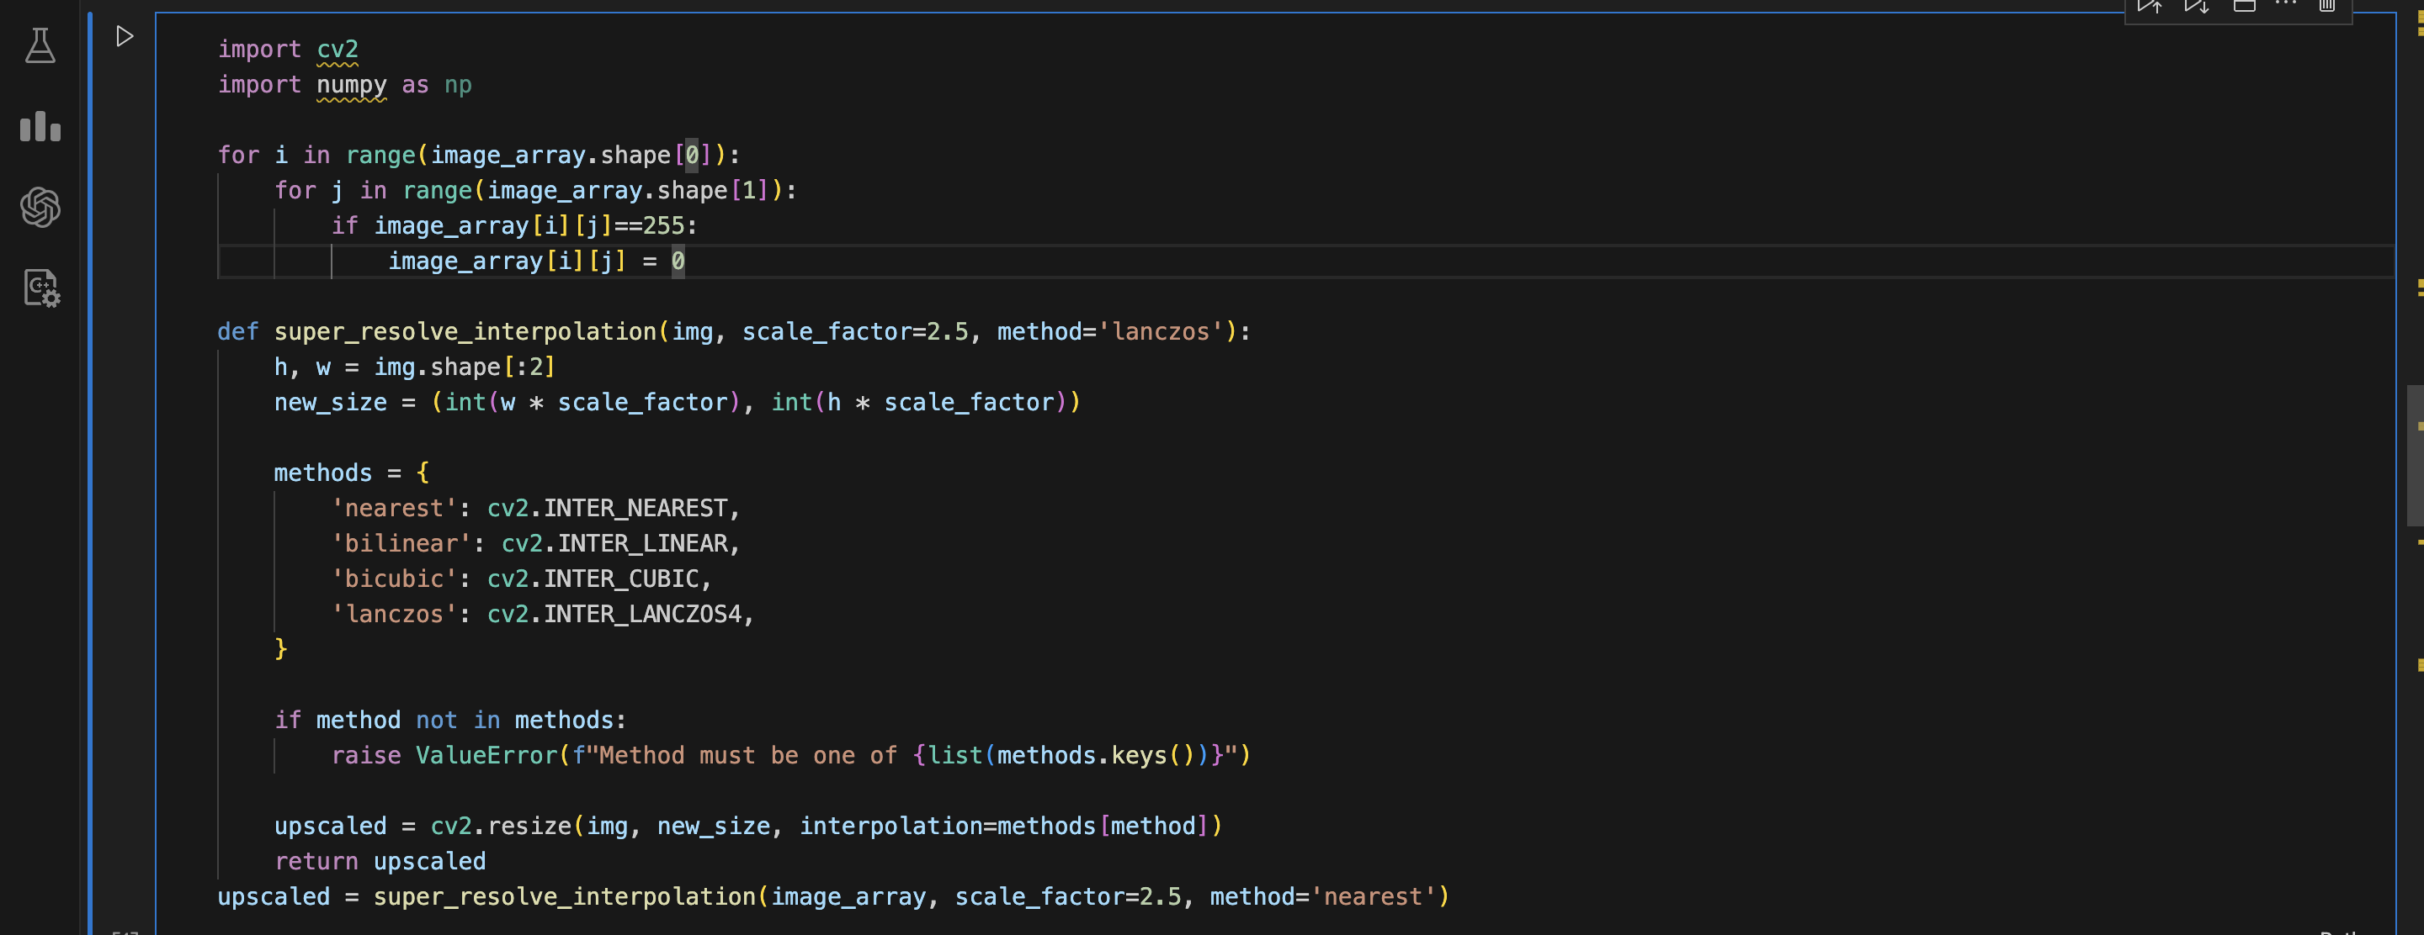
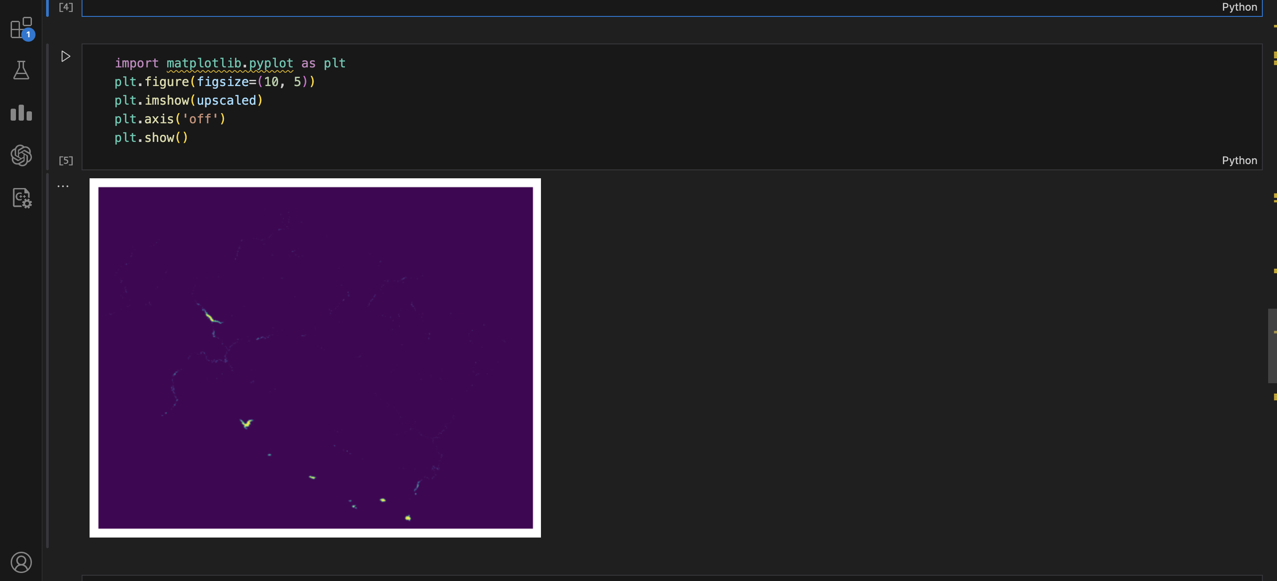
Code For Nearest Neighbour Interpolation and then Plotting it.

Slide 5
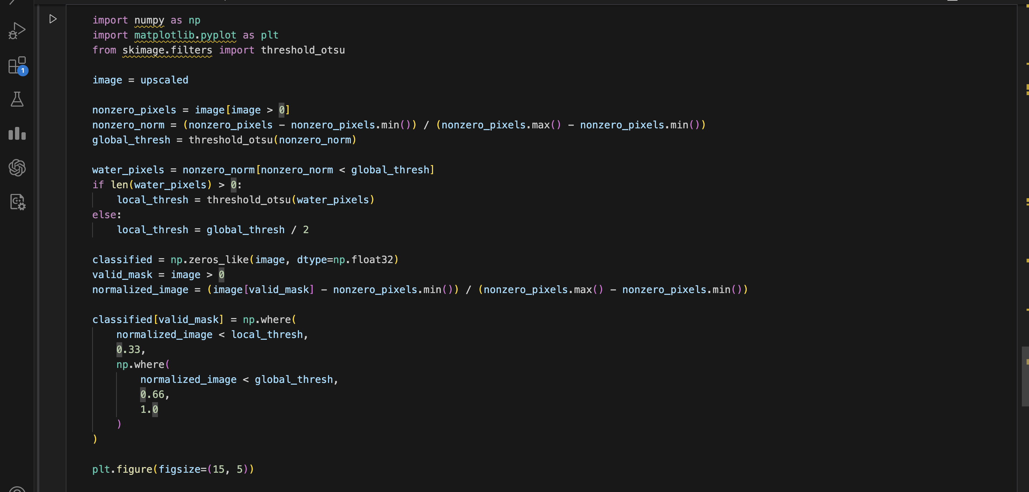
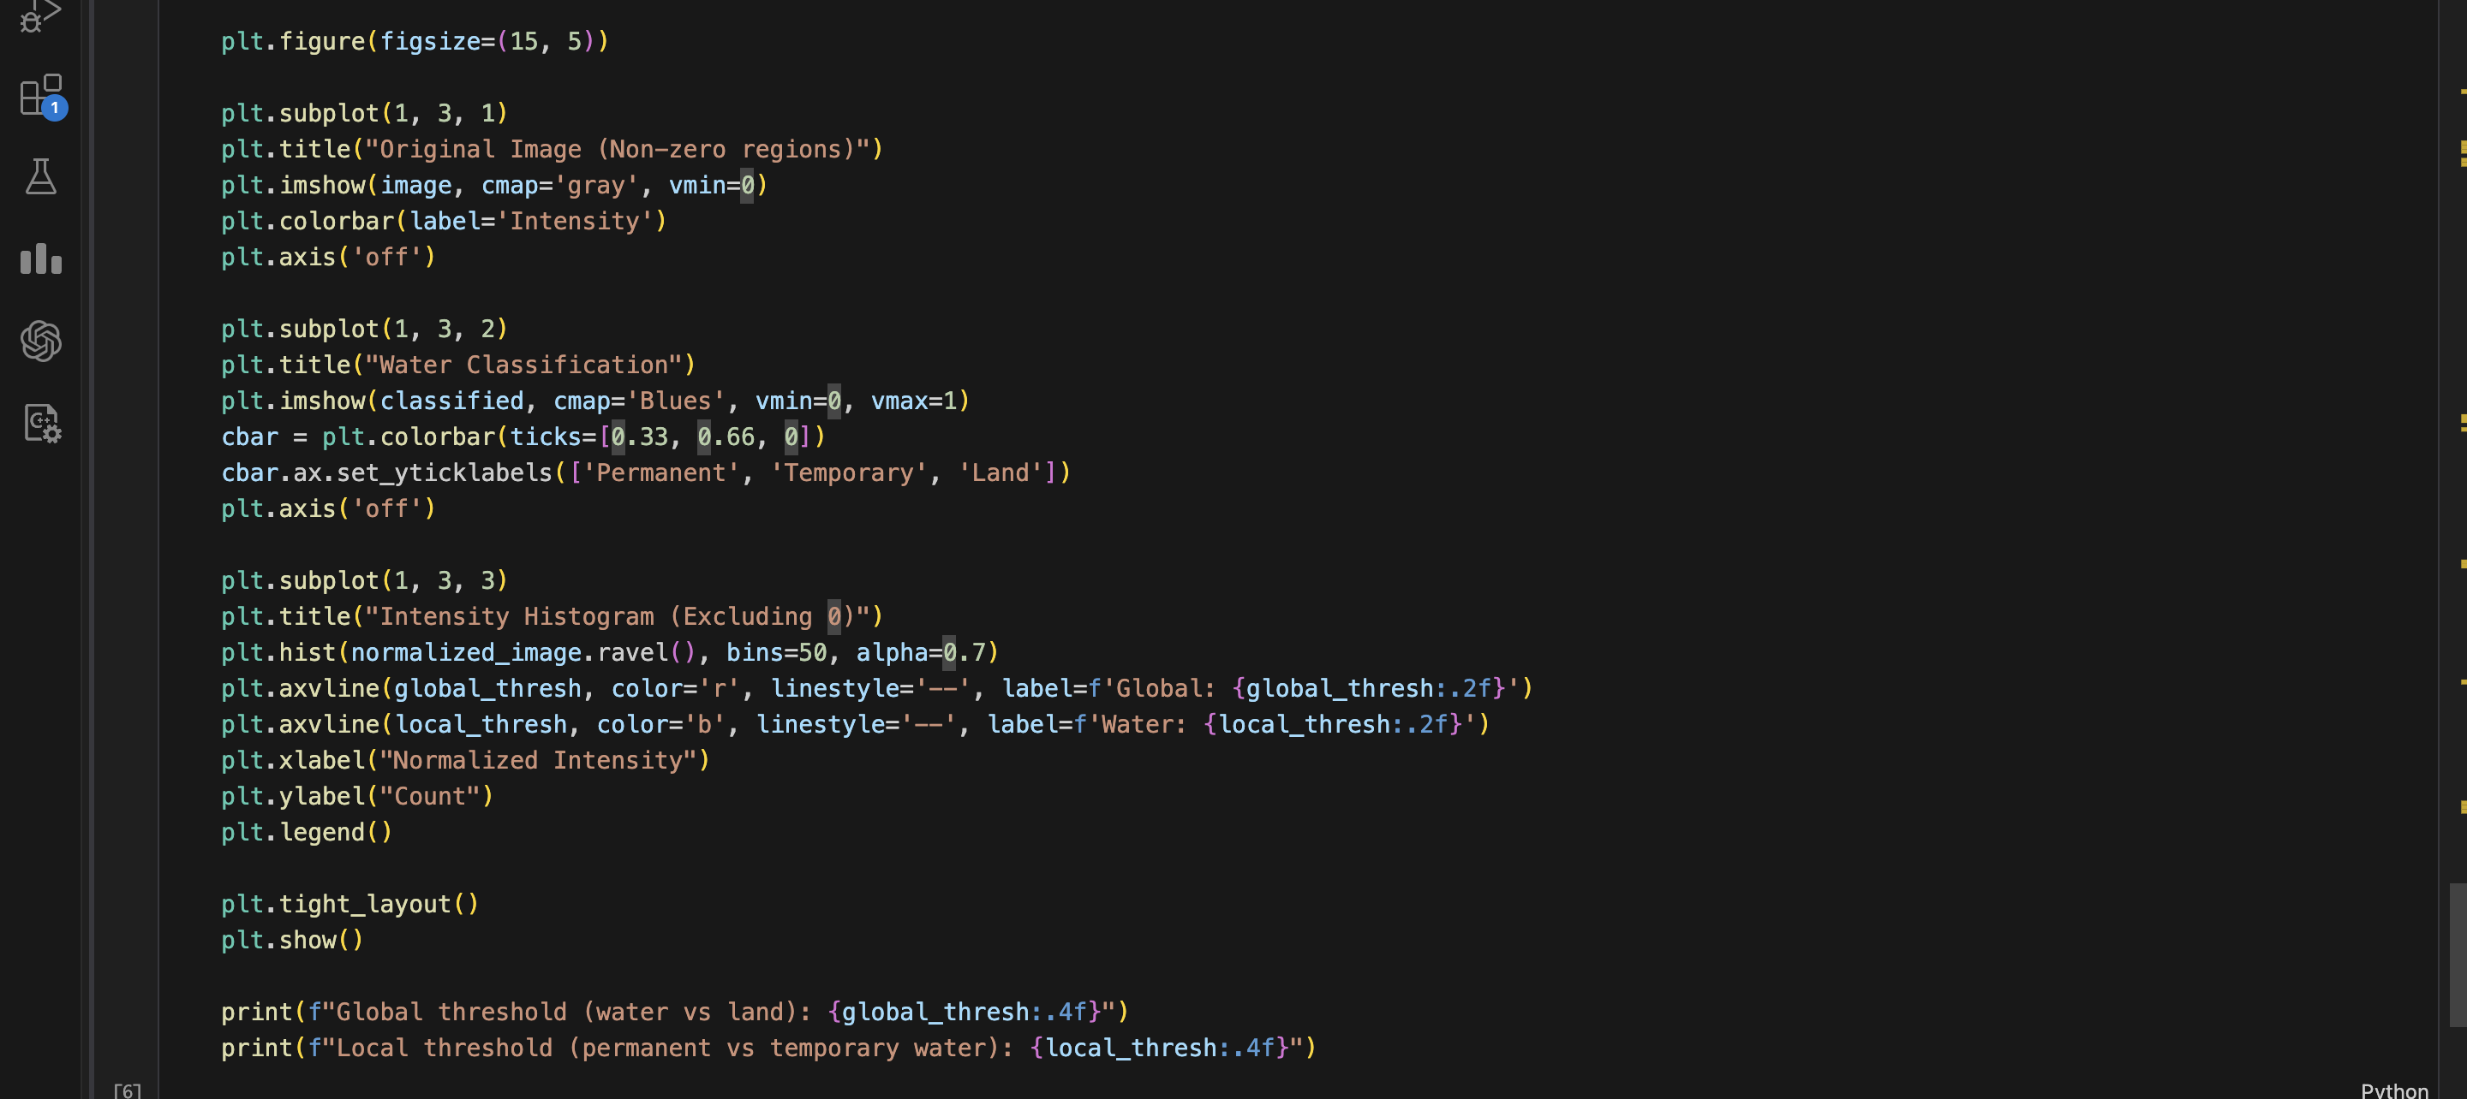
Otsu Algorithm Code

Slide 6
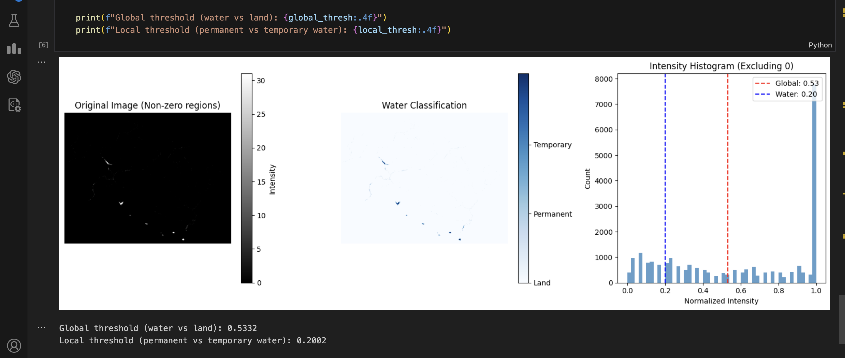
Output for Otsu Algorithm Using Nearest Neighbour Interpolation

Slide 7
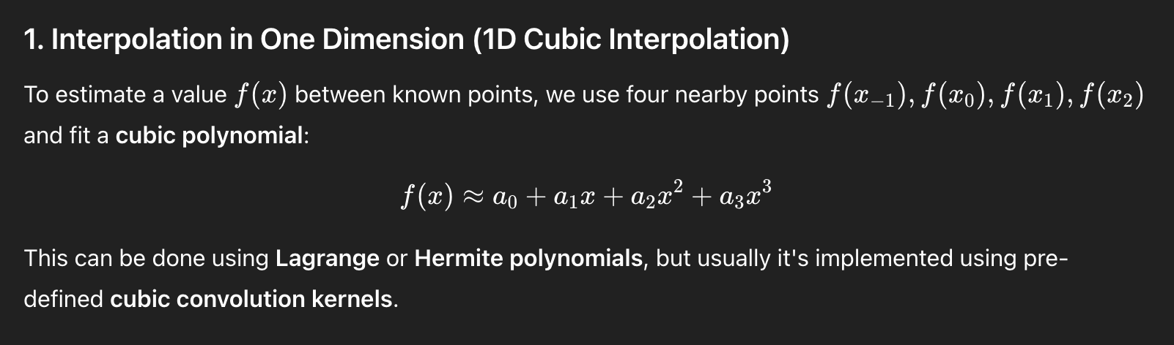
2. Downscaling the Satellite Image using Bicubic Interpolation and Then Using Otsu Algorithm for Thresholding.
Starting Steps are Similar as in Above Method only thing different is Interpolation Method.
Bicubic Interpolation is a method of resizing images that estimates new pixel values using a weighted average of 16 nearby pixels (a 4x4 grid), based on both their intensities and their spatial distance.
Bicubic interpolation does the following:
Find the 4×4 neighbourhood around that point (16 surrounding pixels).
Fit a cubic polynomial in both x and y directions.
Use interpolation kernel to weigh each pixel based on its distance from the target location.
Combine all 16 values using those weights to get the final pixel value.

Slide 8
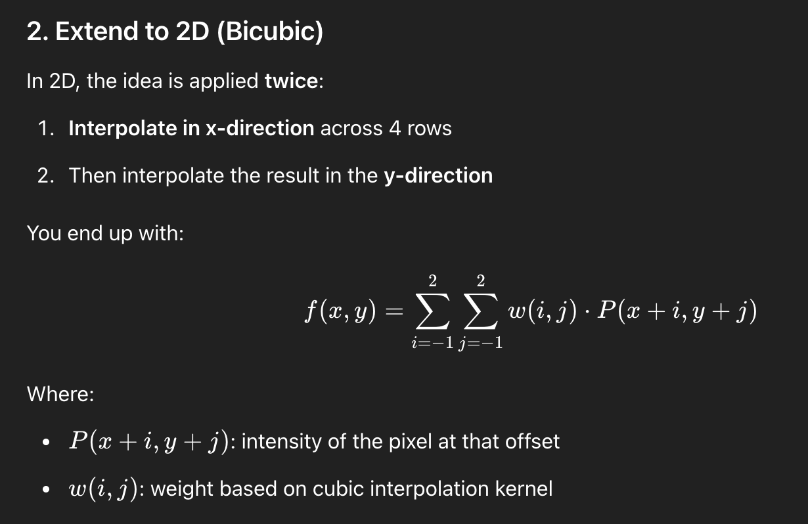
Pros :
Produces smooth, high-quality images.
Good for resizing photos and natural images.
Better preservation of edges and gradients than bilinear.

Slide 9
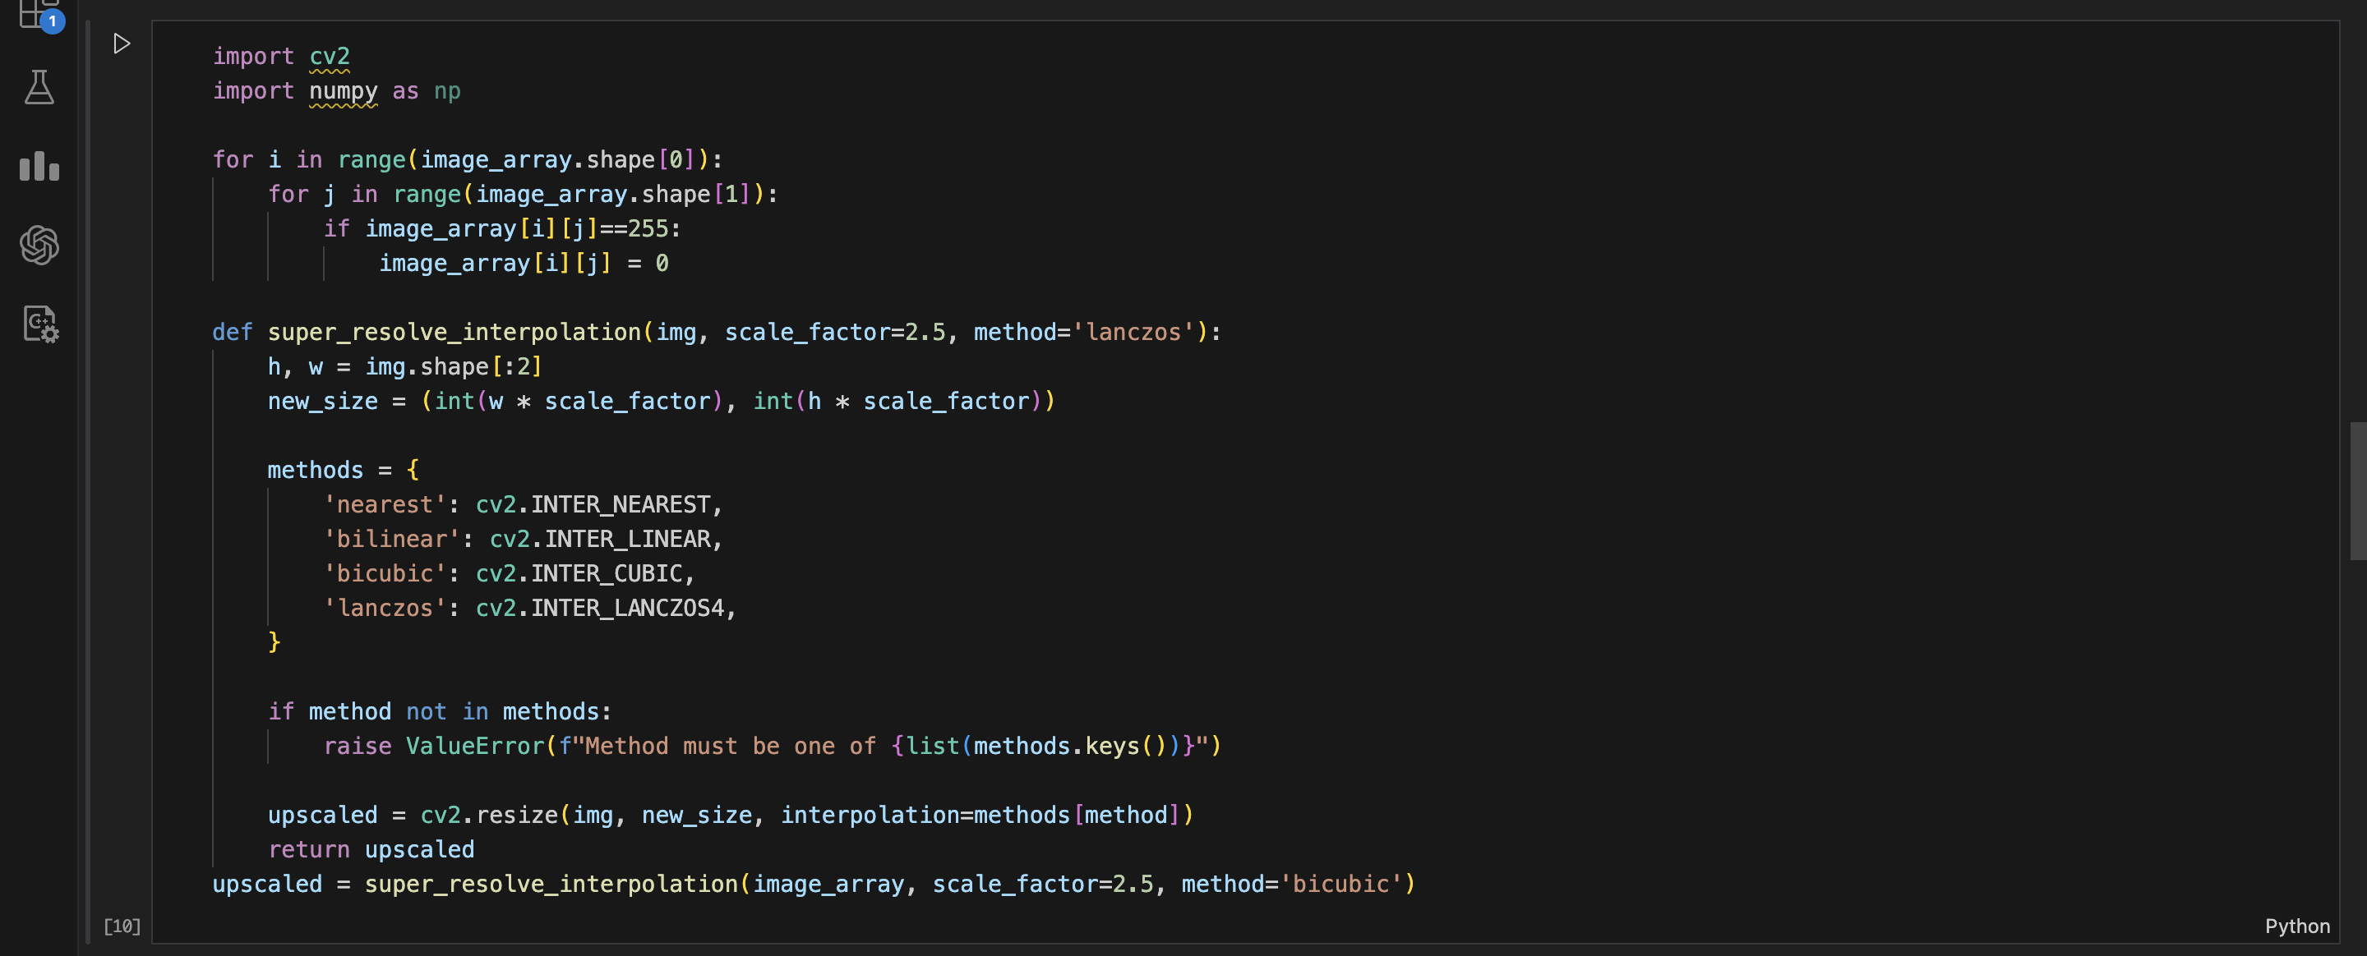
Cons :
Slower than nearest or bilinear.
More computationally expensive (uses 16 pixels per output pixel).
Then Using Otsu Algorithm similarly as Explained in Above Method.

Slide 10
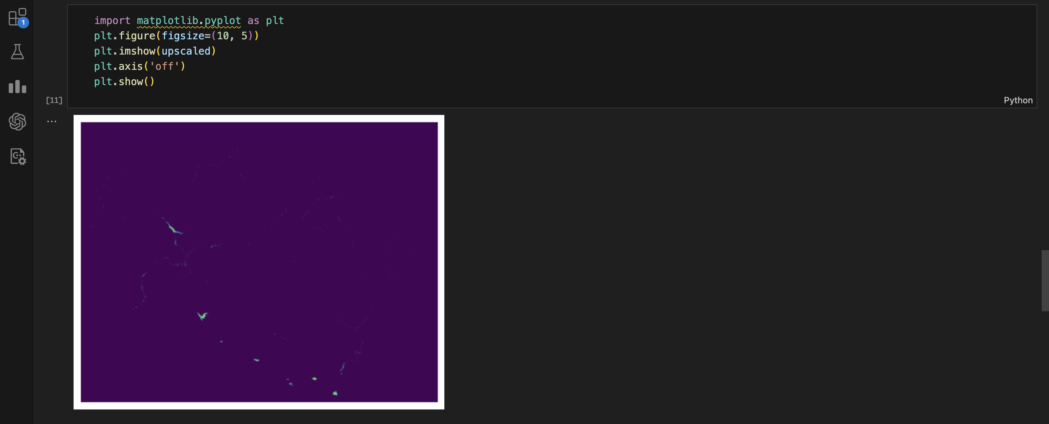
Code For Bicubic Interpolation and then Plotting it.

Slide 11
Otsu Algorithm Code
Output for Otsu Algorithm
Using Bicubic Interpolation

Slide 12
Which Interpolation is Better?
By Looking at the Final Output From Otsu Algorithm There is No major difference, But Bicubic Interpolation is better than Nearest Neighbour Interpolation.
3. Observation on a larger time scale
Firstly we applied precprocessing including downscaling with interpolation and identifying water areas using otsu’s thresholding on each month data for a span of 20 years (2003-2022).
It was then used to calculate seasonal average and annual average.
Seasonal average was used for detecting change in water areas between same seasons for each year.
Yearly average was used in detecting change across each year.
For spatial observation we divided the region in north and south portions and plotted them separately.
4. Area Computation and Categorization
For each processed image:
The total number of pixels in each category (permanent water, temporary water, land) is computed.
These pixel counts are converted to area proportions and stored in arrays.
This provides a time series of area variations across different water categories.

Slide 13
5. Storing and Plotting Results:
Lists are maintained to track:
dates: Time extracted from each image.
areas: Total water-covered areas.
upper_areas and lower_areas: Proxies for temporary and permanent water bodies.
classified_water_images: Thresholded binary images for visualization and qualitative analysis.
6. Outcomes and Visualizations
The final results include a temporal profile of water body coverage, which can be used to:
Study seasonal water changes.
Detect long-term water body shrinkage or expansion.
Support environmental monitoring and policy planning.

Slide 14
