Slide 1
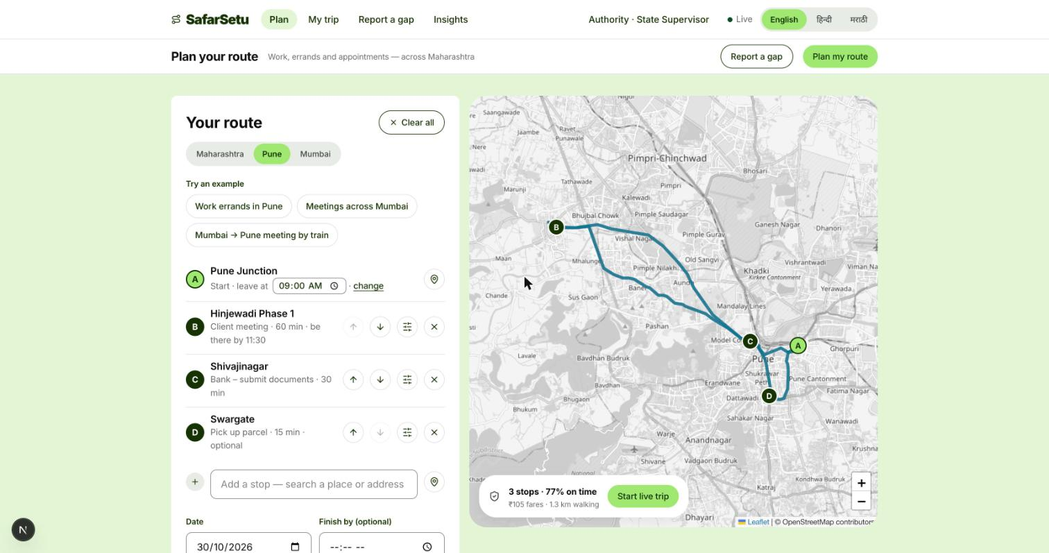
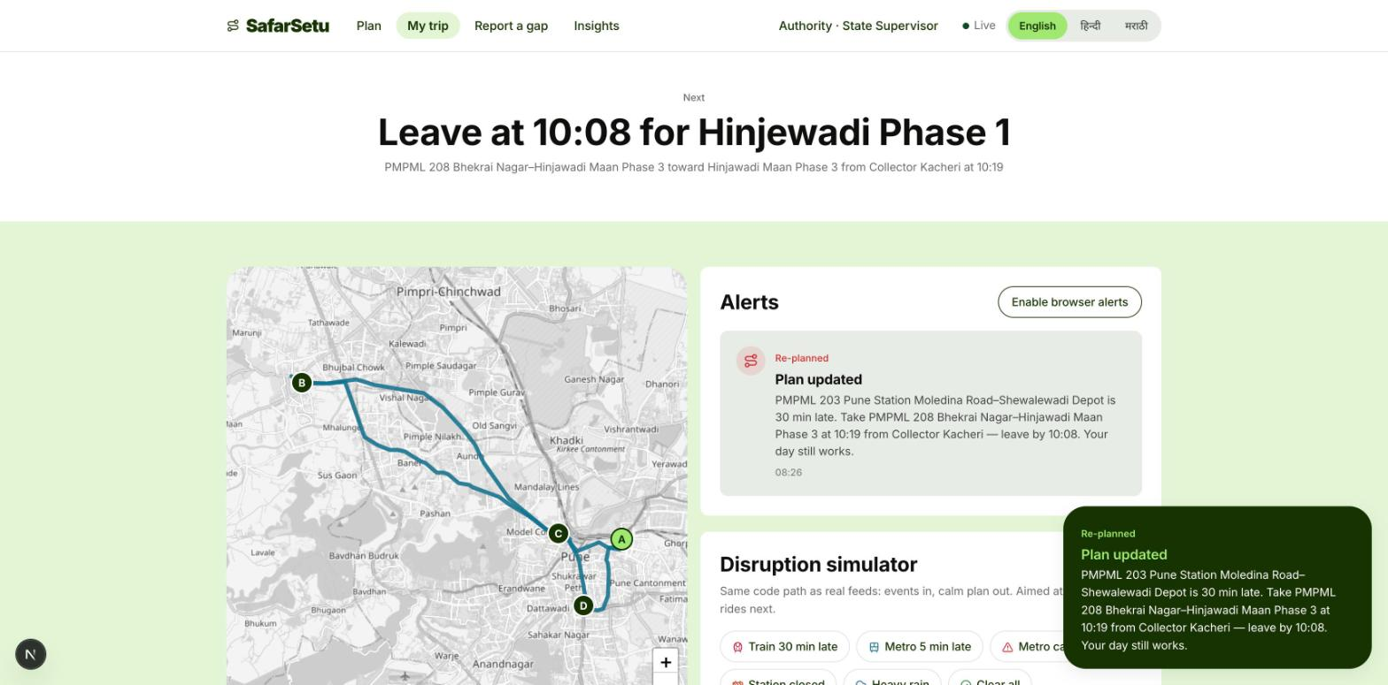
SEVA FIRST INNOVATION CHALLENGE 2026 • MAHARASHTRA ZONE • SUBMISSION
SafarSetu
Plan your work around the buses, metro and trains you can actually catch — with calm alerts when things change.
Notes:
Title slide. Fill every field exactly as entered in the online application form so reviewers can match the deck to the application.

Slide 2
2
The Problem
What real challenge in society, government service or industry are you solving?
What is the problem?
Who is affected, and where?
Commuters juggle several apps and learn of delays late. Google Help: no multi-stop directions for public transit. Nobody plans a working day around deadlines.
Commuters, students, seniors and visitors in Mumbai and Pune. PMPML carries ~10 lakh a day (2025); MSRTC ~50–55 lakh a day statewide (media).
~68 lakh
daily Mumbai suburban rail riders, avg. (CR+WR, FY2025-26)
Evidence
Current gaps
Why it matters
Mumbai suburban rail ~68 lakh/day (CR+WR, FY2025-26). PMPML ~60 breakdowns/day (FPJ 2025). TomTom 2025: Pune 33m20s per 10 km. Baseline interviews planned.
Moovit, m-Indicator and Mumbai One give routes and tickets, not a day of timed stops. We complement agency ITMS, not replace it. Alerts rarely say what to do.
Pune loses ~152 h a year in traffic (TomTom 2025); PMPML ~60 breakdowns a day (FPJ).
Seva Innovation Challenge 2026 | Slide 2 of 6
Notes:
Reviewers look for a clearly defined, real and significant problem backed by evidence. One strong statistic is better than many weak ones. Cite the source for every number.

Slide 3
3
Our Solution & Innovation
What have you built or designed, how does it work, and what is new about it?
Our solution in brief
What makes it new?
A work-and-errands day planner: ordered stops, be-there-by times, must-do flags and a conflict list. Times every bus, metro and train leg, re-plans on delays; alerts in Marathi, Hindi, English.
 | Existing approach | Our approach
Cost | A-to-B apps, cabs | One plan; ₹0 demo
Speed / time | Guess leave time | Exact leave times
Reach / access | One mode per app | Bus, metro, rail
Ease of use | Single trip only | Many stops, one plan
How it works
1
2
3
Input
›
Process
›
Output
Stops, be-there-by times, pace, language
Timetable routing, on-time odds, live re-plan
Leave/board times, calm alerts, shareable trip
Key USP
Plans a working day around deadlines across bus, metro and rail; alerts say what to do; citizen gap reports reach authorities. No patent filed.
Seva Innovation Challenge 2026 | Slide 3 of 6
Notes:
Show clearly how the solution addresses the problem on Slide 2. Compare against what exists today — reviewers score originality and relevance here.

Slide 4
4
Feasibility & Implementation
How ready is the solution, and what will it take to implement it on the ground?
Current stage (mark ✔ where you are today)
✔
Idea
Proof of Concept
Working Prototype
Field Pilot
Ready to Deploy
Technology
Estimated cost
Timeline
Partners
TypeScript engine, Next.js web, Expo app. Real rail, PMPML, BEST timetables (community GTFS). Fixed on the way: tourist planner → work/errands; vague alerts.
Demo ₹0. Pilot est. ₹8.7–13.7k/month for 10,000 users ≈ ₹0.9–1.4 per user (est.; ₹90/$).
3 months: baseline interviews.
6 months: agency pilot.
12 months: second city. (planned)
To approach (no MoUs yet): Urban Development Dept (GoM), PMPML (CMD), BEST (GM), MMRDA, Maha-Metro, MSInS.
Seva Innovation Challenge 2026 | Slide 4 of 6
Notes:
Be realistic. A clear, costed plan with an identified adopting department scores better than an ambitious but vague one. Mention any validation already done (tests, user feedback, certifications).

Slide 5
5
Impact & Scalability
What change will your solution create, and how can it grow beyond the first location?
3,000
~₹980
2 per city
Beneficiaries reached
Saving in cost / time
Jobs or livelihoods
Year-1 pilot target; not a result
est. per work day vs all-cab (model)
data steward + field ambassador (planned)
Social impact
Sustainability
Scale-up plan
Marathi/Hindi alerts, Gentle pace and late-walk warnings include seniors and women commuters; shareable live trips; gap reports reach authorities. Impact not yet measured.
Free for commuters; agencies may fund insights and gap ranking. Pilot est. ₹0.9–1.4 per user a month.
1 corridor, 30 users → 5–10 sites, 300 → one depot, 3,000 → 3 cities, 30,000. A city is a data pack (GTFS + places).
Seva Innovation Challenge 2026 | Slide 5 of 6
Notes:
Quantify impact wherever possible and state your assumptions. Where relevant, link the solution to an existing Government scheme, mission or the Sustainable Development Goals.

Slide 6
6
Team/Individual & Support Required
Who is behind the idea, and what help do you need from the Challenge?
Photo
Divyanshu Patil
Photo
[Add: name 2]
Support we are seeking
[Add: role]
[Add: role]
[Add: qualification]
[Add: qualification]
✔
Mentorship & technical guidance
✔
Pilot with a government department
✔
Funding / grant support
Photo
[Add: name 3]
Photo
[Add: name 4]
[Add: role]
[Add: role]
Incubation & workspace
[Add: qualification]
[Add: qualification]
Testing, certification or IP support
A mentor and an agency pilot take us from working prototype to a one-city field pilot. Work order up to ₹10 lakh, subject to evaluation.
[Add: mentor / faculty guide, designation]
Thank you | [Add: contact email / mobile]
Seva Innovation Challenge 2026 | Slide 6 of 6
Notes:
List only active team members. Be specific about the support requested — it helps the organisers match you with the right mentor, department or incubator.

