Slide 1

Project 1: Brake System Modelling & Control

Slide 2
Objective
To determine the transfer function of air brake system consisting of electro-pneumatic regulator (EPR).
EPR Voltage (input)
Brake pressure model
Brake chamber pressure (output)

Slide 3
Procedure - Modelling
Check for LTI approximation
Frequency spectrum
Frequency response
System transfer function
Time response
Model parameter values

Slide 4
Check for LTI – Spectral analysis
This method feeds a sinusoidal input voltage to the system and analyses the frequency content in the output.

Slide 5
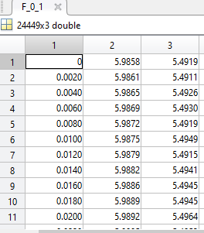
Check for LTI – Spectral analysis
Open the frequency data files with Matlab.
Each matrix contains Time, Voltage and Pressure data.
Frequency
Time
Voltage
Pressure
Plot input and output vs time.
plot(F_0_1(:,1),F _0_1(:,2),'b')
hold on
plot(F _0_1(:,1),F _0_1(:,3),'r')

Slide 6
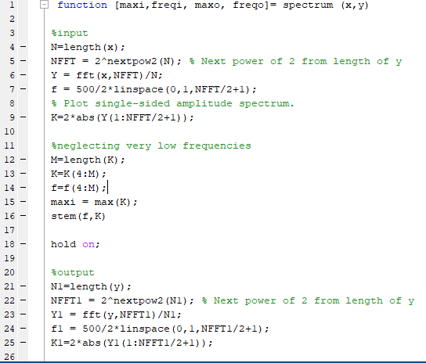
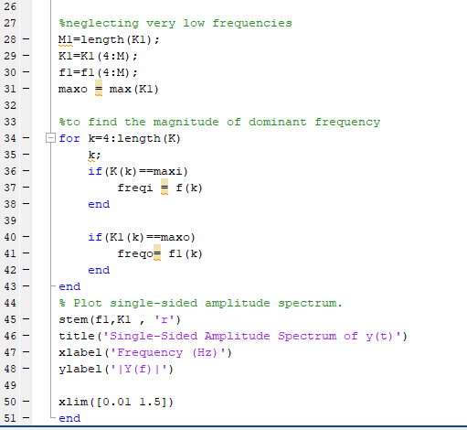
Identify the dominant frequency in each input and output pair.

Slide 7
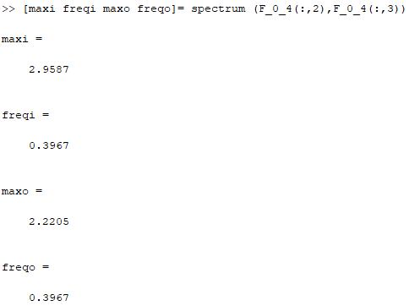
Type this in the command window and press enter to call the function.
Input arguments passed to the function
Output arguments returned from the function
Make a stem plot of magnitude vs frequency for both input and output.
Example: stem(frequency,magnitude)
Check if the system can be approximated as an LTI system.

Slide 8
Frequency response –Bode plot
Get the peak to peak output values for each frequency (use min() max() command in Matlab).
Using the values obtained, calculate gain for each frequency as given below:
Plot frequency vs calculated gain using semilogx() command in Matlab.

Slide 9
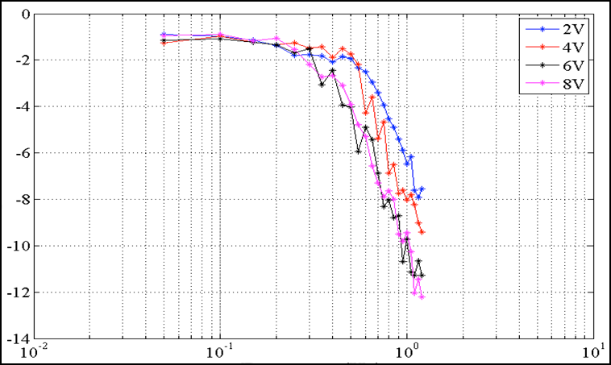
Frequency response –Bode plot
Check for the slope of high frequency asymptote.
Slope (dB/decade) | Relative degree of the system
-20 | 1
-40 | 2
-60 | 3
Low frequency asymptote
High frequency asymptote

Slide 10
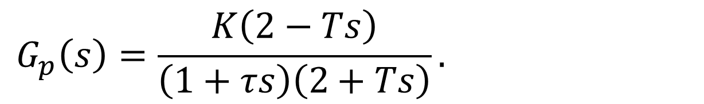
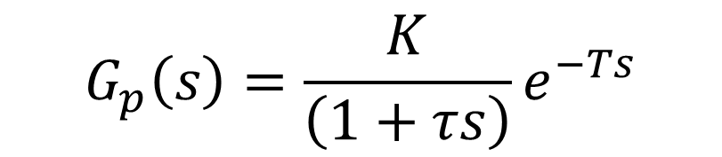
Transfer Function Structure
$$G_{p}\left(s\right)=\frac{K}{\left(1+τs\right)}e^{−Ts}$$
Model values to be found
Using Pade’s Approximation,
$$G_{p}\left(s\right)=\frac{K\left(2−Ts\right)}{\left(1+τs\right)\left(2+Ts\right)}.$$

Slide 11
Step Response Analysis
Import the data
Plot the step input and response
Find the delay and gain
Determine the time constant

Slide 12
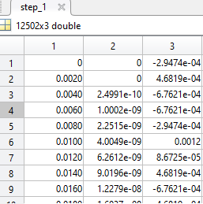
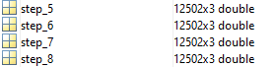
Step Response Analysis
1. Import step response data
Time
Voltage
Pressure
Step response data for 5V input

Slide 13

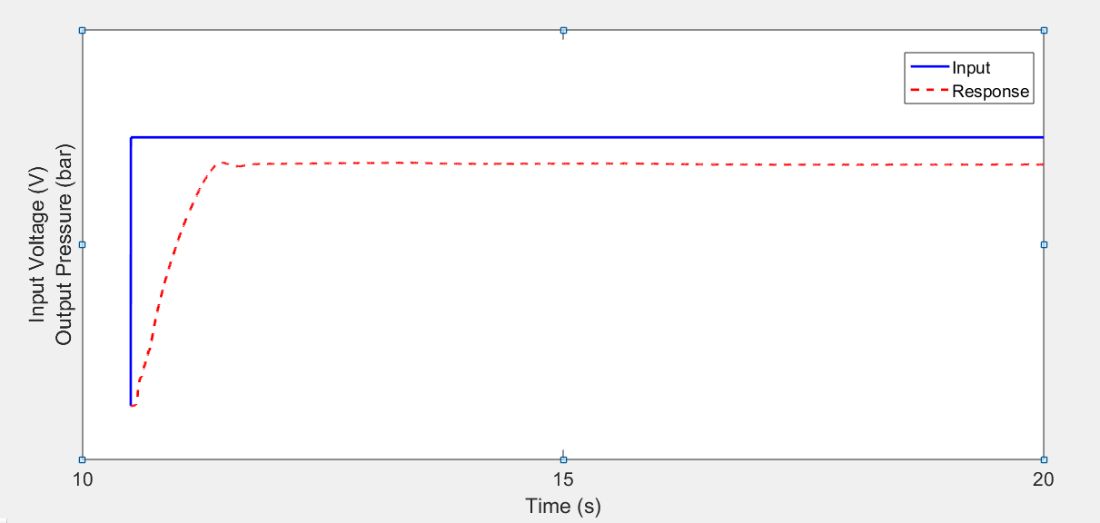
Step Response Analysis
2. To plot the data for step response
Time
Voltage
Time
Pressure

Slide 14
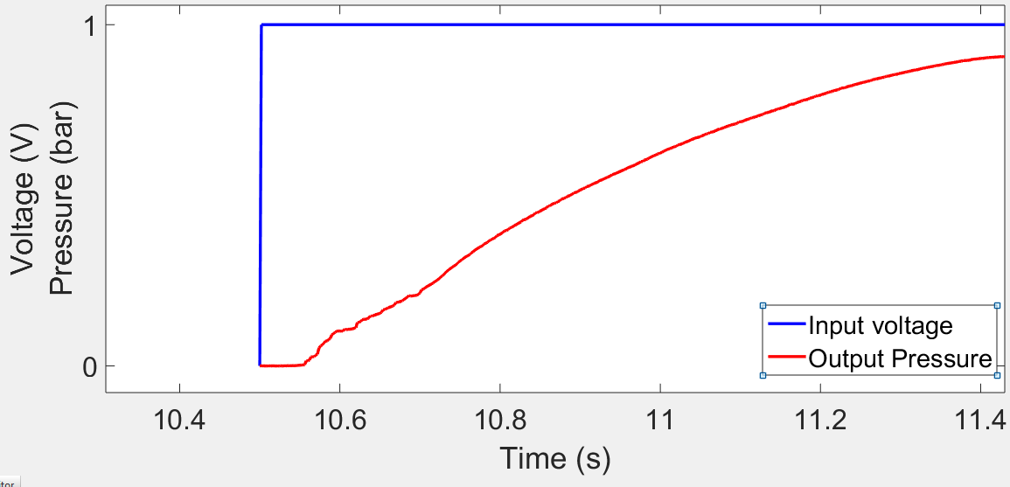
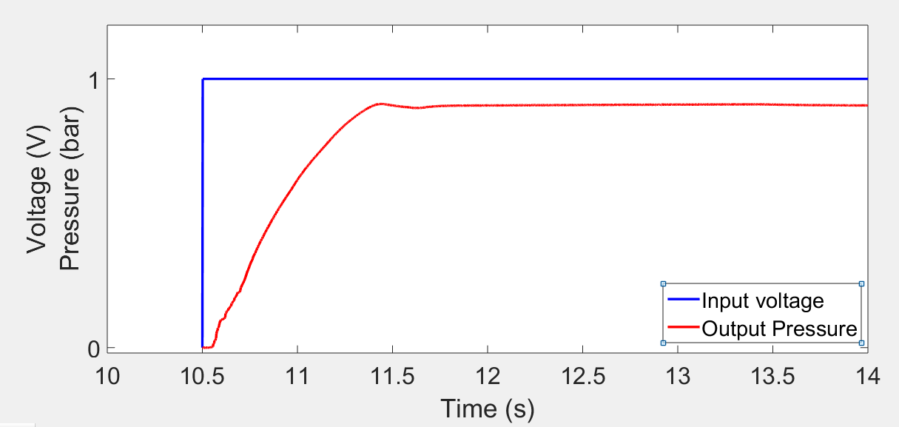
Step Response Analysis
3. To determine the delay and steady state gain of the system
Measure the time delay from the response plots and note down your observations.
Measure the input and output steady state values and calculate gain as the ratio of P_s/V_s which is in bar/V.
Input steady state voltage (V_s)
Output steady state pressure (P_s)

Slide 15
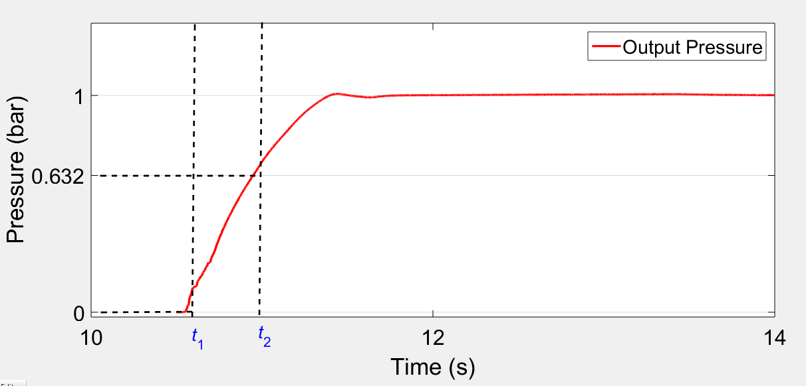
Step Response Analysis
4. Determine the time constant
Determine the time constants for all the four sets and check if it is same.
If not find the range in which it lies.

Slide 16
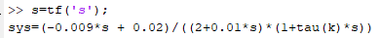
Time constant
With the τ range obtained from previous exercise, assume a suitable step size and obtain a set a values for the same.
Example: If the range is [0.1 0.4] and the assumed step size is 0.05, the set will consist of {0.1,0.15,0.2,0.25, 0.3, 0.35, 0.4}.
With delay and gain value obtained, use the code given below to find the simulated response for the above set and compare it with experimental response.
Time constant values in an array
Step input magnitude
Time range for simulated response

Slide 17
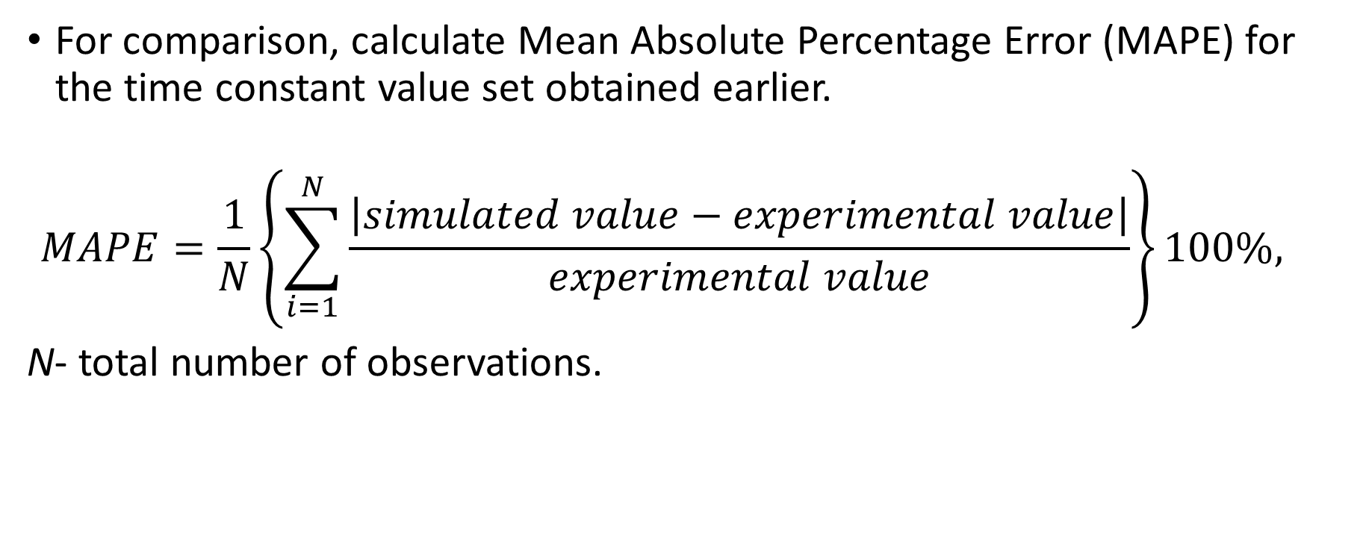
Time constant
For comparison, calculate Mean Absolute Percentage Error (MAPE) for the time constant value set obtained earlier.
$$MAPE=\frac{1}{N}\left\{\sum_{i=1}^{N}{\frac{\left|simulated value−experimental value\right|}{experimental value}}\right\}100\%,$$
N- total number of observations.

Slide 18
Time constant
Compute MAPE for each τ value for all the voltages given and find the τ value for which it is minimum.
Hints to program in Matlab:
Use ‘for loop’ to implement the MAPE formula.
Time constant | MAPE for V1 | MAPE for V2 | MAPE for V3 | MAPE for V4 | Average MAPE
 | … | … | … | … | …
 | … | … | … | … | …
 | … | … | … | … | …
 | … | … | … | … | …

Slide 19
Gdrive link
https://drive.google.com/file/d/1C39mDgku0anc0vufnhKzKuuYiaA24FCb/view?usp=sharing

