Slide 1
MVC Architecture

Slide 2
What is MVC Architecture?
MVC stands for Model - View - Controller
A software design pattern for interactive applications
Main Idea: Separate application logic, UI, and input handling

Slide 3
Components of MVC
1. Model:
Manages data and business logic
Interacts with the database
2. View:
Displays data to the user
Handles UI (User Interface)
3. Controller:
Takes user input
Updates Model and View

Slide 4
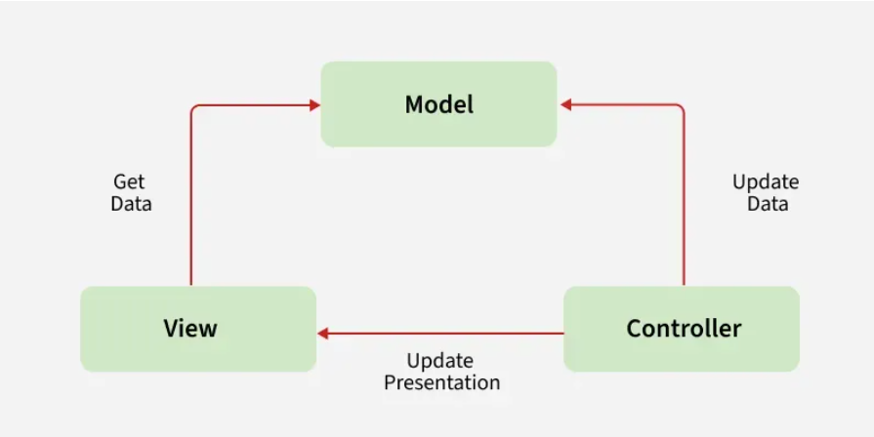
MVC Architecture Diagram
Use a graphical representation to show interaction between:
View ↔ Model
Controller ↔ Model & View

Slide 5
Flow of MVC
User interacts with the View (UI)
View sends input to Controller
Controller processes input using Model
Model updates data and sends it back
View reflects the updated data

Slide 6
Real-World Example: Login Page
Model: Verifies username/password from DB
View: Login form with input fields
Controller: Handles login request, validates, and routes

Slide 7
Benefits of MVC
Separation of concerns – better organization
Scalability – easier feature expansion
Reusability – components can be reused
Maintainability – easier testing and debugging

