Slide 1
B-TREES

Slide 2
A m-way tree is a search tree in which each node
can have from zero to m subtrees. m is the order of the
tree.
Properties of a non-empty multiway tree :
Each node has 0 to m subtrees.
Given a node with k < m subtrees, the node
contains k subtree pointers, some of which may be
Null and k – 1 data entries.
3) The key values in the first subtree are less than
the key in the first entry; the key values in the other
subtrees are all Greater than or equal to the key in their
parent entry. i.e key1 <= key2 <= … key k

Slide 3
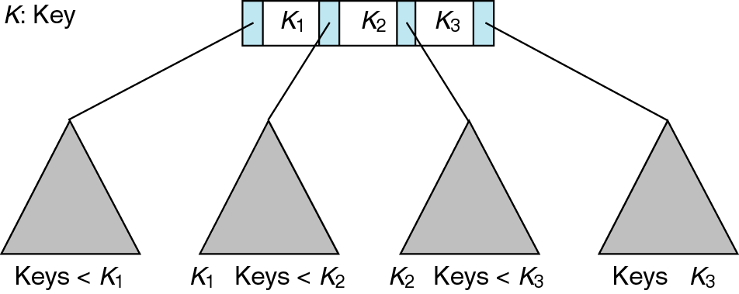
Figure 10-1

Slide 4
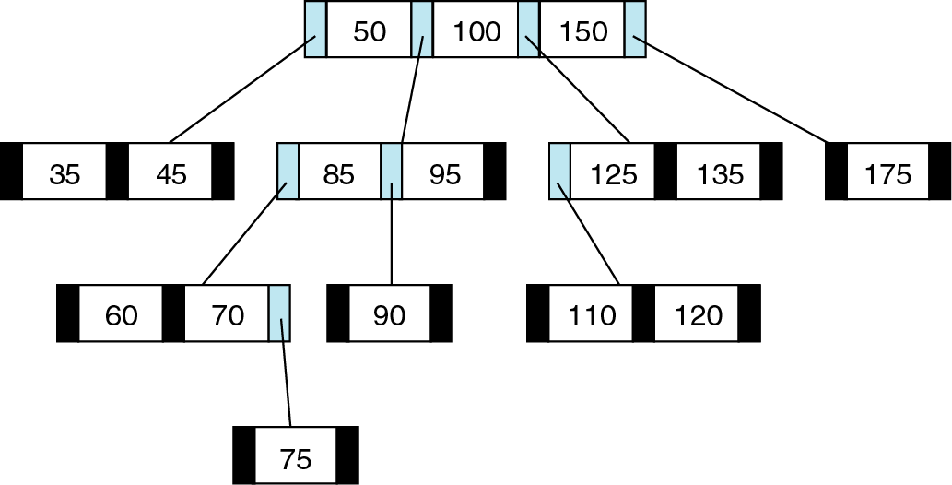
Figure 10-2

Slide 5
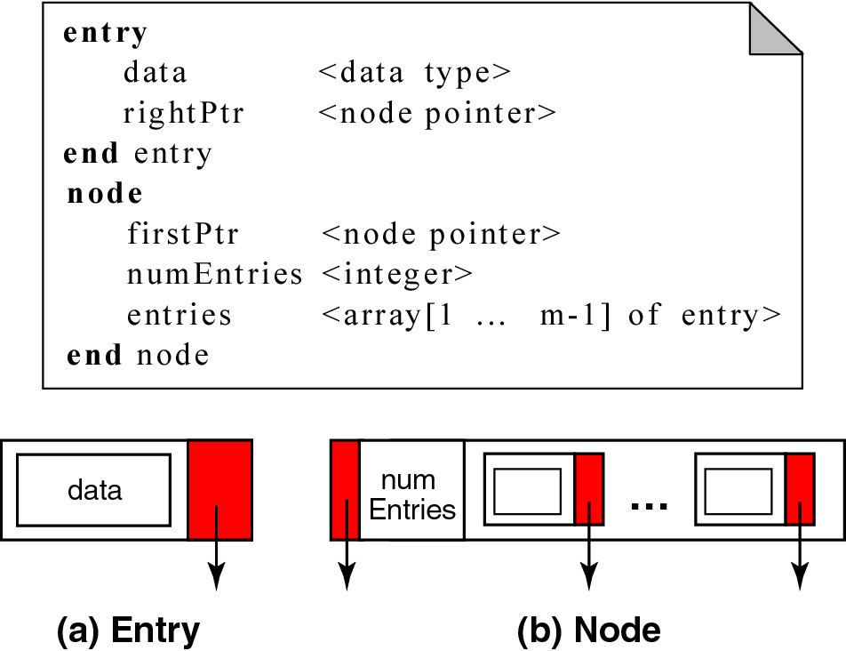
Figure 10-3

Slide 6
B- TREES
A B-tree is an m-way search tree with the
following additional properties.
The root is either a leaf or it has 2 … m subtrees.
All internal nodes have atleast [m /2] nonnull
Subtrees and atmost m nonnull subtrees.
3) All leaf nodes are at the same level; that is, the
tree is perfectly balanced.
4) A leaf node has atleast [m /2 ] – 1 and the most
m – 1 entries.

Slide 7
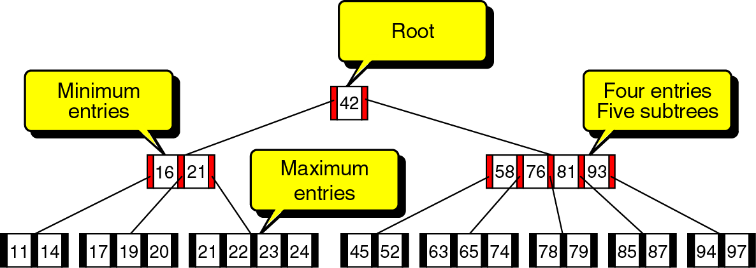
Figure 10-4

Slide 8
B-TREE INSERTION
Like the binary search tree, B-tree insertion takes
place at a leaf node.
Locate the leaf node for the data being inserted.
If the located node is not full, then it has fewer
m – 1 entries, then the new data are simply inserted in
Sequence in the node.
4) When the leaf node is full, we have a condition
known as overflow.
5) Overflow requires that the leaf node be split into
two nodes, each containing half of the data.

Slide 9
6) To split the node, we allocate a new node from the
Available memory and then copy the data from the
end of the full node to the new node.
7) After the data have been split, the new entry is
inserted into either the original or the new node,
depending on its key value.
8) Then the median data entry is inserted into the
parent node.

Slide 10
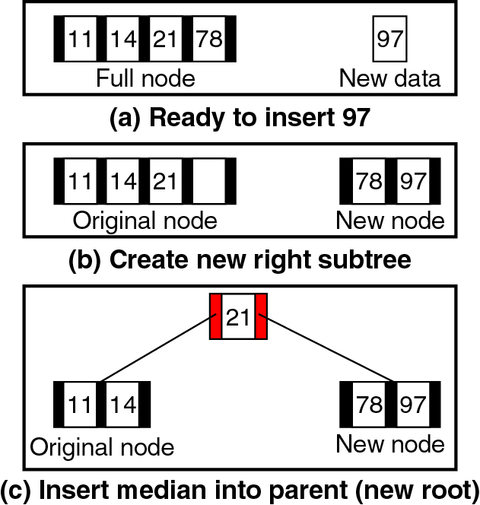
Figure 10-5

Slide 11
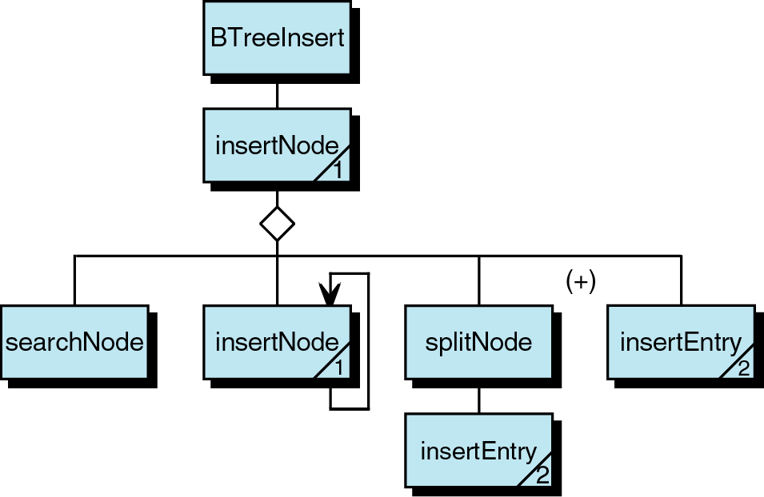
Figure 10-6

Slide 12
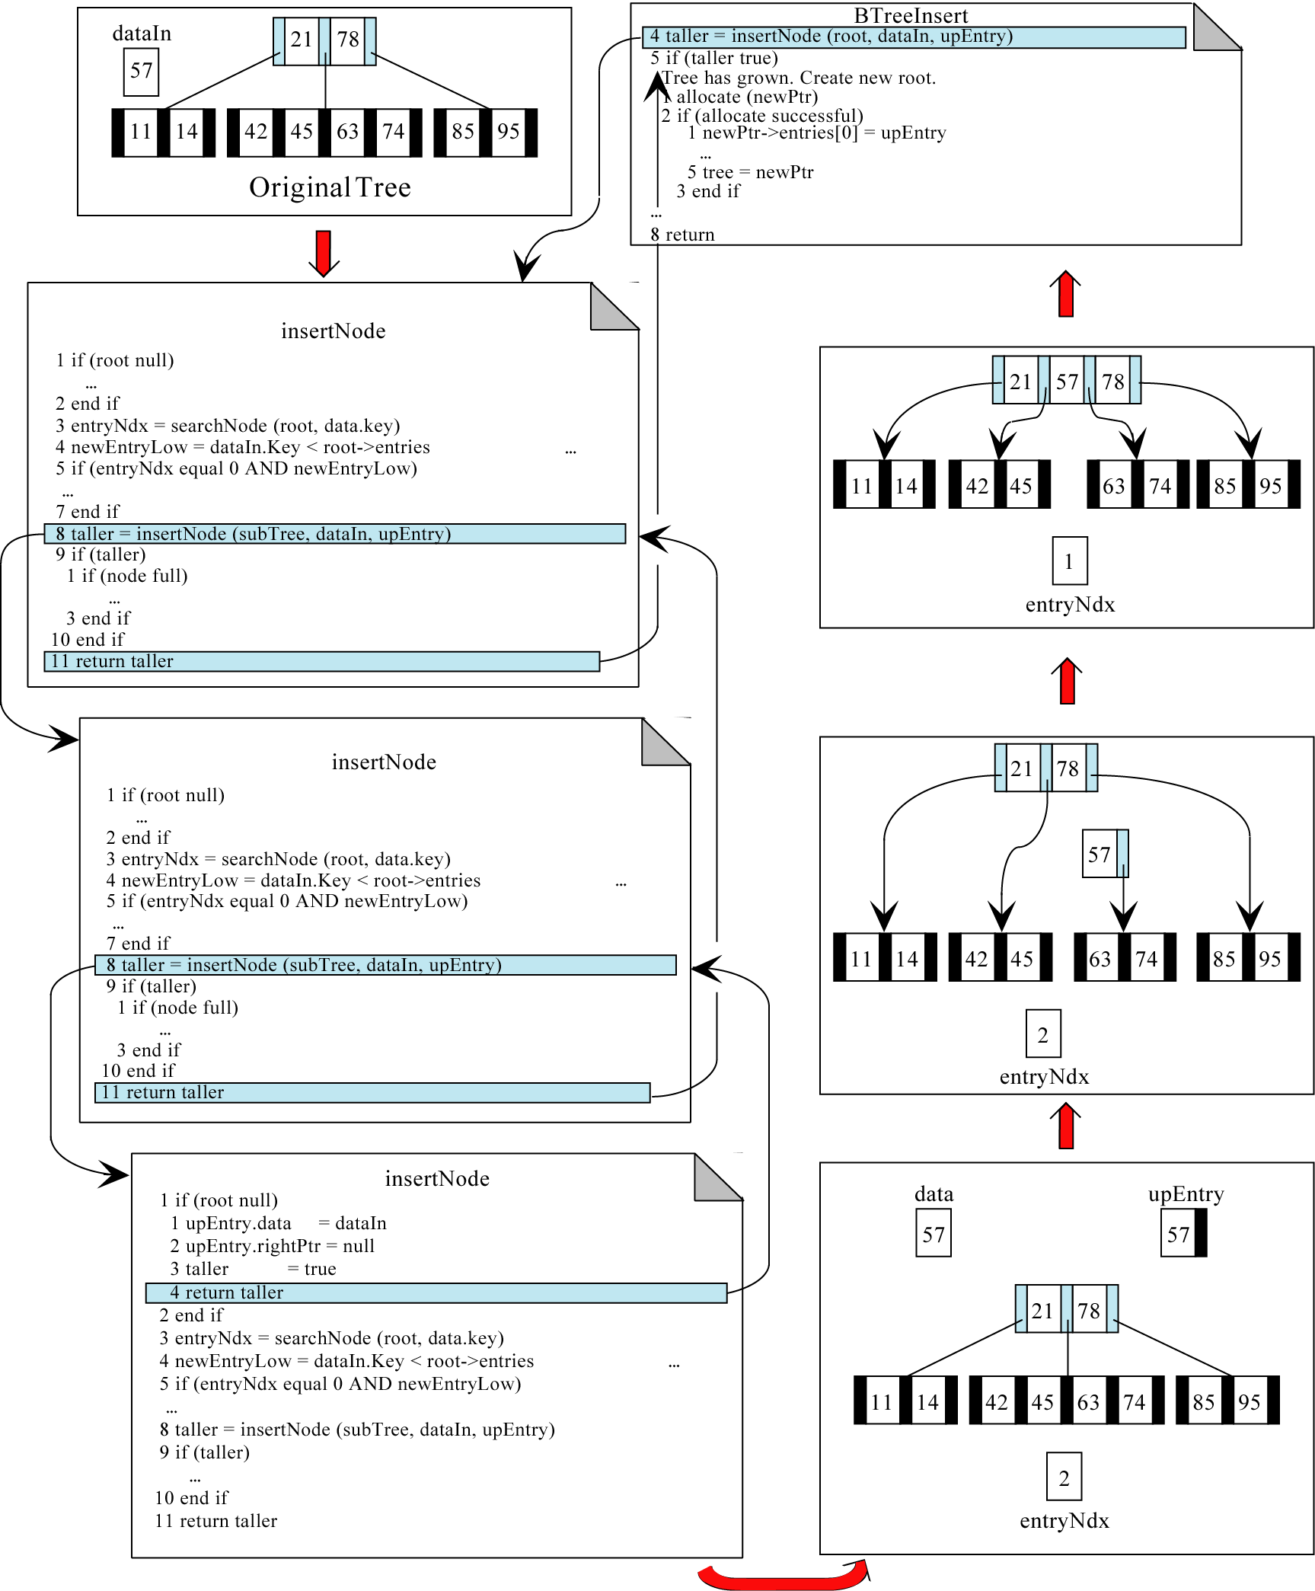
Figure 10-7

Slide 13
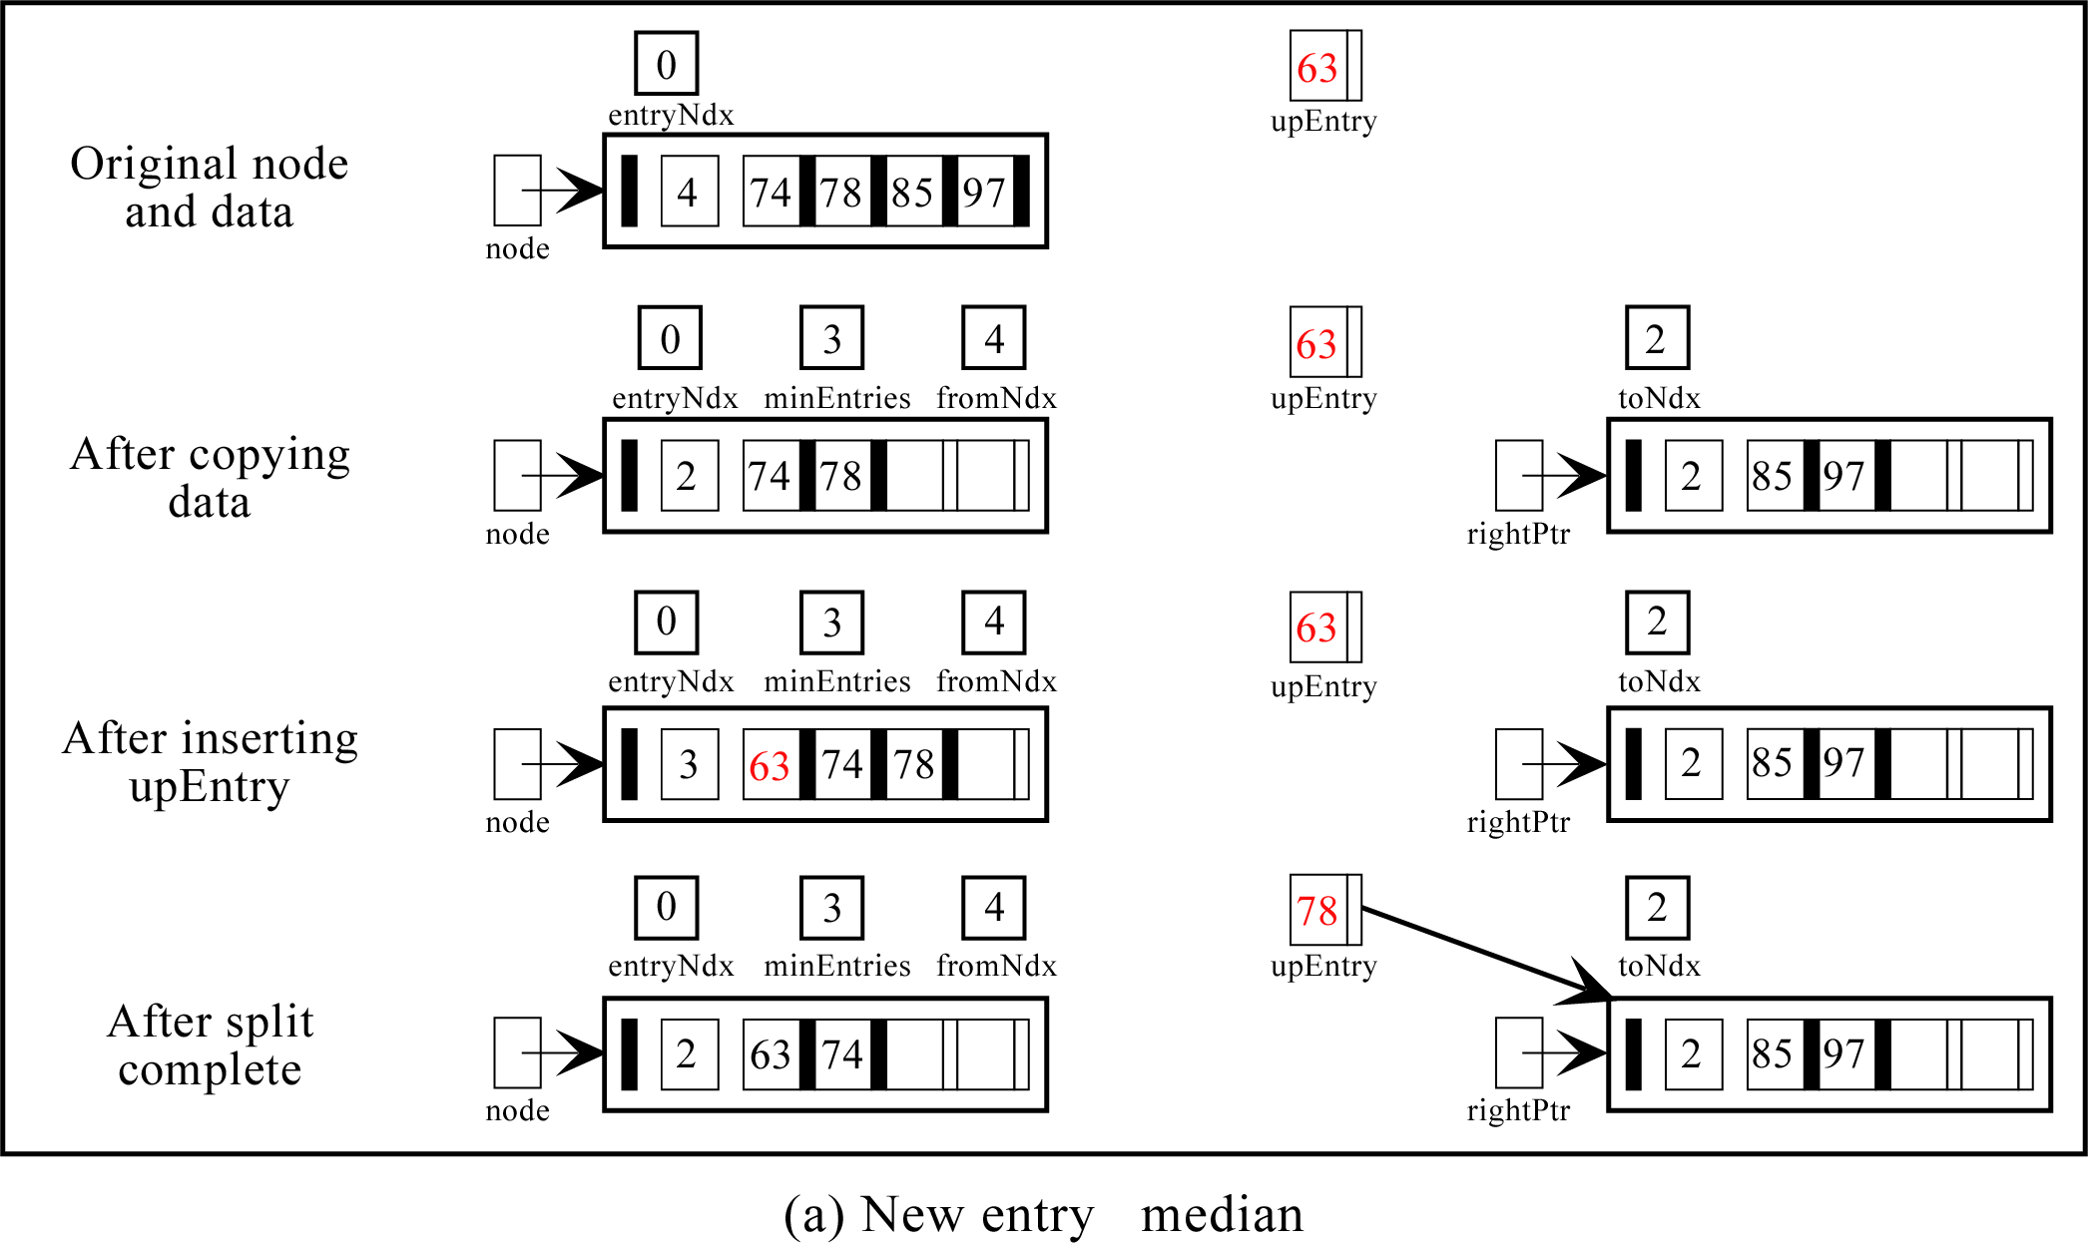
Figure 10-8.a

Slide 14
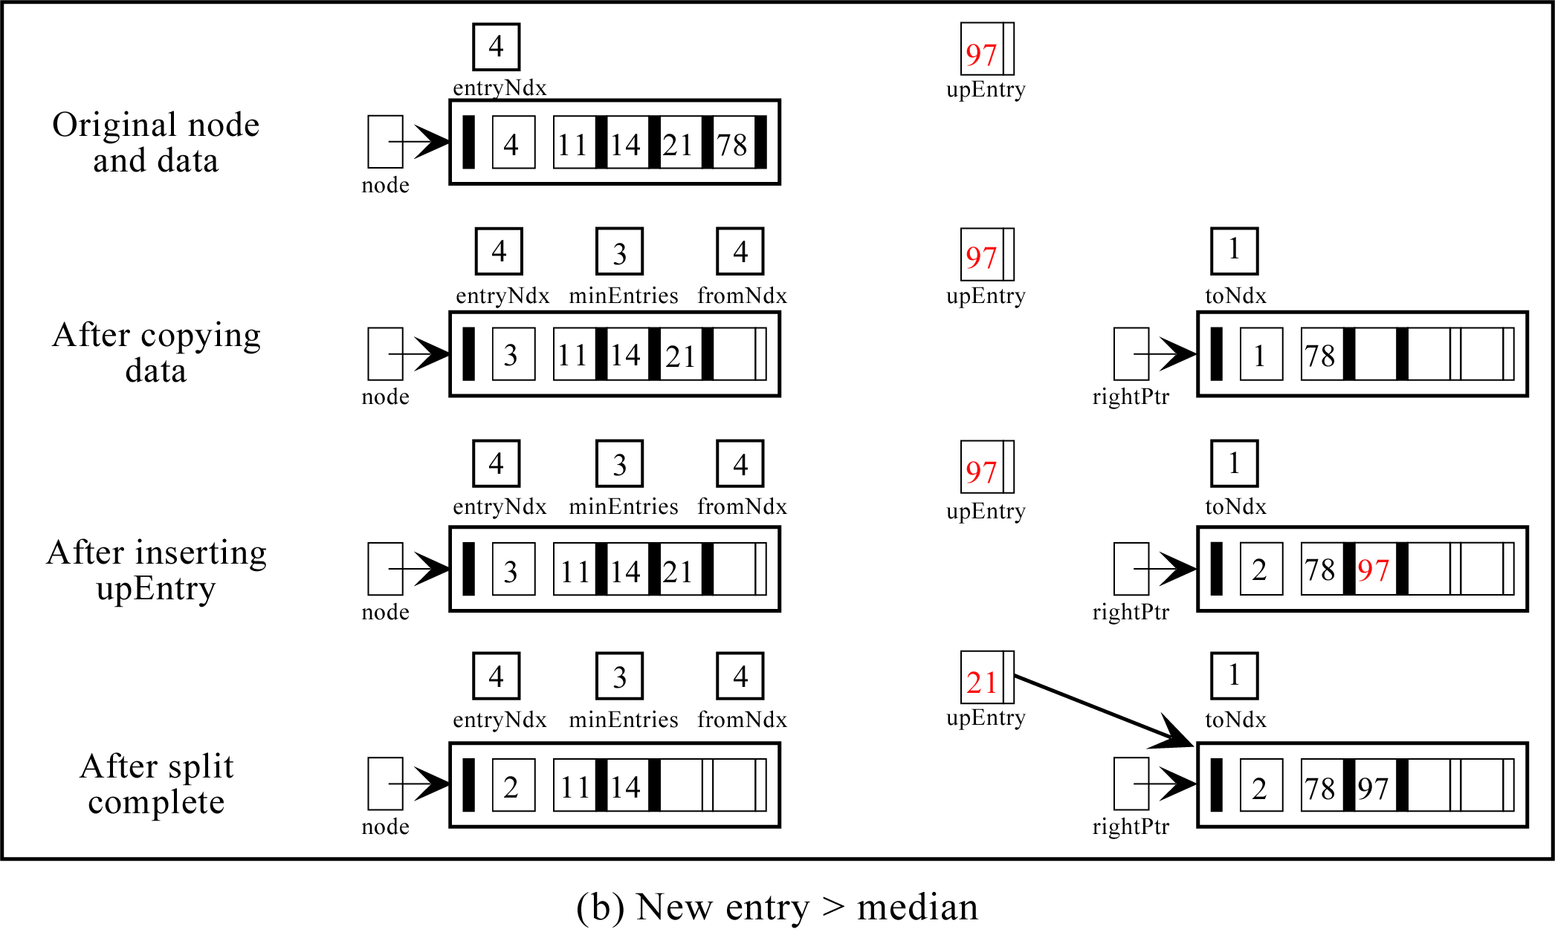
Figure 10-8.b

Slide 15
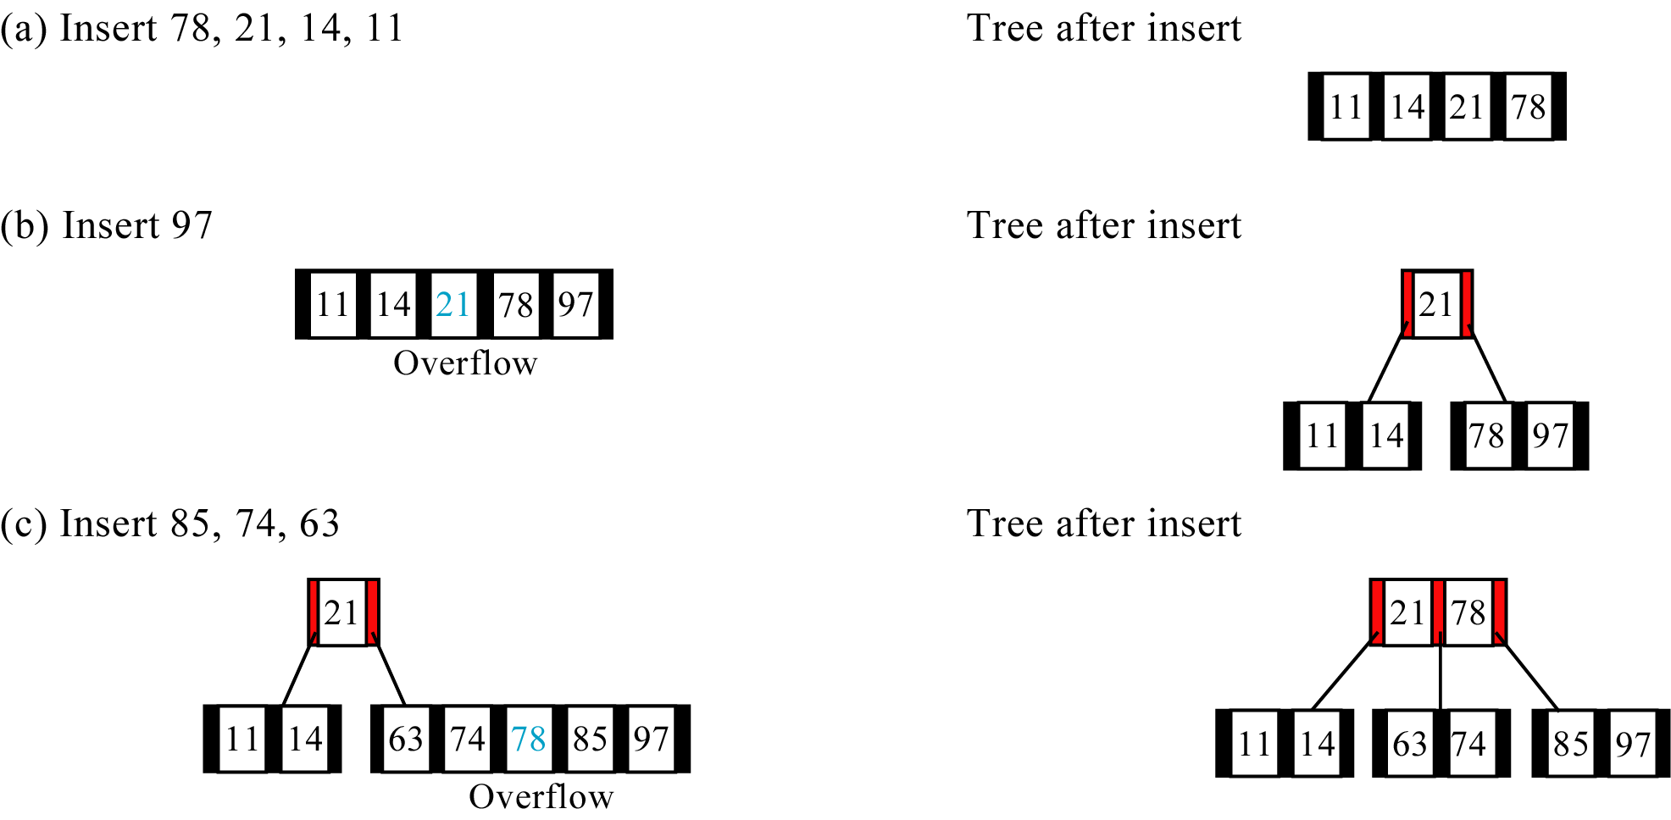
Figure 10-9 (a, b, and c)

Slide 16
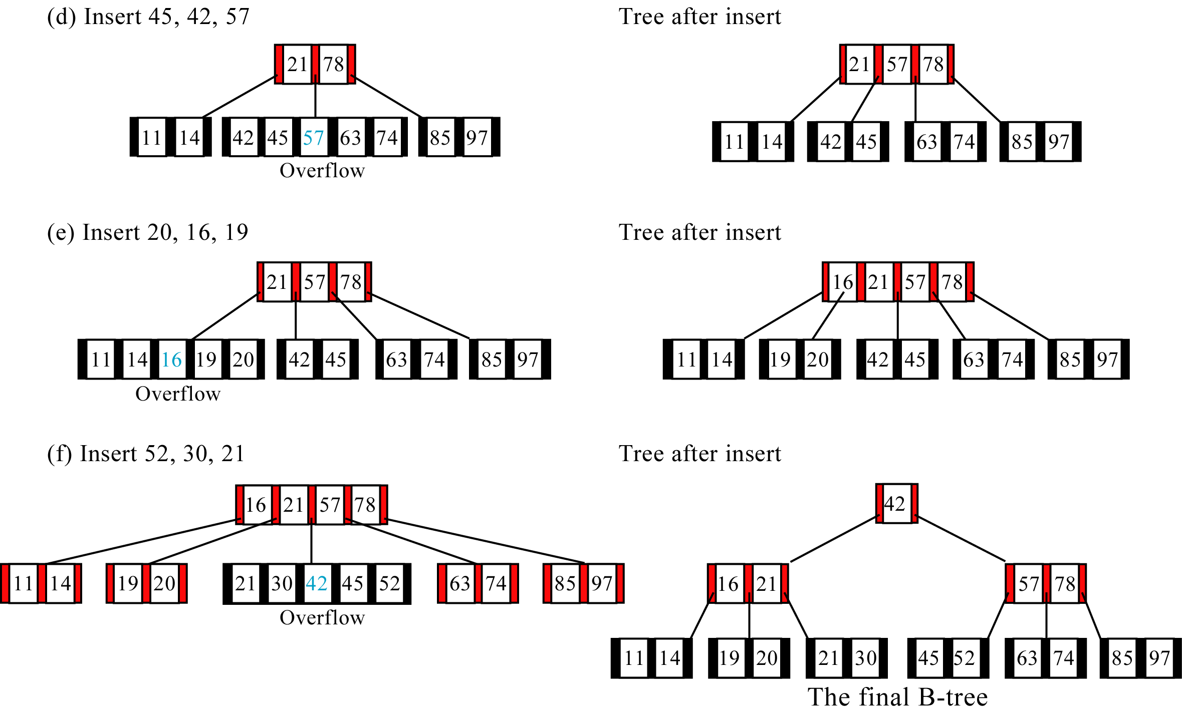
Figure 10-9 (d, e, and f)

Slide 17
B-TREE DELETE
Search for the data to be deleted. If the node delete
reaches a null subtree , it has not found the data to be
Deleted. It therefore prints an error message and
returns no Under flow.
2) If the root is not null, then it searches the node to
See if the data to be deleted are in it.
3) When the delete key is not in the current node, it
calls itself with a new subtree.
4) If the delete key has been found, it deletes the key .
5) After deleting the delete key, it checks for
underflow and if necessary repairs the underflow (reflow).

Slide 18
Reflow :
When Underflow has occurred, we need to bring the
underflowed node up to a minimum state by adding
atleast one entry to it.
To understand reflow we need to review two
concepts, Balance and combine.
Balance shifts data among nodes to reestablish the
integrity of the tree.
When we can’t balance, we must combine nodes.
Combine joins the data from an underflow entry , a
minimum sibling, and a parent in one node. This
results in one node with the maximum number of
entries and an empty node that must be recycled.

Slide 19
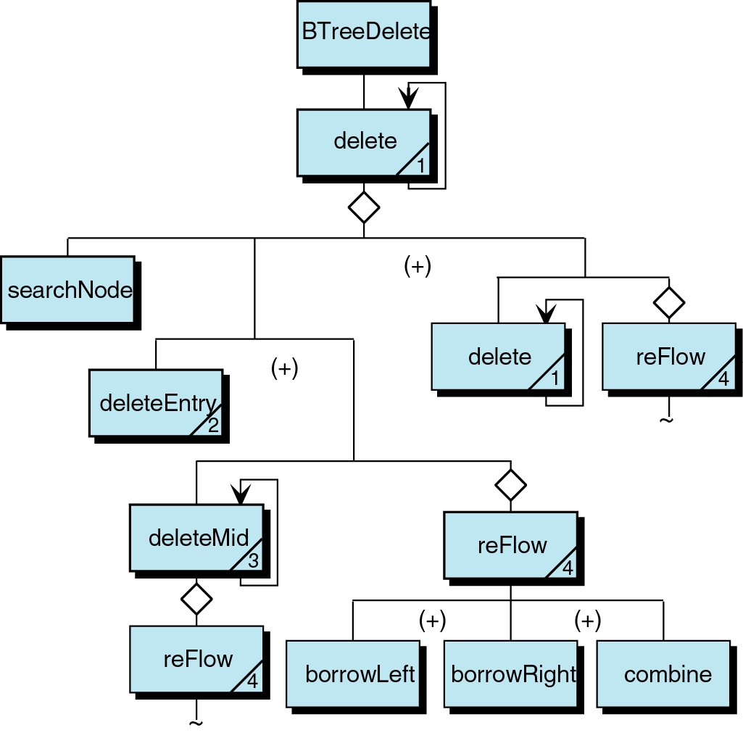
Figure 10-10

Slide 20
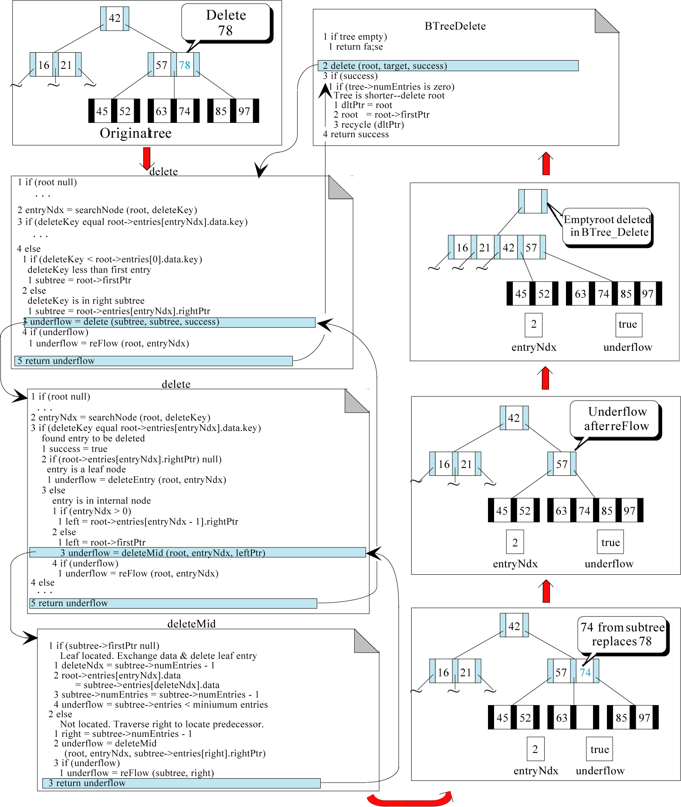
Figure 10-11

Slide 21
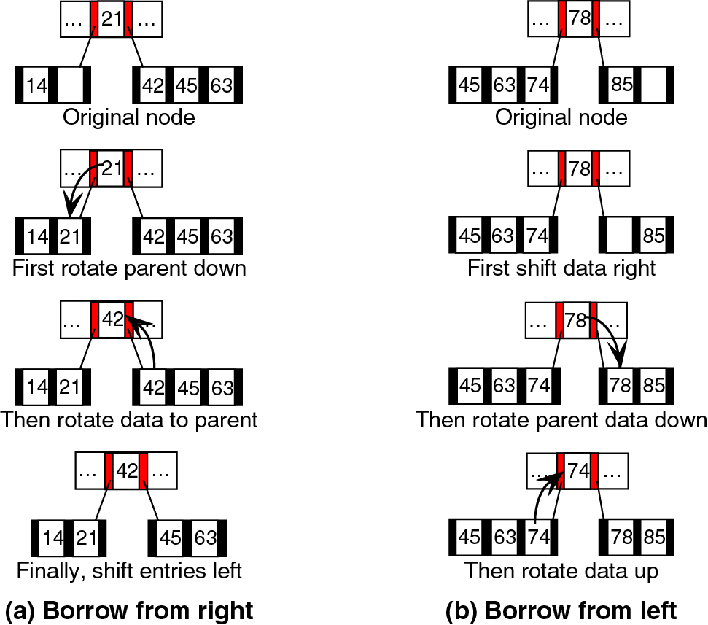
Figure 10-12

Slide 22
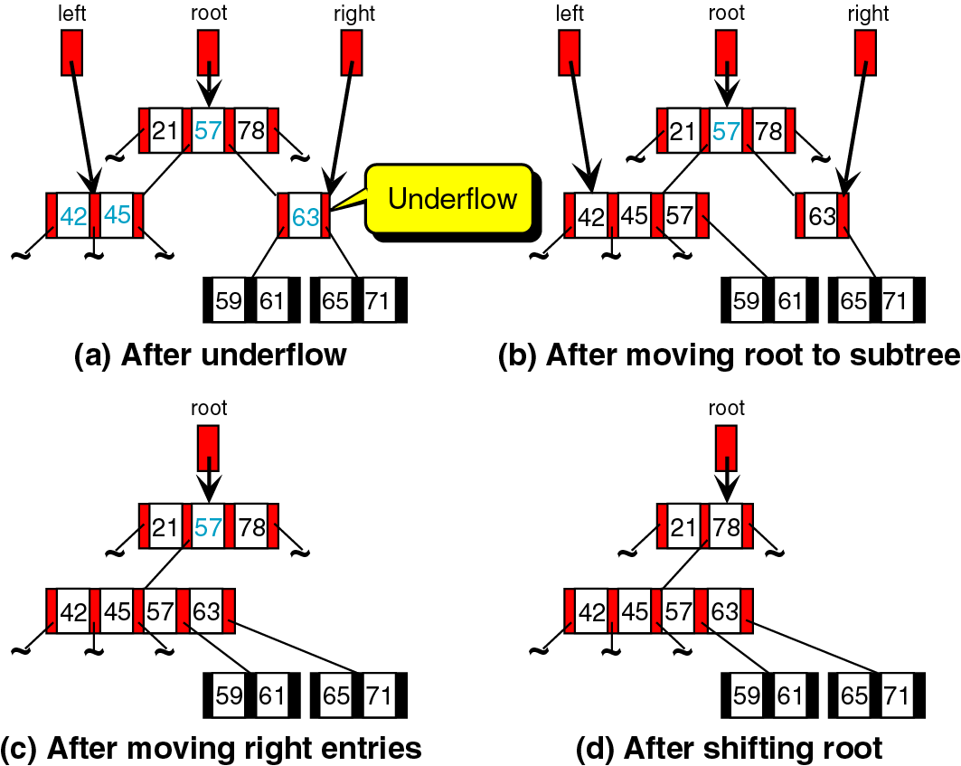
Figure 10-13

Slide 23
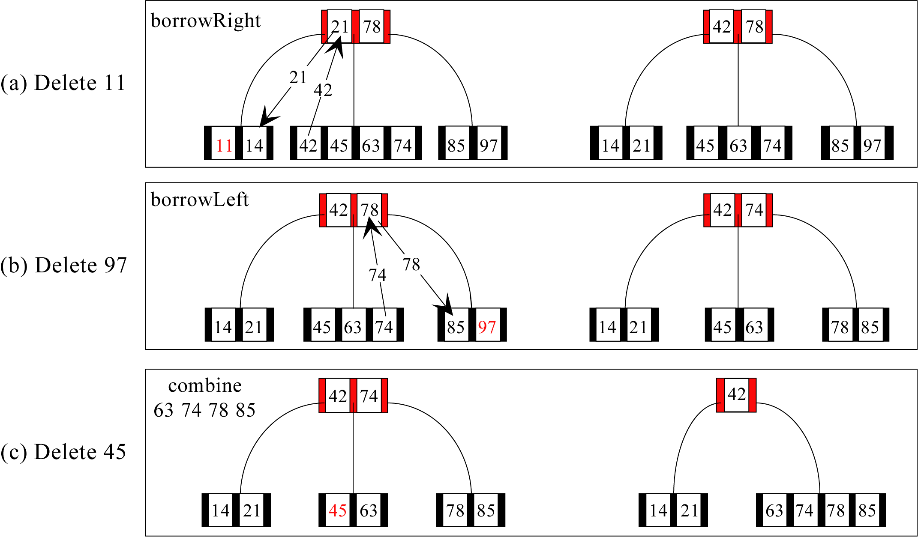
Figure 10-14 (a, b, and c)

Slide 24
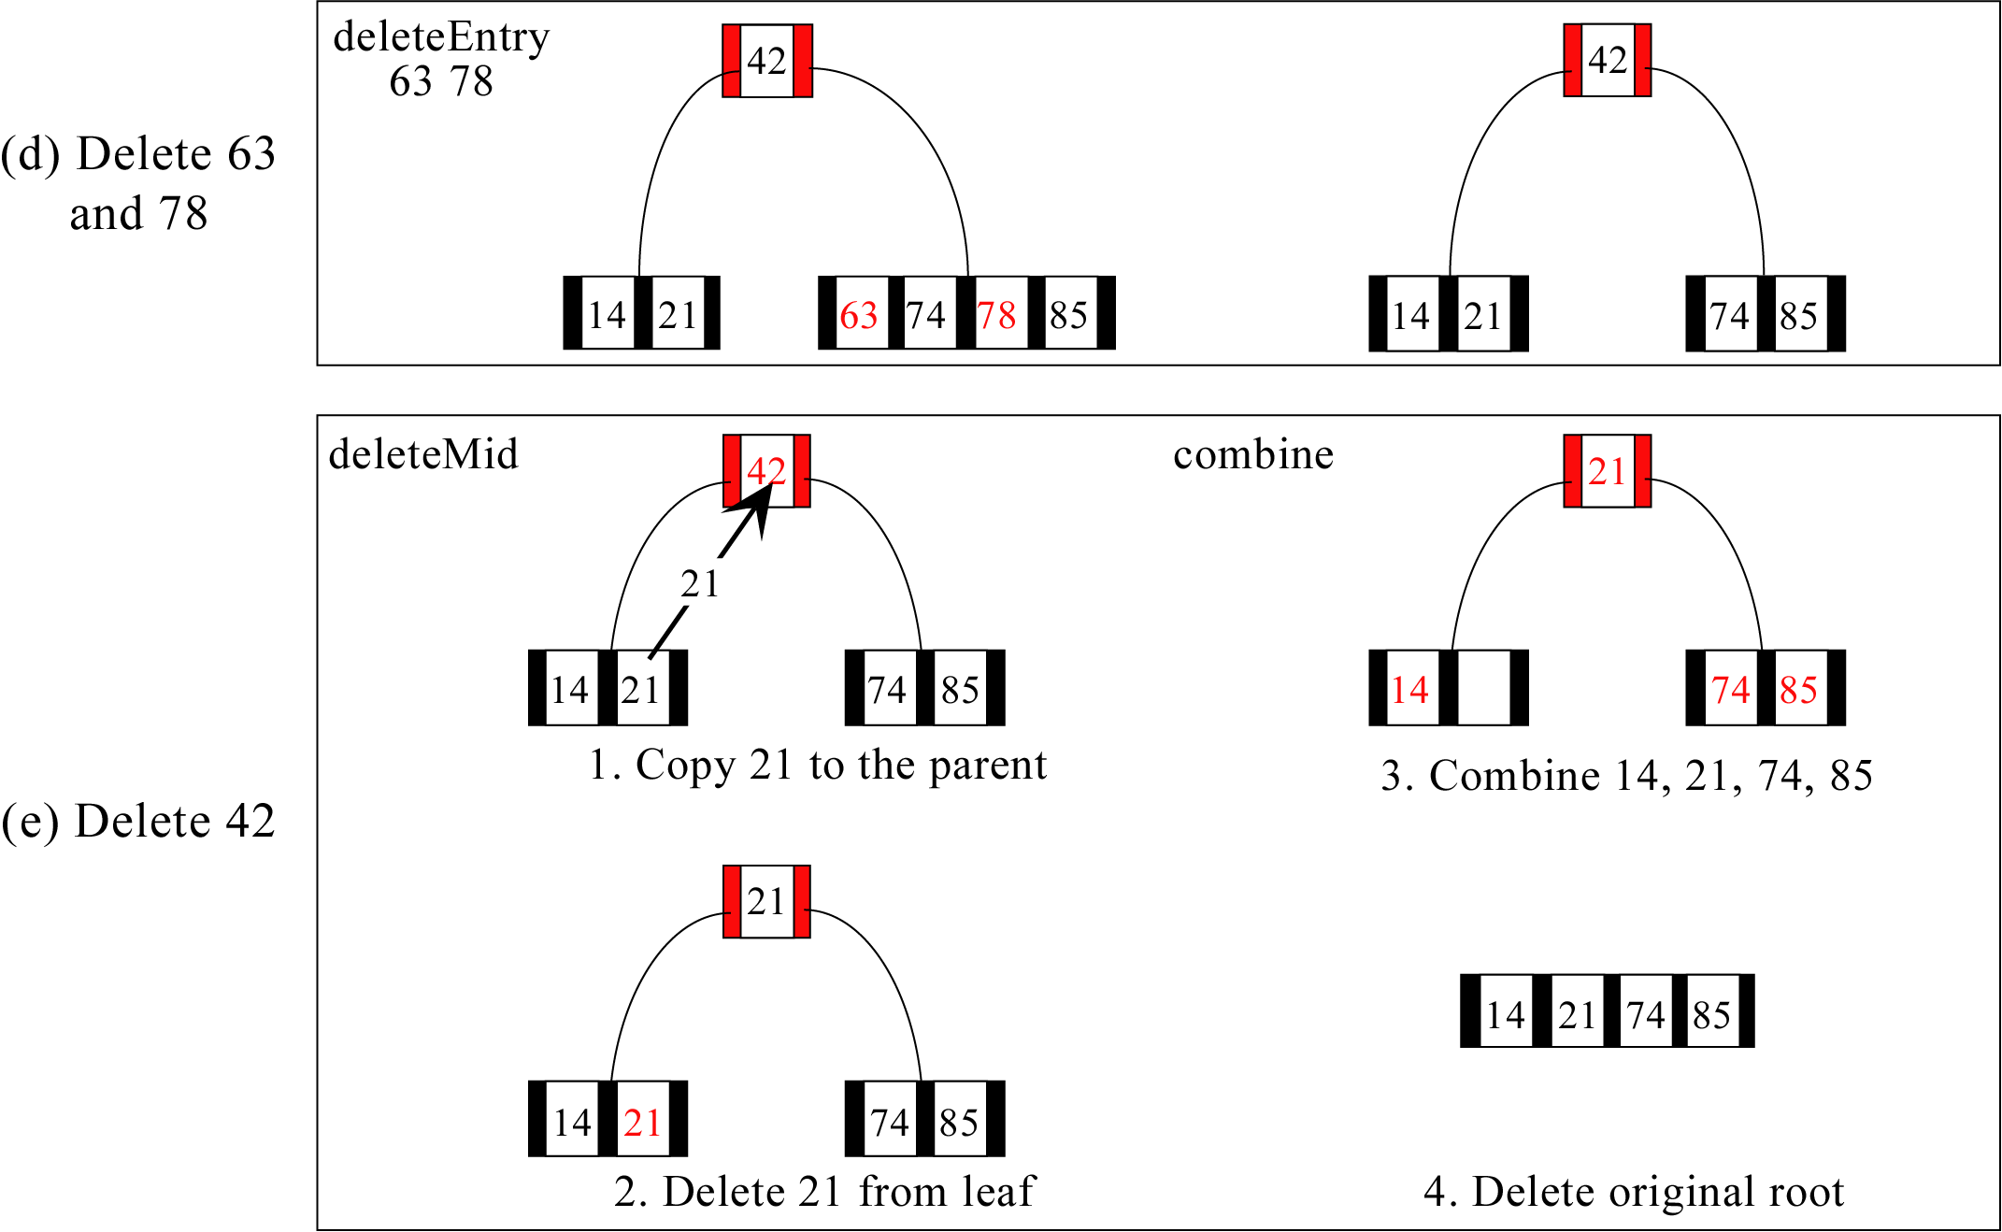
Figure 10-14 (d and e)

Slide 25
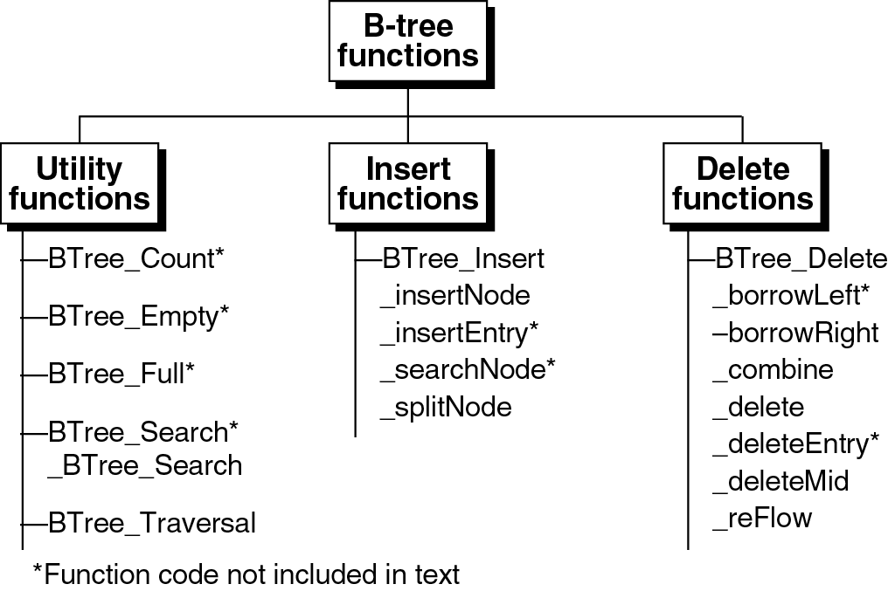
Figure 10-22

