Slide 1
Sorting
Algorithms

Slide 2
Sorting is the process through which data are
arranged according to their values.
Sorting algorithms are classified either as either
Internal or external sorts.
An Internal sort is a sort in which all of the data
are held in primary memory during the sorting
process.
An external sort uses primary memory for all of
the data currently being sorted and secondary
storage for any data that will not fit in primary
memory.

Slide 3
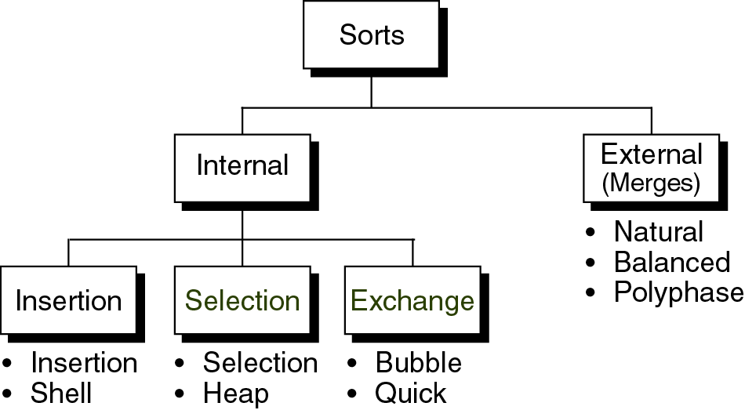

Slide 4
INSERTION SORTS
In each pass of an insertion sort one or more
pieces of data are inserted into their correct
location in an ordered list.
Two Insertion sorts are available
Straight insertion sort
Shell sort

Slide 5
Straight Insertion Sort
In the Straight Insertion Sort, the list is divided
into two parts : sorted and unsorted.
In each pass, the first element of the unsorted
sublist is transferred to the sorted sublist by
inserting it at the appropriate place.
If we have a list of n elements, it will take
at most n – 1 passes to sort the data.
Each pass moves the wall one element to the
right as an element is removed from the unsorted
sublist and inserted into the sorted sublist.

Slide 6
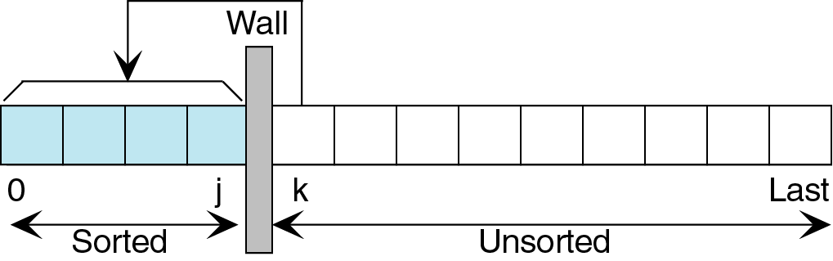

Slide 7
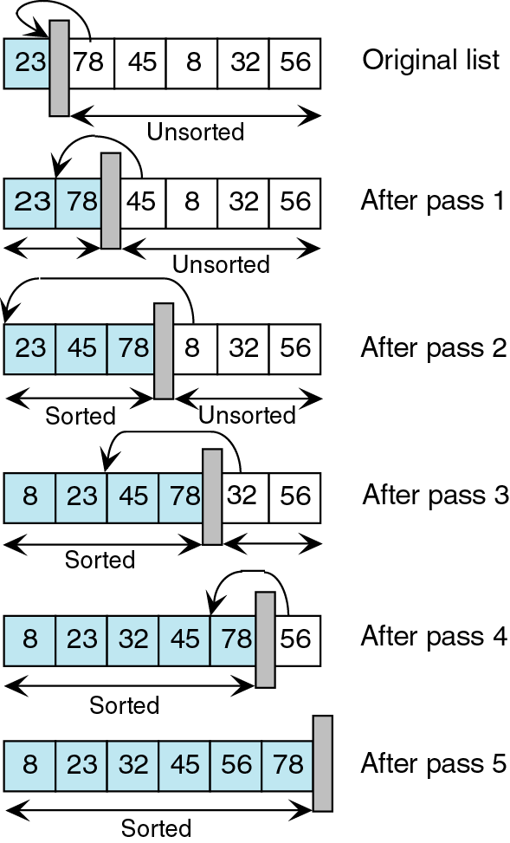

Slide 8
Algorithm insertionsort(A , N)
// A is an array and N is the number of elements
in the array . The first element in unsorted list is
Inserted into sorted list. //
k = 2; // current node
Repeat steps 3 to 5 for k = 2,3 …N
3) Set TEMP := A[k] AND PTR := k – 1
4) Repeat while TEMP < A[PTR] // moves element
Forward //
Set A[PTR + 1] := A[PTR]
Set PTR = PTR - 1
[End of loop]
6) Set A[PTR + 1] := TEMP // inserts element in proper place//
[ End of Step 2 loop]
Return.

Slide 9
SELECTION SORT

Slide 10
Selection sort
In this sort,list is divided in two sublists-sorted & unsorted.
In each pass, We select the smallest
element from the unsorted sublist &
exchange it with the element at the
beginning of unsorted data.

Slide 11
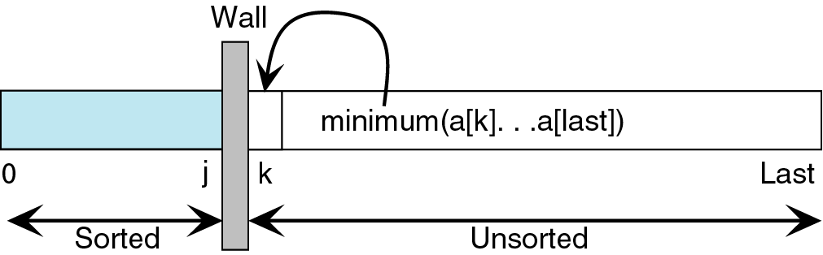

Slide 12
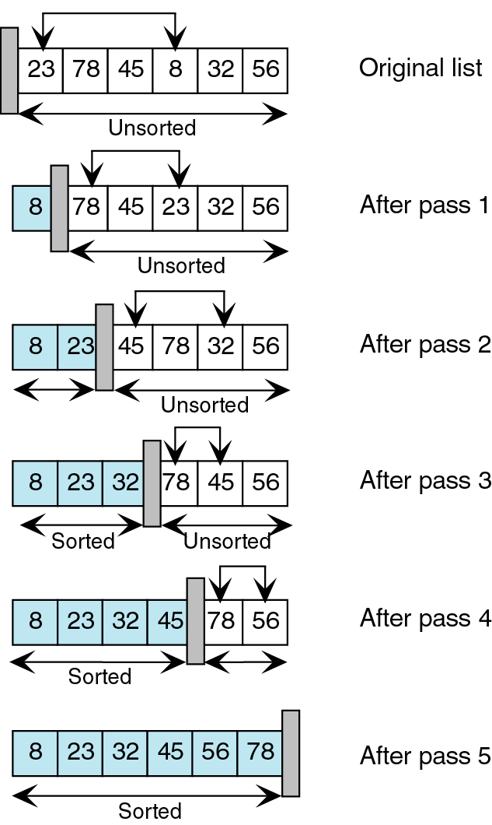

Slide 13
Algorithm selectionsort(A,N)
Repeat steps 2 and 3 for k = 1,2 …N -1
{
2) Call MIN(A,K,N,LOC)
3) // Interchange A[K] and A[LOC] //
Set TEMP := A[K]
A[K] := A[LOC]
A[LOC] := TEMP
} // END OF STEP 2 LOOP
4) Exit.

Slide 14
Algorithm MIN(A,K,N,LOC)
// Procedure to find the location LOC of the
Smallest element among A[K], A[K + 1] ,.. A[N].//
Set MIN := A[K] // INITIALIZE POINTERS
LOC := K
2) Repeat for J = k + 1, k + 2, … N
{
IF MIN > A[J]
{
Set MIN := A[J]
LOC := A[J]
LOC := J
} // END OF LOOP
3) RETURN.

Slide 15
MERGE SORT

Slide 16
It is an example of the divide and conquer algorithmic paradigm.
Conceptually, merge sort works as follows:
Divide the unsorted list into two sublists of about half the size
Divide each of the two sublists recursively until we have list sizes of length 1, in which case the list itself is returned
Merge the two sublists back into one sorted list.
Mergesort incorporates two main ideas to improve its runtime:
A small list will take fewer steps to sort than a large list.
Fewer steps are required to construct a sorted list from two sorted lists than two unsorted lists.

Slide 17
Algorithm mergesort(m)
var list left, right, result
if length(m) ≤ 1 return m
else
var middle = length(m) / 2
for each x in m up to middle
add x to left
for each x in m after middle
add x to right
left = mergesort(left)
right = mergesort(right)
result = merge(left, right)
return result

Slide 18
function merge(left,right)
var list result
while length(left) > 0 and length(right) > 0
if first(left) ≤ first(right)
append first(left) to result
left = rest(left)
else
append first(right) to result
right = rest(right)
if length(left) > 0
append rest(left) to result
if length(right) > 0
append rest(right) to result
return result

Slide 19
