Slide 1
Chapter 3
Stacks
Objectives
Upon completion you will be able to
Explain the design, use, and operation of a stack
Implement a stack using a linked list structure
Understand the operation of the stack ADT
Write application programs using the stack ADT
Discuss reversing data, parsing, postponing and backtracking

Slide 2
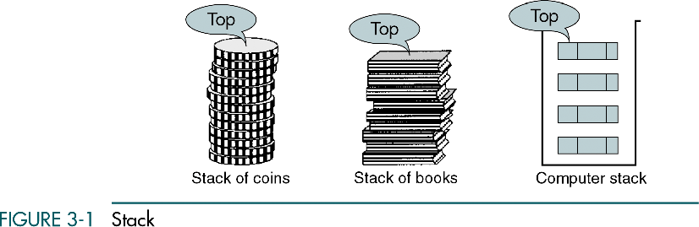
Stacks
A stack is a linear list in which all additions and deletions are restricted to one end, called the top.
Last in – first out (LIFO)

Slide 3
3-1 Basic Stack Operations
The stack concept is introduced and three basic stack operations are discussed.
Push
Pop
Stack Top

Slide 4
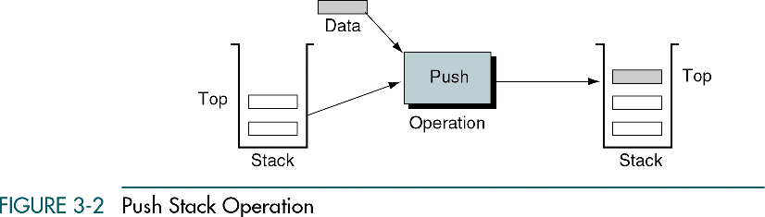
Push
Push adds an item at the top of the stack.

Slide 5
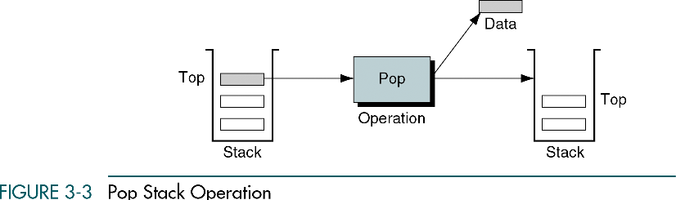
Pop
Pop removes the item at the top of the stack.

Slide 6
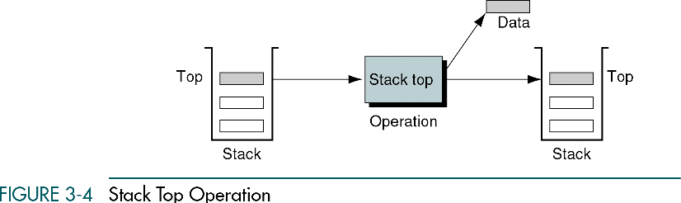
Stack top
Stack top copies the item at the top of the stack.

Slide 7
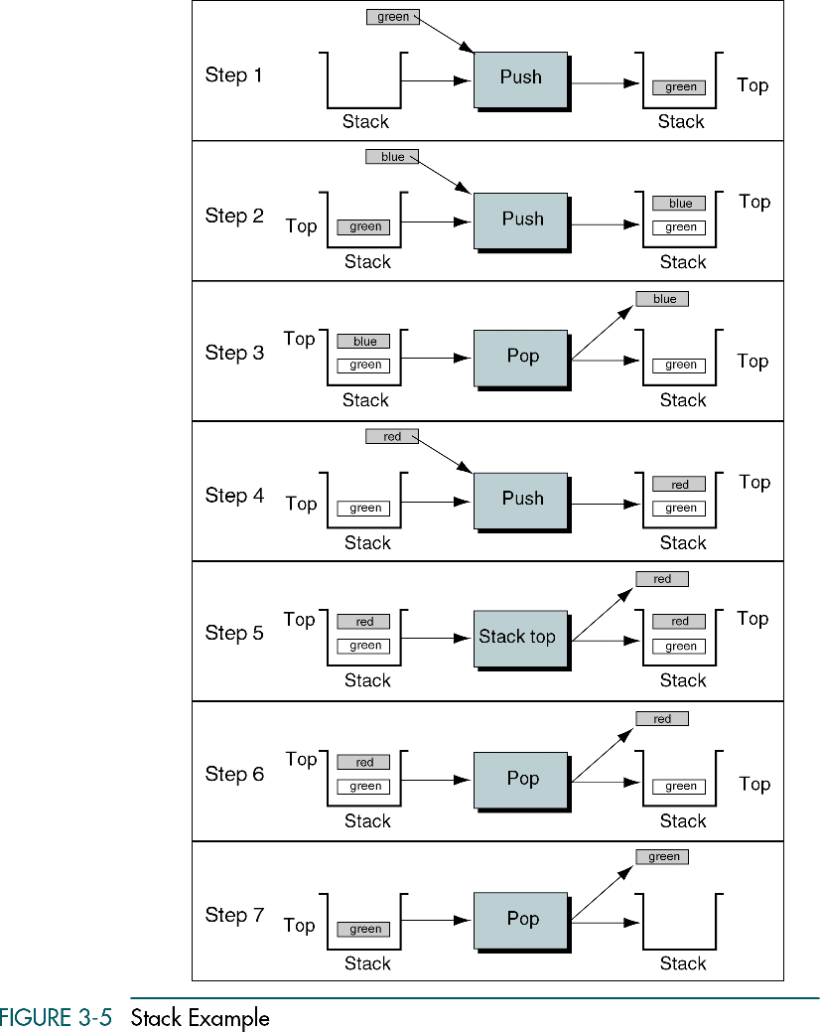

Slide 8
3-2 Stack Linked List Implementation
In this section we present a linked-list design for a stack. After developing the data structures, we write pseudocode algorithms for the stack ADT.
Data Structure
Algorithms

Slide 9
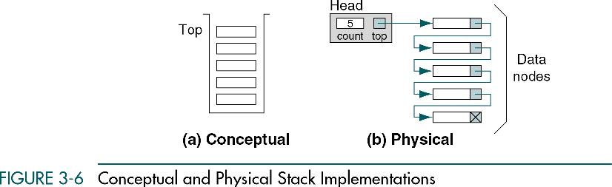
Data Structure

Slide 10
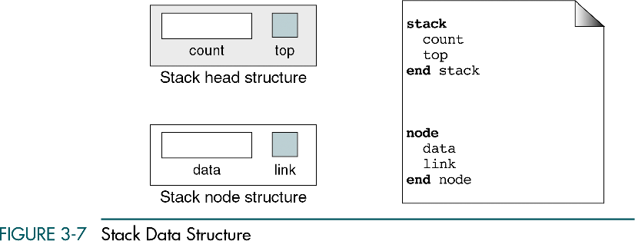
Data Structure
head
data node

Slide 11
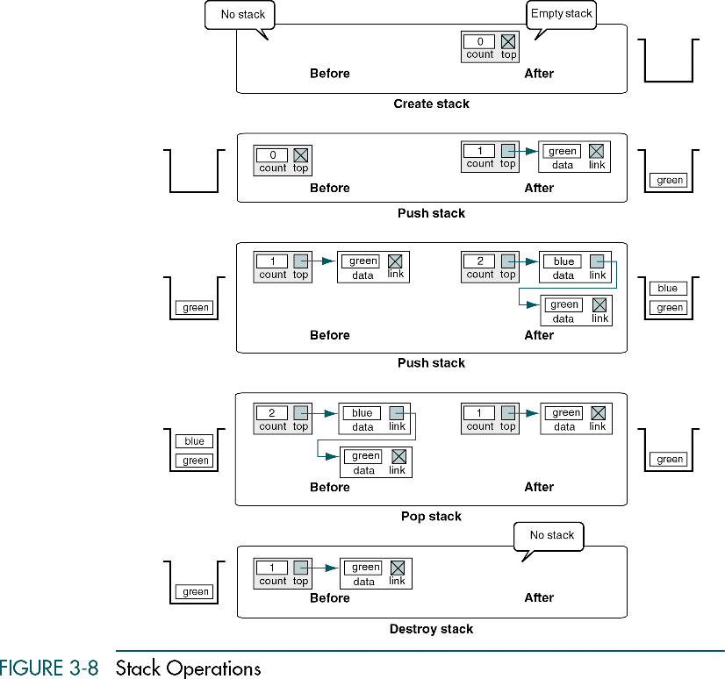

Slide 12
Stack Algorithms
Create stack
Push stack
Pop stack
Stack top
Empty stack
Full stack
Stack count
Destroy stack

Slide 13
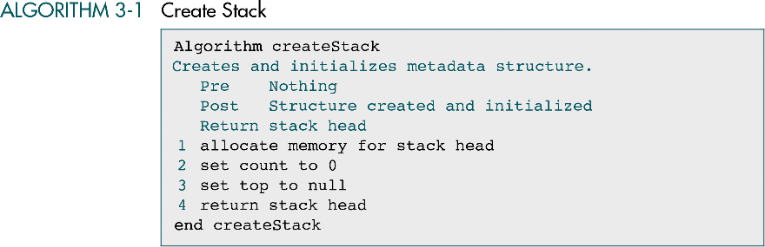
Create stack
Create stack allocates memory for the stack structure and
initializes its metadata.

Slide 14
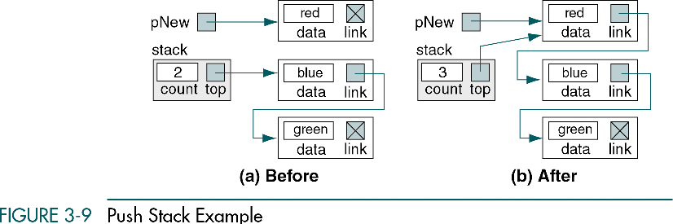
2
1
3
4
5
Push stack inserts an element into the stack.

Slide 15
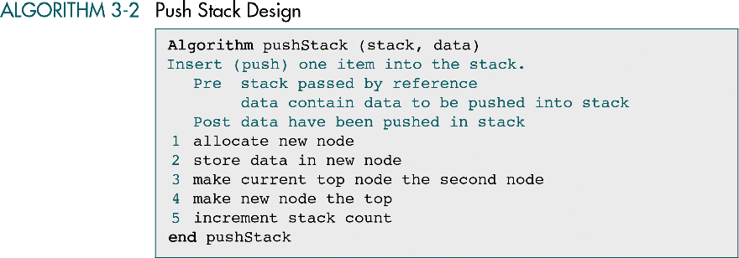

Slide 16
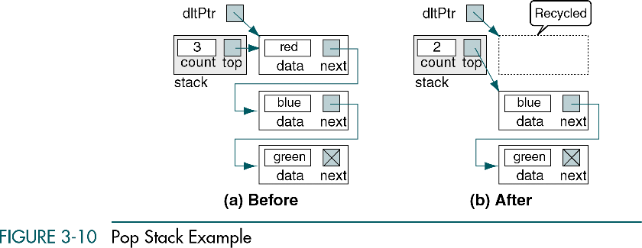
Pop stack sends the data in the node at the top of the stack
back to the calling algorithm.

Slide 17
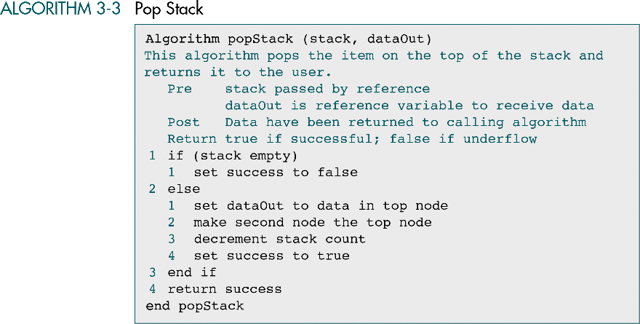
Call by reference

Slide 18
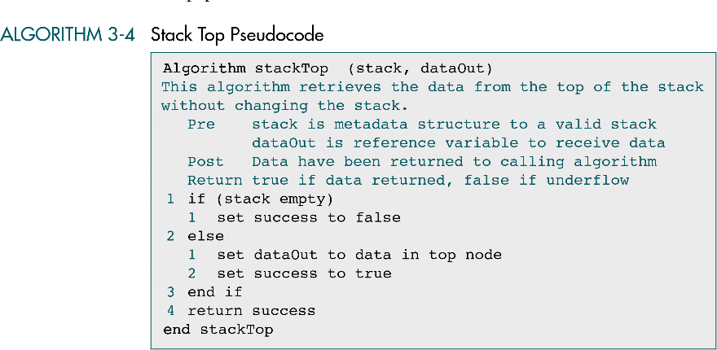

Slide 19
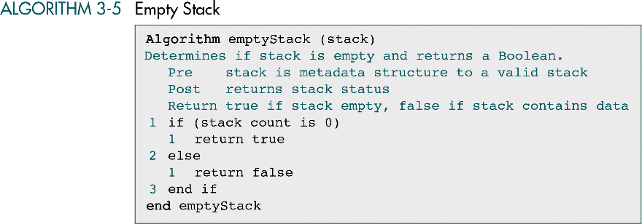

Slide 20
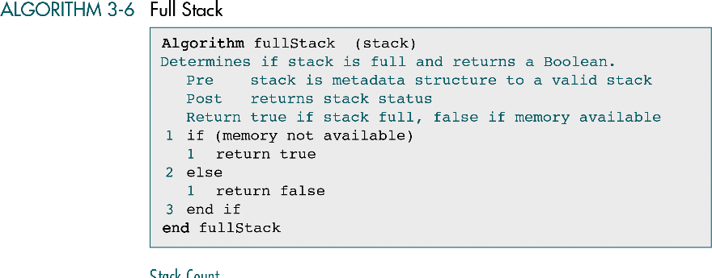

Slide 21
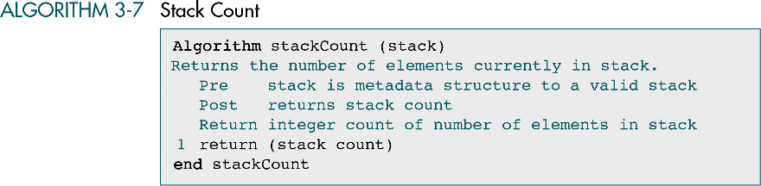

Slide 22
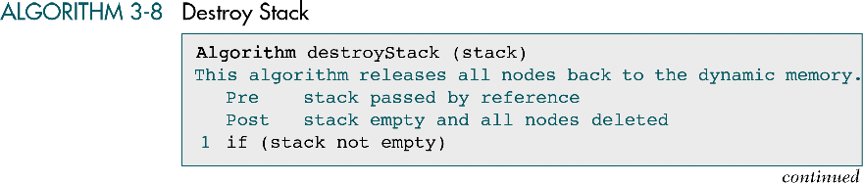
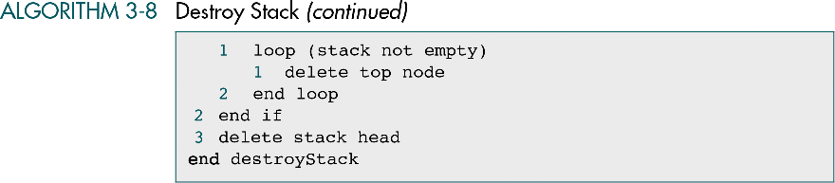

Slide 23
3-3 C Language Implementations
This section presents a simple non-ADT implementation of a stack. We develop a simple program that inserts random characters into the stack and then prints them.

Slide 24
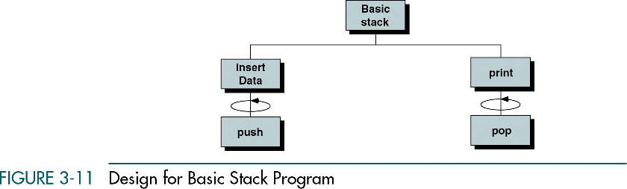

Slide 25
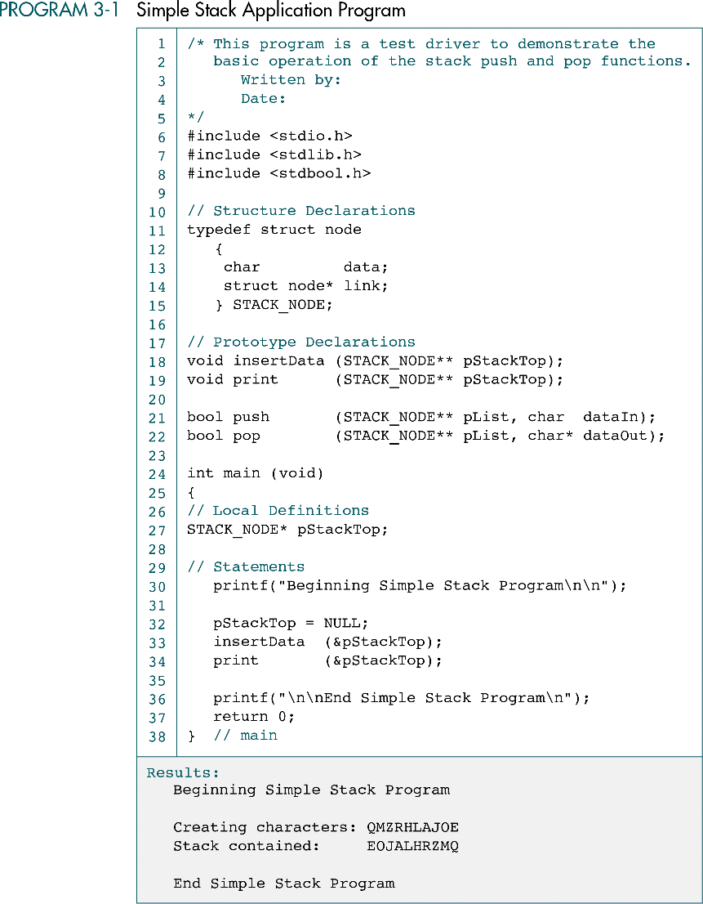
head

Slide 26
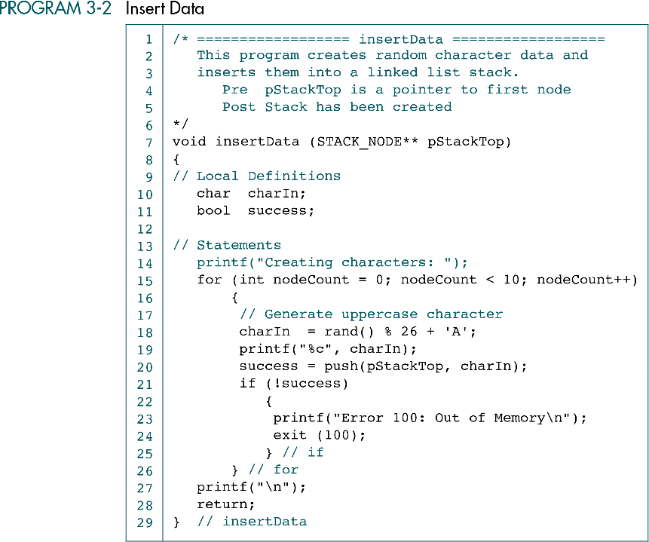

Slide 27
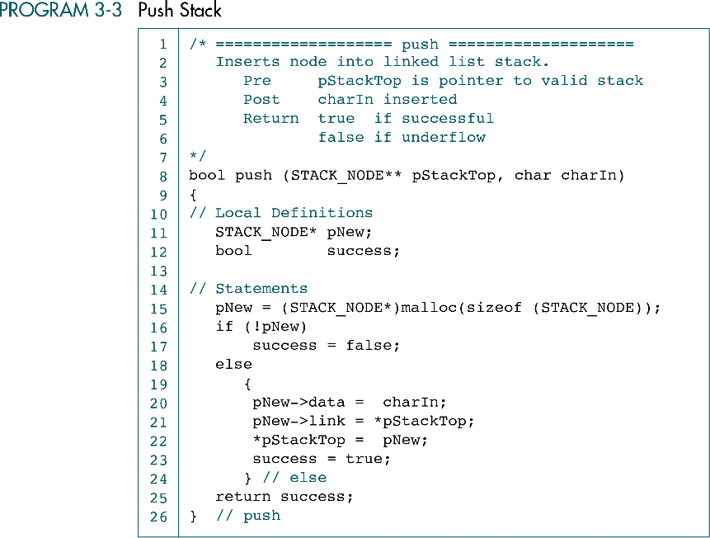

Slide 28
(Continued)

Slide 29
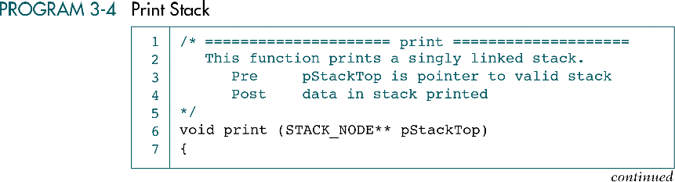

Slide 30
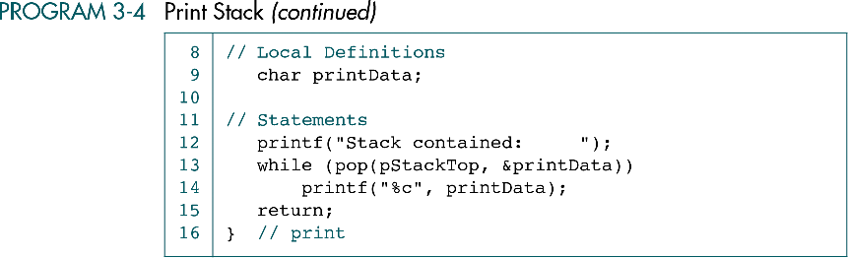

Slide 31
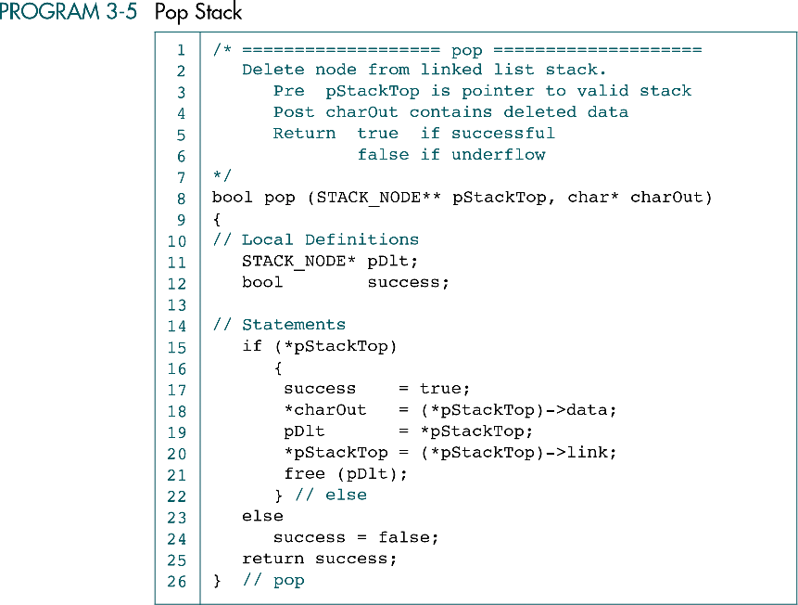

Slide 32
3-4 Stack ADT
We begin the discussion of the stack ADT with a discussion of the stack structure and its application interface. We then develop the required functions.
Data Structure
ADT Implemenation

Slide 33
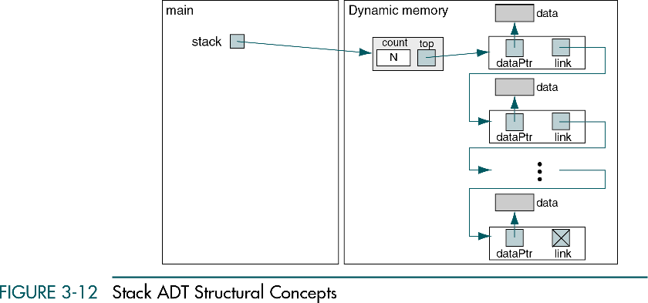
STACK* stack;
…
stack = createStack();

Slide 34
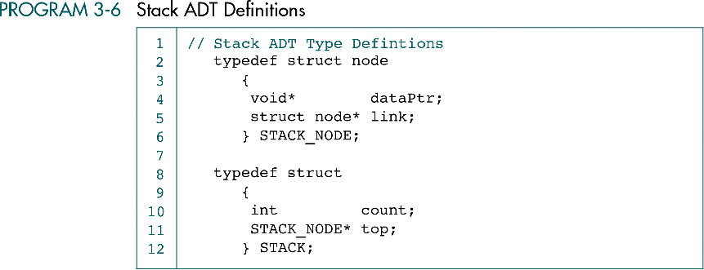
data node
head

Slide 35
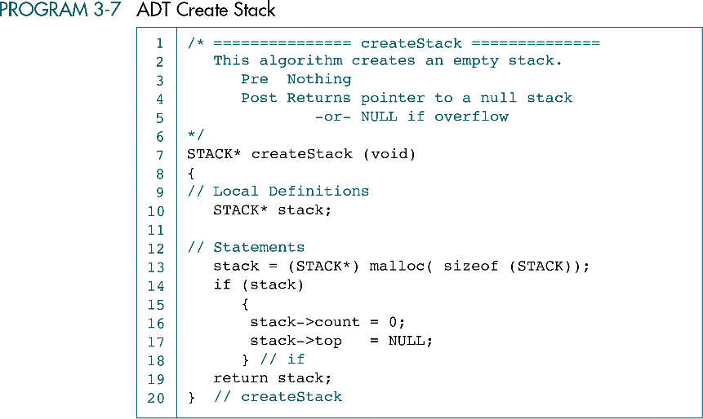

Slide 36
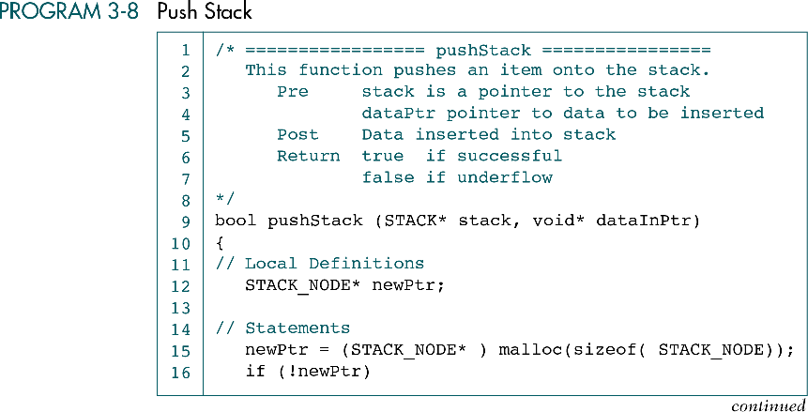

Slide 37
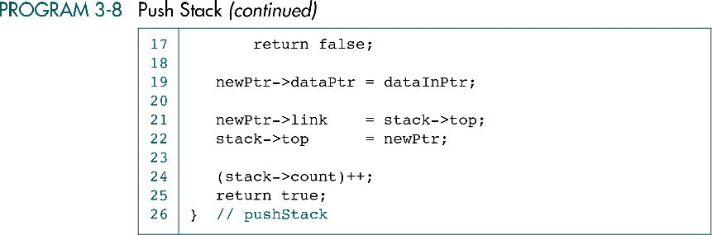

Slide 38
ATD PopStack
/* =================== popStack ==================
This function pops item on the top of the stack.
Pre stack is pointer to a stack
Post Returns pointer to user data if successful
NULL if underflow
*/
void* popStack (STACK* stack)
{
// Local Definitions
void* dataOutPtr;
STACK_NODE* temp;
// Statements
if (stack->count == 0)
dataOutPtr = NULL;
else
{
temp = stack->top;
dataOutPtr = stack->top->dataPtr;
stack->top = stack->top->link;
free (temp);
(stack->count)--;
} // else
return dataOutPtr;
} // popStack

Slide 39
ATD Retrieve StackTop
/* ================== stackTop =================
Retrieves data from the top of stack without changing the stack.
Pre stack is a pointer to the stack
Post Returns data pointer if successful
null pointer if stack empty
*/
void* stackTop (STACK* stack)
{
// Statements
if (stack->count == 0)
return NULL;
else
return stack->top->dataPtr;
} // stackTop

Slide 40
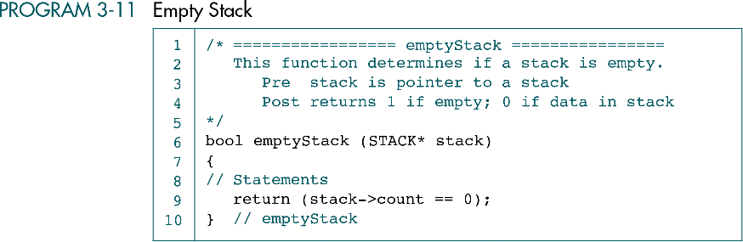

Slide 41
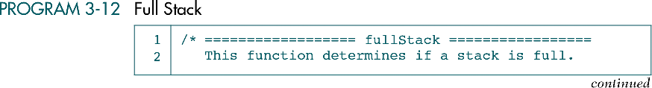
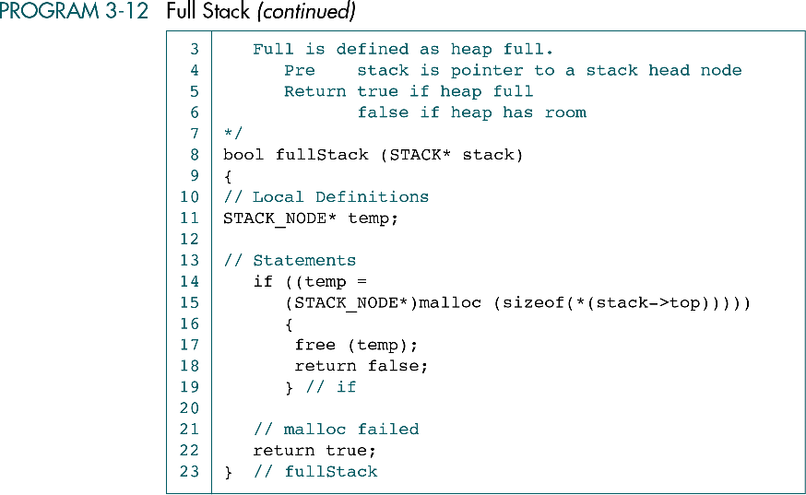

Slide 43
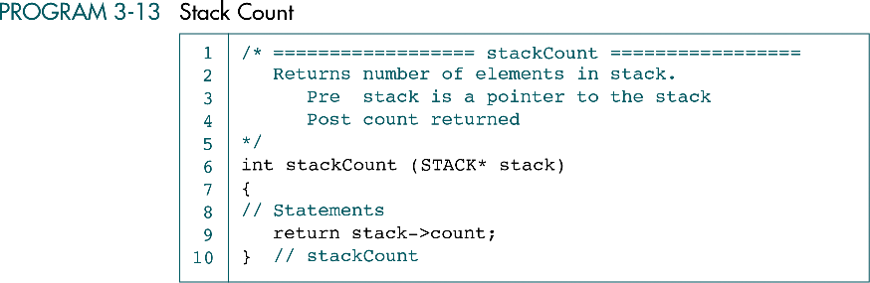

Slide 44
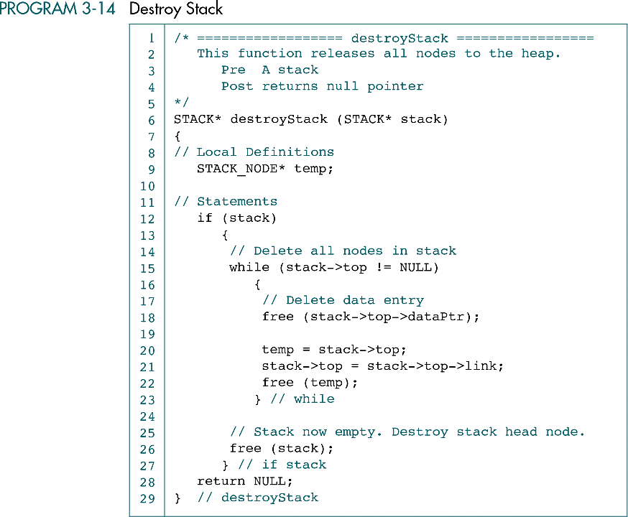

Slide 45
3-5 Stack Applications
Three basic application problems-reversing data, parsing data, postponement data usage, and backtracking steps -are discussed and sample programs developed. In addition, several other stack applications are presented, including the classic Eight Queens problem.
Reversing Data
Converting Decimal to Binary
Parsing
Postponement
Backtracking

Slide 46
Reversing data
{1 2 3 4} becomes {4 3 2 1}
Examples for reversing data
  Reverse a list
  Convert decimal to binary

Slide 47
Reverse a number series
1 … 6 7 8 9 10 11 12 13 14 15 16 17 18 19 20 21 22 23 24 25 | /* */ #include <stdio.h> #include <stdbool.h> #include "stacksADT.h" int main(void) { //local Definitions bool done = false; int* dataPtr; STACK* stack; // Statements // Create a stack and allocate menory fir data Stack = createStack(); //Fill stack While (!done) {

Slide 48
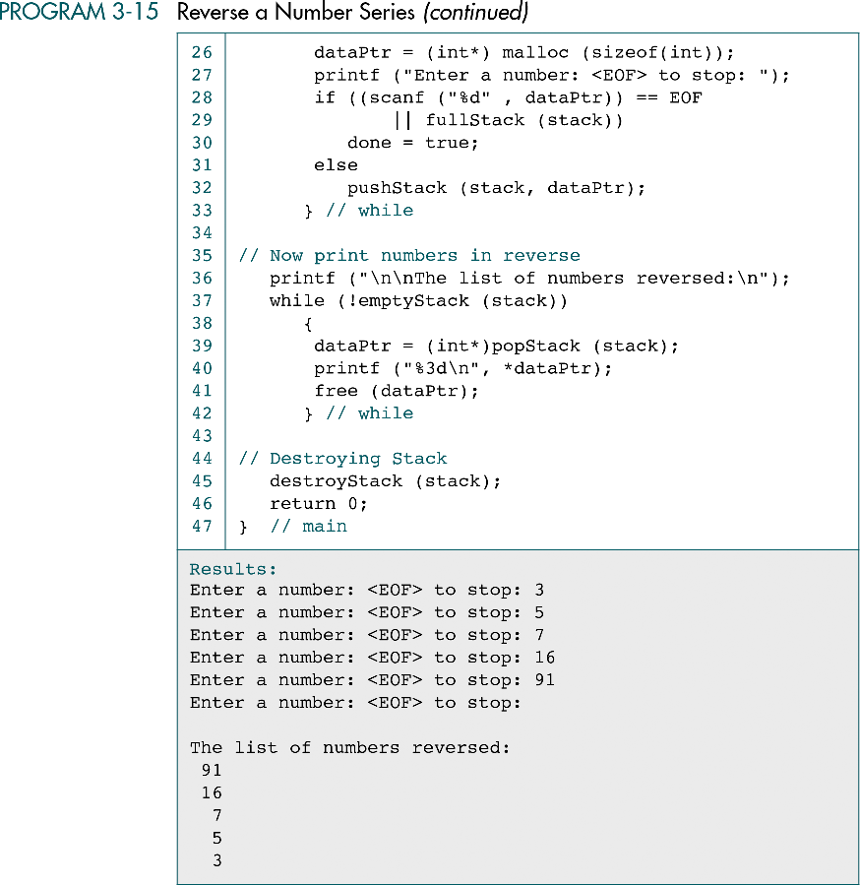

Slide 50
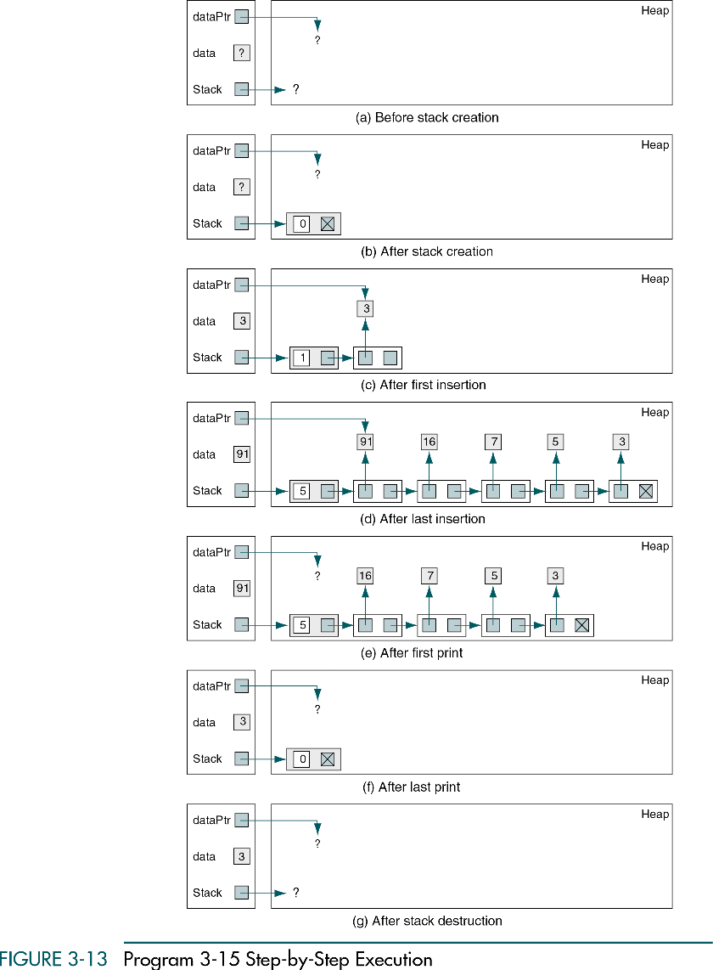

Slide 51
(continued)

Slide 52
Convert decimal binary
1 … 6 7 8 9 10 11 12 13 14 15 16 17 18 19 20 21 22 23 24 25 26 | /* */ #include <stdio.h> #include “stacksADT.h” int main(void) { //local Definitions unsigned int num; int* digit; STACK* stack; // Statements // Create a stack and allocate menory fir data Stack = createStack(); //prompt and read a number printf(“Enter an interger: “); scanf(“%d”, &num); // create 0s and 1s and push them into the stack while (num > 0)

Slide 53
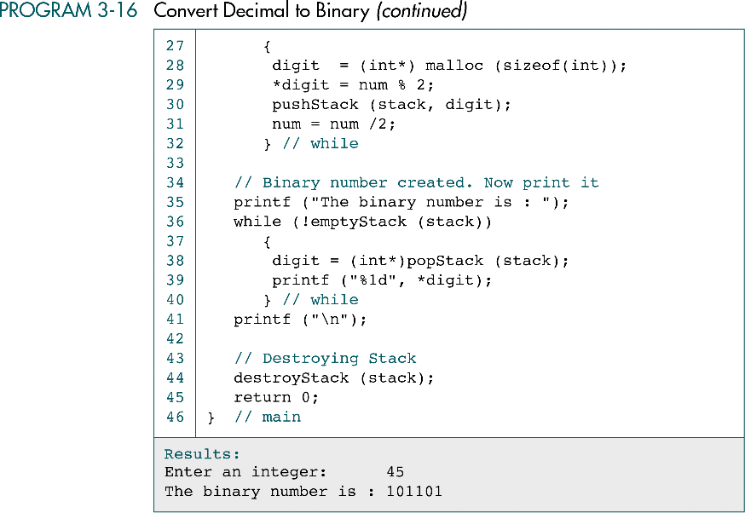

Slide 54
Parsing
Parsing is any logic that breaks data into independent pieces for further processing.
Example for parsing
  Unmatched parentheses

Slide 55
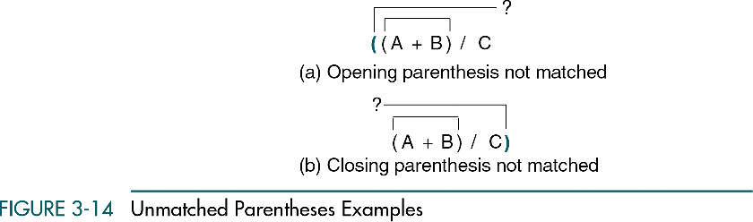

Slide 56
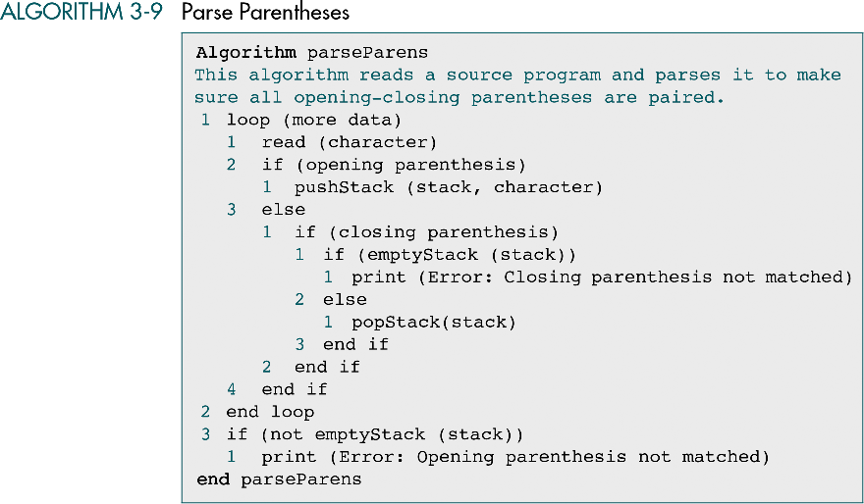

Slide 57
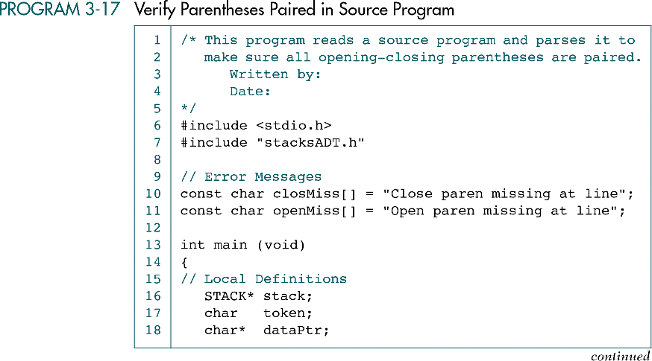

Slide 58
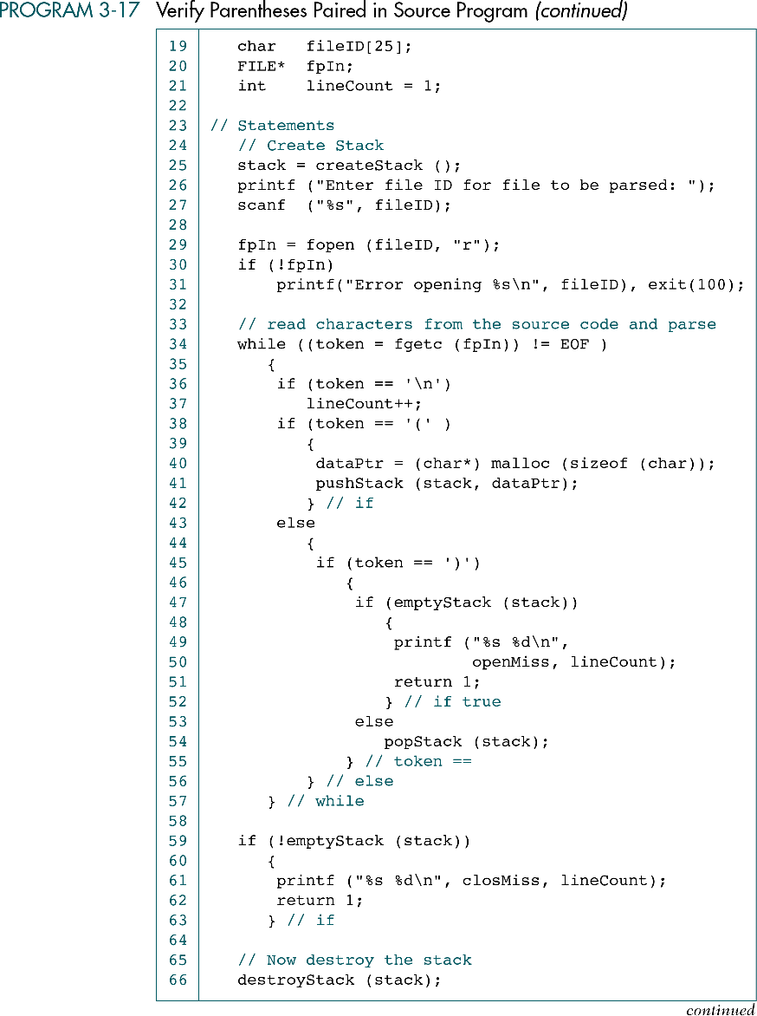

Slide 61
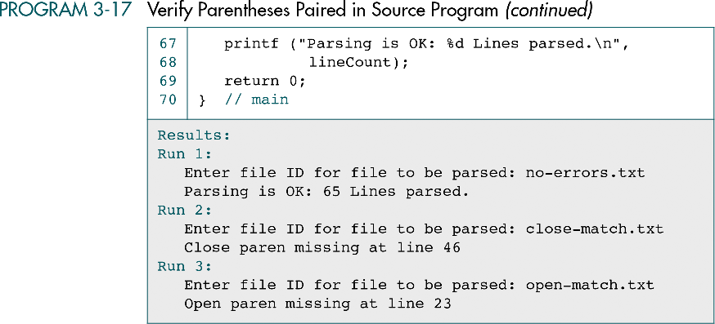

Slide 62
Postponement
Examples for postponement
  Infix to postfix transformation
  Postfix expression evaluation

Slide 63
The formats of an arithmetic expression
Infix
  The operator comes before the operands.
Postfix
  The operator comes between the operands.
Prefix
  The operator comes after the operands.

Slide 64
An example
A + B
  Infix
    A + B
  Prefix
    +AB
  Postfix
    AB-

Slide 65
Concept
Prefix to postfix conversion
  recursion
Infix to postfix transformation
  stacks
Evaluate a postfix expression
  stacks
Evaluate a prefix expression
  queues

Slide 66
Infix to postfix transformation
In the infix notation, we need to use parentheses to control the evaluation of the operators.
We thus have an evaluation method that includes parentheses and two operator priority classes.
  Priority 0 : (
  Priority 1 : + -
  Priority 2 : * /

Slide 67
Manual transformation
Fully parenthesize the expression using any explicit parentheses and the arithmetic precedence.
Change all infix notations in each parenthesis to postfix notation, starting from the innermost expressions. Conversion to postfix notation is done by moving the operator to the location of the expression’s closing parenthesis.
Remove all parentheses.

Slide 68
Example
A+B*C
Step 1
  (A+(B*C))
Step 2
  (A+(BC*))
  (A(BC*)+)
Step 3
  ABC*+

Slide 69
More complex example
(A+B)*C+D+E*F-G
Step 1
  (((((A+B)*C)+D)+(E*F))-G)
Step 2
  (((((AB+)C*)D+)(EF*)+)G-)
Step 3
  AB+C*D+EF*+G-

Slide 70
Algorithmic transformation
When we need to push an operator into the stack, if its priority is higher than the operator at the top of the stack, we go ahead and push it into the stack.
If the current operator’s priority is lower than or equal to that of the operator at the top of the stack than, it is popped and placed in the output expression.

Slide 71
Algorithmic transformation
After doing this, we must check the new top operator.
  If its priority is greater than the current operator, it is popped to the output expression.

Slide 72
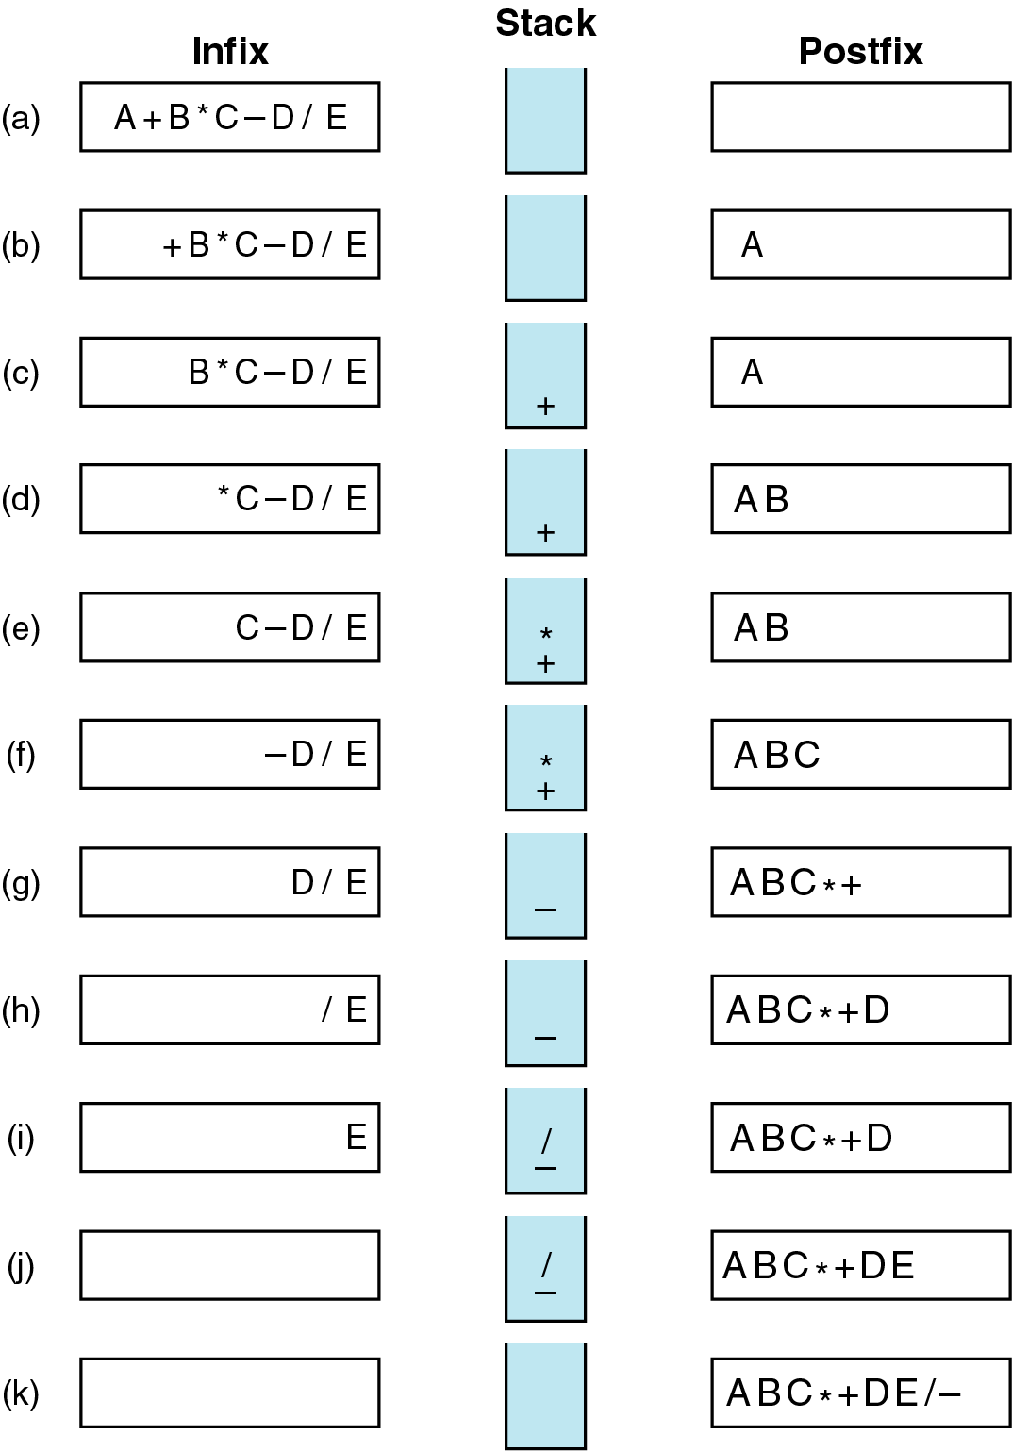
Infix Transformations
A+B*C-D/E
converts to
ABC*+DE/-

Slide 73
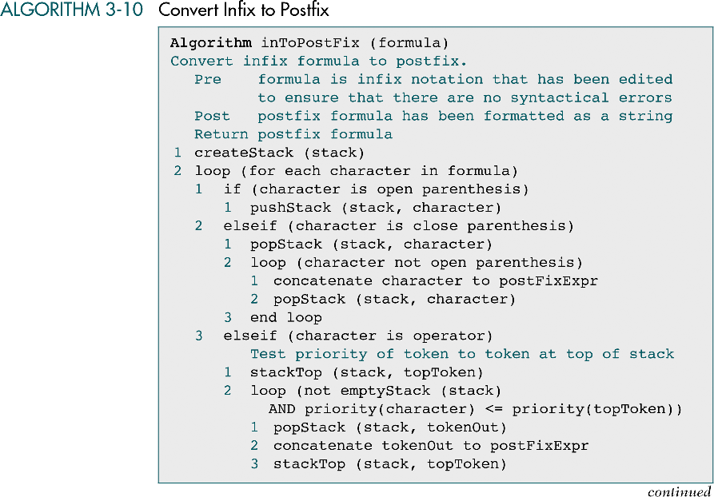

Slide 74
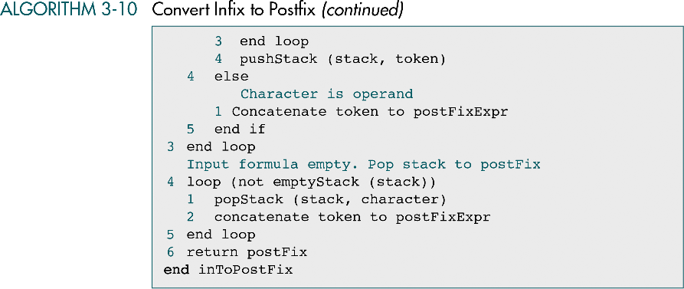

Slide 75
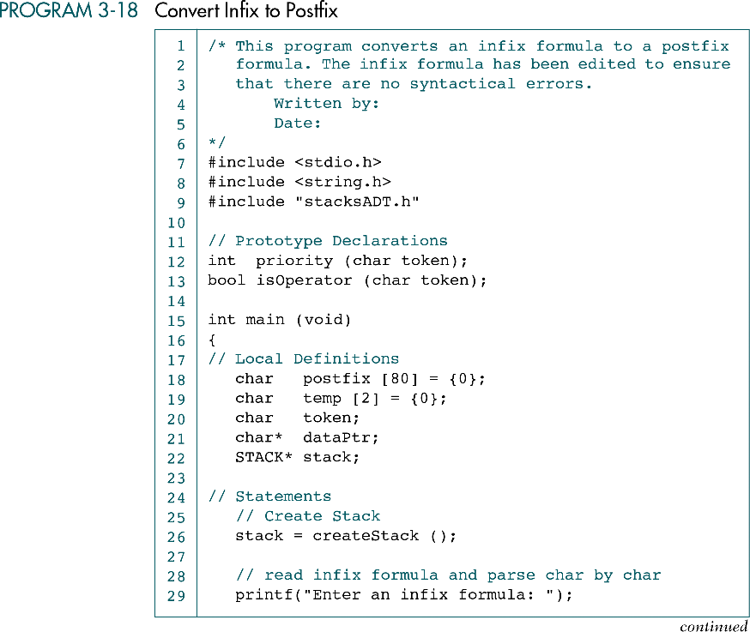

Slide 76
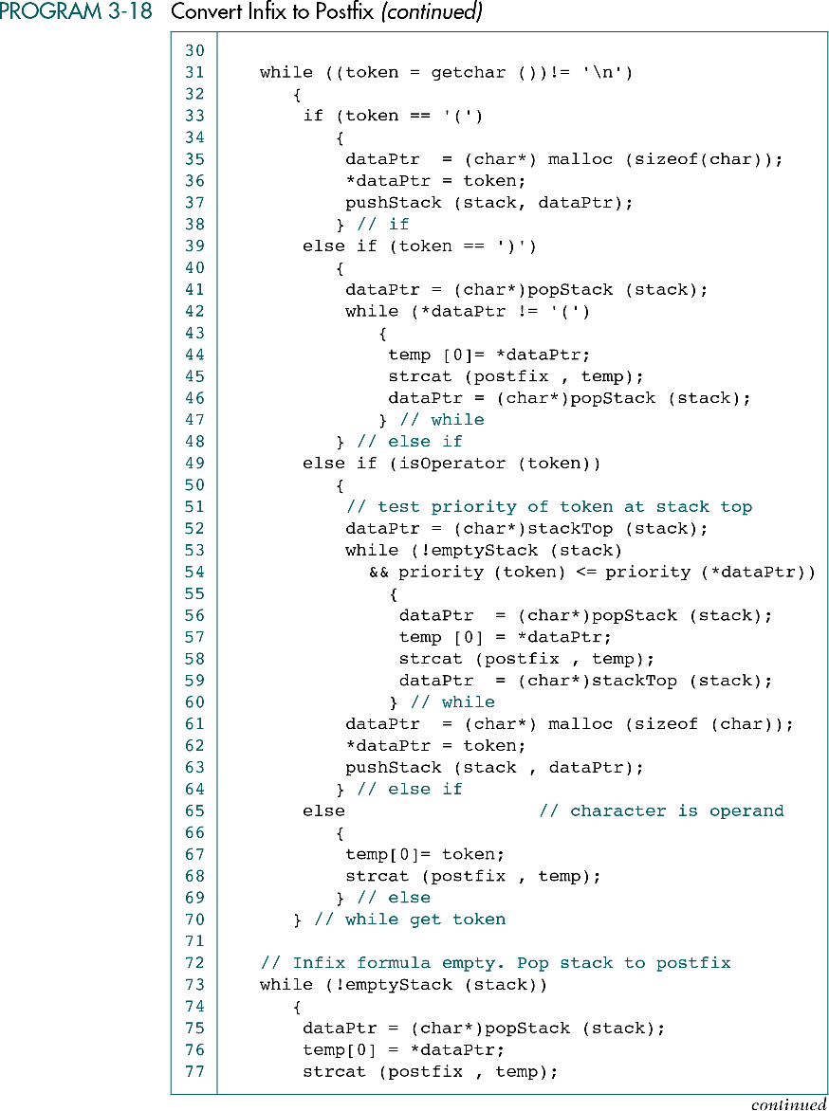

Slide 79
Convert infix to postfix
} // while
// Print the postfix
printf ("The postfix formula is: ");
puts (postfix);
// Now destroy the stack
destroyStack (stack);
return 0;
} // main

Slide 80
Convert infix to postfix
/* =================== priority ====================
Determine priority of operator.
Pre token is a valid operator
Post token priority returned
*/
int priority (char token)
{
// Statements
if (token == '*' || token == '/')
return 2;
if (token == '+' || token == '-')
return 1;
return 0;
} // priority

Slide 81
Convert infix to postfix
/* =================== isOperator ====================
Determine if token is an operator.
Pre token is a valid operator
Post return true if operator; false if not
*/
bool isOperator (char token)
{
// Statements
if (token == '*'
|| token == '/'
|| token == '+'
|| token == '-')
return true;
return false;
} // isOperator
----------------------------------------------------------------------------------------------
/* Results
Run 1
Enter an infix formula: 2+4
The postfix formula is: 24+
Run 2
Enter an infix formula: (a+b)*(c-d)/e
The postfix formula is: ab+cd-*e/
*/

Slide 82
Evaluating postfix expressions
The operands come before the operators.
Postpone the use of the operands.
When we find an operator, we pop the two operands at the top of the stack and perform the operator.
We then push the value back into the stack to be used later.

Slide 83
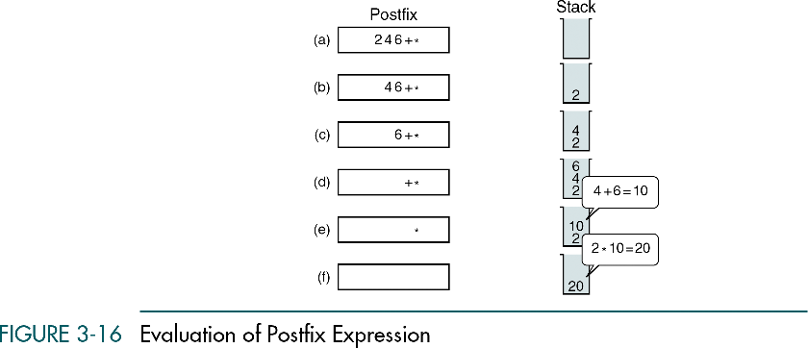

Slide 84


Slide 85


Slide 86


Slide 89


Slide 91
Backtracking
Examples
  Goal seeking
  Eight queens problem

Slide 92


Slide 93

Goal Seeking

Slide 94


Slide 95


Slide 96


Slide 97
(continued)

Slide 98


Slide 99


Slide 100


Slide 101


Slide 103


Slide 104


Slide 105


Slide 107


Slide 108


Slide 110
3-6 How Recursion Works
This section discusses the concept of the stack frame and the use of stacks in writing recursive software
Enqueue
Dequeue
Queue Front
Queue Rear
Queue Example

Slide 111

Local variable:
base, exp, result
When power begins to execute,
it must know the values of the parameter.
It must also know where it needs to return
when its processing is done.
Finally, if it returns a value, it must know
where the value is to be placed when it terminates.

Slide 112
Stackframe
When power begins to execute,
  it must know the values of the parameter.
When its processing is done,
  it must also know where it needs to return.
Finally, if it returns a value,
  it must know where the value is to be placed when it terminates.
These data are conceptually placed in a stackframe.

Slide 113
Stackframe
A stackframe contains four different elements:
  The parameters to be processed by the called algorithm.
  The local variables in the calling algorithm
  The return statement in the calling algorithm
  The expression that is to receive the return value (if any)

Slide 114
Recursive Power Algorithm
Program testPower
1 read (base, exp)
2 result = power (base, exp)
3 print (“base**exp is”, result)
End testPower
Algorithm power(base, exp)
1 If (exp is 0)
1 Return (1)
2 Else
1 Return (base *
power(base, exp – 1))
3 End if
End power

Slide 115


