Slide 1
Operating Systems

Slide 2
Course Overview
Introduction to Operating Systems
Process Management
Resource Management
Memory Management

Slide 3
Virtual Memory
File Management
Protection and Security
Disk Management

Slide 4
What is an Operating System?
Operating system is collection of programs which acts as an interface between the user and computer.
The purpose of O.S is to provide an environment in which user can execute the program.

Slide 5
O.S is the layer of software that runs directly on the hardware and provides support for the software running on the hardware.

Slide 6
Operating System Services
O.S provides an environment for the execution of programs.
It provides certain services to processes and to the users of those programs.
Services provided by O.S is divided in two categories.

Slide 7
User Services
System Services

Slide 8
User services
a. Program Execution
b. I/O operations
c. File manipulation
d. Error detection

Slide 9
System Services:
a. Resource Utilization
b. Accounting
c. Protection

Slide 10
User Services
Program execution:
Whenever user wants to execute the programs they request the O.S to provide CPU to execute the programs.
The O.S will load the programs into main memory and then allocates CPU to the Program.

Slide 11
If the results of the program are produced then it is called normal termination else it is called as abnormal termination.

Slide 12
I/O Operations
Any program during execution wants to perform I/O operation, which may be from a file or from an I/O device.
It is the O.S job for allocation of I/O devices and these devices perform I/O operations.

Slide 13
File Manipulation
Operating systems is responsible for read, write, open, close and deleted file operations.

Slide 14
Error Detection
O.S is aware of all possible errors.
Errors may occur in CPU (like power failure, division by zero), memory (memory error), I/O devices (printer out of paper) and in user programs (Accessing illegal memory locations).
Responsibility of the O.S is to detect such errors and inform the user.

Slide 15
System Services
Resource Utilization:
When many users are working at same time, O.S must allocate resources to each of them, so that each user program can perform some operation or the other.

Slide 16
O.S must distribute the resources to the user processes so that each process get some resources and perform some operation

Slide 17
Accounting
O.S keeps track of which users use what resources.
That is it must maintain an account of all the resources present in the Computer system.
That is O.S should know how many resources each processes is having.

Slide 18
Accounting is useful in situations like deadlock recovery, deadlock prevention.

Slide 19
Protection
When several Jobs being executed in the system, then it should not happen that one user job interface with others that is the resources given to one process should be accessed by that process only and all attempts made by other processes to access these resources should be denied.

Slide 20
O.S should protect the resources to each process from misuse

Slide 21
O.S as a Resource Manager
Main resources O.S manages are the computer hardware in the form of Processor, Storage (Main & Secondary),
I/O devices, Communication devices etc.

Slide 22
Functions of O.S include:
Implementing the User Interface.
Allowing users to share data among themselves.
Preventing users from interfering with one another.
Scheduling resources among users.

Slide 23
Facilitating Input Output
Accounting for resource usage
Recovering from errors.
Facilitating Parallel Operations.
Organizing data for secure and rapid access

Slide 24
Handling network Communication
Efficient Program Execution.
Security and protection.

Slide 25
What is in an OS?
Sql Server
Applications
System Utils
Shells
Windowing & graphics
OS Interface
Naming
Windowing
Operating System Services
Networking
Virtual Memory
Access Control
Generic I/O
File System
Process Management
Device Drivers
Memory Management
Physical m/c Intf
Interrupts, Cache, Physical Memory, TLB, Hardware Devices
Logical OS Structure

Slide 26
Evolution of Operating Systems
Batch Oriented Operating Systems
Interactive Operating Systems
Real Time Operating Systems
Time Sharing Operating Systems
Network Operating Systems
Distributed Operating Systems

Slide 27
Batch Oriented Operating Systems
In this all the jobs which are to be executed are collected together and stored in a magnetic tape.
Now the first job is loaded into main memory from magnetic tape and then executed.
The output of this job is stored in another magnetic tape.

Slide 28
Now the second job is taken from magnetic tape and same operations are repeated.
Thus after each job is finished O.S will automatically read the next job from magnetic tape and executes.
So user intervention is not required here.

Slide 29
When the whole batch is executed the operator will remove the input and output magnetic tapes and load other set of tapes for execution.
Advantage in Batch O.S is CPU utilization is more and there is no wastage of time between execution of jobs.

Slide 30
However the user cant communicate and hence debugging becomes problem.
To overcome this situation Interactive O.S are introduced.

Slide 31
Interactive Operating Systems
Provides online communication between User and O.S
User gives instructions to the computer and O.S responses immediately.
In I.O.S keyboard is used as Input device and monitor as Output device.

Slide 32
When O.S completes the execution of one command it waits for another command from the keyboard.
Here uses gives command and waits for the response and then decides about the next command based on the output of first command.

Slide 33
Thus there is a waste of C.P.U time.

Slide 34
Now tell the Differences between the Batch Operating Systems and Interactive Operating systems.

Slide 35

Real Time Operating Systems
Dedicated Operating systems developed for a specific application.

Slide 36
Example:
Satellite Communication: Main terminal communicating with satellite should be attended more frequently than the other terminals connected to the system.
This is because communication may establish and data may start coming at any time or for more time also.

Slide 37
In such cases O.S should be serving the main terminal to prevent the loss of data.
So Real time systems will solve this problem.

Slide 38
Real Time Systems are of two types:
a) Soft Real time systems
b) Hard Real time systems
Soft Real Time Systems:
This system gives real-time task high priority
But does not guarantee system reaction time.

Slide 39
Example:
Multimedia and Network Servers.

Slide 40
Hard Real-time System:
It gives guaranteed response time and is dedicated to the task.
Example : Robotics and Medical systems

Slide 41
Time Sharing Systems
Time sharing systems are an extension of Multiprogramming systems.

Slide 42
Multiprogramming is that in which several jobs are in main memory at once;
A processor is switched from job to job as needed to keep several jobs advancing while keeping the peripheral devices in use.

Slide 43
For example, on the system with no multiprogramming, when the current job paused to wait for other I/O operation to complete, the CPU simply sat idle until the I/O finished.

Slide 44
The solution for this problem that evolved was to partition memory into several pieces, with a different job in each partition.
While one job was waiting for I/O to complete, another job could be using the CPU.

Slide 45
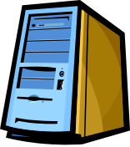

Time Sharing Systems

Slide 46
Time Sharing Systems
Each user has a separate program in memory, also each program is given some time slot or time quantum or time slice.
When a program starts executing it will execute only for this time slot and then CPU goes to the next user program waiting in the job pool.

Slide 47
Example:
A job requires 15 seconds of execution time, and lets assume the time quantum is 4 seconds.
Then the job is executed in 4 phases with time slots 4 4 4 3.

Slide 48
Suppose during the 4 seconds time quantum the job needs to perform I/O operation the CPU releases the job temporarily and goes to the next user program in the job pool.

Slide 49
Suppose a job requires 2 seconds the job itself releases CPU on its own.
In TSO CPU rapidly switches over between one user and the other.

Slide 50
Network Operating systems
A network operating system (NOS) is a computer operating system system that is designed primarily to support workstation, personal computer, and, in some instances, older terminal that are connected on a local area network (LAN).

Slide 51
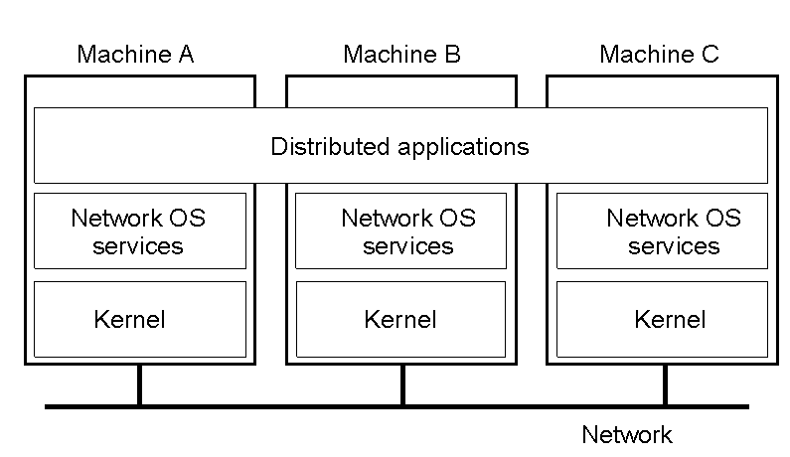

Slide 52
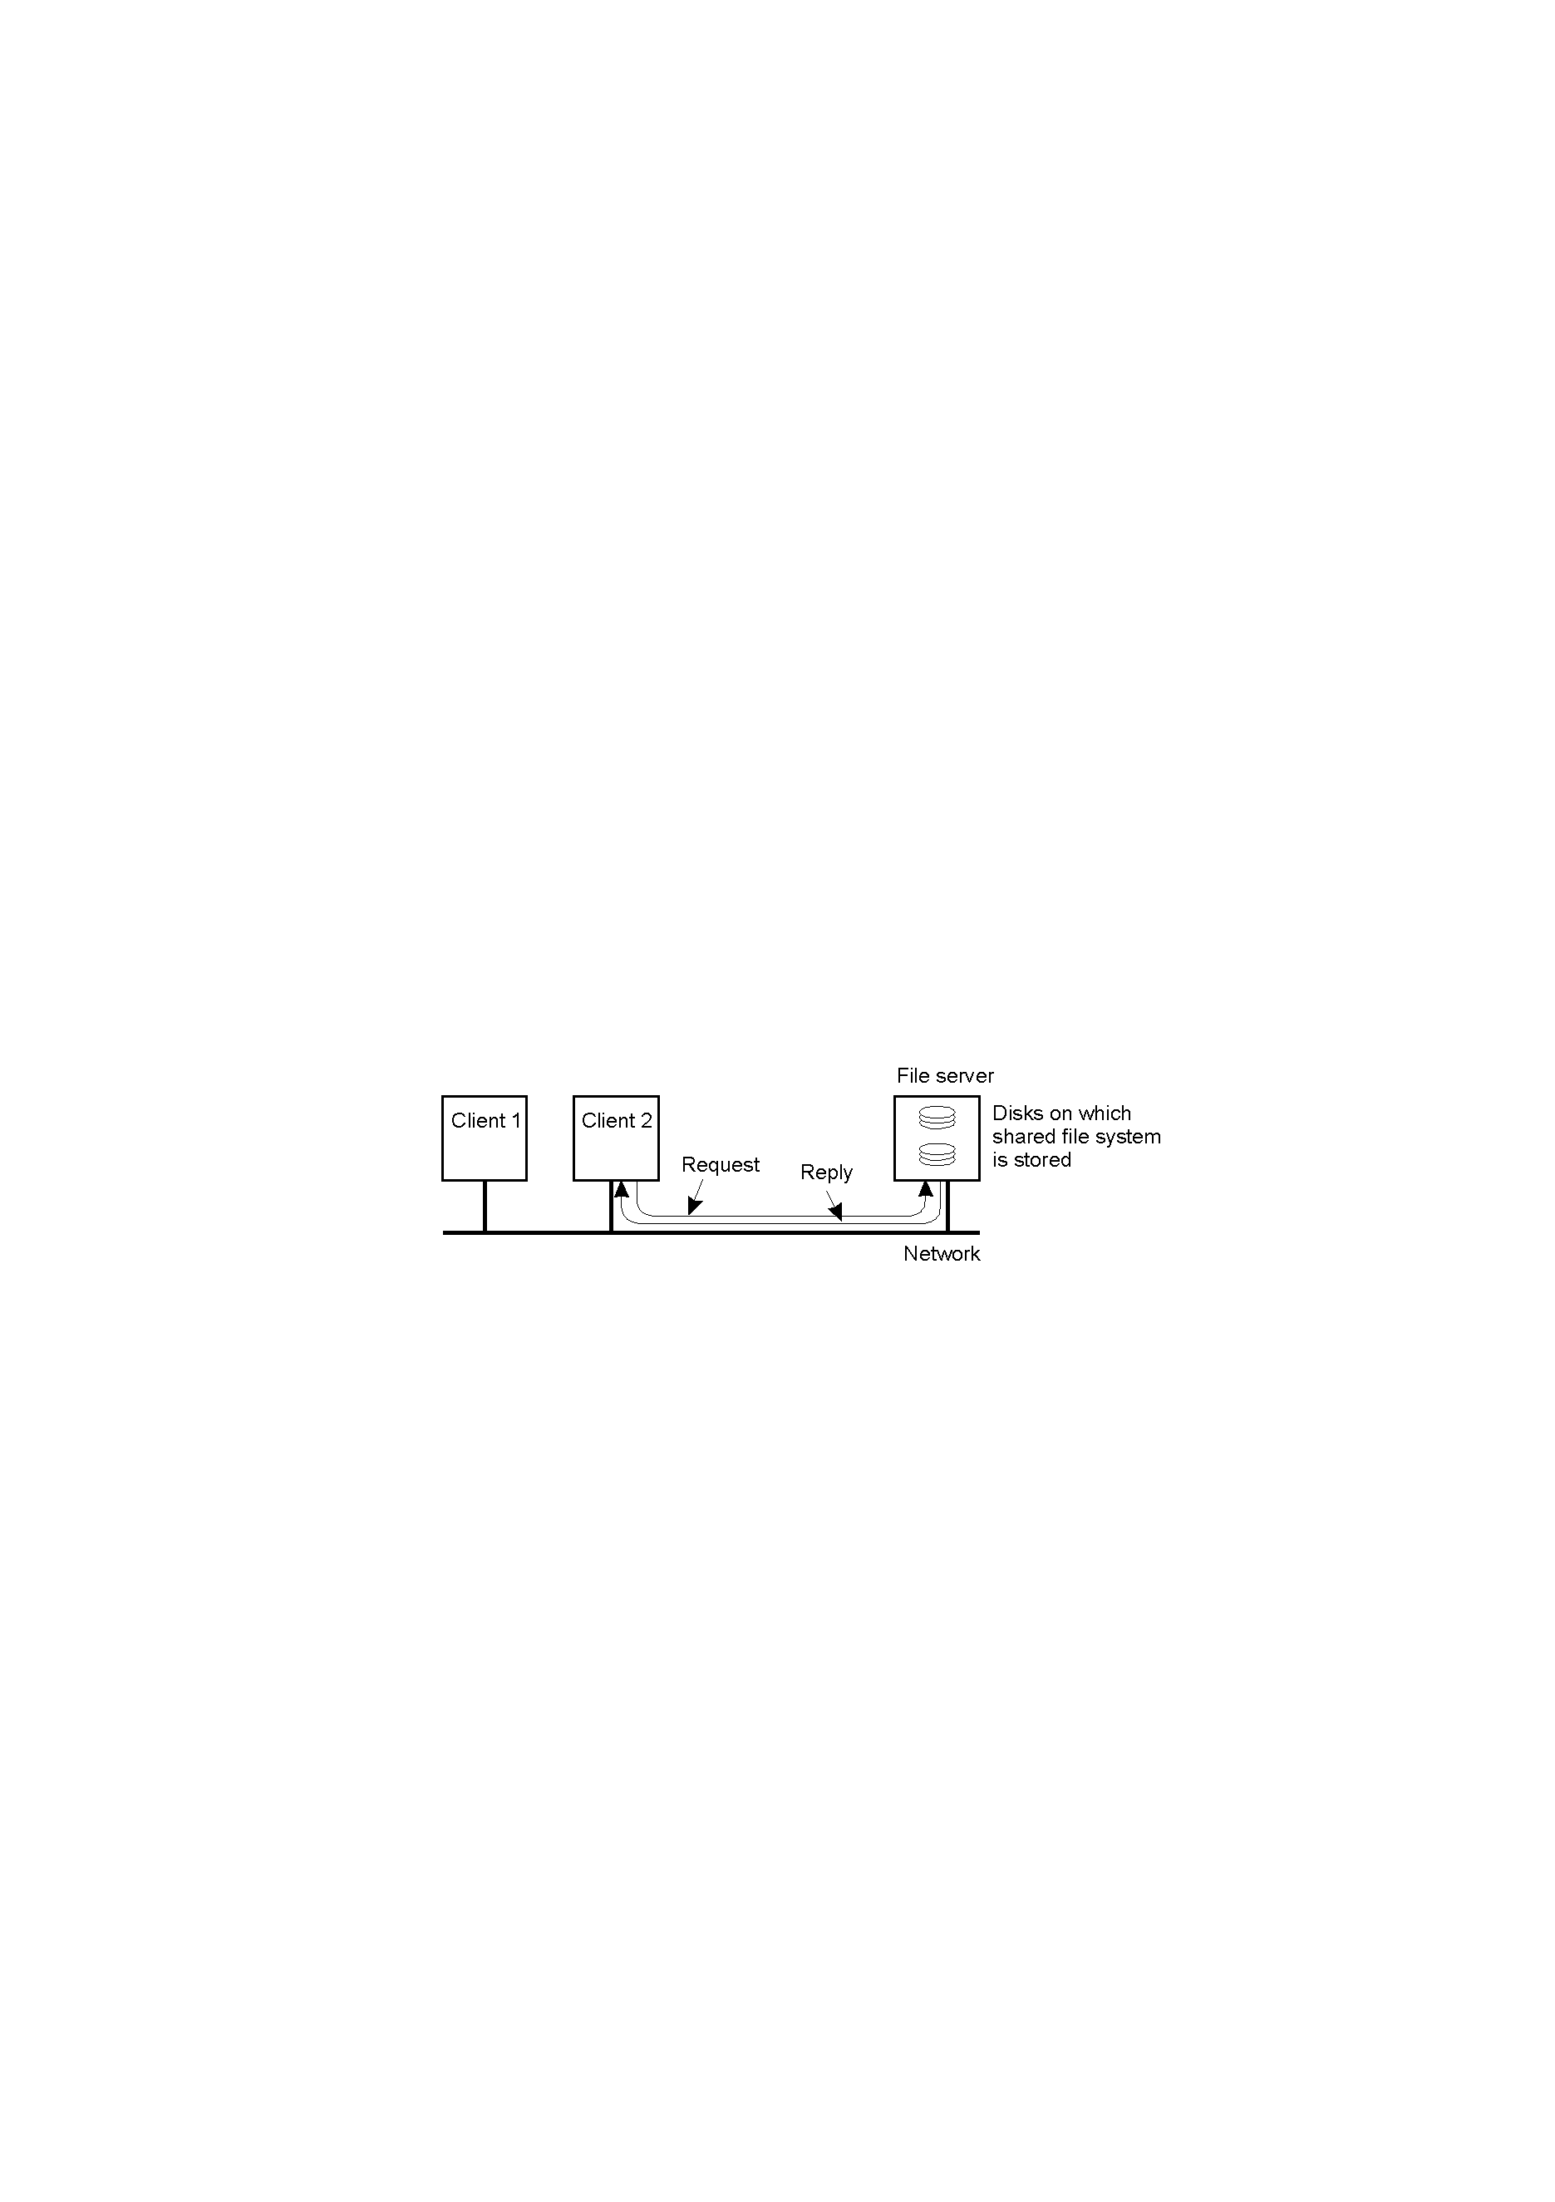

Slide 53
Distributed Operating systems
An operating system which manages a collection of independent computers and makes them appear to the users of the system as a single computer.

Slide 54
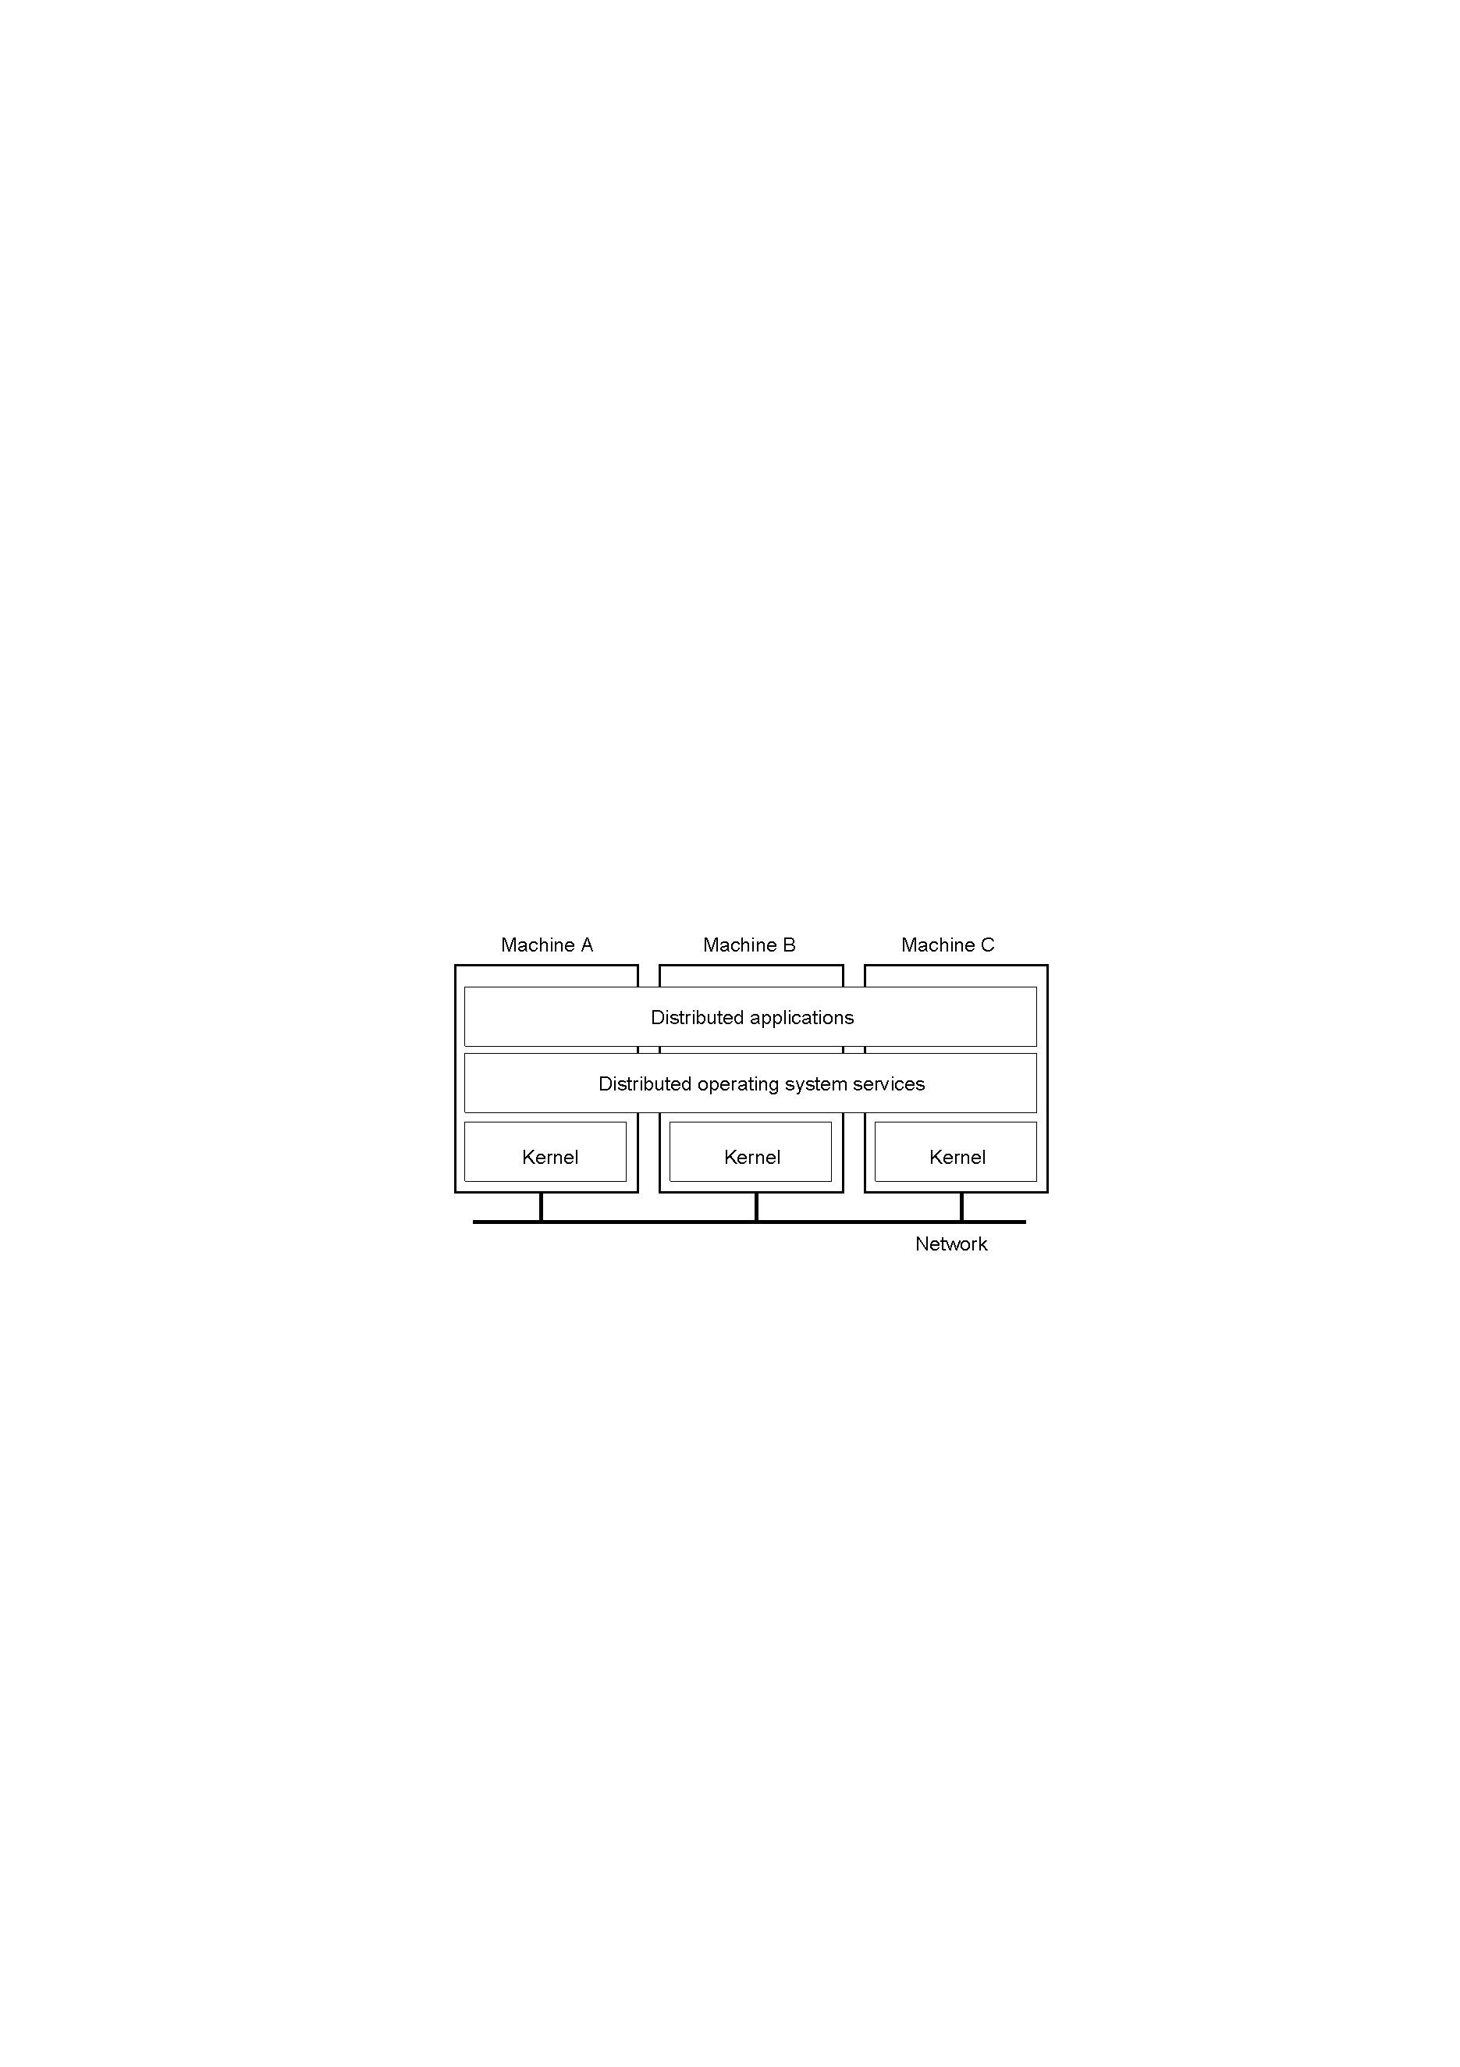

Slide 55
OPERATING SYSTEM STRUCUTRE
Nothing but how the O.S will look like
inside.
3 major operating system structures are:
Monolithic System
Layered System
Virtual Machine

Slide 56
MONOLITHIC SYSTEM
O.S is a collection of programs or procedures.
Each procedure can call another procedure whenever it wants.
These procedure calls are called system calls.
Each system call will have parameters and the outputs of the system calls are results

Slide 57
To construct actual object program of O.S one should compile all the procedures individually and then bind them together into a single object program.
Services provided by O.S are requested by system calls.
Parameters of system calls are stored in either registers or memory.

Slide 58
If they are stored in memory two accesses are required.
One is the registers to retrieve the address of memory and another for memory to retrieve the actual parameters.
If they are stored in registers only one access is required to retrieve the parameters .

Slide 59
System call switches the machine from the user mode to kernel mode and then control is transferred to O.S.
Now O.S will examine the parameters of the system call to determine which system call is to be carried out.
After the system call is finished the control is given back to the user mode.

Slide 60
Disadvantages:
No structure
No Stability
Extensibility

Slide 61
Layered System
Layered Approach :
The operating system is divided into a number of layers (levels), each built on top of lower layers. The bottom layer (layer 0) is the hardware; the highest (layer N) is the user interface.
With modularity, layers are selected such that each uses functions (operations) and services of only lower-level layers.

Slide 62
A layered design was first used in the operating system. Its six layers are as follows:
layer 5: Operator
layer 4: User programs
layer 3: I/O management

Slide 63
layer 2: operator process management
layer 1: Memory management
layer 0: Process Allocation

Slide 64
Layer 0 deals with the C.P.U allocation and switching between processes when interrupts are occurred.
Layer 1 deals with memory management that it makes sure that pages are brought into main memory whenever they are needed.

Slide 65
Layer 2 deals with communication between the operator and process.
Layer 3 deals with managing I/O devices.
Layer 4 user programs are found.
Layer 5 is the operator who types programs gives the input and obtains results.

Slide 66
Advantages:
Modularity
Data Hiding

Slide 67
VIRTUAL MACHINE COMPUTER
Virtual Machines
A virtual machine takes the layered approach to its logical conclusion. It treats hardware and the operating system kernel as though they were all hardware.
A virtual machine provides an interface identical to the underlying bare hardware.

Slide 68
The operating system creates the illusion of multiple processes, each executing on its own processor with its own (virtual) memory.
The resources of the physical computer are shared to create the virtual machines.
CPU scheduling can create the appearance that users have their own processor.

Slide 69
Advantages/Disadvantages of Virtual Machines:
The virtual-machine concept provides complete protection of system resources since each virtual machine is isolated from all other virtual machines.
This isolation, however, permits no direct sharing of resources.

Slide 70
A virtual-machine system is a perfect vehicle for operating-systems research and development.
System development is done on the virtual machine, instead of on a physical machine and so does not disrupt normal system operation.

Slide 71
The virtual machine concept is difficult to implement due to the effort required to provide an exact duplicate of the underlying machine.

Slide 72
System Calls
System calls provide the interface between a running program and the operating system.
Generally available as assembly-language instructions.
Languages defined to replace assembly language for systems programming allow system calls to be made directly (e.g., C, Bliss, PL/360).

Slide 73
Three general methods are used to pass parameters between a running program and the operating system:
Pass parameters in registers.
Store the parameters in a table in memory, and the table address is passed as a parameter in a register.

Slide 74
3. Push (store) the parameters onto the stack by the program, and pop off the stack by the operating system.

Slide 75
System calls can be roughly grouped into five major categories:
Process control: end, execute, wait, fork (create process), allocate and free memory etc.
File manipulation: create/delete file, open/close, read/write, get/set attributes

Slide 76
Device manipulation: request/release, read/write, get/set attributes
Information maintenance: get/set time/date, get process info.
Communications (inter process): create/delete connections, send/receive msgs

Slide 77
Process Management System Calls
A process can be terminated either normally or abnormally. If there is any error in the process then it should be terminated abnormally. This is done by using a system call.

Slide 78
Some of the System calls related to process management are:
Create Process - This system call creates a new process.
Exit - It terminates the process making the system call.
Load - Loads a process into memory

Slide 79
Fork- This system call creates a child process.
Execv- Run a new program in the process making the system call
Wait- Wait for another process to exit.

Slide 80
File Management System Calls
These system calls deals with the file operations. Some of the system calls related to file management are:
Create - Create a new file and open it.
Open - Get ready to read or write a file.
Read - Read bytes from an open file

Slide 81
Write - Write bytes to an open file
Close - Indication that you have completed reading or writing a file.
Delete - It is used to remove the file from the directory.
Stat - Get the information about a file

Slide 82
Device Management System Calls
If there are multiple users in a system, any user before using a resource must request for that resource. If the resource is free then it is allocated to the user otherwise the user process is made to wait.

Slide 83
Some of the systems calls related to device management are:
Request Device –Request for the new resource the process making the system call.
Release Device – Releases the resource from the process making the system call.

Slide 84
Inter process communication system calls
Create Message Queue - Creates a buffer to hold messages.
Send Message - Sends a message to a message queue.

Slide 85
Receive Message -Receive a message from a message queue.
Destroy Message Queue - It destroys a message queue.

Slide 86
Information system calls
Many system calls exist for the purpose of transferring information between user and operating system.
Many systems have system calls to return the current date, current time, number of users working, the version of the operating system, the amount of free memory, and the amount of free disk space.

Slide 87
Some of the Information System Calls are:
Get System Date - It displays the systems date.
Set System Date - This system call can be used to set the systems date.

Slide 88
Get System Time - It displays the systems time.
Set System Time - This system call can be used to set the system time.

Slide 89
Operating systems may be classified by both how many tasks they can perform simultaneously and by how many users can be using the system simultaneously.
i.e. single-user or multi-user and single-task or multi-tasking. A multi-user system must clearly be multi-tasking. The table below shows some examples

Slide 90
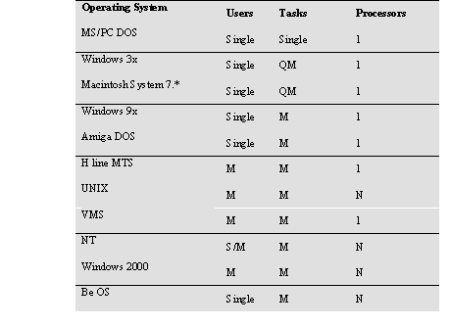

Slide 91
The first of these (MS/PC DOS/Windows 3x) are single user, single-task systems which build on a ROM based library of basic functions called the BIOS.

Slide 92
The Macintosh system 7 can be classified as single-user quasi-multitasking
That means that it is possible to use several user applications simultaneously.

Slide 93
The Macintosh not a true multitasking system in the sense that, if one program crashes, the whole system crashes.
Windows is supported to be preemptive multitasking but most program crashes also crash the entire system.

Slide 94
AmigaDOS is an operating system for the Commodore Amiga computer. It is based on the UNIX model and is a fully multi-tasking, single-user system.
MTS (Michigan timesharing system) was the first time-sharing multi-user system

Slide 95
NT is a `new' operating system from Microsoft based on the old VAX/VMS kernel from the Digital Equipment Corporation (VMS's inventor moved to Microsoft) and the Windows32 API.
Initially it reinvented many existing systems, but it is gradually being forced to adopt many open standards from the Unix world.

Slide 96
The Be operating system, originally developed for a new multimedia computer called the BeBox, is also new and is a fully multitasking OS

Slide 97
Chapter 1 over

