Slide 2
University Timetable Management System
Minor I Project V Sem
Guided by
Dr. Jitendra Rajpurohit(Mentor)
Mrs. Bhavna Kaushik (Activity Coordinator)
By:
Divyanshu Deoli (500078404)
Pratimesh Bajpai (500076055)
Kartik Garg (500077265)

Slide 3
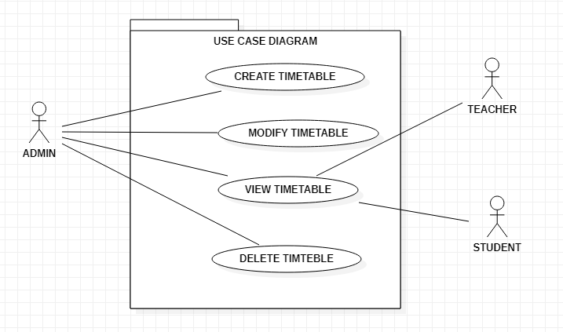
Use Case Diagram

Slide 4
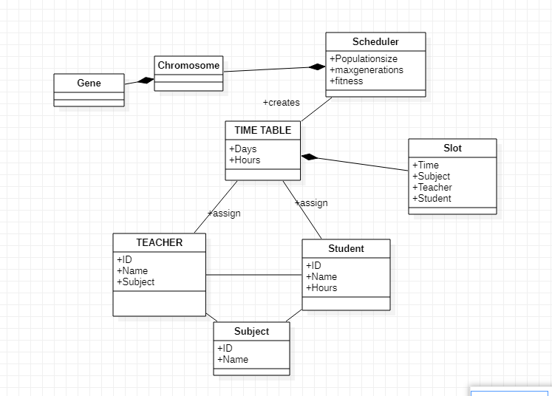
Class Diagram

Slide 5
Genetic Algorithm
A genetic algorithm is a search heuristic that is inspired by Charles Darwin’s theory of natural evolution. This algorithm reflects the process of natural selection where the fittest individuals are selected for reproduction in order to produce offspring of the next generation.
Phases in genetic algorithm are
Initial population
Fitness function
Selection
Crossover
Mutation

Slide 6
Initial Population
The process begins with a set of individuals which is called a Population. Each individual is a solution to the problem.
An individual is characterized by a set of parameters known as Genes. Genes are joined into a string to form a Chromosome (solution).
Fitness Function
The fitness function determines how fit an individual is (the ability of an individual to compete with other individuals). It gives a fitness score to each individual. The probability that an individual will be selected for reproduction is based on its fitness score.

Slide 7
Selection
The idea of selection phase is to select the fittest individuals and let them pass their genes to the next generation.
Two pairs of individuals (parents) are selected based on their fitness scores. Individuals with high fitness have more chance to be selected for reproduction.
Crossover
Crossover is the most significant phase in a genetic algorithm. For each pair of parents to be mated, a crossover point is chosen at random from within the genes.
Offspring are created by exchanging the genes of parents among themselves until the crossover point is reached The new offspring are added to the population

Slide 8
Mutation
In certain new offspring formed, some of their genes can be subjected to a mutation with a low random probability. This implies that some of the bits in the bit string can be flipped.
Mutation occurs to maintain diversity within the population and prevent premature convergence.
Termination
The algorithm terminates if the population has converged (does not produce offspring which are significantly different from the previous generation). Then it is said that the genetic algorithm has provided a set of solutions to our problem.

Slide 9
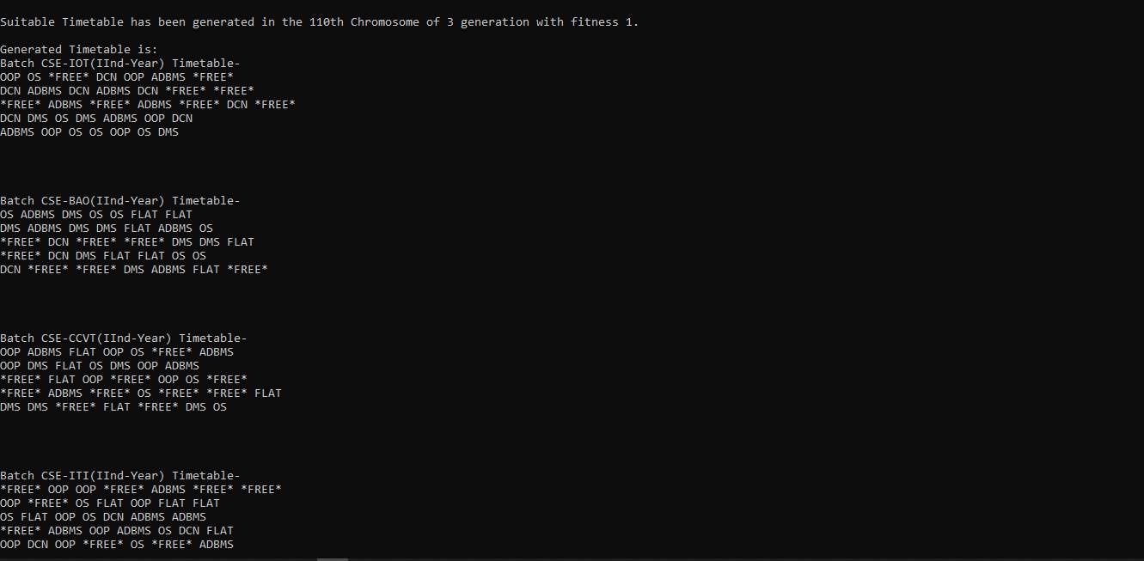
Output

Slide 10
User Interface- Window based application
Coupling
It is loosely coupled as the individual modules can be further used for other programs this shows that how our program modules are independent on each other.
Library used
Java.util
Java.io
Java.util.Random

