Slide 1

ChatSpot: Chatting on the Go Submitted by Aditya Raj(12110346) Divyanshu Kumar (12101600)
School of Computer Science and Engineering
Course Code: CSE 310
Under the Guidance of
Dr. Ranjith Kumar A

Slide 2
Introduction
Chatting Application is a desktop based application.
This application/program is a good example of using java.io, java.net package to create a chat application. A beginner of java language, who is familiar with this packages can able, be beneficiate.
Chatting is a method of using technology to bring people and ideas “together” despite of the geographical barriers. The technology has been available for years but the acceptance it was quit recent. Our project is an example of a multiple client chat server.
It is made up of 2 applications the client application, which runs on the user’s Pc and server application,which runs on any Pc on the network. To start chatting client should get connected to server. We will focus on TCP and UDP socket connections which are a fundamental part of socket programming.

Slide 3
Scope of the Project
The scope of the project chatting application made by Java and socket programming is to create a chat application that allows users to communicate with each other in real-time. The application will be built using Java and socket programming, which will allow for fast and efficient communication between users.
The application will have a user-friendly interface that is easy to navigate and use. Users will be able to create accounts and log in to the application to start chatting with other users. The application will also have features such as group chats, file sharing, and voice calls.
The project will require knowledge of Java programming language and socket programming concepts. It will also require knowledge of GUI development using JavaFX or Swing.
In summary, the project aims to create a chat application that is fast, efficient, and user-friendly. It will allow users to communicate with each other in real-time using features such as group chats, file sharing, and voice calls.

Slide 4
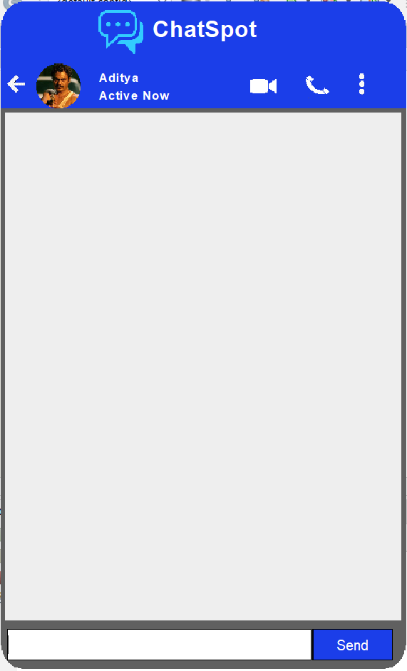
Module 1:
Server
Two Button added in Server module.
Send button: Server can send his/her message by clicking the send button which is at the bottom right corner of the screen
This module is the server side of the of the chatting interface. Name of the file is Server.java.
Back button: Server can exit the screen by clicking on the back button which is at the top left corner of the screen.
Text field area: Server can enter the text or message he/she has to send to the client side..

Slide 5
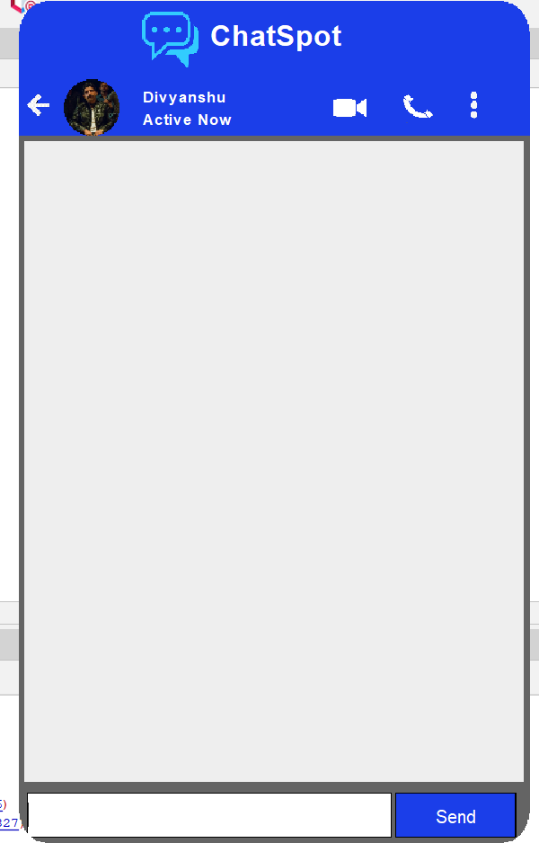
Modules 2:
Client
This module is the client side of the chatting interface. Name of the file Client.java.
Two Button added in Client module.
Send button: Client can send his/her message by clicking the send button which is at the bottom right corner of the screen.
Back button: Client can exit the screen by clicking on the back button which is at the top left corner of the screen.
Text field area: Client can enter the text or message he/she has to send to the server side.

Slide 6
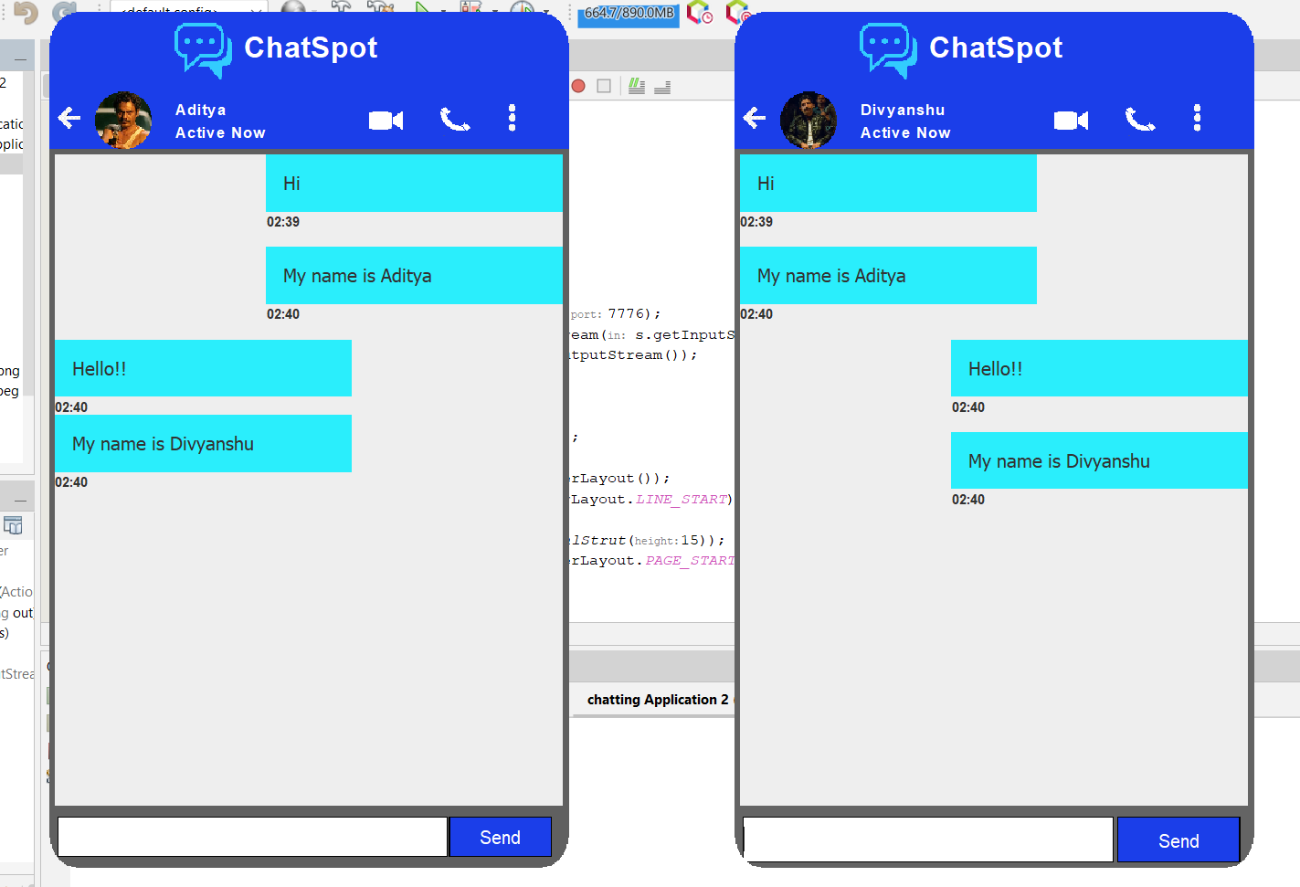
RESULT

Slide 7
Future Scope
Our project will be able to implement in future after making some changes and modification as I have created a low level design. So the modification that can be done in our project are:-
*Run server and client on different machines
* Make each button and image dynamic
*Add camera option
*Add upload file option
*Make video and call icon functionable

Slide 8

Conclusion
We Developed network applications in Java by using socket programming and java swing.
These software is portable, efficient, and easily maintainable for large number of clients. Our developed web-based chatting software is and flexible set of classes for implementing network applications. Typically, programs runninunique in its features and more importantly easily customizable. The java.net package provides a powerful g on client machines make requests to programs on a server Machine. These involve networking services provided by the transport layer. The most widely used transport protocols on the Internet are TCP (Transmission control Protocol) and UDP (User Datagram Protocol).
TCP is a connection-oriented protocol providing a reliable flow of data between two computers. On the other hand, UDP is a simpler message-based connectionless protocol which sends packets of data known as datagrams from one computer to another with no guarantees of arrival.

