Slide 1
JanMitra Health
ET GenAI Hackathon 2026
AI-Powered Patient Communication for India's Primary Healthcare
The Crisis
How It Works
50%
NCDs drive over half of deaths in India—hypertension, diabetes, COPD dominate
1
Capture
9/10
Indians have inadequate health literacy —patients forget medications, diet, follow-ups
Staff snaps prescription photo or records 15-30s voice note in local language
PHCs become "repetition factories" —same uncontrolled cases cycle through with poor self-care
2
Extract & Structure
AI extracts medicines, doses, timings, advice, follow-up dates automatically
3
Generate Care Plan
Plain-language schedule: "Morning—take X mg before food; Evening—walk 30 min"
The Opportunity
1.5L
Ayushman Bharat HWCs scaling to 1.5 lakh sites as chronic care backbone
4
Deliver Instantly
Digital health digitizes records but rarely transforms them into patient-friendly instructions
WhatsApp, SMS, printed slip, or voice call—adapted to patient's access
JanMitra bridges the last-mile gap —converting PHC visits into actionable care plans
Deployment Contexts
Ayushman Arogya Mandirs
NCD Clinics
ASHA Home Visits
Team: Divyanshu Patel (GenAI), Varshith Pilli (Backend), Ashutosh Gunjal (Product)
Contact: itzdivyanshupatel@gmail.com
Slide 1 of 3

Slide 2
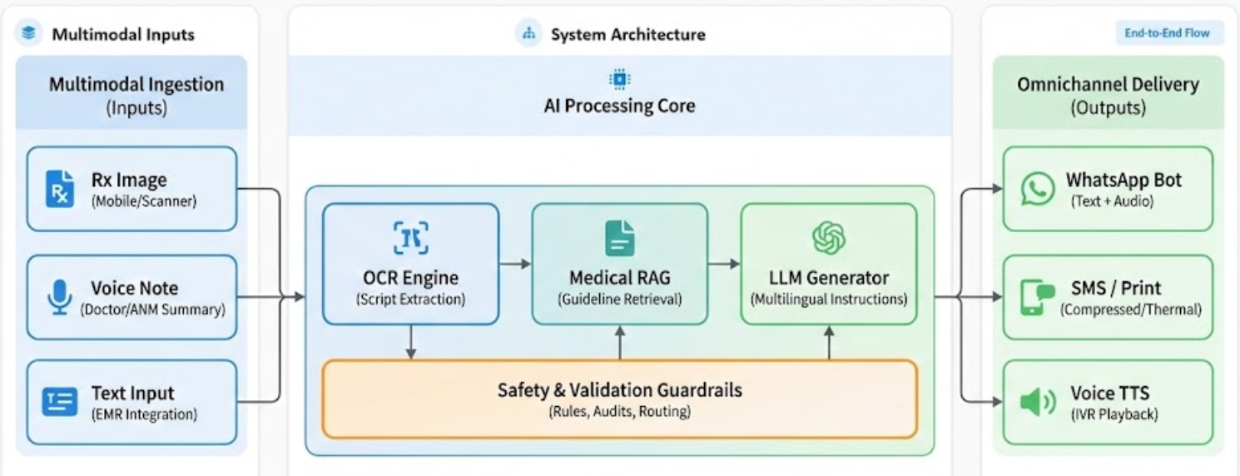
Proposed Method & System Architecture
GenAI-powered multimodal processing with medical RAG and safety guardrails
Multimodal Inputs
System Architecture
End-to-End Flow
Prescription images (handwritten/printed)
Voice notes from doctors/ANMs
Optional text from EMR systems
AI Processing Stack
OCR + Structured Extraction
Robust OCR for Indian scripts + LLM-assisted parsing of drugs, doses, advice
Medical RAG Engine
Retrieval over ICMR/WHO/AIIMS guidelines—grounded explanations, not hallucinations
Multilingual LLM Generator
Parallel outputs in English + local language with culturally appropriate framing
User Layer
Input Layer
AI Layer
Safety Layer
Output Layer
3 stakeholders
3 modalities
OCR+RAG+LLM
Validation
4 channels
Safety Guardrails
Medicines/doses never altered—only rephrased & scheduled
No new drugs, no diagnosis beyond prescription
Low-confidence cases flagged for human review
Slide 2 of 3

Slide 3
Datasets, Experiments, Novelty & Scale
Evidence-based development with rigorous evaluation and national scalability
Data Sources
Novelty
Scalability
Clinical Guidelines
Beyond Generic Chatbots
Language Extensibility
ICMR, MoHFW, AIIMS, WHO protocols for NCDs as RAG corpus
Anchored in actual PHC workflows and prescriptions—not open Q&A. Clear guardrails: structures & translates only, never diagnoses or prescribes.
Swap language packs for pan-India rollout
Guideline Plugins
Prescription Data
State-specific protocols with minimal code change
Synthetic & de-identified PHC/NCD clinic samples for training
India-First Design
API-First Design
Language Resources
Tailored for Ayushman Bharat HWCs as first point of chronic care. Built for low-literacy, multi-lingual, low-resource settings including non-smphone households.
ABDM, AB-HWC, state HIS integration ready
Regional phrase banks (Hindi, Tamil) + doctor→patient parallel corpora
Multi-Channel Output
WhatsApp, SMS, print, voice—universal access
Ecosystem Integration
Ready for ABDM health IDs, AB-HWC apps, state HIS platforms via APIs. Language & guideline "plug-ins" enable rapid state-wise rollout.
Evaluation
National Vision
1
Doctor Validation
Nationwide deployment across 1.5L+ Ayushman Arogya Mandirs
PHC MOs review for correctness, omission, safety
2
Patient Comprehension
Target Impact Metrics
Anonymized analytics on adherence, follow-up patterns, disease burden
Pre-post quiz + teach-back method
30%
2x
3
Adherence Tracking
↓ Repeat visits
↑ Comprehension
PHC-level insights for public health planning & resource allocation
Self-report checklists, IVR, refill patterns
Hallucination Audit
50%
<1%
Transforming PHCs from repetition factories to effective care hubs
!
Quantitative audit driving rate to near-zero
↑ Follow-up
Hallucination
Slide 3 of 3

