Slide 1
Chess Engine
Implementing the concept of Game Theory

Slide 2
Principle Behind the Chess Engines

Slide 3
5
max
max
An adversial seach problem
MiniMax algorithm
Search space b^{d}
0
5
min
7
0
5
9
max
7
5
-1
0
5
0
2
9

Slide 4
How can we reduce search space ?

Slide 5
max
6
Alpha Beta Pruning
New time for search space: O(b^{d/2})
We will see this practically!
5
min
5
a
max
b
c
min

Slide 6
What effort did I put ?

Slide 7
Modification 1: Move Ordering
N
Ordering branches increases pruning depths
Significant difference on high depths
No of branches/moves ⍺ Time
N

Slide 8
Modification 2: Position Memoization
Table[p]
O(1)
The score of the position can be stored in Hash Table
When the same position occur, retrieve the score from Hash Table
This reduces the further node exploring
P
eval(p)
O(n²)
P
P
xyz
Hash Table

Slide 9
How much performance affected ?

Slide 10
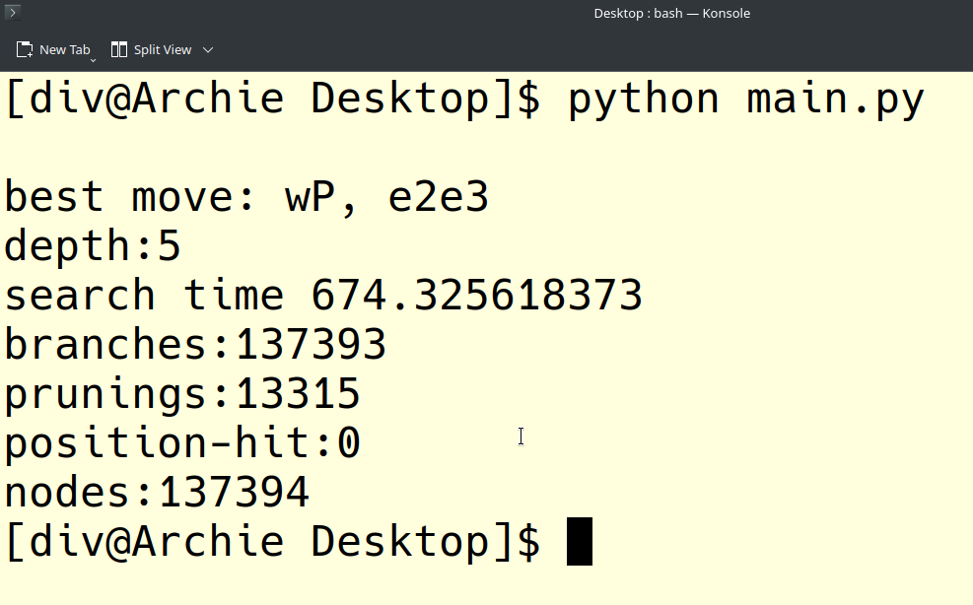
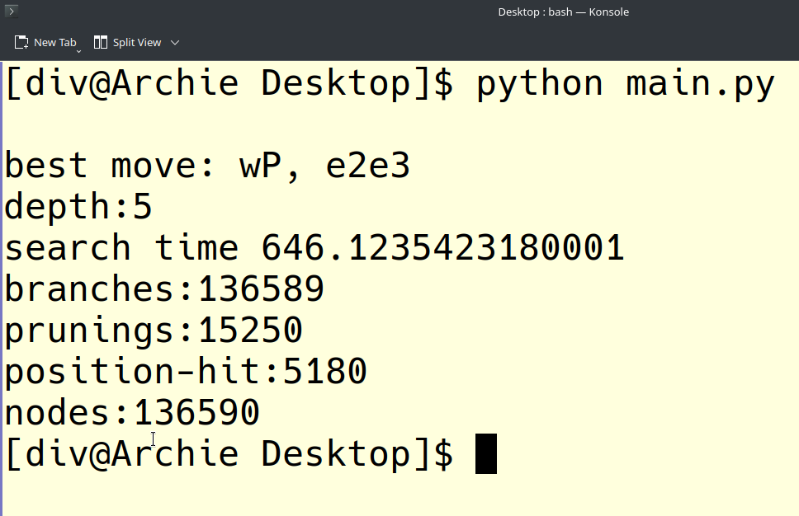
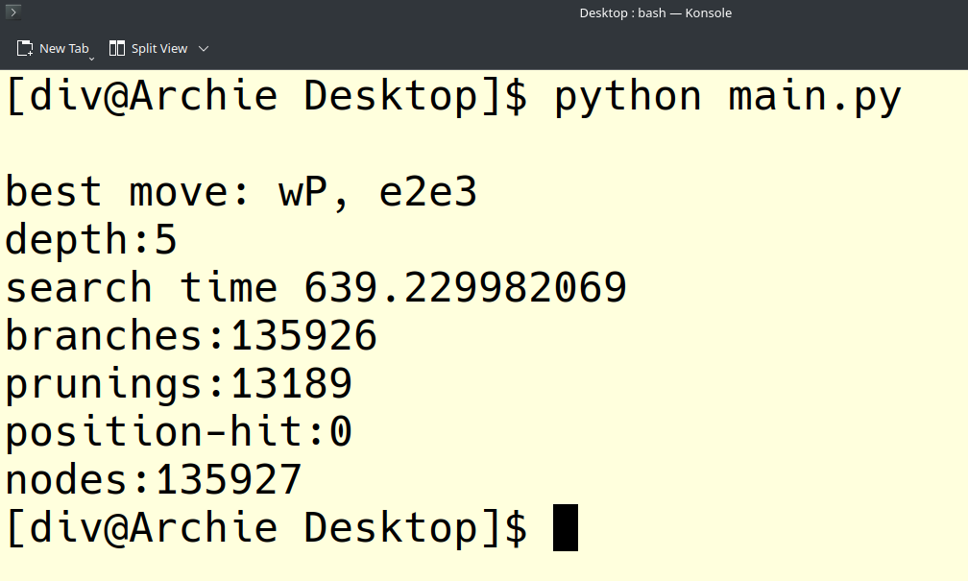
Pruning
Ordering + Pruning
Memorisation + Ordering + Pruning

Slide 11
Enough Thoery! Now Fun Part Begins.

