Slide 1

Ride Performance Analysis
Project

Slide 2
Business Problem Statement
Content:
Rising cancellations
Inconsistent customer ratings
Revenue variation across vehicle types & regions
Business Question:
“How can OLA use ride data to improve revenue, reduce cancellations, and enhance customer satisfaction?”

Slide 3
Dataset Overview
The dataset consists of 100,000 OLA ride booking records, representing end-to-end ride activity over the month of JULY 2024.
Each record captures the complete lifecycle of a ride—from booking creation to completion or cancellation—along with customer, driver, payment, and service quality details.

Slide 4
Tools & Methodology
Raw Data
SQL Analysis
Power BI Dashboard
Insights

Slide 5
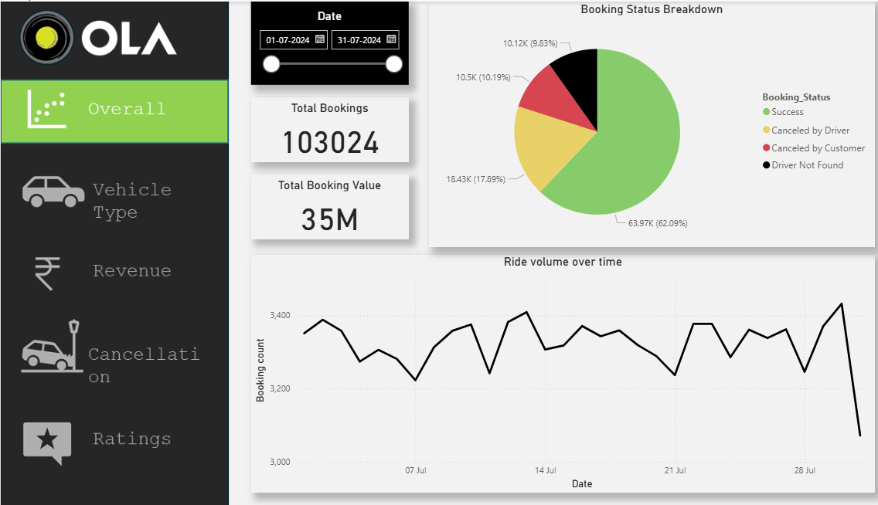
Overall Performance Dashboard

Slide 6
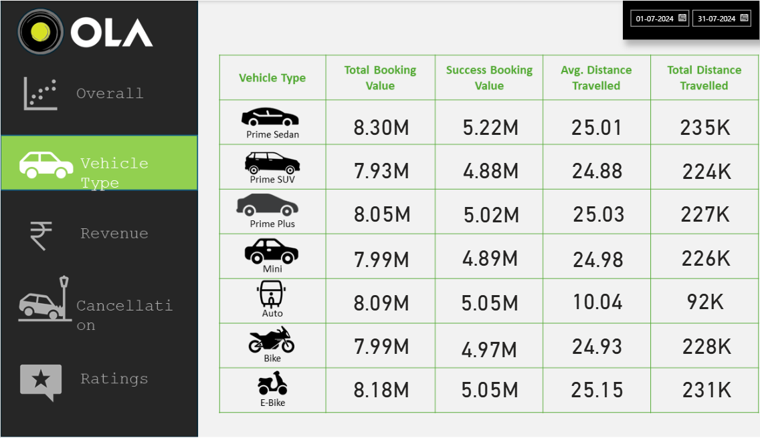
Vehicle Type Impact

Slide 7
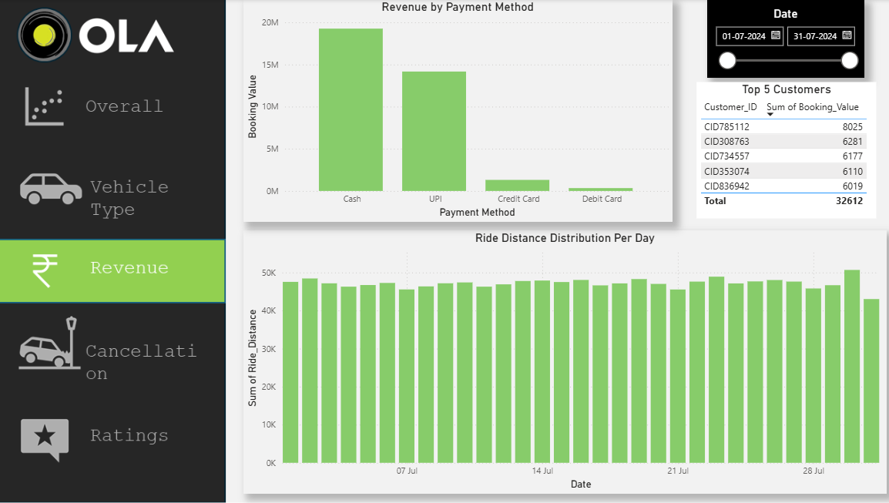
Revenue Analysis

Slide 8
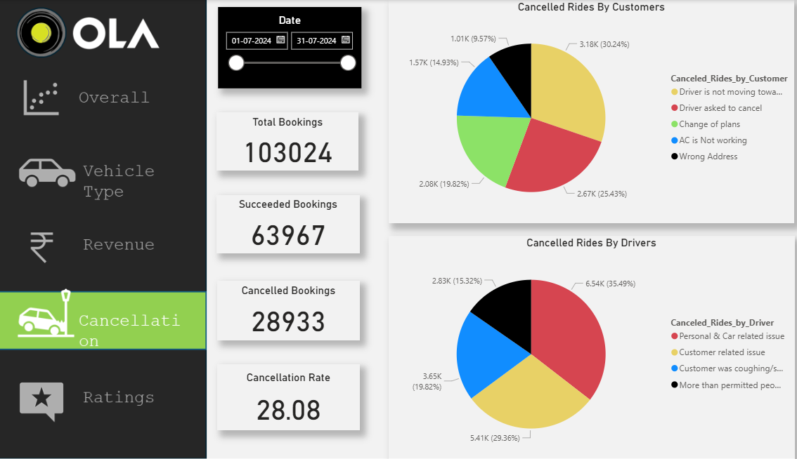
Cancellation Analysis

Slide 9
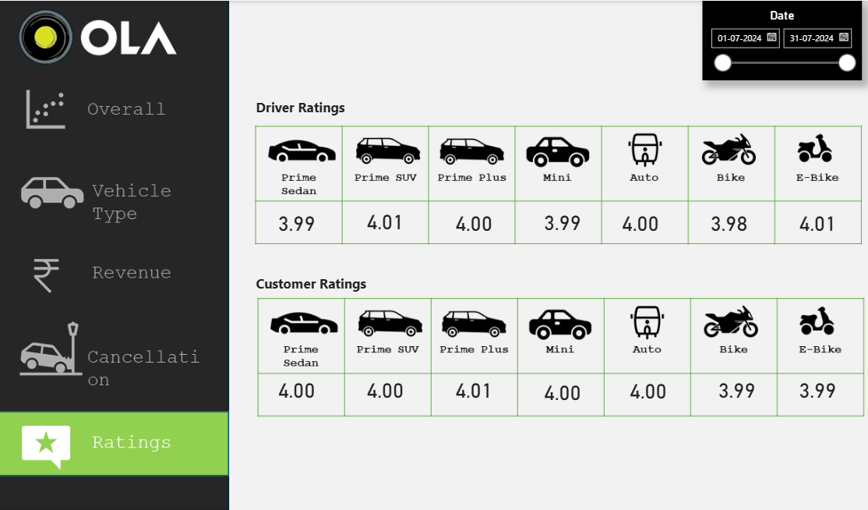
Ratings & Customer Satisfaction

Slide 10
Key Business Insights and Recommendations
Key Business Insights
High cancellations = revenue loss
Ratings impact retention
Vehicle type affects profitability
Payment preferences indicate digital adoption
Recommendations
Improve driver allocation during peak hours
Incentivize high-rated drivers
Reduce customer cancellations via better ETA accuracy
Promote high-revenue vehicle types

