Slide 1

GROUP 8
Reshmi Chowdary Karuturi
Divya Deepak Pai
Mehul Gangwani
Ishani Sharma
Ritu Mamtani
Saloni Dixit

Slide 2
About Hollister
Hollister Co. is a global teen and young adult retail brand owned by Abercrombie & Fitch Co.
Founded on July 27, 2000 in Columbus, Ohio.
Goods are available in-store and through the company's online store.
Hollister’s clothes are designed to be ‘Lived in and made your own, for wherever life takes you’.

Slide 3
Business Objectives
Success Metrics
To sell more in a transaction
Average Order Value
To convert visitors to customers
Conversion Rate
To pull more people to website
Session
To increase customer experience
Customer Retention

Slide 4
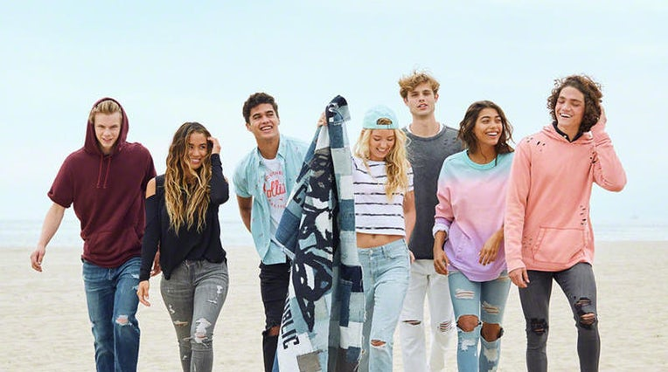
Target customers
For those aged 18 to 34, Hollister's Recommend score
(which asks respondents if they'd recommend the
clothing and apparel store to a friend or colleague)
now sits at an 8 on a scale of 10
Millennials are more likely to recommend
the brand

Slide 5





Our Competitors
Rupert And Buckley
United Colors Of Benetton
Hanesbrands
Aeropostale
Buckle

Slide 6
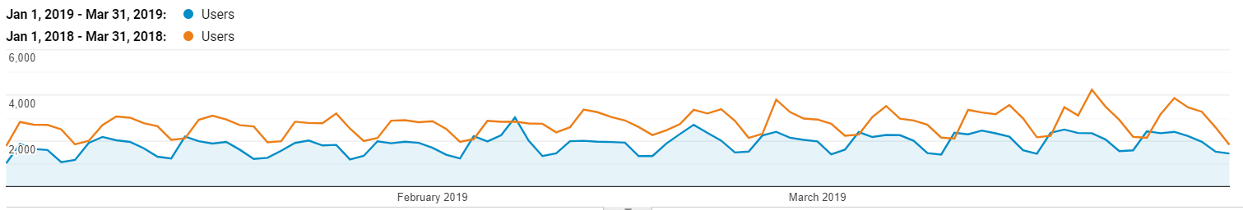
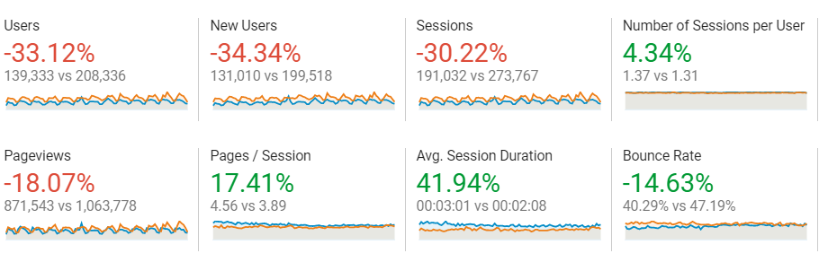
Trend Analysis
There is a decrease of 33.12% in the number of users when comparing the first quarter of 2019 to the previous year’s first quarter
There is also a decline in the number of sessions by 30.22%.

Slide 7
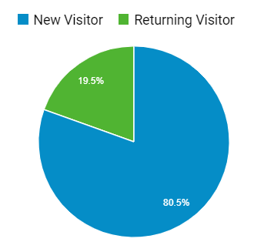
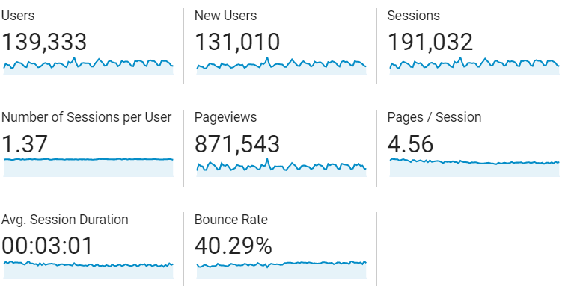
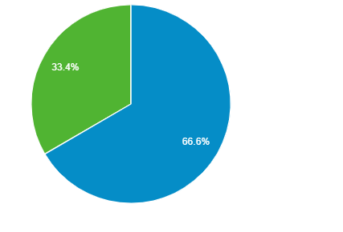

Audience Overview
We see only 19.5% of returning visitors which should be improved to increase customer retention.
Most visitors are male consisting of 66.6%. Hollister needs to focus on attracting more female audience.

Slide 8
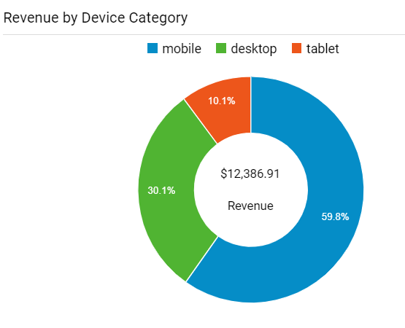
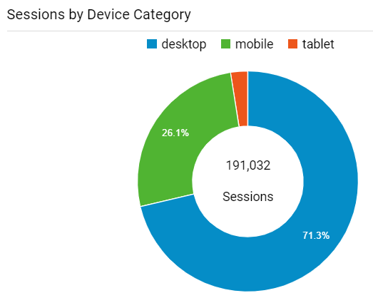
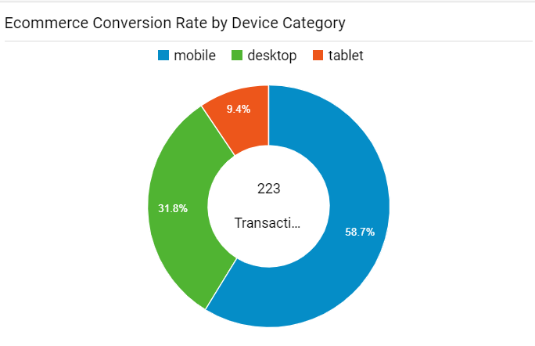
Device Type Overview
Revenue by Device Category:
Most revenue is generated by mobile device type which contributes more than half of the total revenue.
Session by Device Category:
Most sessions are recorded by desktop device type.
Hollister should focus more on increasing sessions
by mobile device type.
Conversion rate by device category:
Mobile device type has the highest conversion rate even with a smaller number of sessions.

Slide 9
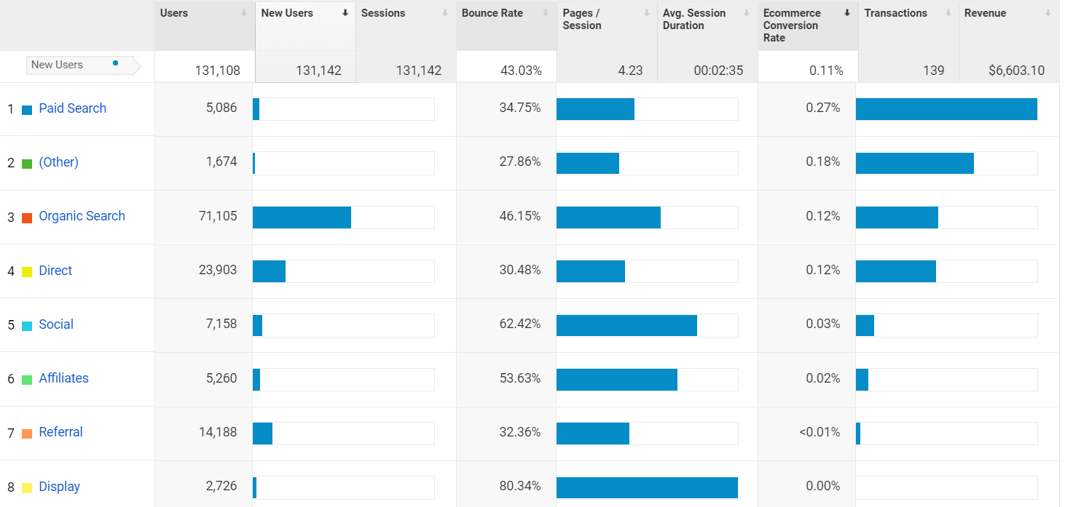
Acquisition Overview for New Users
Organic search has the highest share in the acquisition of new users.
Paid search has the highest conversion rate but has a very low share in the number of new users.

Slide 10
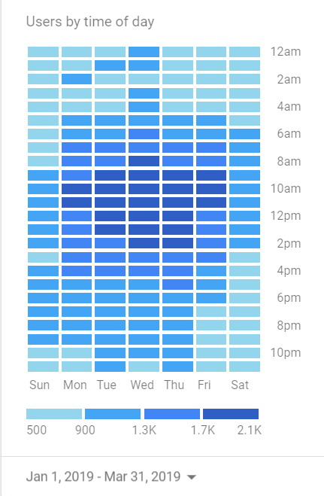
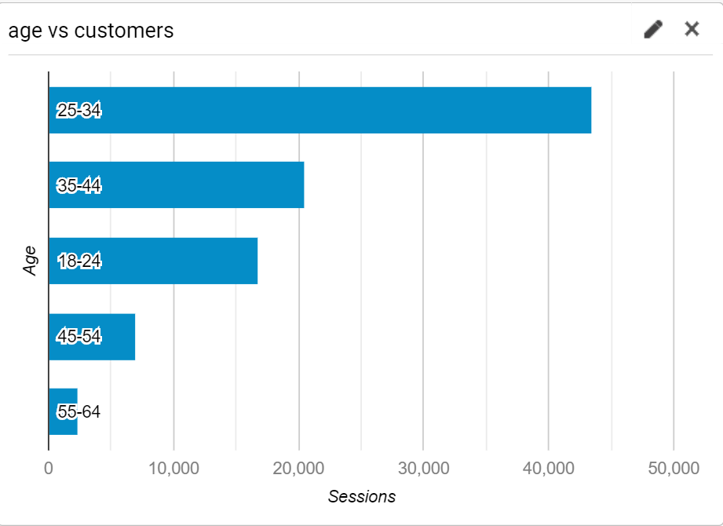
Users Engagement
The age group of 25-34 has the highest engagement with the website.
Most of the users are active from 9am to 12 pm during weekdays.

Slide 11
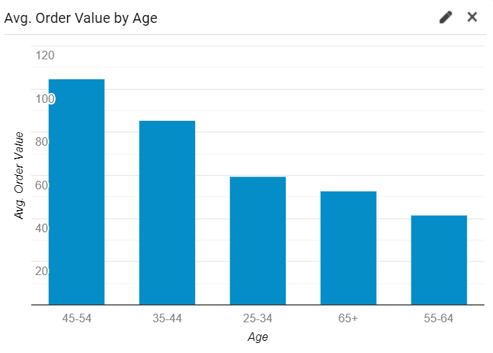
Average Order Value by Age
The highest Average Order Value is generated by the age group 45-54.
Hollister should focus on increasing the AOV of the age group 25-34, which has the highest engagement with the website.

Slide 12
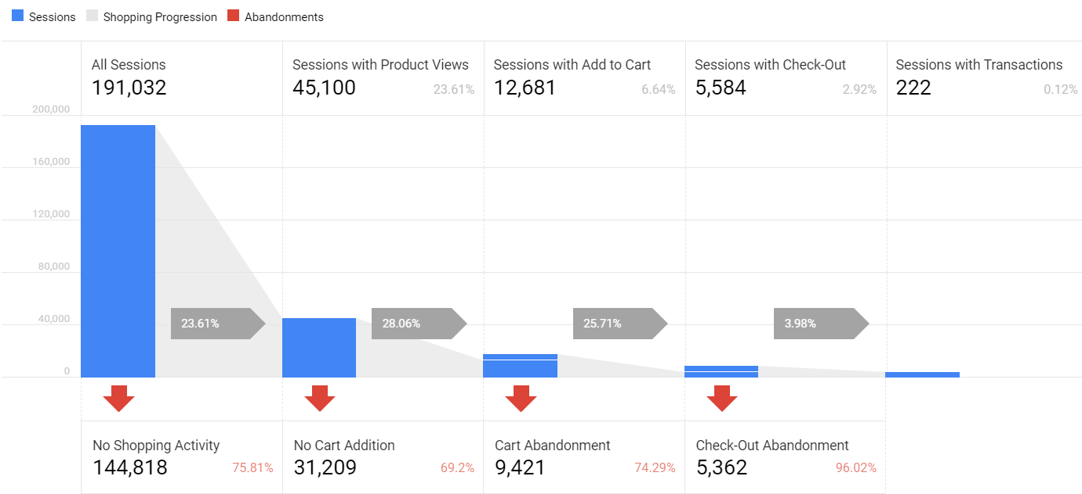
Shopping Overview

Slide 13
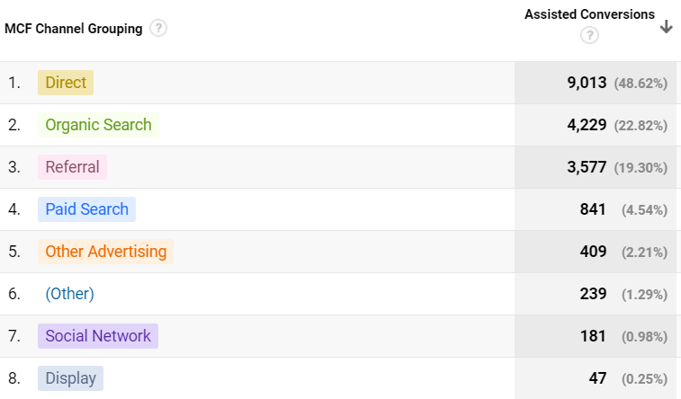
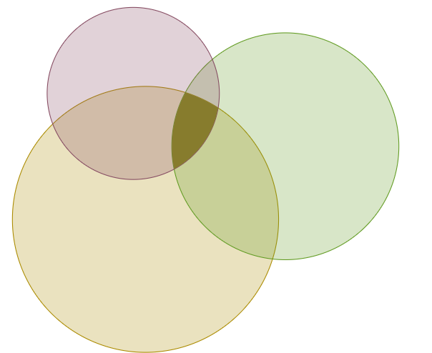
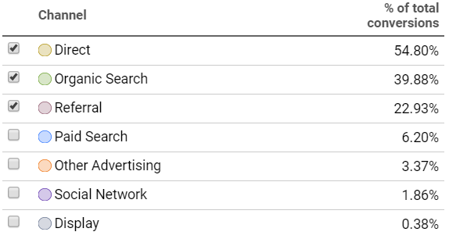
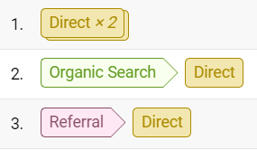
Power of Direct Search

Slide 14
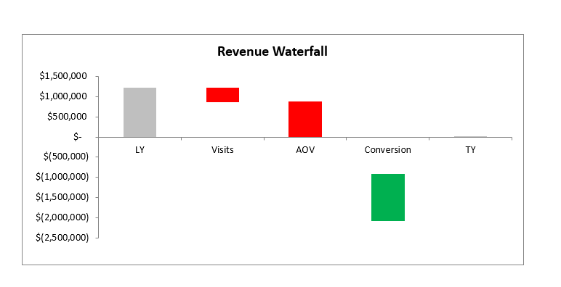
Revenue Waterfall Analysis
 | Last Year | This Year | % vs Last Year | # vs Last Year
Revenue | $ 1,234,193.31 | $ 12,386.91 | -99% | $ (1,221,806)
Visits | 273,767 | 191,032 | -30% | (82,735)
AOV | $ 198.42 | $ 55.55 | -72% | $ (142.87)
Conversion | 2.27% | 0.12% | -95% | -2.15%
Metric Change Impact on Demand
$ (372,650)
$ (887,867)
$ (1,167,898)
Conversion rate followed by the Average order value are the main reasons for the large decrease in revenue.

Slide 15
Recommendations
Hollister should invest more in Paid Search marketing channel so that it attracts more users as it has the highest conversion rate.
Email campaigns and cart reminders should be sent to the target audience on weekday mornings.
Hollister should provide high value bundle deals and recommendations to increase the average order value.
Improve the user interface for mobile device type to draw more traffic through mobile.
Start a loyalty program to improve customer retention.

Slide 16
THANK YOU

