Slide 1
Android Stress Indicator
Lab Information Systems: Data Extraction for the Quantified Self
Prof: Dr. Alexander Markowetz
Students: Panagiotis Salonitis (info@salo.gr)
Komninos Georgios (admin@gkomninos.gr)

Slide 2



What is Stress Indicator for Android?
It is an Android application that can give you information about the “loudness” of your voice when you speak on the phone
The difference in the way you speak on the phone at different times and with different peopel could be an indicator about how much stressed you feel

Slide 3
Why I should use it ?
Because it's cool
You can monitor which people make you more angry when you talk to.
You can also determine if there are specific days that you appear “loud” on the phone

Slide 4
Why I should use it?
Self-tracking is becoming a trend
By tracking your habbits and your behavior makes it easier to find out ways to self improve
You can check the blog: http://quantifiedself.com/
to find more about self-tracking.

Slide 5
Security concerns
Voice calls are a very sensitive kind of information.
We understand that if someone hears your concersations you can be at a very uncomfortable position.
All communication with third party servers happens using the funf framework from MIT Labs.

Slide 6
Security Concerns
The data transmitted are analyzed data from which the original signal cannot be reconstructed
On a local storage ( = your cell phone ) some data are stored for reporting
The data stored on your phone are only accessible from your phone

Slide 7
Wha kind of reports can I have?
There are reports about the “loudness” of your call per day or in total.
Reports are shown with graphs
SCREENSHOTS EDW

Slide 8
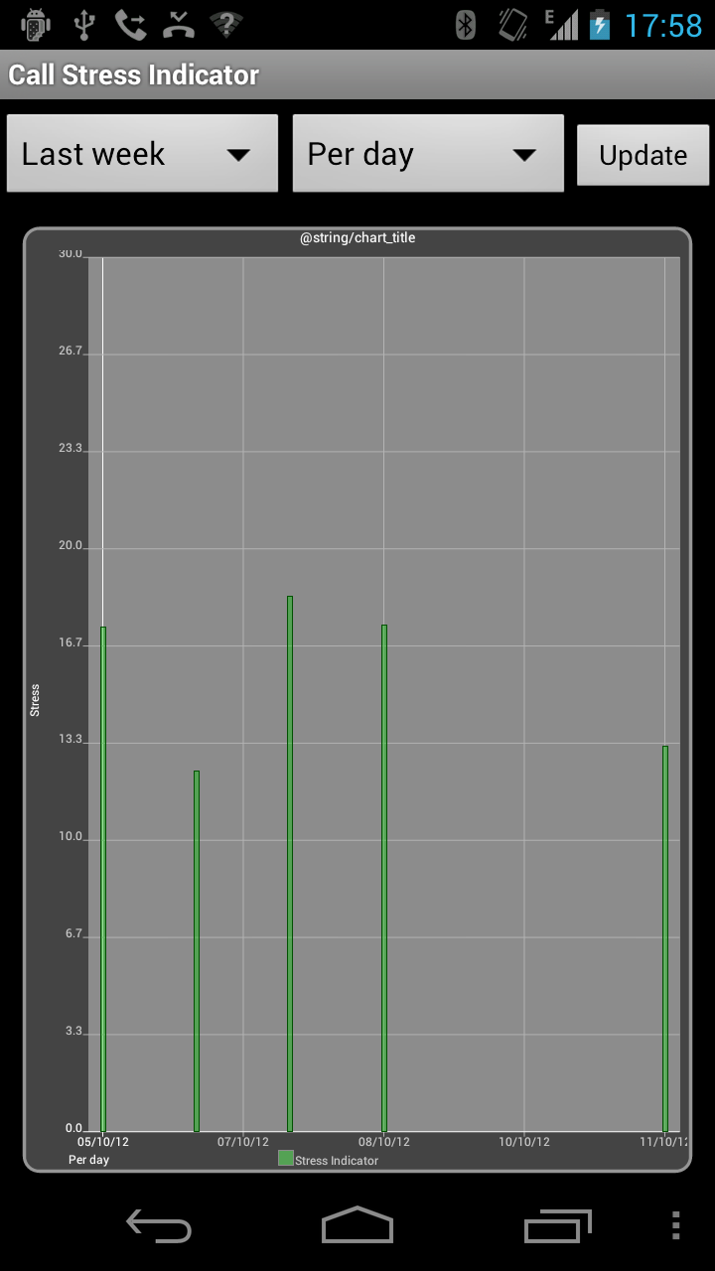
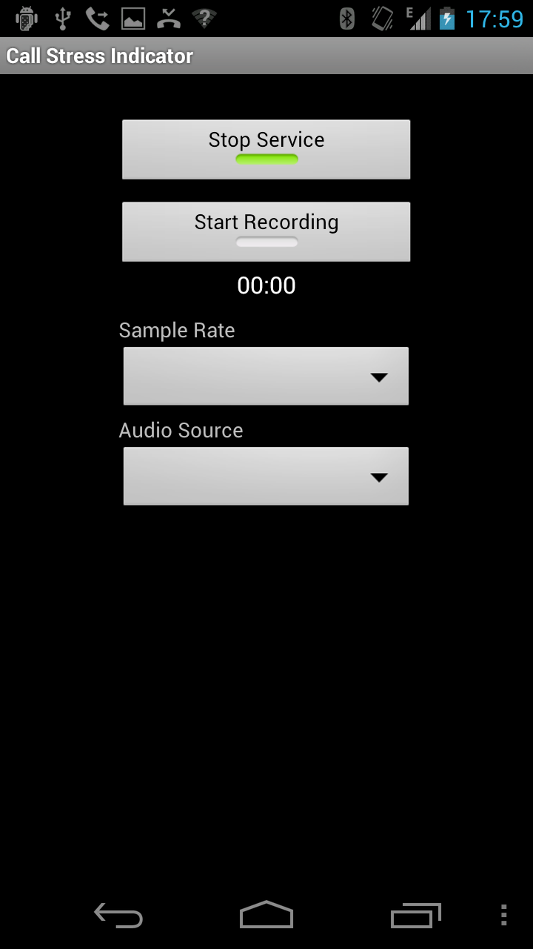
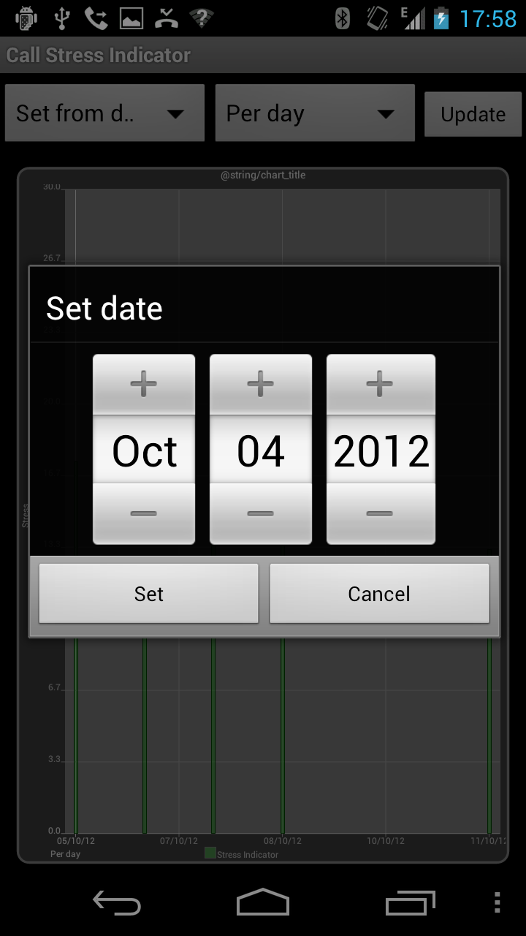
Screenshots

Slide 10
Where is the code?
The project is hosted on google code
https://code.google.com/p/android-call-data-funf/

Slide 11

So, how you enable it?
You just have to install the application.
Everything else ( well...almost ) works automagically

Slide 12
Wait a sec, what do you mean with “loudness”
Loudness is the way we perceive sound
The more loud you speak the more the loudness.
We measure loudness we an invented unit , which we call score.
We are calculating the score by using the RMS = ( Root Mean Square )

Slide 13

RMS
RMS is a measure of amplitude
For discrete signals it is defined as:
The RMS value of any signal cannot be negative. Also The RMS amplitude of a signal may equal the peak amplitude but never exceeds it; and it may be as little as times the peak amplitude, but never less than that.
http://en.wikipedia.org/wiki/Root_mean_square

Slide 14
How we compute the score
We record the call using Anroid'd AudioRecord class
http://developer.android.com/reference/android/media/AudioRecord.html
While speaking on the phone we “read” the data(=your voice) from the hardware(=microphone) in chunks.
Then foreach chunk we compute the RMS value

Slide 15
How we compute the score
Each of these RMS values is compared to the the average RMS value of a silent recording.
Depending how bigger is the computed RMS value from the base value(=silence) we give a score to each RMS value.
When we have the score for each rms value we take the average. This is the score of the call

Slide 16
How we compute the score - example
Assume that we use sample rate of 8000Hz
We use chunk size of 256
Then for each second we have 32 chunks with 256 items each except the last one which has 64 ( 8000 = 256 * 31 + 64 )
For each of these chunks we compute the RMS value
We compare each one of these RMS values with the “silence” RMS and we give it a score.
We get the average of the scores and return the call's score

Slide 17
What happens next ?
We store this score to the db with the phone number the time and the duration of the score
Funf is responsible to send all the RMS data to the servers for future analysis

Slide 18
Improvements
In humans the audible range of frequencies is usually said to be 20 Hz (cycles per second) to 20 kHz (20,000 Hz).
So it will be probably a reasonable improvement if we are able to remove from the signals all the frequencies that are not in the above range.

Slide 19
Improvements
Tones of the same intensity ( power per area ), but of different frequency,are peceived as being of different loudness.
See : http://www.physics.mcgill.ca/~guymoore/ph224/notes/lecture13.pdf
So we will have much more accurate results if we were able to compute the score also taking into account the frequency and not ony the intensity.

Slide 20
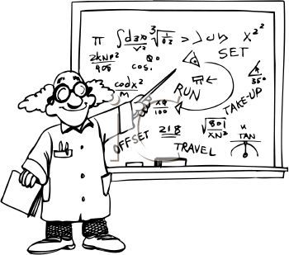
Fourier Transformation
To do all the previous improvements we should do a windowed Fast Fourier Transformation (window size = chunk size).
After applying the FFT we can filter out all the frequencies we do not want and also give a score by using also the frequency.
http://en.wikipedia.org/wiki/Fast_Fourier_transform

Slide 21
More Improvements
Anger: Anger can be divided into two types: "anger" and "hot anger". In comparison to neutral speech, anger is produced with a lower pitch, higher intensity, more energy (500 Hz) across the vocalization, higher first formant (first sound produced) and faster attack times at voice onset (the start of speech). "Hot anger", in contrast, is produced with a higher, more varied pitch, and even greater energy (2000 Hz).
http://en.wikipedia.org/wiki/Emotional_prosody#cite_note-Nonverbal-2
The more audio features we are able to extract , the more accurate predictions we can do.
A good idea would be to be able to port current audio features libraries to Android.

Slide 22
Audio Feature extraction tools
OpenEar
openEAR is the Munich Open-Source Emotion and Affect Recognition Toolkit developed at the Technische Universitat Munchen (TUM). It provides efficient (audio) feature extraction algorithms implemented in C++, classfiers, and pre-trained models on well-k
http://sourceforge.net/projects/openart/
http://openart.sourceforge.net/
CMUSphinx
CMUSphinx is a speaker-independent large vocabulary continuous speech recognizer released under BSD style license. It is also a collection of open source tools and resources that allows researchers and developers to build speech recognition systems.
http://sourceforge.net/projects/cmusphinx/
http://cmusphinx.sourceforge.net/

Slide 23
Want to learn more?
Does emotion detection really work?http://www.callcentrehelper.com/does-emotion-detection-really-work-9047.htm
Emotion Detection from Speech
http://cs229.stanford.edu/proj2007/ShahHewlett%20-%20Emotion%20Detection%20from%20Speech.pdf
Perceptual cues in nonverbal vocal expressionsof emotion
http://www.tandfonline.com/toc/pqje20/current
Automatic Recognition of Anger in Spontaneous Speech
http://www.speech.kth.se/prod/publications/files/3189.pdf
Cross cultural communication
http://www.academia.edu/1748462/Cross-Cultural_Communication

