Slide 1
Sorting Algorithms

Slide 2
Problem – Given an array of integers, sort the array
Const arr = [ -6, 20, 8, -2, 4]
Sort(arr) => should return [-6, -2, 4, 8, 20]

Slide 3
Sorting Algorithm
A Sorting Algorithm is used to rearrange a given array or list of elements according to a comparison operator on the elements. The comparison operator is used to decide the new order of elements in the respective data structure.
Bubble Sort
Insertion Sort
Quick Sort
Merge Sort

Slide 4
Bubble Sort
In Bubble sort we compare adjacent elements in the array and swap the positions if they are not in the intended order.
Repeat the instructions as you step through each element in the array
Once you step through the whole array with no swaps, the array is sorted.

Slide 5
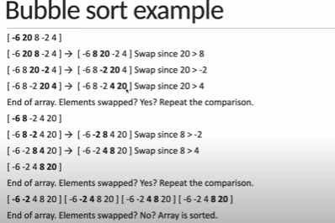

Slide 6
Insertion sort
In insertion we virtually split the array into a sorted and an un sorted part.
Assume that the first element is already sorted and remaining elements are unsorted
Select an unsorted element and compare with all elements in the sorted part.
If the element in the sorted part is smaller that the selected element , proceed to the next element in the unsorted part. Else , shift larger elements in the sorted part towards the right.
Insert the selected element at the right index.
Repeat till all the un sorted elements are placed in the right order

Slide 7
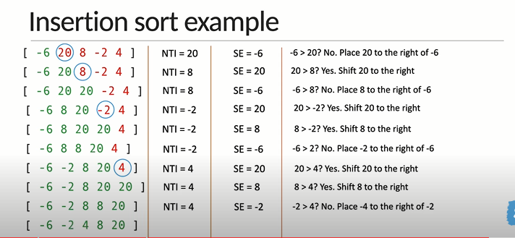

Slide 8
Quick Sort
Identify the pivot element in the array
Pick first element as a pivot
Pick last element as a pivot(Our approach)
Pick a random element as pivot
Pick a median as a pivot
Put everything that’s smaller than the pivot into a ‘left’ array and everything that’s greater that the pivot into a ‘right’ array
Repeat the process for the individual ‘left’ and ‘right’ arrays of the length 1 which is sorted by definition
Repeatedly concatenate the left array, pivot and right array till one sorted array remains.

Slide 9
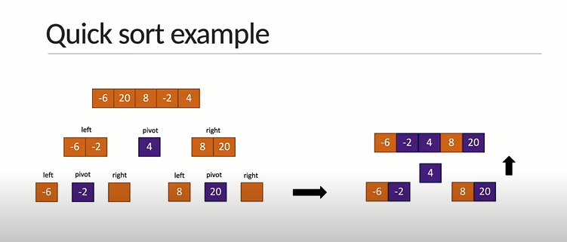

Slide 10
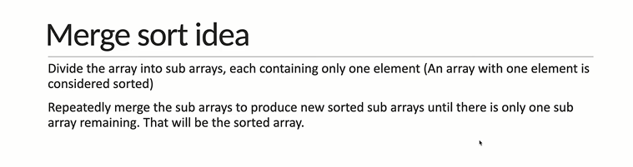
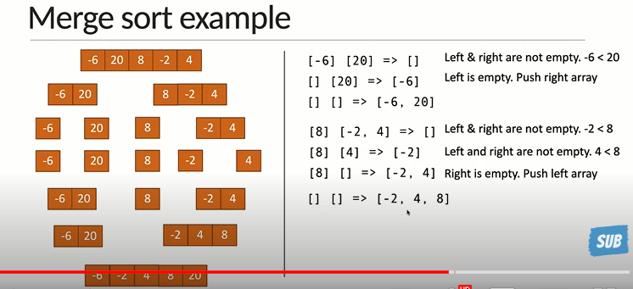
Merge Sort

Slide 11
