Slide 1
PROJECT 09 · MULTIMODAL
Multimodal Document Intake Pipeline
Reads scanned invoices, receipts and purchase orders, falls back to a vision model only when OCR is unreliable, validates against business rules and routes by field confidence.
Topics: Multimodal, OCR, Structured extraction, Business rules, Human review
Notes:
Reads scanned invoices, receipts and purchase orders, falls back to a vision model only when OCR is unreliable, validates against business rules and routes by field confidence.

Slide 2
The problem
Finance and ops teams still key in invoices by hand. Sending every page to a vision LLM is accurate but expensive and still makes silent mistakes on handwritten totals. The goal is high straight-through processing with z…
• Document intake is one of the highest-ROI enterprise AI use cases.
• Extraction errors in money fields are costly and hard to spot later.
• Vision models cost ~8x OCR here; use them only where they add accuracy.
• Auditors need to see why each document was approved or held.
Notes:
Finance and ops teams still key in invoices by hand. Sending every page to a vision LLM is accurate but expensive and still makes silent mistakes on handwritten totals. The goal is high straight-through processing with zero wrong values auto-approved.

Slide 3
Goals & success criteria
Goal | Success criterion
OCR quality gate | Mean token confidence < 0.75 triggers vision fallback
Typed extraction per document type | Invoice (10 fields), receipt (4), PO (4) with normalisation
Repair OCR confusions | O->0, l->1, S->5, B->8 in numeric fields, logged
Business rules | Totals add up, VAT 23%, dates, VAT-id format, PO in ERP, duplicates
Zero-escape routing | Auto-approve only if all fields >= 0.85 and rules pass
Notes:
Non-goals: Real OCR/vision inference: token streams with confidence are simulated; Tesseract/Textract/GPT-4o plug in at the same interface. Line-item table extraction.

Slide 4
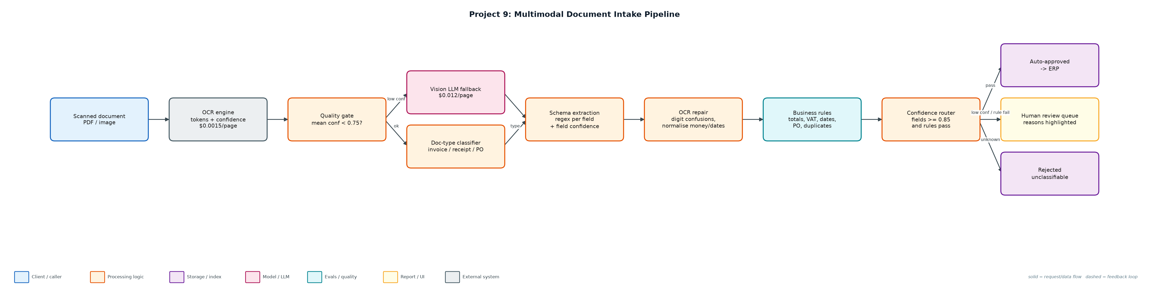
Architecture
Notes:
Components: Document generator (generate_docs.py): 80 seeded documents across 5 scenarios: clean, OCR noise, handwritten total, bad scan, business error.; Intake pipeline (intake.py): Quality gate, vision fallback, classifier, schemas, normalisation, business rules, routing.; Runner + evaluation (run_intake.py): Processes all docs, scores against ground truth, writes approved/review/rejected JSONL.; Outputs (outputs/*.jsonl): Approved extractions, review queue with reasons, rejections.

Slide 5
Components
Component | File | Responsibility
Document generator | generate_docs.py | 80 seeded documents across 5 scenarios: clean, OCR noise, handwritten total, bad scan, business error.
Intake pipeline | intake.py | Quality gate, vision fallback, classifier, schemas, normalisation, business rules, routing.
Runner + evaluation | run_intake.py | Processes all docs, scores against ground truth, writes approved/review/rejected JSONL.
Outputs | outputs/*.jsonl | Approved extractions, review queue with reasons, rejections.

Slide 6
How a request flows
• 1. OCR returns tokens with confidence for every line of the page.
• 2. If mean confidence is below 0.75, the page is re-read by the vision model (8x cost).
• 3. The document type is classified by keyword evidence; unknown documents are rejected.
• 4. Fields are extracted with a schema per type; each field's confidence is the minimum of its tokens.
• 5. Numeric fields are repaired for OCR digit confusions and normalised (money, ISO dates, ids).
• 6. Business rules check arithmetic, VAT rate, date order, VAT-id format, PO existence and duplicate invoice numbers.
• 7. Documents with any low-confidence field or rule failure go to human review with the reasons; the rest are auto-approved.

Slide 7
Key design decisions & trade-offs
Decision | Why | Trade-off
Vision only as fallback | Bad scans are ~10% of volume; cost/doc stays at $0.003. | A second model to monitor.
Min-token confidence per field | One bad digit should hold the whole amount. | More conservative routing.
Rules are the safety net | Handwritten totals passed OCR but failed arithmetic. | Rules must be written per document type.
Log every repair | Reviewers and auditors see what was changed. | Noisier logs.
Optimise for zero escapes, then STP | Wrong auto-approved money is the costly error. | Lower straight-through rate.

Slide 8
Evaluation & metrics
• 80 documents: 100% type accuracy, 98.9% field accuracy over 614 fields.
• 78% straight-through processing, 0 auto-approved documents with any wrong field.
• All 3 business-rule issues (duplicate invoice, totals mismatch) caught; all 7 handwritten totals held for review.
• Vision fallback used on the 10 bad scans only: $0.0030/doc vs $0.0135/doc if every page used vision.
• 6 unit tests for repair, classification, clean path, fallback, handwritten totals and duplicates.

Slide 9
Demo run
$ python3 run_intake.py
Documents: 80 · type accuracy 100% · field accuracy 98.9% (614 fields)
Routing: {'human_review': 18, 'auto_approve': 62} · straight-through rate 78%
Auto-approved with an error (escapes): 0 []
Business-rule issues caught: 3/3
Vision fallback: 10 docs · total cost $0.2400 ($0.00300/doc vs $0.0135/doc if every page used vision)
OCR corrections applied: 8
Route by scenario:
bad_scan {'auto_approve': 10}
business_error {'human_review': 3}
clean {'auto_approve': 50}
handwritten_total {'human_review': 7}
ocr_noise {'human_review': 8, 'auto_approve': 2}
Sample review items:
doc-000 (ocr_noise): low confidence: total
doc-001 (handwritten_total): low confidence: total
doc-002 (business_error): subtotal + VAT (1273.05) != total (1283.05)
doc-012 (handwritten_total): subtotal + VAT (4102.05) != total (4102.06)
doc-027 (ocr_noise): low confidence: total
Field accuracy:
Notes:
Documents: 80 · type accuracy 100% · field accuracy 98.9% (614 fields)
Routing: {'human_review': 18, 'auto_approve': 62} · straight-through rate 78%
Auto-approved with an error (escapes): 0 []
Business-rule issues caught: 3/3
Vision fallback: 10 docs · total cost $0.2400 ($0.00300/doc vs $0.0135/doc if every page used vision)
OCR corrections applied: 8
Route by scenario:
bad_scan {'auto_approve': 10}
business_error {'human_review': 3}
clean {'auto_approve': 50}
handwritten_total {'human_review': 7}
ocr_noise {'human_review': 8, 'auto_approve': 2}
Sample review items:
doc-000 (ocr_noise): low confidence: total
doc-001 (handwritten_total): low confidence: total
doc-002 (business_error): subtotal + VAT (1273.05) != total (1283.05)
doc-012 (handwritten_total): subtotal + VAT (4102.05) != total (4102.06)
doc-027 (ocr_noise): low confidence: total
Field accuracy:
total 73/80
supplier 63/63
invoice_number 49/49
invoice_date 49/49
due_date 49/49
vat_id 49/49
po_number 63/63
buyer 49/49
subtotal 49/49
vat 49/49
order_date 14/14
merchant 17/17
date 17/17
card_last4 17/17

Slide 10
Interview talking points
• Confidence routing is the product: 78% straight-through with zero wrong values auto-approved.
• OCR first, vision as fallback: 4.5x cheaper than sending every page to a multimodal model.
• Business rules caught what confidence could not: a handwritten total off by one cent.
• Every OCR repair is logged so a reviewer can see '2O5' became '205'.
• The same interface accepts Textract, Azure Document Intelligence or GPT-4o vision.

Slide 11
Production roadmap
• Plug in Tesseract/Textract for OCR and GPT-4o/Claude vision with structured output for fallback.
• Streamlit review UI showing the page image with low-confidence fields highlighted.
• Feed reviewer corrections back as few-shot examples and to tune thresholds per field.
• ERP integration for PO matching and payment scheduling.
Resume bullet: Built a document intake pipeline with OCR quality gating, vision-LLM fallback, OCR repair and business-rule validation, reaching 78% straight-through processing with zero erroneous auto-approvals at $0.003/document.

