Slide 1
PROJECT 11 · OBSERVABILITY
AI Trace Explorer & Root-Cause Analyzer
Traces every step of an AI workflow, classifies what went wrong, points at the span that caused it, and turns failures into eval cases.
Topics: Observability, Tracing, Debugging, Regression detection, Evals
Notes:
Traces every step of an AI workflow, classifies what went wrong, points at the span that caused it, and turns failures into eval cases.

Slide 2
The problem
When an AI feature gives a bad answer, logs show only the final output. Was it retrieval, the reranker, a 429 storm, a tool outage or the new prompt version? Without step-level traces, every incident becomes guesswork an…
• AI failures are multi-step; the root cause is rarely the LLM call.
• Prompt-version regressions only show up in aggregate.
• On-call engineers need an owner and a fix, not a stack trace.
• Failures are the best source of new eval cases.
Notes:
When an AI feature gives a bad answer, logs show only the final output. Was it retrieval, the reranker, a 429 storm, a tool outage or the new prompt version? Without step-level traces, every incident becomes guesswork and the same failure ships again.

Slide 3
Goals & success criteria
Goal | Success criterion
Step-level tracing | OpenTelemetry-shaped spans with parent ids and attributes in SQLite
Failure taxonomy | 9 categories with owner and suggested fix
Root cause per trace | Highest-severity, earliest finding; 100% vs injected faults
Regression detection | Error rate and categories by prompt version
Close the loop | Failing traces exported as draft eval cases
Notes:
Non-goals: Replacing Langfuse/Phoenix/Datadog: the span schema is OTel-shaped so it can export there. Real provider calls: a simulated clock and seeded faults make 300 traces run instantly.

Slide 4
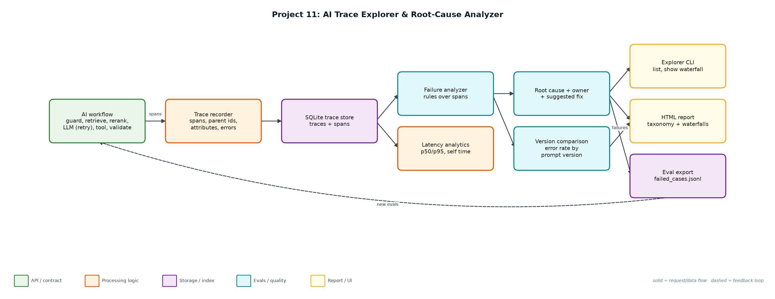
Architecture
Notes:
Components: Span model + store (trace_store.py): SimClock, TraceRecorder with nested spans, SQLite persistence and queries.; Workflow + faults (workflow.py): Six-step support workflow with retries and 8 seeded fault types; prompt v8 adds a JSON regression.; Analyzer (analyzer.py): Rules over spans, severity ordering, owner/hint taxonomy, self-time.; Explorer CLI (explorer.py): simulate, summary, list, show (ASCII waterfall), report (HTML), export.; Outputs (reports/, evals/): trace_report.html and failed_cases.jsonl.

Slide 5
Components
Component | File | Responsibility
Span model + store | trace_store.py | SimClock, TraceRecorder with nested spans, SQLite persistence and queries.
Workflow + faults | workflow.py | Six-step support workflow with retries and 8 seeded fault types; prompt v8 adds a JSON regression.
Analyzer | analyzer.py | Rules over spans, severity ordering, owner/hint taxonomy, self-time.
Explorer CLI | explorer.py | simulate, summary, list, show (ASCII waterfall), report (HTML), export.
Outputs | reports/, evals/ | trace_report.html and failed_cases.jsonl.

Slide 6
How a request flows
• 1. Each request opens a root span; each step opens a child span with attributes (hits, tokens, grounding, HTTP status).
• 2. Errors propagate up the span tree; 429 retries are separate error spans followed by a successful attempt.
• 3. Traces and spans are stored in SQLite.
• 4. The analyzer applies rules per span: timeouts, context overflow, tool errors, invalid JSON, empty retrieval, low grounding, latency SLOs, 429s.
• 5. Findings are ordered by severity and time; the first one is the root cause, with an owner and a suggested fix.
• 6. Aggregates show the taxonomy, p50/p95 per span, where time goes and error rate by prompt version.
• 7. Failing traces are exported as draft eval cases for the dataset builder (Project 5).

Slide 7
Key design decisions & trade-offs
Decision | Why | Trade-off
OTel-shaped spans | Portable to Langfuse, Phoenix, Jaeger. | More fields than a flat log.
Rules before an LLM judge | Deterministic, cheap, explainable root causes. | New failure types need new rules.
Severity, then time | A timeout outranks a slow rerank in the same trace. | Secondary causes are listed, not ranked.
Simulated clock | Thousands of traces in seconds, reproducible. | No real network jitter.
Owner per category | Routes incidents to the right team. | Ownership map must be maintained.

Slide 8
Evaluation & metrics
• 300 traces, 18% hard failures; root-cause accuracy vs injected faults 111/111 with 0 false alarms on healthy traces.
• Detected the prompt regression: support-v8 had 29 schema_invalid vs 9 for v7 (error rate 12.7% -> 23.3%).
• Latency: request p95 3.6 s; the LLM call is 93% of self time, so reranker tuning would not help.
• 90 failing traces exported as draft eval cases.
• 3 unit tests: span nesting/persistence, classifier vs injected faults, error propagation.

Slide 9
Demo run
$ python3 explorer.py demo
Simulated 300 traces; injected faults: {'none': 176, 'schema_invalid': 38, 'retrieval_empty': 19, 'ungrounded': 17, 'rate_limited': 14, 'tool_error':
Traces: 300 · hard failures: 54 (18%) · traces with any finding: 111
Root-cause taxonomy (owner -> suggested fix):
38 schema_invalid [prompt] Output was not valid JSON: use structured output / JSON mode; compare prompt versions.
19 retrieval_empty [rag] No documents retrieved: check query rewriting and index freshness before blaming the model.
17 ungrounded [quality] Answer has low grounding and no citations: enforce citations via the output guardrail.
11 rate_limited_recovered [platform] Recovered after 429 retries; latency cost of backoff is visible in the waterfall.
10 latency_slo [performance] Span exceeded its latency SLO: profile this dependency or cache its results.
10 llm_timeout [provider] Set a per-call timeout budget and fail over to a second model (gateway routing).
4 tool_error [integrations] Downstream API failed: add a circuit breaker and a graceful 'cannot check order' answer.
2 context_overflow [rag] Retrieved context exceeds the model window: lower k, trim chunks or summarise before generation.
Root-cause accuracy vs injected faults: 111/111 (100%) · false alarms on healthy traces: 0
Latency by span (p50 / p95 ms):
request 1908 3623
retrieve 67 88
rerank 44 60
llm.generate 1670 2415
tool.lookup_order 99 132
Where time goes (self time): llm.generate 93%, rerank 3%, retrieve 2%
Notes:
Simulated 300 traces; injected faults: {'none': 176, 'schema_invalid': 38, 'retrieval_empty': 19, 'ungrounded': 17, 'rate_limited': 14, 'tool_error': 11, 'slow_rerank': 10, 'llm_timeout': 10, 'context_overflow': 5}
Traces: 300 · hard failures: 54 (18%) · traces with any finding: 111
Root-cause taxonomy (owner -> suggested fix):
38 schema_invalid [prompt] Output was not valid JSON: use structured output / JSON mode; compare prompt versions.
19 retrieval_empty [rag] No documents retrieved: check query rewriting and index freshness before blaming the model.
17 ungrounded [quality] Answer has low grounding and no citations: enforce citations via the output guardrail.
11 rate_limited_recovered [platform] Recovered after 429 retries; latency cost of backoff is visible in the waterfall.
10 latency_slo [performance] Span exceeded its latency SLO: profile this dependency or cache its results.
10 llm_timeout [provider] Set a per-call timeout budget and fail over to a second model (gateway routing).
4 tool_error [integrations] Downstream API failed: add a circuit breaker and a graceful 'cannot check order' answer.
2 context_overflow [rag] Retrieved context exceeds the model window: lower k, trim chunks or summarise before generation.
Root-cause accuracy vs injected faults: 111/111 (100%) · false alarms on healthy traces: 0
Latency by span (p50 / p95 ms):
request 1908 3623
retrieve 67 88
rerank 44 60
llm.generate 1670 2415
tool.lookup_order 99 132
Where time goes (self time): llm.generate 93%, rerank 3%, retrieve 2%
By prompt version:
support-v7: error rate 12.7% · schema_invalid 9 of 150
support-v8: error rate 23.3% · schema_invalid 29 of 150
REGRESSION: support-v8 schema_invalid 29 vs 9 in v7 -> roll back or fix the prompt's JSON instructions
Example trace b78e429dee9a42ce (rate_limited_recovered):
request |########################################| 4127 ms
guard.input |# | 5 ms
retrieve |# | 55 ms
rerank |# | 32 ms
llm.generate |XXXXXX | 622 ms HTTP 429 rate limited
llm.generate | XXXXXXXXXXX | 1112 ms HTTP 429 rate limited
llm.generate | ##################### | 2190 ms
tool.lookup_order | # | 106 ms
validate.output | #| 5 ms
Wrote reports/trace_report.html
... (1 more lines)

Slide 10
Interview talking points
• Most AI incidents are not the model: here a third of root causes were retrieval or integrations.
• Self-time analysis showed 93% of latency is generation, so I would not spend time on the reranker.
• Comparing prompt versions caught a 3x JSON-failure regression the day it shipped.
• Every root cause has an owner and a fix, which is what on-call actually needs.
• Failures flow straight into the eval dataset, so each incident becomes a regression test.

Slide 11
Production roadmap
• Emit real OpenTelemetry spans (OTLP) and view them in Phoenix/Langfuse alongside this analyzer.
• LLM-assisted root-cause summaries for traces the rules cannot classify.
• Alerting on category spikes per prompt version, wired into the rollout monitor (Project 13).
• Streamlit explorer with search by user, feature and version.
Resume bullet: Built an AI trace explorer with OTel-shaped spans, a 9-category failure taxonomy and owner-routed fix hints; diagnosed 111/111 injected faults, caught a prompt-version regression (3x JSON failures) and exported 90 failures as eval cases.

