Slide 1
Research Paper Simplification
IT594: Deep Neural NLP
Instructor – Prof. Sourish Dasgupta
Team – ThisTime4Sure
Divya Patel [202001420] Pathik Patel [202003002]
Kunj Patel [202001421] Suyash Vyas [202001002]

Slide 2
Using Pretrained Encoders for Text Summarization

Slide 3
Goals
Section-wise Summary: The system aims to provide a comprehensive, section-wise summary of given research paper. This allows readers to quickly grasp the key points of each section.
Layman-friendly Summaries: Our model tries to present the summaries in layman’s terms. This makes the content of research papers more accessible to readers who may not be experts in the field.
Due to Lack of Compute Resources using pretrained encoder significantly boosts the performance of summarization transformer over training transformer from scratch given the limited compute time in GPUs therefore we went with this approach.
Dataset used - For our project, we have selected the pszemraj/scientific_lay_summarisation-elife-norm · Datasets at Hugging Face dataset from Hugging Face. This dataset primarily consists of biomedical research papers, which are typically devoid of complex scientific and mathematical terms that can be challenging for models to interpret and learn. Furthermore, extracting data from PDFs containing scientific terms and mathematical formulas can be a difficult task.

Slide 4
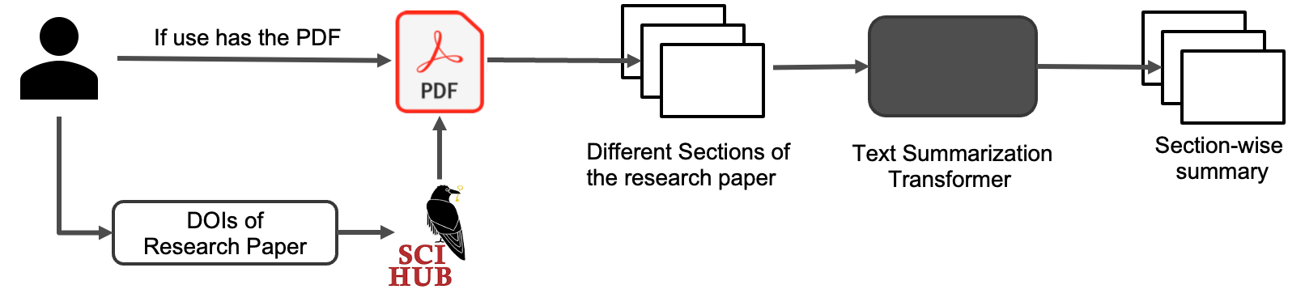
Workflow
PDF Input: The user provides the PDF of the research paper they wish to understand.
Alternative Input - DOI: In case the user does not have the PDF of the research paper, they can provide the Digital Object Identifier (DOI) of the paper. We will fetch the corresponding paper from Sci-Hub using this DOI.
Text Extraction and Segmentation: Once we have the research paper, we extract the text and split it into different sections using Regex rules.
Sequential Summarization: Each section of the paper is then passed to a text summarization transformer.
Section-wise Summary Output: The output is a section-wise summary of the research paper.

Slide 5
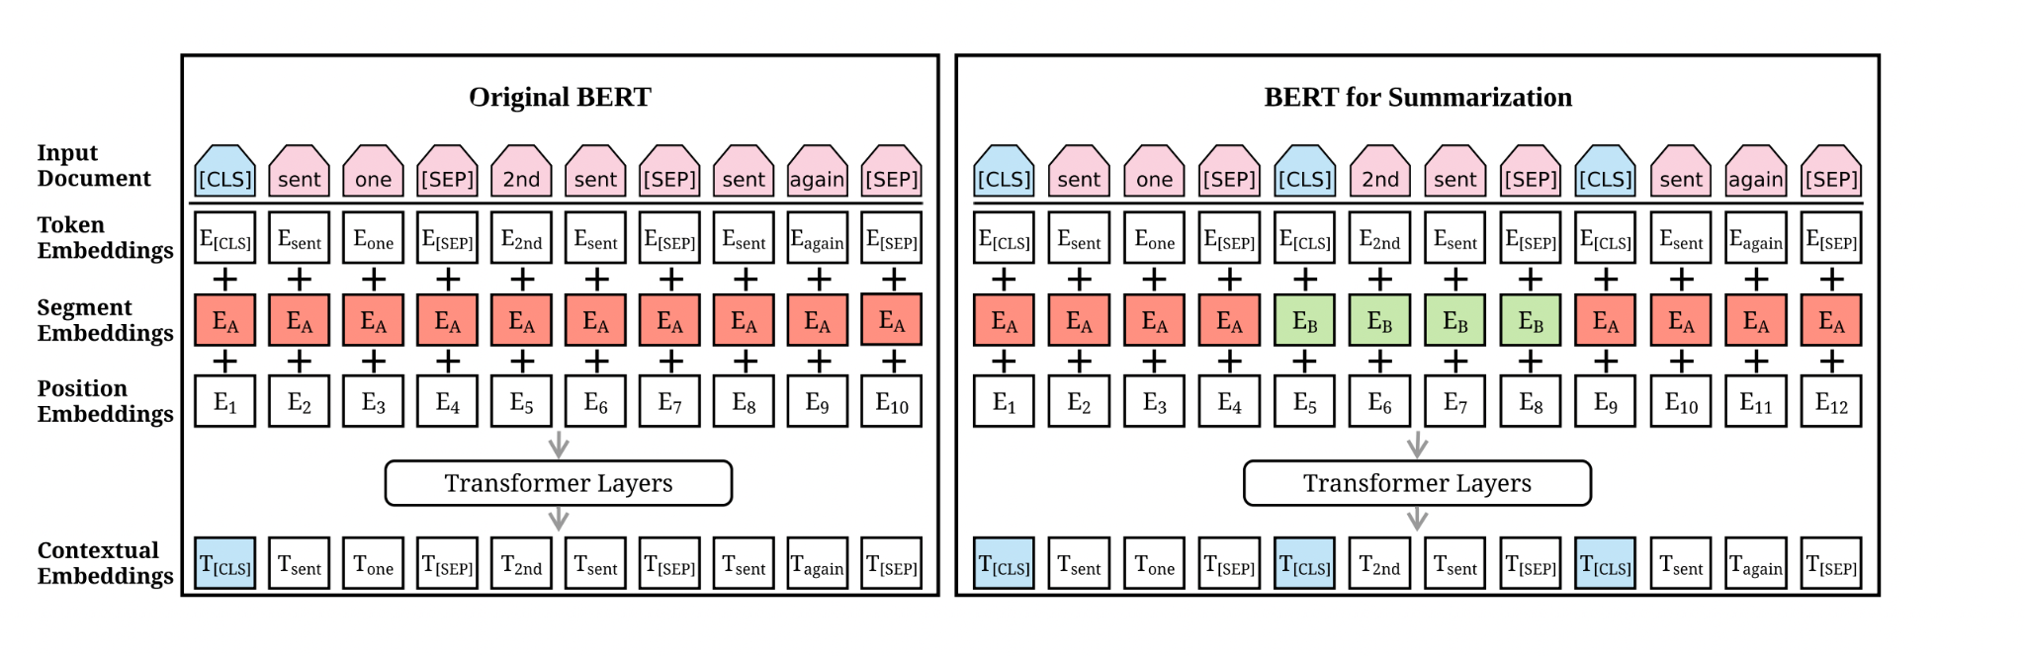
Model Architecture
Encoder - We are using pretrained bert-base-uncased model
We modify BERT by inserting multiple [CLS] symbols to learn sentence representations and using interval segmentation embeddings (illustrated in red and green color) to distinguish multiple sentences.

Slide 6
Encoder

Slide 7
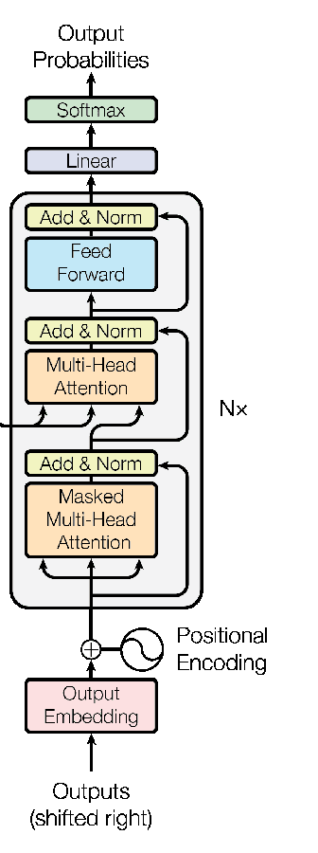
Decoder
Standard Vanilla Transformer Decoder
We use standard 6-12 layer decoder from ‘Attention is all you need’ paper and replace the encoder with bert-base-uncased as discussed before.
Bert-base-uncased
Inputs

Slide 8
Parameters and Hyperparameters
Encoder (bert-base-uncased)
Layers – 12
Hidden Size – 768
Attention Heads – 12
Decoder
Layers – 12
Hidden Size – 768
Attention Heads – 12
Decoder FFN Size – 2048
Dropout – 0.2
On Experimenting with different values of Attention heads and layers we found that on decoder side there was no performance improvement after 8 layers, same for attention heads. It looked like attention heads after 8 were redundant.

Slide 9
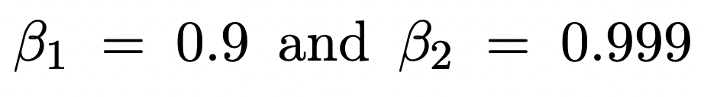
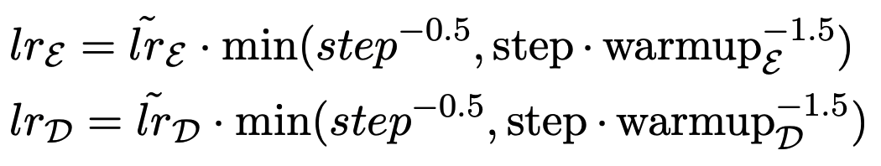




Optimizer
We use Adam optimizer with the following parameters as suggested by the paper:
We use different LRs for encoder and decoder. This is based on the assumption that the pretrained encoder should be fine-tuned with a smaller learning rate (so that the encoder can be trained with more accurate gradients when the decoder is becoming stable).

Slide 10
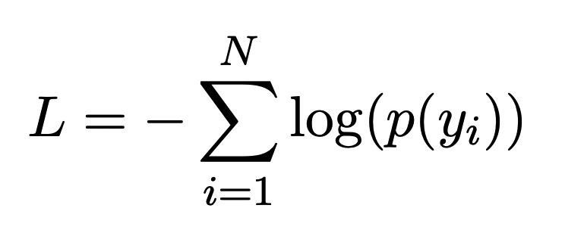
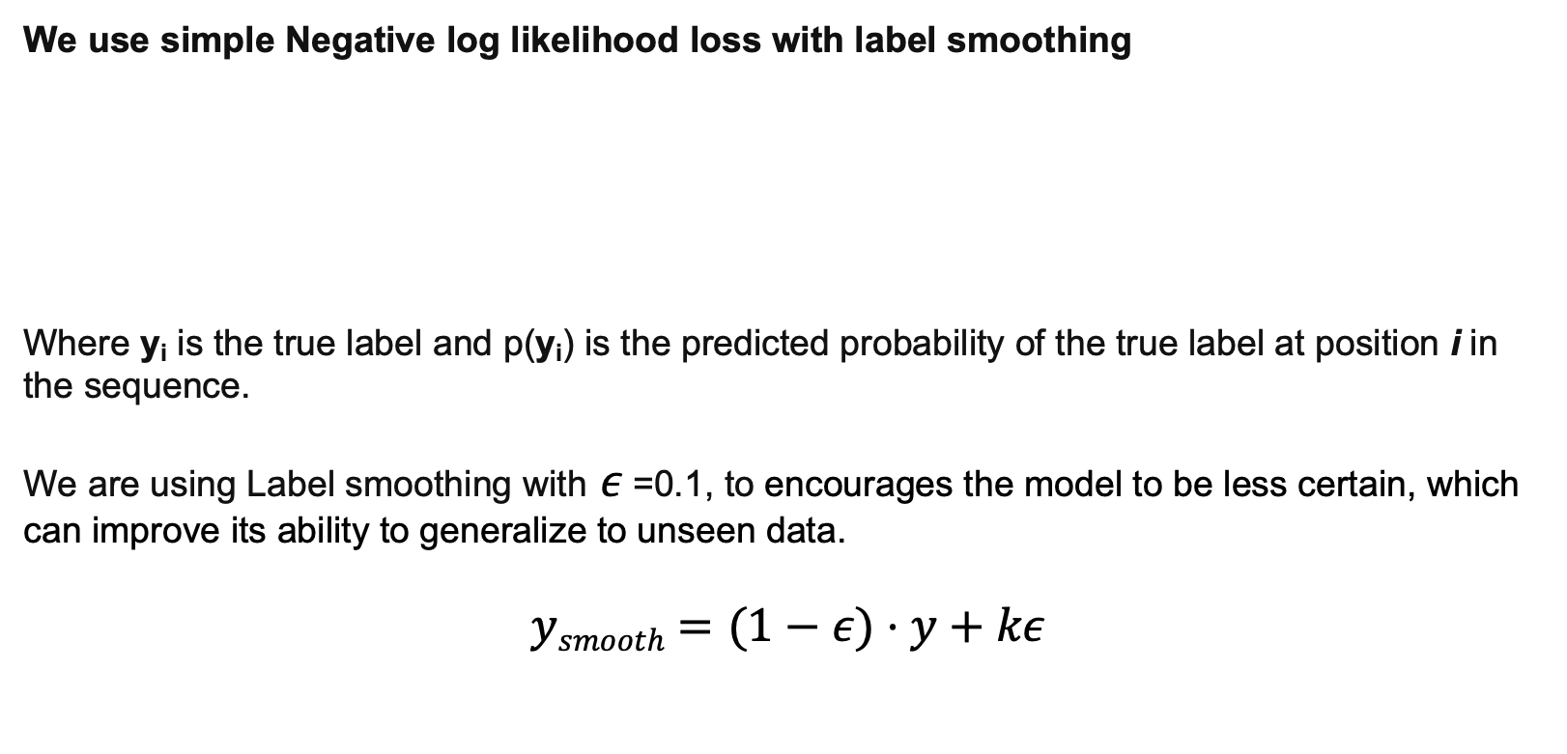
Loss Function
We use simple Negative log likelihood loss with label smoothing
Where y_{i} is the true label and p(y_{i}) is the predicted probability of the true label at position i in the sequence.
We are using Label smoothing with $ε​$ =0.1, to encourages the model to be less certain, which can improve its ability to generalize to unseen data.
$$ysmooth​=(1−ε)⋅y+kε​$$

Slide 11
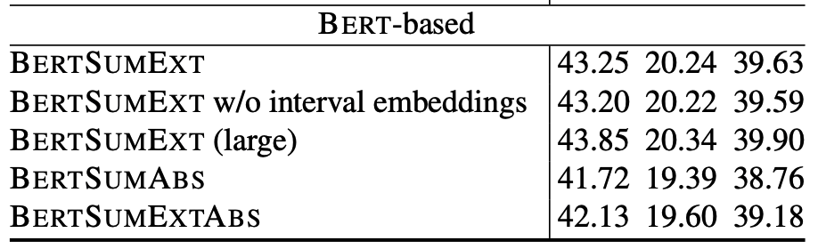
Results
Model (Variations in Decoder) | ROUGE-1 | ROUGE-2 | ROUGE-L
6 layer, 8 heads | 39.61 | 15.93 | 26.43
8 layer, 8 heads | 40.23 | 16.12 | 26.88
12 layer, 8 heads | 40.62 | 17.16 | 27.73
6 layer, 12 heads | 40.38 | 16.72 | 27.11
8 layer, 12 heads | 41.88 | 16.91 | 27.47
Performance of Reference Paper:

Slide 12
Demo

Slide 13
Using LLAMA-2 as Q&A Assistant

Slide 14
About the LLM & Embedding Model
Model Details – Llama-2-13b-HF
We use the llama2-13b-hf model, a large language model. The model is loaded onto a Tesla t4x2 GPU (2x16GB GPU Memory) on Kaggle.
Quantization – We employ 4-bit quantization to efficiently load the model with less GPU memory.
No Fine-Tuning –The model is used as-is, without any fine-tuning. This means the model’s pre-trained weights are not further trained on a specific task.
Query Pipeline – We use HuggingFace’s querypipeline for processing queries.
Embedding Model used for Text Data – pretrained microsoft/mpnet-base model and fine-tuned in on a 1B sentence pairs dataset.

Slide 15
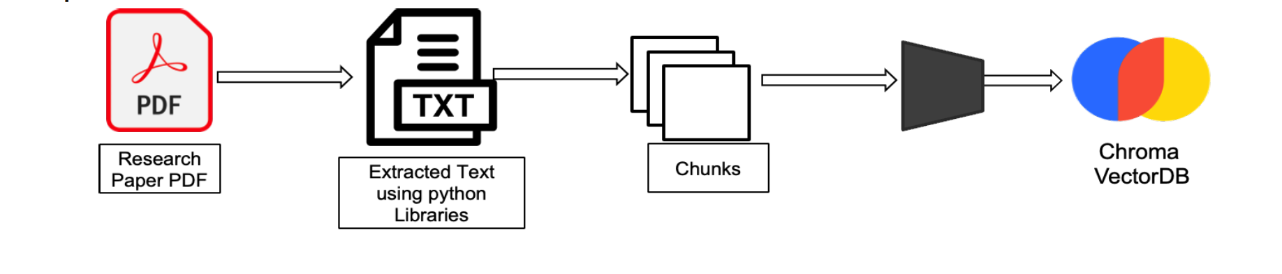
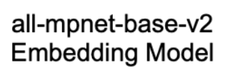


Data Ingestion
We utilize PDF Miner to extract text from PDF documents. This text is then segmented into chunks, each containing 1000 tokens, with an overlap of 200 tokens between consecutive chunks. These chunks are subsequently transformed into sentence embeddings using the all-MPNet-v2 model. The resulting embeddings are stored in the Chroma Vector Database for future use.
In the absence of readily available PDFs, we can also use the DOIs of research papers. The system is designed to fetch the corresponding papers from Sci-Hub and store them in the vector database.
DOIs of
Research Papers

Slide 16
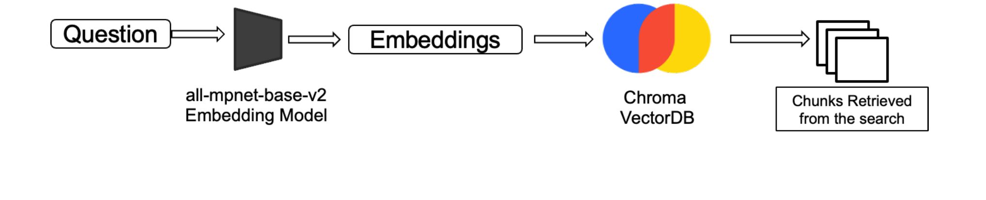
Searching
Our search process begins by converting the query into an embedding using the same model as for the document chunks.
This query embedding is then used to perform a search in the Chroma Vector Database.
The system retrieves the top-k chunks that are most similar to the query embedding, providing a precise and efficient method for information retrieval.

Slide 17
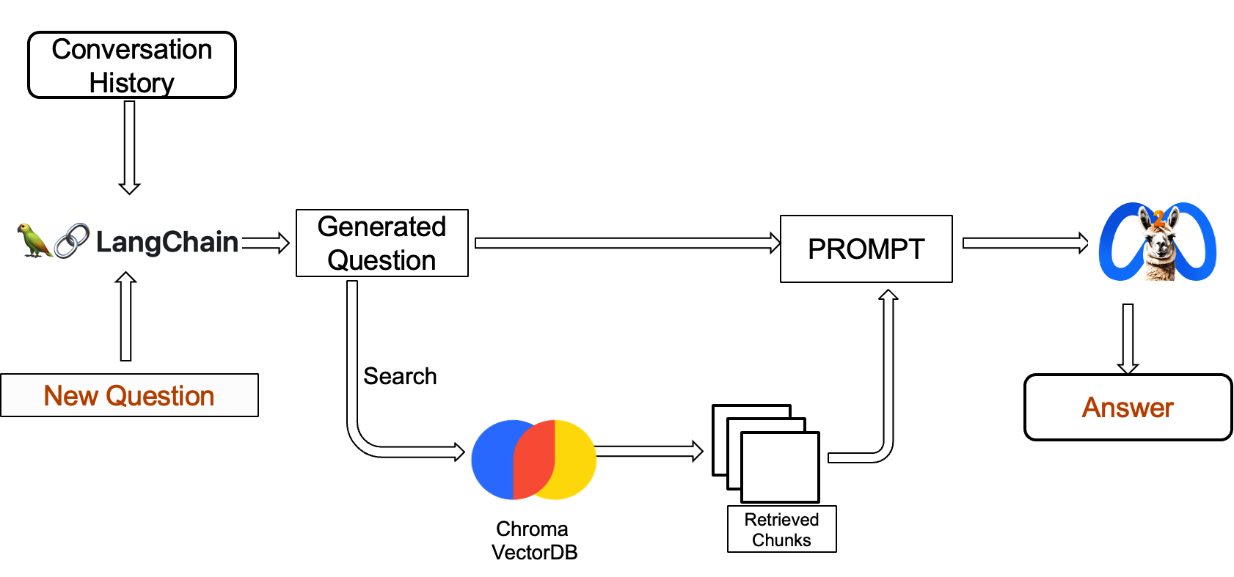
Answer Retrieval
The process begins by passing the new question, along with the conversation history, to our language model.
This model uses its question generator to search and retrieve the most relevant chunks from the Chroma Vector Database.
The question, along with the retrieved information, is then passed to our LLM for generating the answer. This ensures that the responses are not only accurate but also contextually relevant, providing a comprehensive and effective solution for information retrieval and response generation.

Slide 18
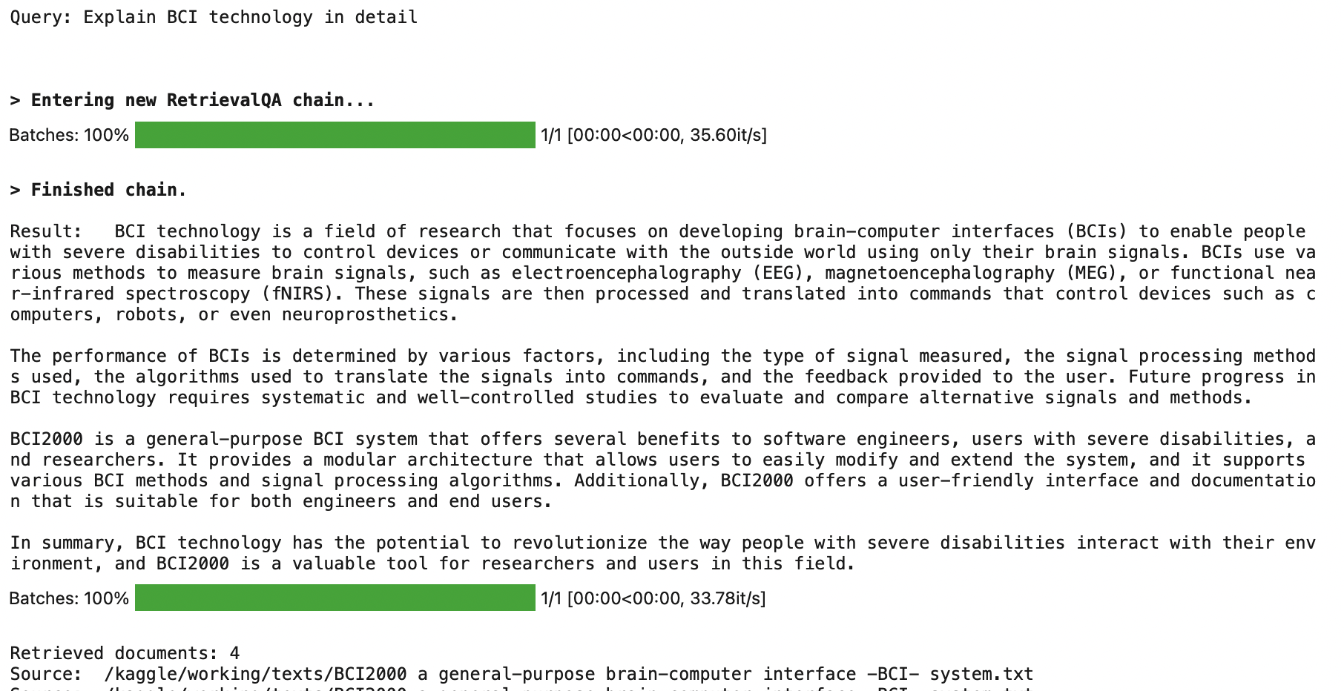
Question Answering Demo

Slide 19
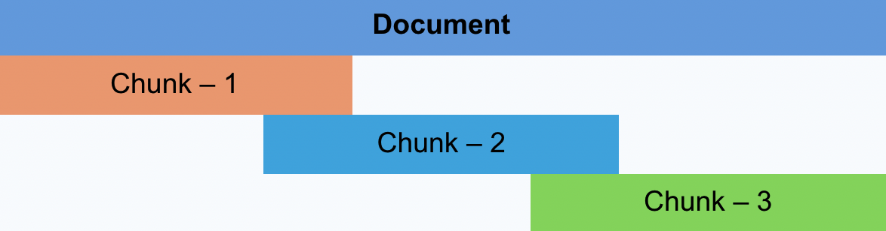
Experiments with Different Chunk Size and Overlaps
During our experimentation with different chunk sizes and overlaps, we observed the following:
Small Chunks: With smaller chunks (default size of 250 tokens), the answers were concise and to the point. They also had the advantage of referring to multiple sources. However, they sometimes lacked detail.
Large Chunks: Larger chunks (up to 2000 tokens) resulted in detailed answers. However, they often restricted the answers to a few chunks and prevented referencing multiple parts of a paper or different papers.
After various trials, we found that a chunk size of 1000 tokens provided a balance between detail and diversity of sources in the answers.
We also experimented with the overlap size and settled for an overlap of 200 tokens. We hypothesized (not sure about this) that a larger overlap would bring consecutive chunks closer, which could help generate detailed answers referring to consecutive chunks.
Our final configuration, therefore, is a chunk size of 1000 tokens with an overlap of 200 tokens.

Slide 20

https://meet.google.com/tfy-poua-qhk

