Slide 1
How Much Does Attention Actually Attend?
Questioning the Importance of Attention in Pretrained Transformers
Pathik Patel [202003002]
Divya Patel [202001420]
Kunj Patel [202001421]
Suyash Vyas [202001002]

Slide 2

Motivation
Gain insight into how much attention is really required in pre-trained transformers.
The significance of input dependent attention on various downstream tasks.
Reducing the time required to calculate query, key and attention and optimizing the model.

Slide 3
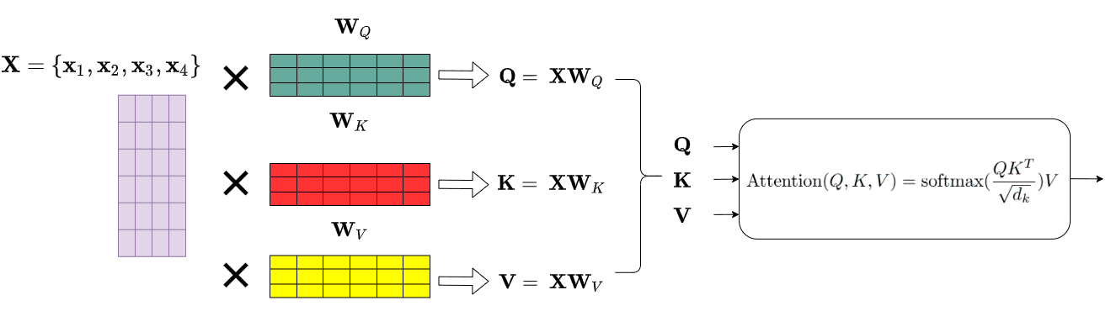
Background
Transformers consist of interleaving attention and feed-forward layers. The attention mechanism contextualizes the input by computing input-specific attention matrices.
Each attention layer consists of H heads, each generating an input-dependent attention weight matrix. Recent work has shown varying patterns of attention usage in pretrained language models.

Slide 4
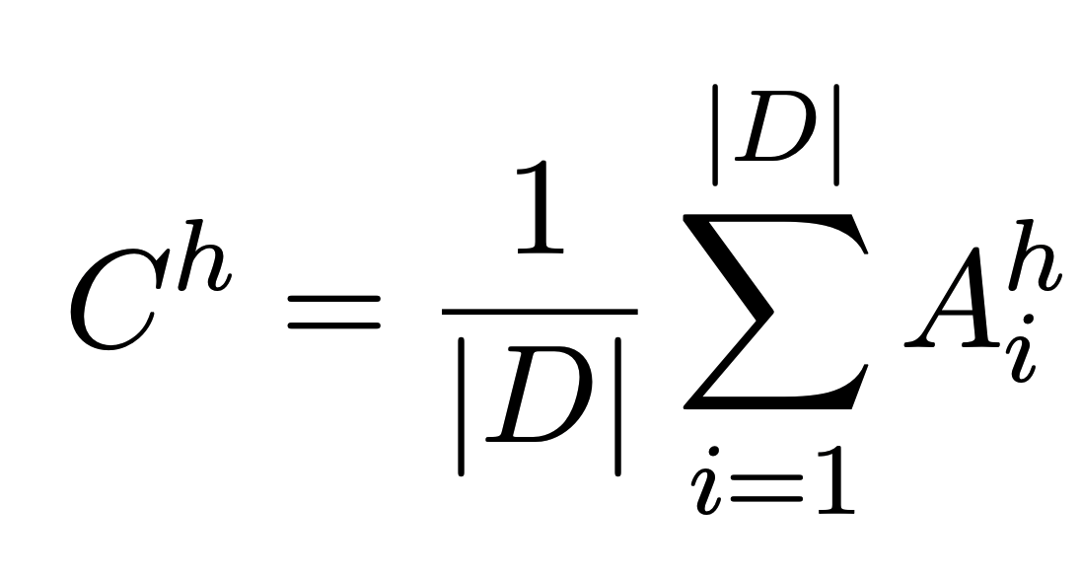
The PAPA Method
Authors introduce PAPA (Probing Analysis for PLMs' Attention) a probing method that measures the relyance of PLM on the attention mechanism.
PAPA constructs, for a given head h, a constant matrix Ch by averaging the attention matrix Ah over a corpus of raw text (D) :

Slide 5
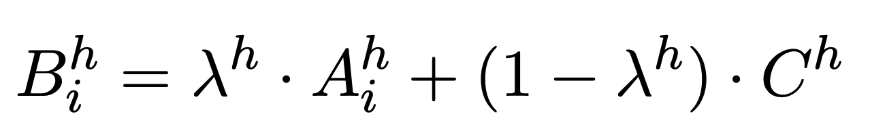
PAPA: Replacing a Subset of the Heads Content
To estimate this dependence, we introduce a new weighting parameter λ_{ℎ}∈ (0, 1)
λ_{h} is a learned weighting of the two matrices: the attention matrix A^{h} and the constant matrix C^{h}.
We use the learned ‘λ_{h}‘s to decide which heads should be
replaced with constant matrices. We replace k% attention heads with the smallest λ_{h} values for some hyperparameter k.

Slide 6
Probing
The goal is to evaluate how much attention a given PLM uses so we avoid fine-tuning for a specific downstream task to prevent changing all of its weights.
They uses a probing approach by freezing the model and adding a classifier on top.
We compare the downstream performance of the original model m with the new model m′. The larger the performance gap between m and m′, the higher m’s dependence on the attention mechanism.
Notes:
The goal is to evaluate how much attention a given PLM uses so we avoid fine-tuning for a specific downstream task to prevent changing all of its weights.
They uses a probing approach by freezing the model and adding a classifier on top. The classifier calculates a weighted (learned, non-attentive) representation of the different token representations.
We compare the downstream performance of the original model m with the new model m′. The larger the performance gap between m and m′, the higher m’s dependence on the attention mechanism.

Slide 7
Is PAPA FFN ?
Unlike a feed-forward network (FFN), the representations computed via the PAPA model are still contextualized. This means that the representation of each word depends on the representations of all other words.
In a standard Transformer model, the contextualization varies by the input. However, in the PAPA method, it remains fixed for all inputs.
Therefore, while PAPA is attention-free, it is not equivalent to an FFN due to its ability to maintain contextualized representations.
Notes:
PAPA replaces the attention matrices with constant ones, resulting in an attention-free model.
Unlike a feed-forward network (FFN), the representations computed via the PAPA model are still contextualized. This means that the representation of each word depends on the representations of all other words.
In a standard Transformer model, the contextualization varies by the input. However, in the PAPA method, it remains fixed for all inputs.
Therefore, while PAPA is attention-free, it is not equivalent to an FFN due to its ability to maintain contextualized representations.

Slide 8
Evaluation and Experiments

Slide 9
Experimental Setup
We evaluate BASE and LARGER versions of BERT, RoBERTa and DeBERTa.
Evaluated over 4 benchmarks
GLUE
MNLI
MRPC
CoLA
Amount of input dependent matrices used {1, ½, ⅛, 1/16 , 0}

Slide 10
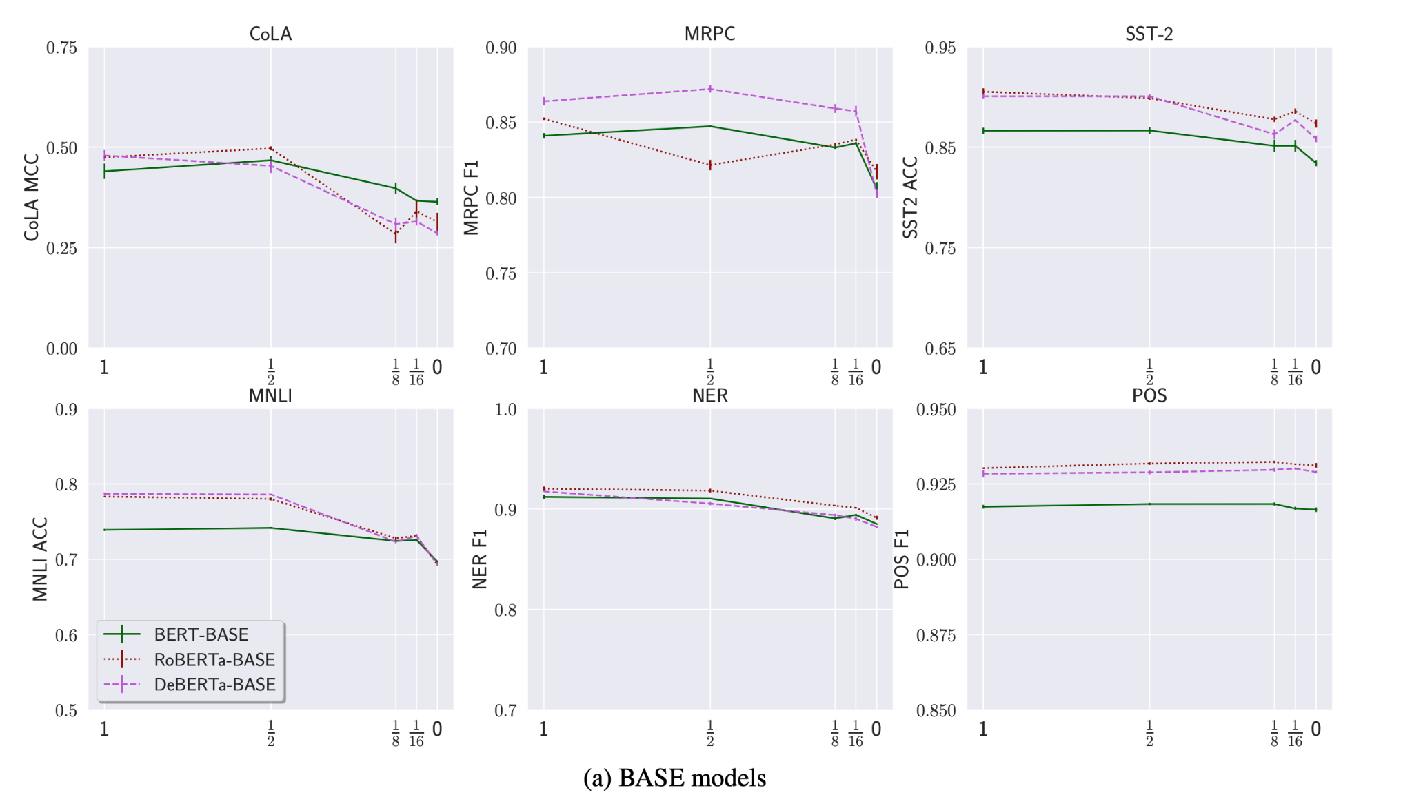
Results

Slide 11
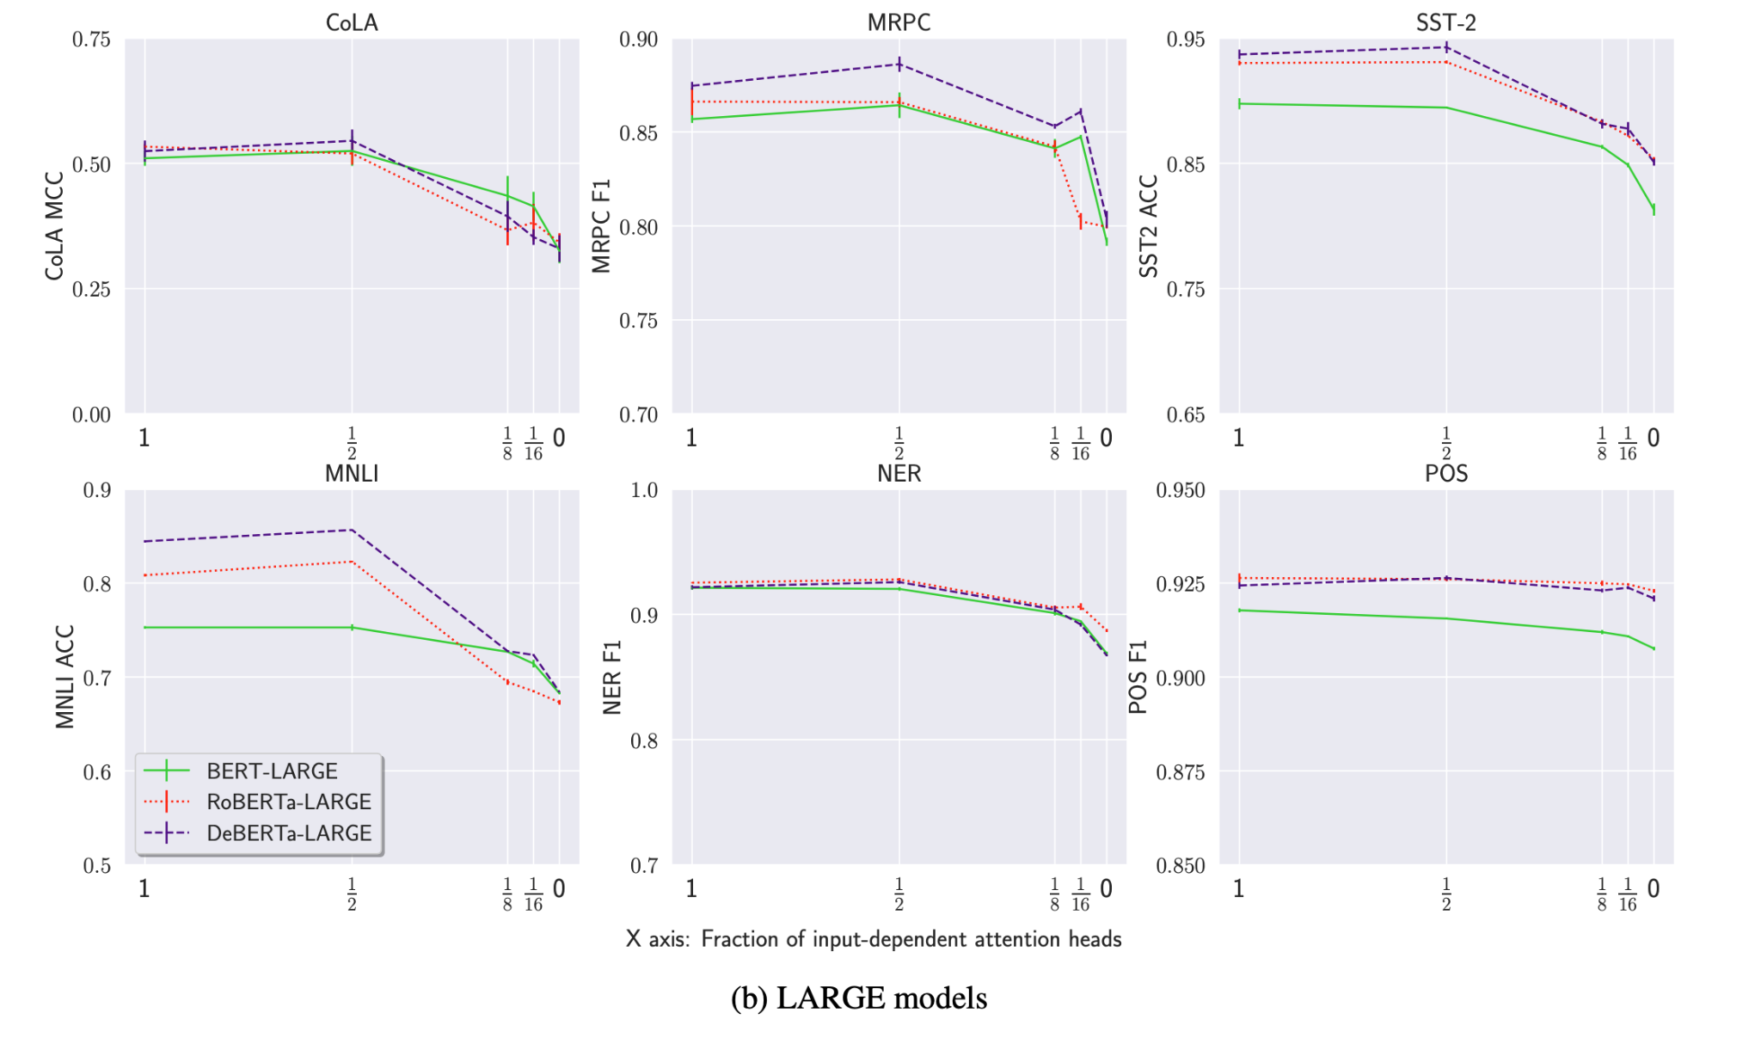
Results

Slide 12
Results
Replacing all attention matrices with constant ones incurs a moderate performance drop.
8% relative performance drop on average and not greater than 20% from original model.
Half of the attention matrices can be replaced without loss in performance.
Performant models rely more on attention

Slide 13
Further
Analysis

Slide 14
Pattern in Constant Matrices
Diagonal Pattern is observed in 90% of the constant matrices which are generated which suggests each token mostly attends to itself or to its neigh- boring words.
Close to 40% of heads put most of their weight mass on the [CLS] and/or [SEP] tokens.
In most of cases the weight mass is distributed over several entries (corresponding to several different tokens)
All the above observations/patterns are similar to patterns observed in BERT’s attention heads. Thus many of the attention heads mostly focus on fixed patterns that can also be captured by a constant matrix

Slide 15
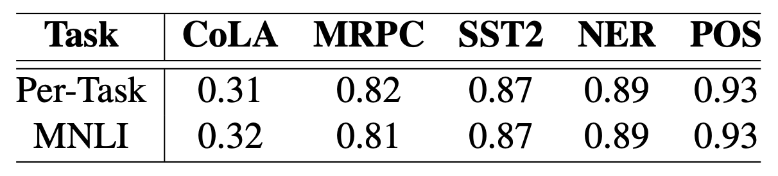
Are the Constant Matrices Data-Dependent?
PAPA constructs the constant matrix for a given head as the average of the model’s attention matrices over a given corpus D, which in the experiments is set to be the training set of the task at hand
To examine Data-dependency the Constant matrices are generated using MNLI dataset which is out of distribution for the other tasks..
Comparison of task performance between two setups of constructing Averaged the Constant Matrix. 1) Per-Task uses the taks training set. 2) MNLI uses the Constant Matrices generated by the MNLI dataset.

Slide 16
Comparison between head selection methods
Comparing the method to for selecting and replacing heads as discussed earlier(replacing top k% heads with smallest Lambda values) with other alternatives.
Other alternatives are: 1) Sort the head from first to last layer(select top k%). 2).Sort the head from last to first layer(select top k%). 3). Random replacement of k% of heads. 4). Replacing top k% heads with highest Lambda values.
It turns out that the method discussed earlier outperforms all the other alternatives discussed and the 4th method is the worst of them all. Which suggests that the earlier discussed method not only replaces the least attention dependent heads first but also replaces most attention dependent ones last (as method 4 is reverse of the original method).

Slide 17
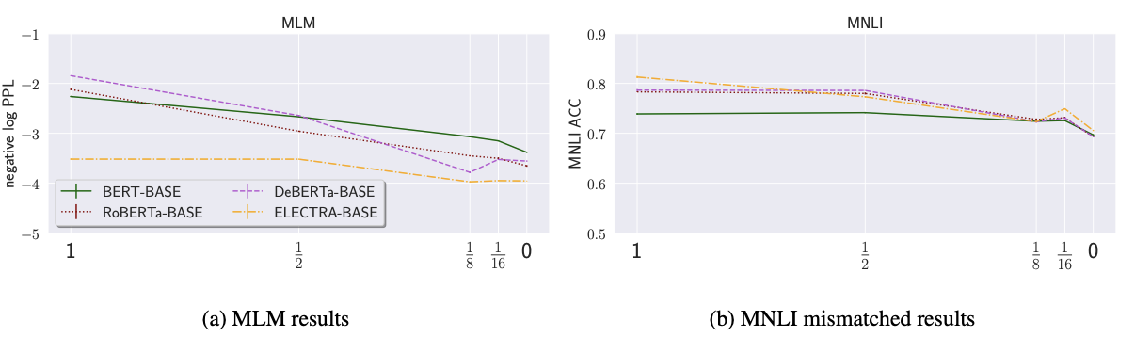
Effect of PAPA on MLM
When replacing attention matrices using PAPA on all the BASE models, MLM suffers larger performance drop compared to other downstream tasks as these pretrained Transformers are more specialized in MLM, the task they are pre-trained on..
To prove above hypothesis ELECTRA(which is trained with replaced token detection objective rather then MLM) is probed by PAPA. Firstly original performance of ELECTRA was much worse compared to other models(MLM based) despite showing similar performance on downstream tasks.
But as we start replacing heads ELECTRA’s performance drop on MLM is much similar to its performance drop on MNLI.

Slide 18
Conclusion
Attention Mechanism Analysis: The study reveals that Pretrained Language Models (PLMs) are less reliant on the attention mechanism than previously assumed.
PAPA Method: Introduces the Probing Analysis for PLMs’ Attention (PAPA) method to quantify PLM reliance on attention by replacing attention matrices with constant ones.
Performance Insights: Even with constant attention matrices, PLMs maintain competitive performance, suggesting potential for simpler or more efficient models.

Slide 19
Limitation
Probing vs. Finetuning: The analysis focuses on probing rather than finetuning, which may not fully capture the attention mechanism’s role in task-specific adaptations.
Data Dependency: The constant matrices are built by averaging attention matrices over a dataset, which may not represent the optimal attention-free model.
Task and Language Specificity: The study’s findings are based on English tasks, and results may vary for other tasks or languages.

Slide 20

https://meet.google.com/tfy-poua-qhk

Slide 21
