Slide 1
Economies of Scale, Imperfect Competition and International Trade

Slide 2
Introduction
When defining comparative advantage, the Ricardian model and the Heckscher-Ohlin model both assume constant returns to scale:
If all factors of production are doubled then output will also double.
But a firm or industry may have increasing returns to scale or economies of scale:
If all factors of production are doubled, then output will more than double.
Larger is more efficient: the cost per unit of output falls as a firm or industry increases output.

Slide 3
The Ricardian and Heckscher-Ohlin models also rely on competition to predict that all income from production is paid to owners of factors of production: no “excess” or monopoly profits exist.
But when economies of scale exist, large firms may be more efficient than small firms, and the industry may consist of a monopoly or a few large firms.
Production may be imperfectly competitive in the sense that excess or monopoly profits are captured by large firms.

Slide 4
Types of Economies of Scale
Economies of scale could mean either that larger firms or that a larger industry (e.g., one made of more firms) is more efficient.
External economies of scale occur when cost per unit of output depends on the size of the industry.
Internal economies of scale occur when the cost per unit of output depends on the size of a firm.
External economies of scale may result if a larger industry allows for more efficient provision of services or equipment to firms in the industry.
Many small firms that are competitive may comprise a large industry and benefit from services or equipment efficiently provided to the large group of firms.
Internal economies of scale result when large firms have a cost advantage over small firms, which leads to an imperfectly competitive market.

Slide 5
A Review of Monopoly
A monopoly is an industry with only one firm.
An oligopoly is an industry with only a few firms.
A characteristic of a monopoly (and to some degree an oligopoly) is that is marginal revenue generated from selling an additional unit of output is lower than the price of output.
Without price discrimination, a monopoly must lower the price of an additional unit sold, as well as the prices of other units sold.
The marginal revenue curve lies below the demand curve (which determines the price of units sold).

Slide 6
Monopolistic pricing and production decisions

Slide 7
If monopolistic firms have linear demand curves, then the relationship between price and quantity may be represented as:
Q = A – B.P where A and B are constants
and marginal revenue may be represented as
MR = P – Q/B
When firms maximize profits, they set marginal revenue = marginal cost: MR = P – Q/B = c
Average cost is the cost of production (C) divided by the total quantity of output produced (Q) at a time.
AC = C/Q
Marginal cost is the cost of producing an additional unit of output.

Slide 8
Suppose that costs are measured by C = F + c.Q, where F represents fixed costs, independent of the level of output. c represents a constant marginal cost: the constant cost of producing an additional unit of output Q.
AC = F/Q + c
A larger firm is more efficient because average cost decreases as output Q increases: internal economies of scale.

Slide 9
Average versus Marginal cost
This figure illustrates the average and marginal costs corresponding to the total cost function C= 5+x. Marginal cost is always 1; average costs decline as output rises.

Slide 10
Monopolistic Competition
Monopolistic competition is a model of an imperfectly competitive industry which assumes that
Each firm can differentiate its product from the product of competitors.
Each firm ignores the impact that changes in its own price will have on the prices competitors set: even though each firm faces competition, it behaves as if it were a monopolist.
A firm in a monopolistically competitive industry is expected:
to sell more the larger the total sales of the industry and the higher the prices charged by its rivals.
to sell less the larger the number of firms in the industry and the higher its own price.

Slide 11
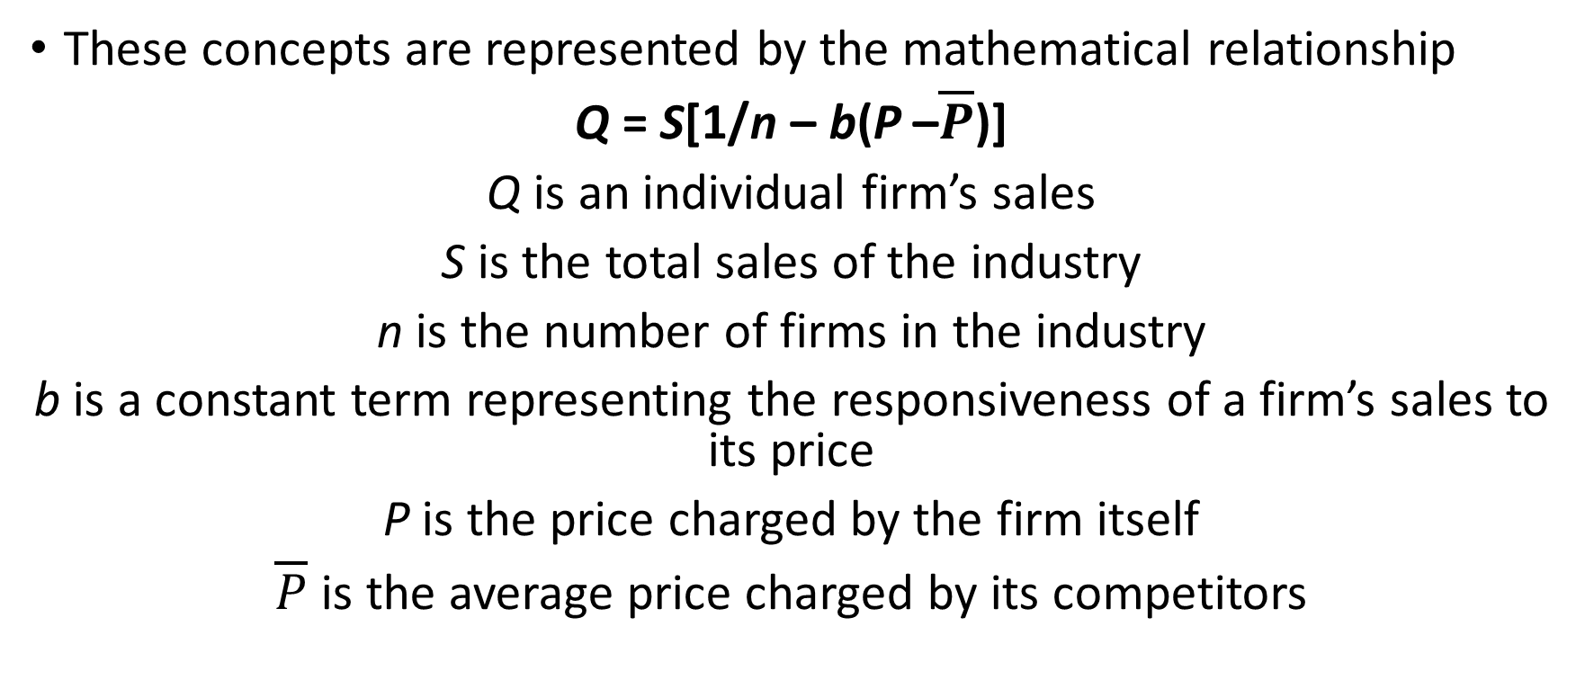
These concepts are represented by the mathematical relationship
Q = S[1/n – b(P –$\overline{P}$)]
Q is an individual firm’s sales
S is the total sales of the industry
n is the number of firms in the industry
b is a constant term representing the responsiveness of a firm’s sales to its price
P is the price charged by the firm itself
$\overline{P}$ is the average price charged by its competitors

Slide 12
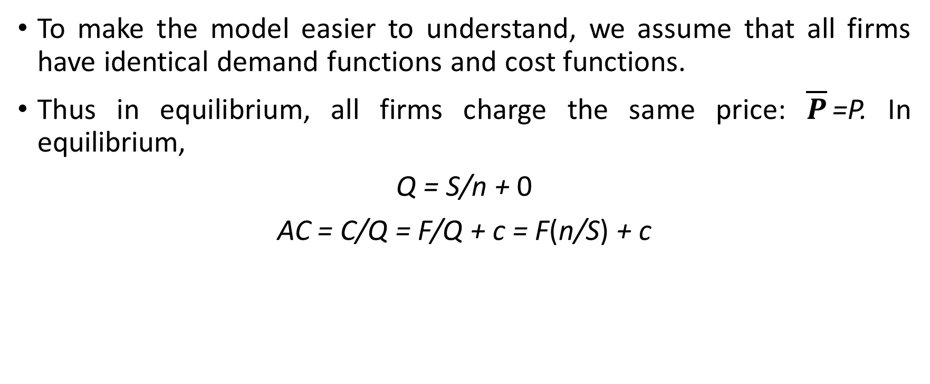
To make the model easier to understand, we assume that all firms have identical demand functions and cost functions.
Thus in equilibrium, all firms charge the same price: $\overline{P}$=P. In equilibrium,
Q = S/n + 0
AC = C/Q = F/Q + c = F(n/S) + c

Slide 13
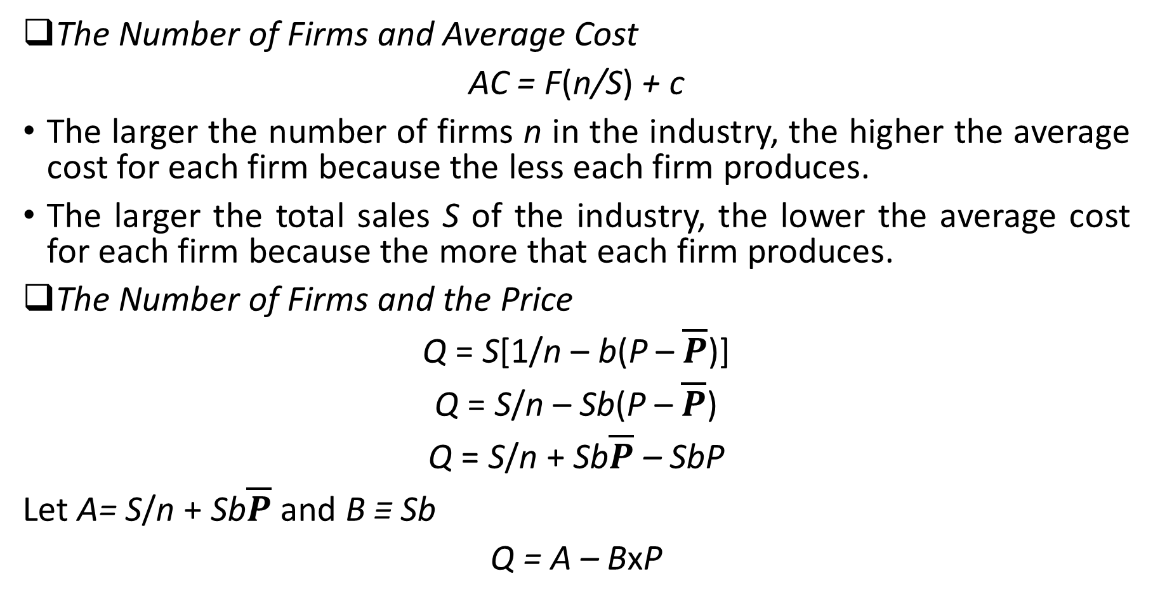
The Number of Firms and Average Cost
AC = F(n/S) + c
The larger the number of firms n in the industry, the higher the average cost for each firm because the less each firm produces.
The larger the total sales S of the industry, the lower the average cost for each firm because the more that each firm produces.
The Number of Firms and the Price
Q = S[1/n – b(P – $\overline{P}$)]
Q = S/n – Sb(P – $\overline{P}$)
Q = S/n + Sb$\overline{P}$ – SbP
Let A= S/n + Sb$\overline{P}$ and B ≡ Sb
Q = A – BxP

Slide 14
MR = P – Q/B = c
MR = P – Q/Sb = c
P = c + Q/Sb
P = c + (S/n)/Sb
P = c + 1/(nxb)
The larger the number of firms n in the industry, the lower the price each firm charges because of increased competition.
At some number of firms, the price that firms charge (which decreases in n) matches the average cost that firms pay (which increases in n).
This number of firms is the number at which each firm has zero profits: price matches average cost. This number is the equilibrium number of firms.

Slide 15
Equillibrium in a monopolistically competitive market
The number of firms in a monopolistically competitive market, and the prices that they charge are determined by two relationships. On the one hand, the more firms there are, the more intensely they compete, and hence lower is the industry price. This relationship is described by PP. On the other side, more firms there are, the less each firm sells and therefore higher is its average cost. This relationship is described by CC. If price exceeds average cost, industry will be making profits and new firms will enter; if PP lies below CC industry will be making losses and firms will exit.

Slide 16
If the number of firms is greater than or less than n₂, then in industry is not in equilibrium in the sense that firms have an incentive to exit or enter the industry.
Firms have an incentive to enter the industry when profits are greater than zero (price > average cost).
Firms have an incentive to exit the industry when profits are less than zero (price < average cost).

Slide 17
Because trade increases market size, trade is predicted to decrease average cost in an industry described by monopolistic competition.
Industry sales increase with trade leading to decreased average costs: AC = F(n/S) + c
Because trade increases the variety of goods that consumers can buy under monopolistic competition, it increases the welfare of consumers.
Because average costs decrease, consumers can also benefit from a decreased price.

Slide 18
Effects of a Larger Market
An increase in the size of the market allows each firm, other things equal, to produce more and thus have lower average cost. This is represented by a downward shift from CC₁ to CC₂. The result is a simultaneous increase in the number of firms and hence in the variety of goods available and fall in the price of each.
As a result of trade, the number of firms in a new international industry is predicted to increase relative to each national market. But it is unclear if firms will locate in the domestic country or foreign countries.

Slide 20
Inter-industry Trade
According to the Heckscher-Ohlin model or Ricardian model, countries specialize in production.
Trade occurs only between industries: inter-industry trade
In a Heckscher-Ohlin model suppose that:
The capital abundant domestic economy specializes in the production of capital intensive cloth, which is imported by the foreign economy.
The labour abundant foreign economy specializes in the production of labour intensive food, which is imported by the domestic economy.

Slide 21
Intra-industry Trade
Suppose now that the global cloth industry is described by the monopolistic competition model.
Because of product differentiation, suppose that each country produces different types of cloth.
Because of economies of scale, large markets are desirable: the foreign country exports some cloth and the domestic country exports some cloth.
Trade occurs within the cloth industry: intra-industry trade
If domestic country is capital abundant, it should therefore export more cloth than it imports.
Suppose that the trade in the food industry continues to be determined by comparative advantage.

Slide 22
Trade with increasing returns and monopolistic competition
If cloth is a monopolistically competitive industry, Home and Foreign will produce differentiated products. As a result, even if Home is a net exporter of cloth goods, it will import as well as export cloth, giving rise to intra industry trade.

Slide 23
Inter-industry trade and intra-industry trade
Gains from inter-industry trade reflect comparative advantage.
Gains from intra-industry trade reflect economies of scale (lower costs) and wider consumer choices.
The monopolistic competition model does not predict in which country firms locate, but a comparative advantage in producing the differentiated good will likely cause a country to export more of that good than it imports.
The relative importance of intra-industry trade depend on how similar countries are.
Countries with similar relative amounts of factors of production are predicted to have intra-industry trade.
Countries with different relative amounts of factors of production are predicted to have inter-industry trade.

Slide 24
Unlike inter-industry trade in the Heckscher-Ohlin model, income distribution effects are not predicted to occur with intra-industry trade.
About 25% of world trade is intra-industry trade according to standard industrial classifications.
But some industries have more intra-industry trade than others: those industries requiring relatively large amounts of skilled labour, technology and physical capital exhibit intra-industry trade.
Countries with similar relative amounts of skilled labour, technology and physical capital engage in a large amount of intra-industry trade.

Slide 25
Dumping
Dumping is the practice of charging a lower price for exported goods than for goods sold domestically.
Dumping is an example of price discrimination: the practice of charging different customers different prices.
Price discrimination and dumping may occur only if
imperfect competition exists: firms are able to influence market prices.
markets are segmented so that goods are not easily bought in one market and resold in another.

Slide 26
Dumping may be a profit maximizing strategy because of differences in foreign and domestic markets.
One difference is that domestic firms usually have a larger share of the domestic market than they do of foreign markets.
Because of less market dominance and more competition in foreign markets, foreign sales are usually more responsive to price changes than domestic sales.
Domestic firms may be able to charge a high price in the domestic market but must charge a low price on exports if foreign consumers are more responsive to price changes.

Slide 27
We can see how dumping occurs when a firm is a monopolist in the domestic market but a small competitive firm in foreign markets.
Because the firm is a monopolist in the domestic market, the domestic market demand curve is downward sloping, and the marginal revenue curve lies below that demand curve.
Because the firm is a small competitive firm in foreign markets, the foreign market demand curve is horizontal, representing the fact that exports are very responsive to small price changes

Slide 29
The figure shows a monopolist that faces a demand curve D_{DOM} for domestic sales, but which can also sell as much as it likes at the export price P_{FOR}. Since an additional item can always be sold at P_{FOR}, the firm increases output until the marginal cost equals P_{FOR}. This profit maximizing output is shown as Q_{MONOPOLY} . Since the firm’s marginal cost at Q_{MONOPOLY} is P_{FOR}, it sells output in the domestic market upto the point where marginal revenue equals P_{FOR}. This profit maximizing level of domestic sales is shown as Q_{DOM}. The rest of its output Q_{MONOPOLY} - Q_{DOM} is exported.
The price at which domestic consumers demand Q_{DOM} is P_{DOM}. Since P_{DOM}> P_{FOR}, the firm sells exports at a lower price than it charges domestic consumers.

Slide 30
To maximize profits, the firm will sell a low amount in the domestic market at a high price P_{DOM} , but sell in foreign markets at a low price P_{FOR}
Since an additional unit can always be sold at P_{FOR} , the firm will sell its products at a high price in the domestic market until marginal revenue there falls to P_{FOR}.
Thereafter, it will sell exports at P_{FOR} until marginal costs exceed this price.
In this case, dumping is a profit-maximizing strategy.

Slide 31
Protectionism and Dumping
Dumping (as well as price discrimination in domestic markets) is widely regarded as unfair.
The Commerce Department may impose an “anti-dumping duty”, or tax, as a precaution against possible injury.
This tax equals the difference between the actual and “fair” price of imports, where “fair” means “price the product is normally sold at in the manufacturer's domestic market ”.

Slide 32
External Economies of Scale
If external economies exist, a country that has a large industry will have low costs of producing that industry’s good or service.
External economies may exist for a few reasons:
Specialized equipment or services may be needed for the industry, but are only supplied by other firms if the industry is large and concentrated.
For example, Silicon Valley in California has a large concentration of silicon chip companies, which are serviced by companies that make special machines for manufacturing silicon chips.
These machines are cheaper and more easily available for Silicon Valley firms than for firms elsewhere.

Slide 33
Labour pooling: a large and concentrated industry may attract a pool of workers, reducing employee search and hiring costs for each firm.
Knowledge spillovers: workers from different firms may more easily share ideas that benefit each firm when a large and concentrated industry exists.
If external economies exist, the pattern of trade may be due to historical accidents:
countries that start out as large producers in certain industries tend to remain large producers even if some other country could potentially produce the goods more cheaply.

Slide 34
External economies and specialization
The average cost curve for Thailand AC_{THAI}, lies below the average cost curve for Switzerland AC_{SWISS}. Thus, Thailand could potentially supply the world market more cheaply than Switzerland. If the Swiss industry gets established first, however, it may be able to sell watches at the price P₁, which is below the cost C₀ that an individual Thai firm would face if it began production on its own. So a pattern of specialization established by historical accident may persist even when new producers could potentially have lower costs.

Slide 35
Trade based on external economies has an ambiguous effect on national welfare.
There may be gains to the world economy by concentrating production of industries with external economies.
But there is no guarantee that the right country will produce a good subject to external economies.
It is even possible that a country is worse off with trade than it would have been without trade: a country may be better off if it produces everything for its domestic market rather than pay for imports.

Slide 36
External economies and losses from trade
When there are external economies, trade can potentially leave a country worse off than it would be in the absence of trade. Thailand imports watches from Switzerland, which is able to supply the world market D_{WORLD} at a price P₁ low enough to block entry by Thai producers who must initially produce watches at cost C₀. Yet if Thailand were to block all trade in watches, it would be able to supply its domestic market D_{THAI} at a lower price P₂.

Slide 37
We have considered cases where external economies depend on the amount of current output at a point in time.
But external economies may also depend on the amount of cumulative output over time.
Dynamic external economies of scale (dynamic increasing returns to scale) exist if average costs fall as cumulative output over time rises.
Dynamic increasing returns to scale could arise if the cost of production depends on the accumulation of knowledge and experience, which depend on the production process over time.
A graphical representation of dynamic increasing returns to scale is called a learning curve.

Slide 38
The Learning Curve
The learning curve shows that unit cost is lower the greater the cumulative output of a country’s industry to date. A country that has extensive experience in an industry may have a lower unit cost than other country with little or no work experience, even if the second country’s learning curve (L*) is lower is lower, for example, because of lower wages.

Slide 39
Like external economies of scale at a point in time, dynamic increasing returns to scale can lock in an initial advantage or head start in an industry.
Like external economies of scale at a point in time, dynamic increasing returns to scale can be used to justify protectionism.
Temporary protection of industries enables them to gain experience: infant industry argument.
But temporary is often for a long time, and it is hard to identify when external economies of scale really exist.

