Slide 1
OBSTOCKER
AI-Powered Inventory & Demand Forecasting
PREDICT DEMAND • PREVENT STOCKOUTS • OPTIMIZE INVENTORY
Because empty shelves lose sales, and overstocked shelves lose money.
Hack In Motion
[RICR-HIM-1273] • [Mayank Singh Bhati, Vivek Chauhan, Divya Prajapati, Arham Jamal]
OBSTOCKER • 1

Slide 2
The Inventory Balancing Problem
Two ways to lose money — and one question every retailer asks.
!
STOCKOUT
!
OVERSTOCK
Too little inventory → products run out → customers leave → sales are lost.
Too much inventory → capital gets stuck → storage costs rise → slow-moving stock becomes a liability.
How much stock should we keep today for the demand of tomorrow?
OBSTOCKER • 2

Slide 3
Why This Problem Is Hard
Demand changes constantly — but many inventory decisions are still reactive.
01
GUESSWORK
02
CHANGING DEMAND
03
EXPENSIVE TOOLS
Small and mid-sized businesses may rely on spreadsheets, experience, or basic analysis.
Seasons, festivals, trends, discounts, and other factors can shift buying patterns.
Advanced forecasting systems can be difficult for smaller businesses to access.
The opportunity:
Make data-driven inventory forecasting practical, understandable, and actionable.
OBSTOCKER • 3

Slide 4
Meet OBSTOCKER
A business tool that turns historical data into future inventory decisions.
Historical Sales + Current Inventory
→
Demand Forecast
→
Risk Detection
→
Action
1
Manage
2
Analyze
3
Predict
4
Alert
5
Act
Products, stock, categories, suppliers
Historical sales data
Future demand
Stockout / overstock risk
Make a smarter restocking decision
Manage → Analyze → Predict → Alert → Act
OBSTOCKER • 4

Slide 5
What OBSTOCKER Delivers
The must-have capabilities from the challenge, connected into one workflow.
01
Secure Accounts
02
Inventory Management
03
Sales Data
Sign-up / login with private user data.
Add, edit, delete, and view stock levels.
Upload or seed historical sales data.
04
Demand Forecasting
05
Smart Stock Alerts
06
Actionable Dashboard
Generate future demand predictions per product.
Flag products likely to run low or become overstocked.
See inventory, forecast trends, and alerts in seconds.
OBSTOCKER • 5

Slide 6
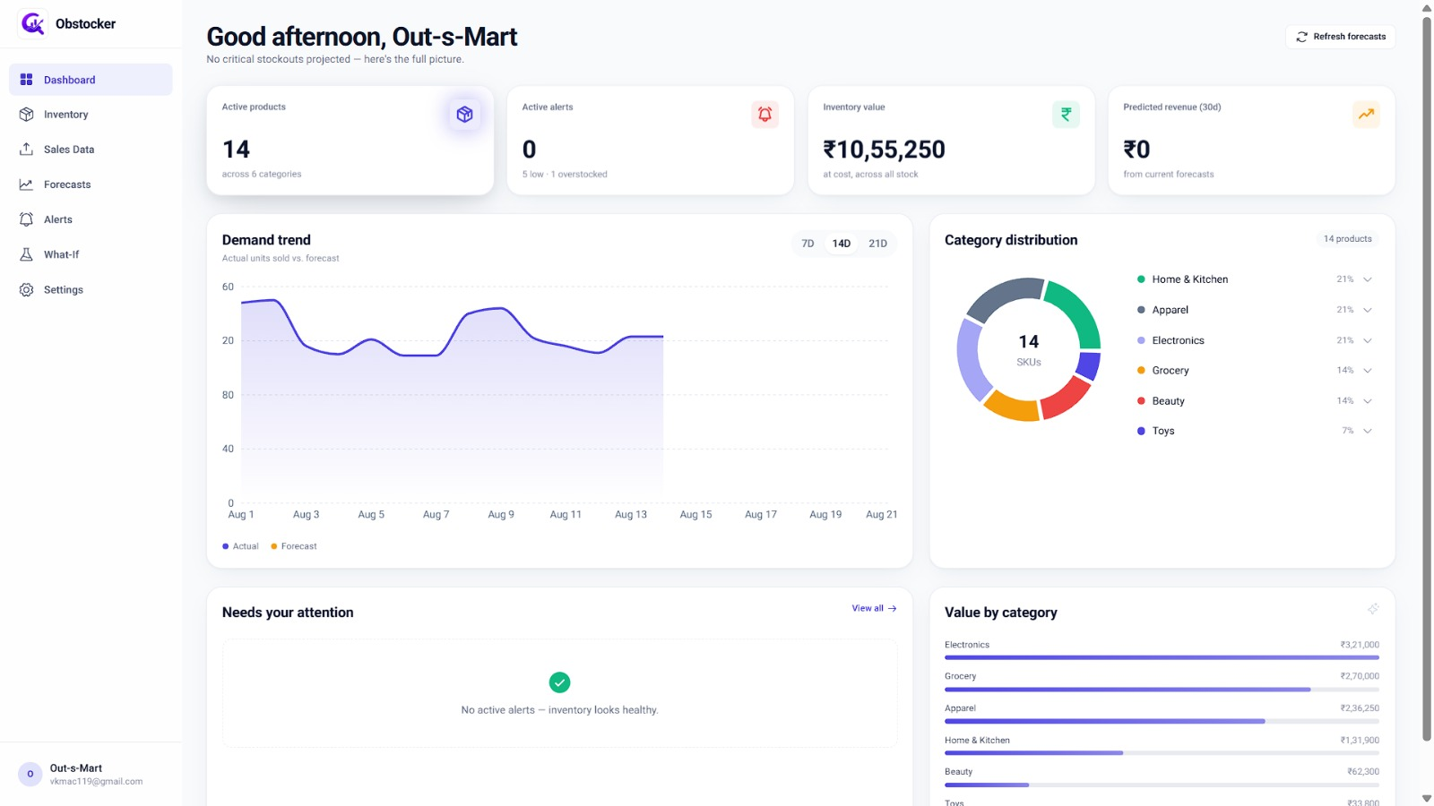
Product Experience
OBSTOCKER • 6

Slide 7
Demand Forecasting — The Technical Core
Forecasts should be genuinely data-driven, not random numbers.
PAST
FORECAST
DECISION
Historical sales
→
Future demand
→
What should we do?
Trend + seasonality where applicable
Expected units sold next week / month
Reorder • Monitor • Review overstock
Illustrative forecast view
Historical
Forecast
OBSTOCKER • 7

Slide 8
Smart Stock Alerts
Turn prediction into an action before the problem reaches the customer.
!
LOW-STOCK / STOCKOUT RISK
!
OVERSTOCK RISK
Forecasted demand is approaching or exceeding available stock. → Trigger a reorder alert → Keep the user ahead of the shortage
Available stock is high compared with expected demand. → Highlight slow-moving risk → Give the user a reason to review inventory
Predict
→
Alert
→
Act
OBSTOCKER • 8

Slide 9
From Raw Data to a Business Decision
A simple user journey designed for speed and clarity.
1
LOGIN
2
MANAGE
3
UPLOAD
4
FORECAST
5
ALERT
6
ACT
Secure account access
Products & stock levels
Historical sales / CSV
Future product demand
Stockout / overstock risk
Make a smarter decision
→
→
→
→
→
No complicated workflow. One platform, one clear decision path.
OBSTOCKER • 9

Slide 10
Architecture & Technology
A modular full-stack foundation that keeps the product extensible.
USER
Business user
FRONTEND
[Your frontend technology]
AI
FORECASTING
Java + Spring Boot / REST APIs
Suitable data-driven forecasting approach / API integrated with the backend.
BACKEND
DATA + LOGIC
Inventory • Sales • Forecast workflow
DATABASE
MySQL / persistent application data
↓
Forecast + Alerts → Dashboard
OBSTOCKER • 10

Slide 11
What Makes OBSTOCKER Different?
Move from inventory visibility to inventory intelligence.
A
TRADITIONAL / REACTIVE
B
OBSTOCKER / PREDICTIVE
What do I have? → Look at current stock → Manually inspect sales → Guess future demand → React when a problem appears
What am I likely to need? → Combine stock + sales history → Forecast future demand → Detect risk early → Act before the problem grows
We don't just monitor inventory. We help businesses anticipate it.
OBSTOCKER • 11

Slide 12
Real-World Impact
The value is not the forecast itself — it is the decision the forecast enables.
1
REDUCE STOCKOUT RISK
2
REDUCE OVERSTOCK
Avoid missed sales caused by insufficient inventory.
Minimize unnecessary inventory and blocked capital.
3
FASTER DECISIONS
4
DATA-DRIVEN PLANNING
Turn complex sales data into actionable insights.
Replace guesswork with evidence from sales patterns.
Business outcome: smarter inventory decisions with less manual effort.
OBSTOCKER • 12

Slide 13
Future Roadmap
NOW
Inventory + Sales + Forecasting + Alerts
↓
NEXT
Multi-location / warehouse support
↓
NEXT
Automated reorder quantity + timing suggestions
↓
NEXT
Price optimization for slow-moving stock
↓
VISION
What-if simulation + supplier integration
Long-term vision: an intelligent system that can recommend — and eventually automate — inventory actions.
OBSTOCKER • 13

Slide 14
Live Demo Story
01
LOGIN
02
DASHBOARD
03
INVENTORY
Secure business user access
See inventory health
Add / update products
04
SALES
05
FORECAST
06
ALERT
Upload historical data
Generate future demand
Show reorder / overstock risk
Demo narrative: Problem → Data → Forecast → Risk → Action
OBSTOCKER • 14

Slide 15
THE FUTURE OF INVENTORY IS PREDICTIVE.
Don't wait for inventory problems to happen. Predict them before they happen.
OBSTOCKER
Manage → Analyze → Predict → Alert → Act
Thank you • Questions?
OBSTOCKER • 15

