Slide 1
Joint Representation Learning for Recommendation with Heterogeneous Information Sources

Slide 2
Dataset
Amazon (24 product categories: 24 sub-datasets)
Basic data format (Actually it is a sparse matrix)
user-id: which is denoted as “reviewerID” in the dataset
product-id: which is denoted as “asin” in the dataset
rating: a 1-5 integer star rating, which is the rating that the user rated on the product, it is denoted as “overall” in the dataset
review: a piece of review text, which is the review content that the user commented about the product, it is denoted as “reviewText” in the dataset
title: the title of the review, which is denoted as “summary” in the dataset
timestamp: time that the user made the rating and review
image: image of the product
description: a piece of text description of the product

Slide 3
Project Description - Tasks
Basic Requirements
Step 1: Data prepressing and split, create a training dataset and a testing dataset for experiment
Step 2: Rating prediction, develop an algorithm to predict the ratings in the testing set based on the information (ratings and others) in the training dataset, and evaluate the predictions based on MAE and RMSE.
Step 3: Item Recommendation, construct a recommendation list for each user, and then evaluate the recommendation quality based on precision, recall, F-measure, and NDCG.

Slide 4
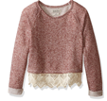

Deep Representation Learning
Deep
Representation
Learning
Deep
Representation
Learning
Deep
Representation
Learning
…
…
…

Slide 5








Joint Representation Learning
A Multi-View Machine Learning Framework with Heterogeneous Information Sources
Entity₁
Entity₂
Entity₃
Entity₄
…
Entity_{N-1}
Entity_{N}
(Deep) Representation Learning
…
…
…
…
…
…
…
V₁
…
…
…
+Item $v_{j1}$
User $u_{i}$
-Item $v_{j2}$
V₂
…
…
…
+Item $v_{j1}$
User $u_{i}$
-Item $v_{j2}$
V₃
…
…
…
+Item $v_{j1}$
User $u_{i}$
-Item $v_{j2}$
…
…
…
+Item $v_{j1}$
User $u_{i}$
-Item $v_{j2}$
S₁
>
S₂

Slide 6
Joint Representation Learning
A Multi-View Machine Learning Framework with Heterogeneous Information Sources
Review₁
Review₂
Review₃
Review₄
…
Review_{N-1}
Review_{N}
(Deep) Representation Learning
…
…
…
…
…
…
…
V₁
…
…
…
+Item $v_{j1}$
User $u_{i}$
-Item $v_{j2}$
V₂
…
…
…
+Item $v_{j1}$
User $u_{i}$
-Item $v_{j2}$
V₃
…
…
…
+Item $v_{j1}$
User $u_{i}$
-Item $v_{j2}$
…
…
…
+Item $v_{j1}$
User $u_{i}$
-Item $v_{j2}$
S₁
>
S₂

Slide 7
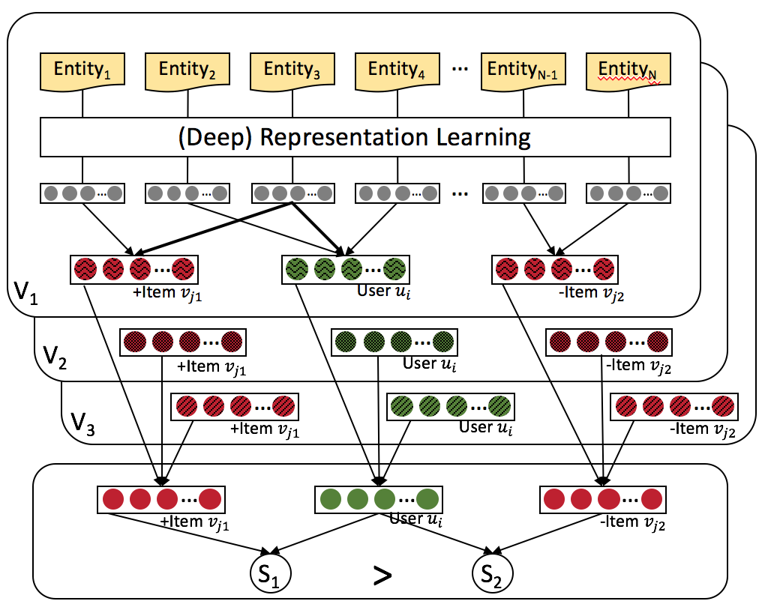


Joint Representation Learning
A Multi-View Machine Learning Framework with Heterogeneous Information Sources
L₁
L₂
L₃

Slide 8
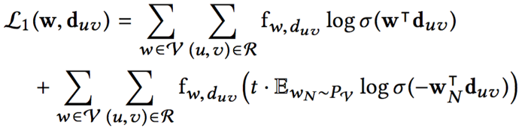








Modeling of Textual Reviews (View V₁)
Review $d_{uv}$
$$w_{uv}^{1}$$
$$w_{uv}^{2}$$
$$w_{uv}^{3}$$
…
$$w_{uv}^{n_{uv}−1}$$
$$w_{uv}^{n_{uv}}$$
Projection
…
V₁
…
…
User $u$
Item $v$
Word Embedding by Paragraph Vector Learning

Slide 9
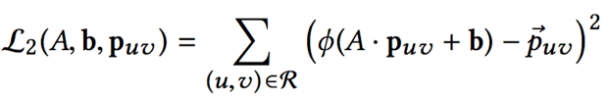



Modeling of Visual Images (View V₂)
Image $p_{uv}$
Multi-Layer Convolutional Neural Network
Multiple Fully Connected Layers
…
Fully Connected Layer
…
V₂
…
…
User $u$
Item $v$
Image Embedding by Convolutional Neural Network

Slide 10




Modeling of Numerical Ratings (View V₃)
Rating $r_{uv}$
Fully Connected Layer 2
Fully Connected Layer 1
…
…
V₃
…
…
User $u$
Item $v$
Rating Embedding by Fully Connected Layers

Slide 11
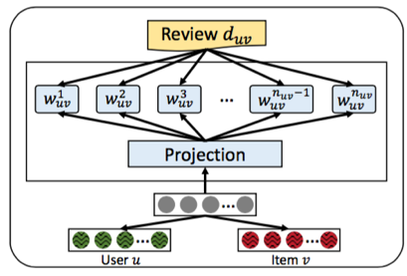
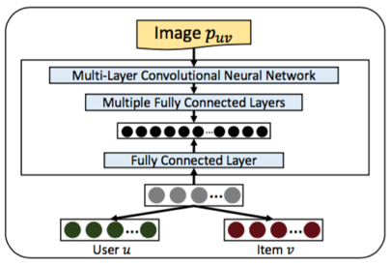
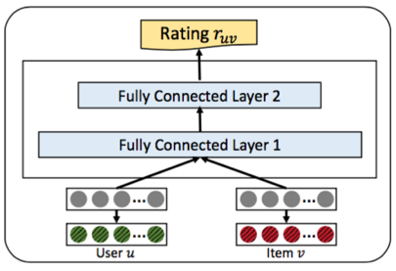
Joint Representation Learning
V₁
V₂
V₃

Slide 12
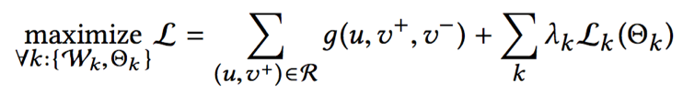
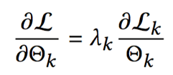
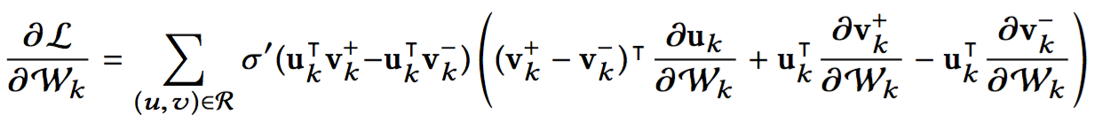
Extendable to New Information Sources
Voice
➕
Video
Text
Image
Ratings
Gradient on parameters from view k
Only contains parameters of view k itself
Independent from other views

Slide 13
Baseline methods
Baseline Methods
BPR: Bayesian Personalized Ranking with implicit feedback.
HFT: Hidden factor and topics model integrated into BPR, because the original model is designed for rating prediction. It relies on reviews.
VBPR: Visual Bayesian Personalized Ranking method based on images.

Slide 14

Summary and Future Works
Use various heterogeneous data to provide
Significant personalization performance.
Develop a Joint Representation Learning framework for recommendation based on heterogeneous information sources.
Not only ratings, review, and images, but also extendable to new information sources.
Achieved significant improve for top-N recommendation.
Future work
Consider other representation learning architectures for recommendation
Consider other information sources for recommendation

Slide 15
Thesis Timeline
Complete Textual, Visual and Rating based Joint Representation Learning for Recommendation Systems by the first week of May. Possibly 1st May 2019.
Improve the Recommendation System implementing one of the following research topics: Complete by August 2019
Hidden factors and hidden topics: understanding rating dimensions with review text (http://dl.acm.org/citation.cfm?id=2507163)
VBPR: Visual Bayesian Personalized Ranking from Implicit Feedback (www.aaai.org/ocs/index.php/AAAI/AAAI16/paper/download/11914/115 76)
Joint Representation Learning for Recommendation with Heterogeneous Information Sources (https://dl.acm.org/citation.cfm?id=3132892)
Towards conversational search and recommendation: System ask, user respond (https://dl.acm.org/citation.cfm?id=3271776)

Slide 16


