Slide 1
Customer Churn Prediction in Telecom Industry and Insights
Proactive Solutions for Customer Retention and Revenue Optimization.
Turning Data into Business Decisions.

Slide 2

Agenda
Project Objectives and Scope
Dataset Overview and Preprocessing
Analytical Insights from visualizations
Dashboard Demonstration
Key Recommendations and Strategic Actions
Challenges, Learnings and Future Scope.

Slide 3
Project Objectives and Scope
Why This Project?
Customer churn impacts long-term profitability and growth.
Businesses need actionable insights to retain customers and sustain revenue.
Goals:
Analyze patterns in customer churn.
Identify high-risk customer segments.
Provide a visual, interactive dashboard for strategic decisions.
Business Use Cases:
Customer Retention: Identify at-risk customers and proactively implement retention strategies.
Marketing Campaigns: Tailor marketing efforts towards customers who are more likely to churn.
Service Improvement: Analyze churn patterns to improve service offerings and customer support.
Revenue Optimization: Reduce churn rates to maintain a steady revenue stream.
Customer Segmentation: Segment customers based on churn probability to offer personalized experiences.

Slide 4
Dataset Overview
Dataset Source: Provided CSV file.
Key Features:
Demographics: Age, Gender, Marital Status.
Behavioral Metrics: Tenure, Contract Type, Monthly Charges, Total Charges.
Service Usage: Online Backup, Streaming TV, Internet Services.
Customer Status: Churned, Stayed, Joined.
Volume:
Total Records: 7,043 data, 21 columns.
Purpose: To cover churn behavior patterns and derive business insights.

Slide 5
Data Preprocessing
Steps Taken:
Handling Missing Values: Replaced with default values based on the type (e.g., 0 for numeric, "Unknown" for categorical).
Correcting Invalid Values: Addressed negative entries in financial columns.
Feature Engineering: Created calculated fields like Tenure Group and Churn Rate.
Data Normalization: Scaled numerical columns (e.g., Monthly Charges) for analysis consistency.
Tools Used:
MySQL

Slide 6
Analytical Insights from Visualizations
Business Use Case: Customer Retention
1. Churn Rate by Contract Type
Purpose: Identify contract types with the highest churn rates.
2. Top 10 High-Value Churned Customers
Purpose: Focus on high-revenue customers who have churned.
3. Age Distribution of Churned Customers
Purpose: Highlight the age groups most likely to churn.
Business Use Case: Marketing Campaigns
4. Most Common Services Used by Churned
Purpose: Show frequently used services among churned customers.
5. Churn Rate by Region
Purpose: Visualize geographic areas with the highest churn rates.
Business Use Case: Service Improvement
6. Online Services Analysis
Purpose: Compare the usage of online security and backup services by churned and non-churned customers.
7. Monthly Charges Distribution for Churned.
Purpose: Highlight pricing dissatisfaction among churned customers.

Slide 7
Analytical Insights from Visualizations
Business Use Case: Revenue Optimization
8. Churned Customers’ Contribution to Revenue.
Purpose: Display the percentage of revenue lost due to churn.
9. Average Monthly Charges by Customer.
Purpose: Compare monthly charges across churned, stayed, and joined customers.
Business Use Case: Customer Segmentation
10. Customer Segmentation by Tenure.
Purpose: Segment customers into short-term, medium-term, and long-term categories.
11. Customer Segmentation by Demographics.
Purpose: Segment customers by age group and marital status.

Slide 8
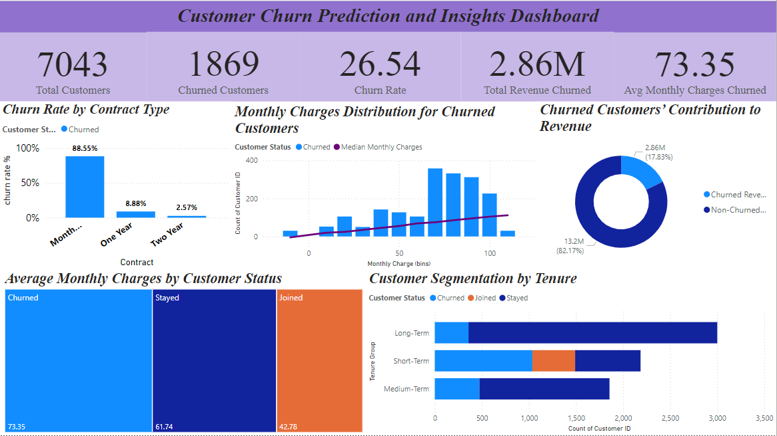
Dashboard Demonstration
Interactive Features:
KPIs: Total Customers, Churn Rate, Revenue Lost.
Drill-down options for exploring churn by contract type, tenure, and demographics.
Real-time updates for actionable insights.
Tools Used: Power BI for visualizations and dashboard creation.

Slide 9
Challenges and Learnings
Challenges:
Missing or inconsistent data required thorough preprocessing.
Balancing visual complexity with interpretability in dashboards.
Key Learnings:
Data preprocessing ensures accuracy and reliability.
Effective visualizations simplify complex data for stakeholders.

Slide 10
Recommendations
Retention:
Focus on month-to-month contract customers with loyalty programs.
Marketing:
Develop targeted campaigns for customers aged 30–60.
Service Improvement:
Enhance streaming and online security services to improve satisfaction.
Revenue Optimization:
Provide tailored offers for high-revenue customers.

Slide 11
Future Scope
Predictive Modeling:
Use machine learning models to predict churn probability.
Automation:
Automate data collection and dashboard updates for real-time insights.
Enhanced Features:
Include customer satisfaction surveys for additional data points.

Slide 12
Conclusion
Improved Retention: Targeted strategies have the potential to significantly reduce churn, increasing customer loyalty and satisfaction.
Revenue Optimization: Retaining high-value customers and addressing churn-related losses contributes to a stable revenue stream.
Resource Efficiency: Insights help prioritize resources, enabling focused efforts on high-impact areas.
Enhanced Decision-Making: The project highlights the value of data-driven approaches to proactive business decisions.
Future Readiness: This analysis sets the stage for implementing predictive models and real-time churn management solutions.

