Slide 1

INSIGHTVISTA
Group name
Visual Rangers
Enrollment numbers
250843116004
250843116005
250843116008
250843116018
RNGPIT | Department of IT
Dataset
Sales Forecasting
Notes:
Introduce the competition, the group Visual Rangers and the dataset name. Insert the RNGPIT logo at the top left of this slide.

Slide 2
USA Sales Dashboard Analysis
Sales performance 2015–2018: insights, weak areas and recommendations.
Notes:
Introduce the project: a Power BI style sales dashboard for USA retail data from 2015 to 2018. Walk through dataset, cleaning, dashboard, insights and recommendations.

Slide 3
Observation of dataset: Sales Forecasting
2.26M
~9.8K
793
2015–18
Total sales
Rows (records)
Unique customers
Period covered
What the data contains
Initial issues spotted
Columns: Order Date, Customer ID, Segment, Region, State, Category, Sub-category, Sales
3 categories, 17 sub-categories
4 regions, 3 segments
Count of Sales (5.757K) does not match the row count
Dates and Sales may be stored as text
Notes:
Explain what the dataset holds and the first problems noticed. Count of Sales shows 5.757K, but total sales divided by the average sale implies about 9.8K rows.

Slide 4
Data cleaning: problems found
1
2
3
Missing values
Duplicate rows
Wrong data types
Blank cells such as Postal Code
Repeated records inflate sales
Order Date and Sales stored as text
4
Inconsistent text
Extra spaces and mixed case in State and Region
Notes:
Mention only the issues you actually found in your file. Remove any card that does not apply to your dataset.

Slide 5
Solution: clean dataset
1
2
3
4
5
Remove
Handle
Convert
Standardise
Create
duplicates and blank rows
missing values
Date and decimal types
State and Region text
Year and Month columns
Result: a clean dataset ready for analysis. Count of Sales is fixed by counting Order ID.
Notes:
Name the tool you used (Power Query, Excel or Power BI). Add before and after row counts if you have them.

Slide 6
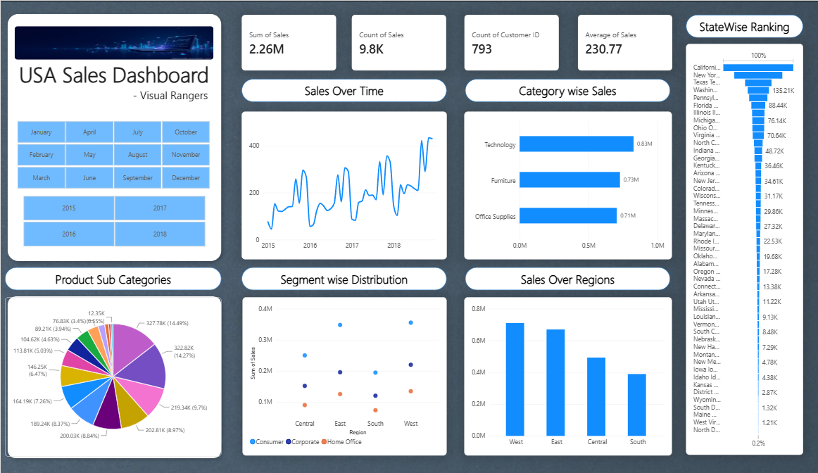
Visualizations: dashboard
Visuals used
4 KPI cards
Sales trend line
Category and region bars
Region by segment scatter
Sub-category pie
State funnel
Year slicer
Notes:
Point to each visual on the screenshot. Be ready to explain why the pie, funnel and scatter are weak choices and what you would use instead.

Slide 7
Insights
Phones and Chairs
Segments
States and time
Phones (14.5%) and Chairs (~14%) give almost 30% of sales.
Consumer leads every region. Home Office is lowest, weakest in South.
California and New York dominate. Sales peak at the end of 2018.
Notes:
Chart values are read from your dashboard bars, so they are approximate. Amber bars mark the weak regions: Central and South.

Slide 8
Recommended to business
Business recommendations
Boost South and Central with local campaigns
Grow Home Office using bundle offers
Push low sellers like Paper and Supplies
Reduce dependence on California and New York
Plan stock for seasonal peaks
Notes:
Stress that without profit data we cannot confirm whether high sales are actually profitable. That is the main limitation of this dataset.

Slide 9
Thank you
Notes:
Keep the conclusion to one sentence, then invite questions.

