Slide 1
Robust OFDM Channel Modelling for Wi-Fi CSI Sensing in GNU Radio
ECE 310 Wireless Communications · Milestone 4 (final) · Team G1
GSoC track · GNU Radio issues #6891 and #7997 · PR #8271
Hirva Vekariya · Tirth Pathar · Divyaraj Vaghela · Jahnavi Patel · Jinay Shah

Slide 2
The problem: Wi-Fi sensing needs every packet
Wi-Fi sensing = infer motion/activity from CSI, the per-subcarrier channel estimate of each received OFDM packet
1 received packet = 1 CSI sample → a receiver that silently drops packets makes an irregular CSI time series
GNU Radio = open, controllable OFDM chain → could be a reproducible CSI source, but:
#6891: official OFDM loopback example loses packets with ZERO noise (maintainer: "a rather serious" bug)
#7997: OFDM flowgraph freezes silently after inserting a Channel Model
Research question: how reliable is GNU Radio's OFDM chain, why does it fail, and what is the smallest upstream-acceptable change?

Slide 3
Four milestones
Milestone | What we did
M1 | Chose the problem; reviewed CSI sensing, 802.11bf, SSL sensing; positioned project below the sensing layer
M2 | Built harness; reproduced #6891 (95.9 % PDR, ideal channel); ruled out the scheduler; freeze mechanism (#7997); drafted a test (not submitted then)
M3 | Sample-level root cause (trigger jitter 69–73) predicting 100/100 runs; multipath, CFO, CSI, ≥1020 B bug
M4 | Issue comment on #6891 and our one pull request, PR #8271 (11 Nov); maintainer asked a question (12 Nov); revision prepared, not pushed yet; consolidated evaluation; SOTA; GSoC 2027 proposal

Slide 4
Background: how GNU Radio finds a packet
OFDM: 64 subcarriers, 16-sample cyclic prefix, 80-sample symbols; 50-byte packet = 12 symbols = 960 samples
Schmidl & Cox (1997): preamble with two identical halves → correlation metric has a PLATEAU (because of the CP), not a single peak
Plateau detector picks a point → trigger = estimated frame start
Header/Payload Demux: on a trigger, reads the header, then consumes the whole frame; triggers inside that frame are ignored
If packets touch (no gap), a trigger that comes a few samples early falls inside the previous frame → packet lost, CRC hides it

Slide 5
Method: a measurement harness that cannot be fooled
Sequence number in every packet → each lost packet identified exactly
Streaming vs offline execution → if losses are equal, the scheduler is not the cause
Watchdog: each trial in a child process with timeout → freezes recorded as HANG
Fixed seeds 1–5, flush packets; metrics defined before running (PDR, trigger offset, NMSE, …)
M3 instrumentation: log every Schmidl & Cox trigger + per-frame channel estimate
Replay model of Header/Payload Demux: trigger used only if ≥ frame_len − 1 samples after the last used one
Numpy channel: multipath (4 profiles), CFO, AWGN, time-varying reflector at 0.5 Hz

Slide 6
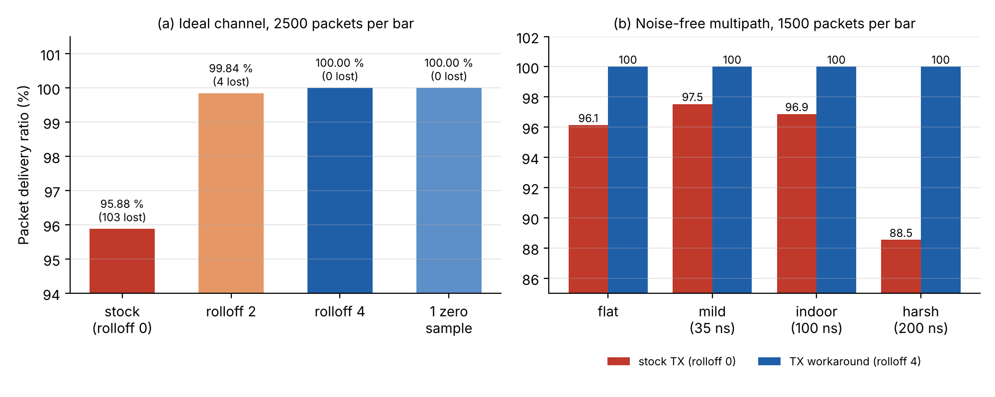
Result 1: 4 % loss, and it is not the scheduler
TX setting | PDR (stream / offline)
rolloff 0 (default) | 95.87 / 95.88 %
rolloff 2 | 99.84 / 99.84 %
rolloff 4 | 100 / 100 %
1 zero sample | 100 / 100 %
Lost packets per seed identical in both modes (26, 21, 19, 18, 19) → signal processing, not scheduler.

Slide 7
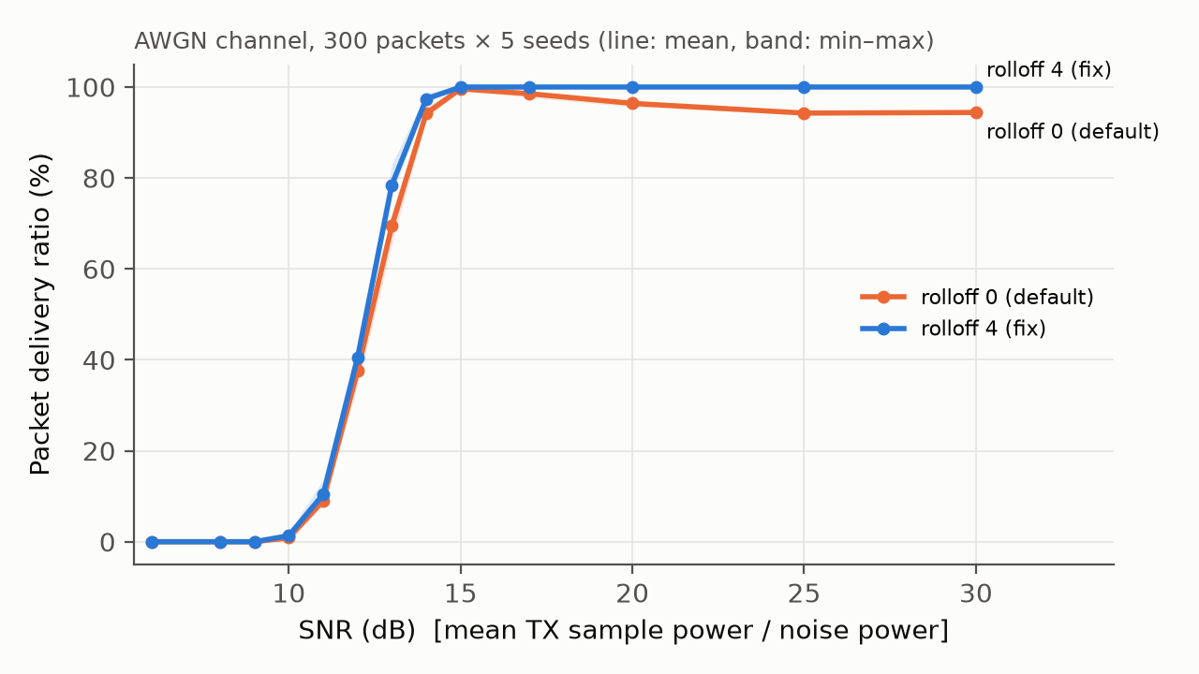
Result 2: cleaner channel, MORE loss
Stock: 99.6 % at 15 dB → 94.4 % at 30 dB
Fix: 100 % for every SNR ≥ 15 dB
Noise randomises the trigger error; a clean channel makes it systematic
A noisy test can pass while the bug is there

Slide 8
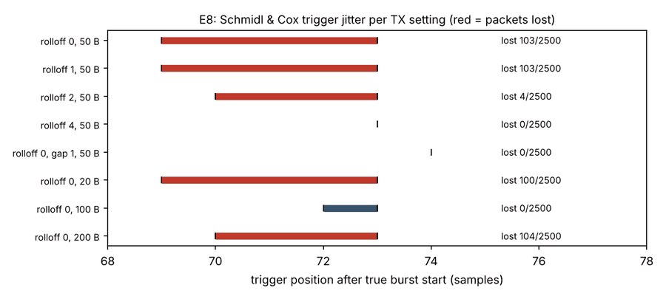
Result 3: root cause to the sample
Stock: trigger lands 69–73 samples after the burst start
rolloff 4: always 73; one zero sample: always 74
Replay rule predicts EXACTLY the lost packets in 100/100 runs (40 E8 + 60 E8b)
100-byte mystery solved: jitter ≤ 1 sample → no loss; "last symbol full" hypothesis rejected

Slide 9
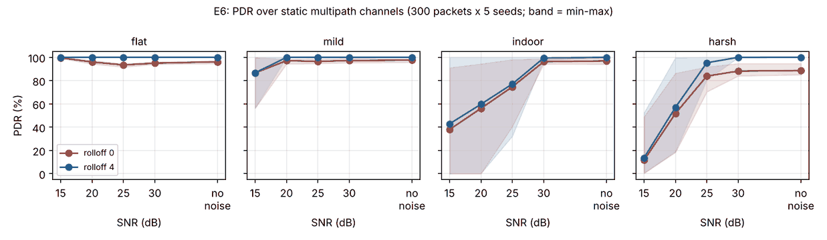
Result 4: realistic channels (multipath, CFO)
Workaround never worse: 20/20 conditions
Multipath makes the bug worse: harsh noise-free 88.5 % → 100 %
Low SNR + multipath: both collapse (uncoded BPSK), not the bug
CFO up to 3.5 subcarriers: no effect

Slide 10
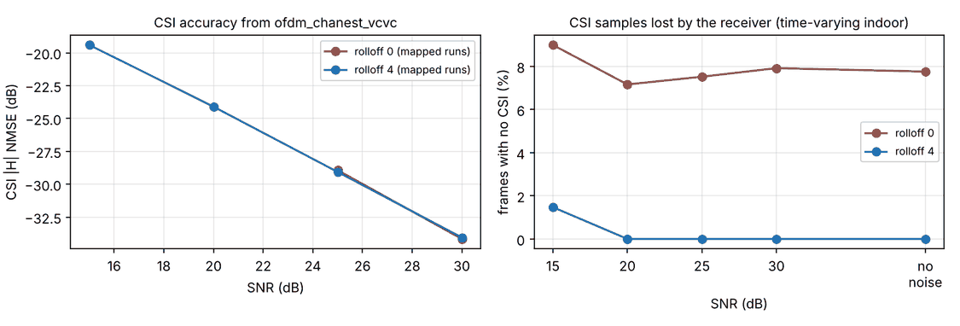
Result 5: What it means for Wi-Fi sensing?
GNU Radio already computes good CSI: −19 dB NMSE at 15 dB, −34 dB at 30 dB
…but ofdm_rx does not output it
Stock TX: 7–9 % of CSI samples silently missing
0.5 Hz motion estimated 7–8 % too high; < 0.1 % with workaround or sequence-number timestamps

Slide 11
Result 6: Silent freezes and the 1020-byte wall
Packet size | Default buffers | Buffers 65536
50–250 B | OK | OK
300–1000 B | HANG (Buffer too small for min_noutput_items) | OK 20/20
≥ 1020 B | ends normally, 0 packets sent | 0 packets sent
Failing block's thread exits; rest of flowgraph waits forever; run() never returns = #7997 symptom (2 builds)
Leaked TX length tag causes the same freeze via header_payload_demux
≥ 1020 B: tagged_stream_mux needs 12032 items, max 8191 → Wi-Fi-MTU packets impossible

Slide 12
The upstream contribution: PR #8271
11 Nov: measurements posted on #6891; our one pull request, PR #8271, opened (2 signed-off commits, DCO passed)
qa_ofdm_txrx.py: first multi-packet OFDM test (100 × 50 B back-to-back)
ofdm_loopback.grc: rolloff 0 → 4
Test shown to detect the bug: rolloff 0 → FAIL 4850 != 5000; passes on 3.10.12 and 3.10.9.2
12 Nov, maintainer marcusmueller: "are you proposing to abuse the rolloff factor to hide a bug?" (label: Needs Action)

Slide 13
Responding to review: from workaround to honest test
We agreed: the rolloff hides a receiver bug; one zero sample hides it just as well
Our response explains the root cause with our data and proposes a revision of the same PR:
drop the ofdm_loopback.grc change
test with the default rolloff=0, marked @unittest.expectedFailure (refs #6891)
→ documents the bug, CI stays green, flags the day the receiver is fixed
Deterministic: setUp() seeds payloads with 0 → loss every run
Alternative: pair the test with a real header_payload_demux fix. Revision not pushed yet; waiting for the maintainer
Lesson: in a mature project, a change that hides a problem is worse than no change

Slide 14
Baseline comparison
Approach | Change in | PDR ideal | PDR harsh, noise-free | Limitation
Stock GNU Radio | – | 95.88 % | 88.5 % | silent loss
rolloff 2 | TX | 99.84 % | – | still loses
rolloff 4 (PR #8271) | TX | 100 % | 100 % | hides RX bug
1 zero sample | TX | 100 % | – | hides RX bug
Test (proposed revision) | tests | – | – | detects, not fixes
RX fix (GSoC 2027) | RX | target 100 % | target 100 % | not built yet

Slide 15
Final SOTA positioning
Existing work | Their state | After G1
GNU Radio gr-digital OFDM | bug known, cause qualitative, single-packet tests | sample-exact predictive cause, multi-packet test under review
gr-ieee802-11 | own sync, no packet-level reliability tests | our trigger-logging + replay method applies
CSI tools (5300, Nexmon, ESP32) | real HW, closed PHY | open CSI is accurate in GNU Radio, just not exposed
SenseFi / 802.11bf | assume uniform, timestamped CSI | 7–9 % silent drop → 7–8 % frequency bias
No new algorithm, no merged code yet, no hardware: gap = RX fix, merge, CSI output, SDR validation

Slide 16
Limitations and challenges
Contribution is a test, not a fix; receiver still drops touching bursts
Simulation only; synthetic channels
#7997 reporter's flowgraph not public → mechanism shown, not confirmed
Why some packet lengths have no jitter: still open
Tested on packaged 3.10.9.2 / 3.10.12, not a source build of main
Challenges: freezes that never return (watchdog), losses hidden by repeated payloads (sequence numbers), learning upstream etiquette

Slide 17
GSoC 2027 proposal: reliable, CSI-producing OFDM receiver
Weeks (planned) | Planned work | Planned outcome
Bonding | design note, source build, finish review of our PR #8271 | design note
1–2 | benchmark / test matrix | benchmark + QA tests
3–6 | RX fix: early-trigger tolerance vs timing refinement; remove expectedFailure | receiver fix (midterm)
7–8 | loud failures, ≥ 1020 B | clear errors, no freezes
9–10 | per-packet CSI message port + dataset example | CSI output
11–12 | validation, tutorial, final report | docs
All of this is planned for GSoC 2027; none of it is done or submitted yet. So far: one PR (#8271) and one issue comment (#6891).

Slide 18
Conclusion
Turned a 2-year-old "serious" bug into a measured, predicted and tested failure
Linked receiver reliability to Wi-Fi sensing error (first quantitative link in GNU Radio)
Took it upstream with one PR (#8271), listened to the maintainer, prepared an honest revision
Everything reproducible: Code/run_all.sh, fixed seeds, all CSVs and figures in the repo
Repository: github.com/divyarajv1-ship-it/g1_gsoc_wifisensing · PR: gnuradio/gnuradio#8271

