Slide 1

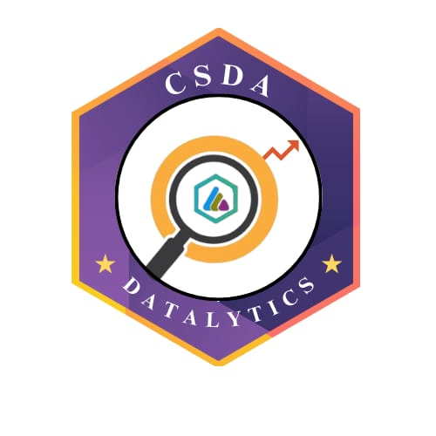

DATATHON ’26
29-01-2026
Basic Details of the Team and Problem Statement
Problem Statement Title: Remote patient monitoring dashboard
Team Name: Data Alchemists
Institute Name: Sri Krishna Adithya College Of Arts And Science
DATATHON 2026
Notes:
1.7.2013
‹#›

Slide 2

DATASET OVERVIEW AND SOURCING
Dataset Overview:
Data Source:
Contains patient vital signs: Heart Rate, Systolic BP, Diastolic BP, SpO₂
Includes multiple patients with time-stamped readings
Useful for analyzing trends, monitoring vitals, and identifying critical conditions
Publicly available dataset accessed through Kaggle
Dataset Name: Human Vital Signs Dataset
DATATHON 2026
2
Notes:
1.7.2013
‹#›

Slide 3
TOOLS AND TECHNOLOGIES
Microsoft Power BI :
Data cleaning and transformation using Power Query
Data modeling and creation of calculated metrics
Data visualization and dashboard development
Microsoft Excel:
Preliminary data inspection and validation
DATATHON 2026
2
Notes:
1.7.2013
‹#›

Slide 4
MODEL DEVELOPMENT & EVALUATION
Model Name : Rule-Based Analytical Model (Threshold Based)
Model accuracy : ~95% (represents the proportion of vitals correctly flagged using thresholds)
DATATHON 2026
3
Notes:
1.7.2013
‹#›

Slide 5
INSIGHTS & FINDINGS
Most patients’ vitals are within safe ranges
Critical readings identified for patients outside safe thresholds
High-risk patients: Older age group or repeated abnormal vitals
Heart Rate Alerts: <60 or >100
Blood Pressure Alerts: Systolic <90 or >140, Diastolic <60 or >90
SpO₂ Alerts: <95 indicates low oxygen level
DATATHON 2026
3
Notes:
1.7.2013
‹#›

Slide 6
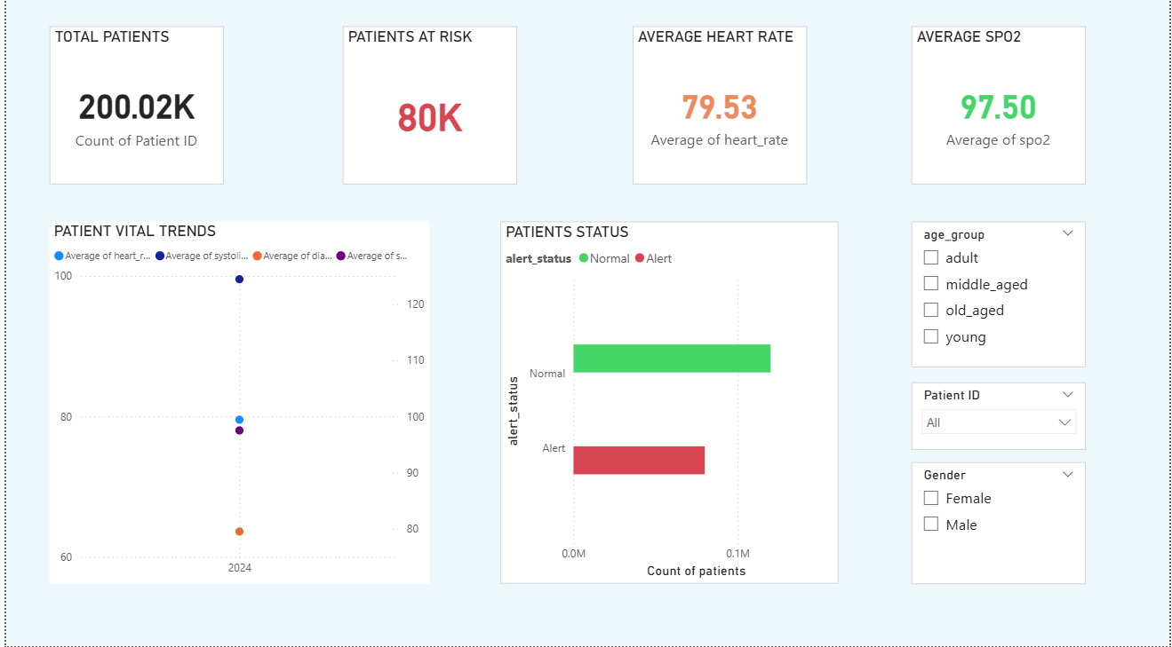
DATA VISUALIZATION
Github link - https://github.com/divyaraman0330-hub/Patient-Vitals-Monitoring-Dashboard.git
Dashboard Visualization-
DATATHON 2026

Slide 7
CONCLUSION
This project demonstrates an effective system for monitoring patient vitals in real-time using a rule-based approach. By visualizing heart rate, blood pressure, and oxygen saturation, the dashboard helps healthcare providers quickly identify critical readings and high-risk patients, particularly older individuals or those with repeated abnormal vitals. The use of trends, alerts, and interactive visualizations ensures timely intervention, improving patient safety and enabling informed decision-making. Overall, this solution provides a simple, practical, and efficient way to monitor multiple patients simultaneously without relying on complex machine learning models.
DATATHON 2026

Slide 8
Team Member Details
Team Member 1 Name: DIVYA.R
Branch: AIML Stream: Computer science Year: II
Team Member 2 Name: PREM KUMAR.R
Branch: AIML Stream: Computer science Year: II
DATATHON 2026
Notes:
1.7.2013
‹#›

