Slide 1
DMart Sales Analysis – Power BI Dashboard
Created by: Divya Dattaram Rane

Slide 2
Problem Statement
DMart generates large volumes of sales, customer, and product data across multiple states and categories. However, the absence of a centralized and interactive view makes it difficult to track performance, understand customer behavior, and evaluate product pricing effectively.

Slide 3
Project Objective
Provide a quick overview of overall sales performance
and key business KPIs
Analyze customer behavior and demographic trends
Evaluate product-wise sales and pricing effectiveness
Assess the impact of discounts, delivery, and marketing
channels
Enable interactive, data-driven decision-making through
filters and visuals

Slide 4
Dataset Summary
Rows: 25,000 Columns: 29
Data Types:
object: Customer ID, Product ID, Gender, Product Name, Category, State, City, Subscription, Marketing/Advertisement, Ship Mode, Order Status, Order Date, Delivery Date, Cancellation Date, Payment Method, Total Order Value, Payment Status, Month, Shipping Charges
int64: Order ID, Customer Age, Pin Code, No of Clicks, Year
float64: MRP, Discount Price, Bill Number, Time Spent on Website, Rating

Slide 5
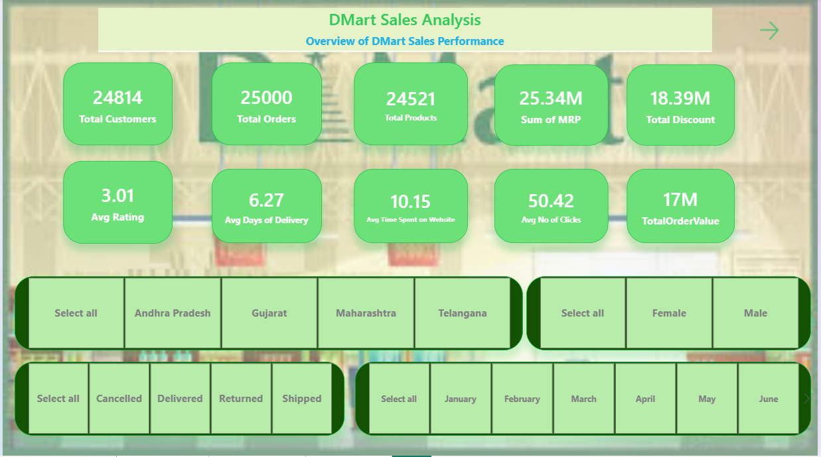

Slide 6
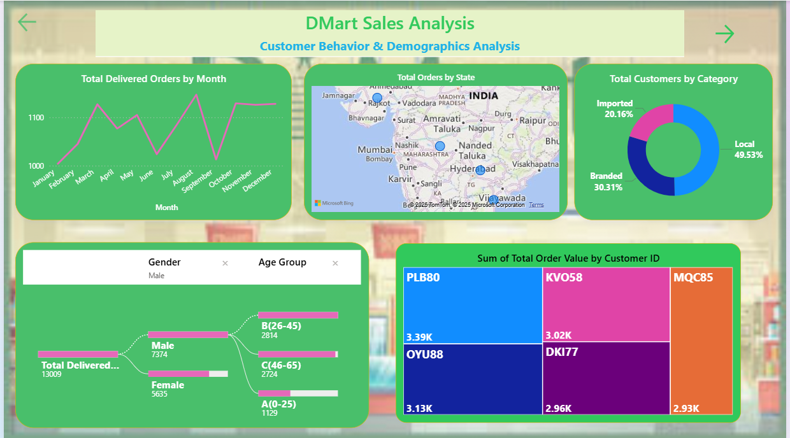

Slide 7
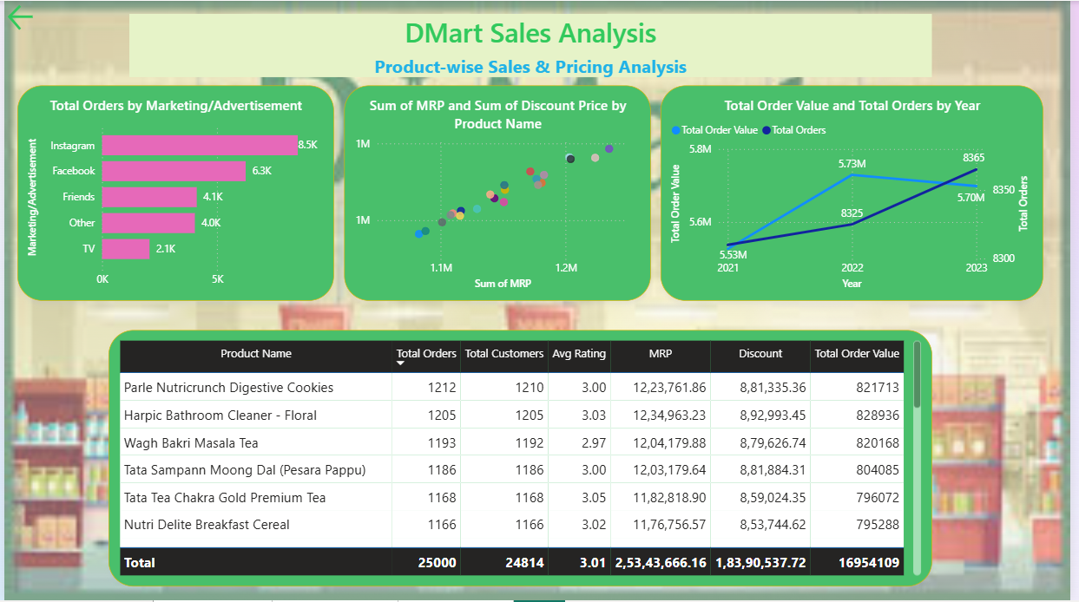

Slide 8
Data Cleaning & Preparation
Removed 'Cancellation Date' column.
Replaced cancelled order values with 0.
Set correct data types: decimal, number, text.
Fixed measure callout formatting.

Slide 9
Data Transformations
Created Age Group column based on Customer Age.
Added Month Number to sort months correctly.
Formula: Date.Month(Date.FromText("1 " & [Month] & " " & Text.From([Year]), "en-US"))
Enabled slicer sync across all report pages.
Added page navigation buttons.

Slide 10
DAX Measures Created
Total Delivered Orders
Average Time Spent
Average Discount
Average Rating
Total Order Value
Total Products
Total Orders
Total Customers
Avg Days to Deliver
Average No. of Clicks

Slide 11
Dashboard Visuals
Line Chart – Total Order Value by Month
Dual Line Chart – Total Order values and Total Order counts by Year
Map – Total Orders by State
Decomposition Tree – Age Group & Gender
Donut Chart – Customer Category Split
Scatter Chart – MRP vs Discount
Stacked Bar – Orders by Marketing Source
Table – Product-level KPIs
Tree Map - Top 5 Customers by Orders
Slicers – Month, State, Gender, Order Status

Slide 12
Key Insights
August had the highest orders (1147).
Maharashtra recorded the most orders (6343).
Local category customers dominate the distribution.
Male age 26–45 segment had highest delivered orders.
Instagram is top marketing source (8.5K orders).
PLB80 customer generated 3.4K order value.
2022 saw highest value; 2023 had highest order count.
Top-selling product: Parle Nutricrunch Digestive Cookies.

Slide 13
Recommendations
Increase
Increase focus in Maharashtra to boost sales further.
Target
Target female customers with engagement campaigns.
Invest
Invest more in Instagram advertising.
Enhance
Enhance promotions for top-performing products.

Slide 14
Conclusion
Dashboard delivers comprehensive sales insights.
Interactive visuals improve decision-making.
Data modeling and DAX enhance analytical accuracy.
Supports marketing and sales strategy planning.

