Slide 1
Presented By -
Divya Rane

Slide 2
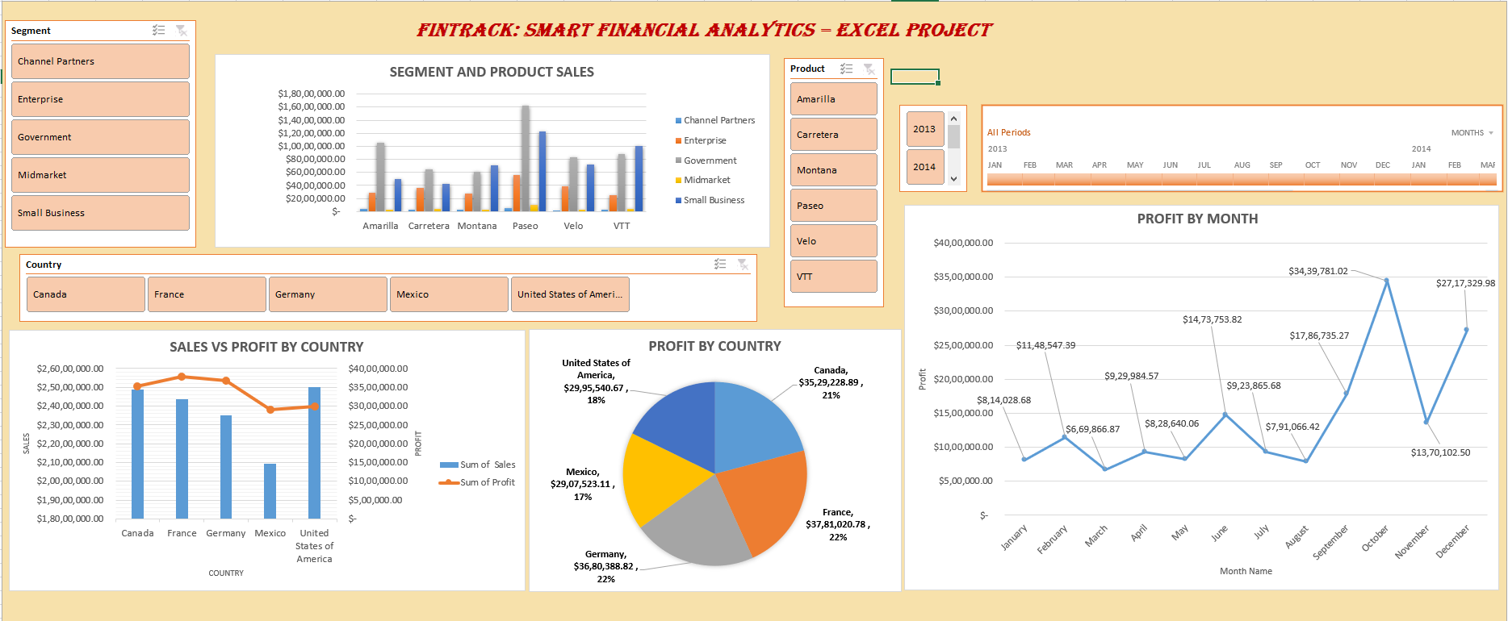
SALES DATA ANALYSIS USING MICROSOFT EXCEL

Slide 3
Overview
➢ OBJECTIVE.
➢ DATA PREPROCESSING.
➢ PLOTTING PIVOT CHART
a. SEGMENT AND PRODUCT SALES
b. SALES VS PROFIT BY COUNTRY
c. PROFIT BY COUNTRY
d. PROFIT BY MONTH
➢ SEGMENT, PRODUCT , COUNTRY AND YEAR FILTER USED BY SLICER
➢ TIMELINE FOR PROFIT
➢ CONCLUSION
➢ RECOMMENDATIONS

Slide 4
OBJECTIVE
➢Analyze sales data to identify trends, optimize product offerings, and improve customer satisfaction.
➢The dashboard aims to offer insights into sales trends, profit margins, and customer behavior, enabling businesses to make informed decisions and optimize their strategies.
➢ Provides a comprehensive overview of sales data, including total sales, profit, and customer information.

Slide 5
DATA PREPROCESSING
➢ Data Cleaning: Handling missing values, removing duplicates, and correcting errors.
➢ Data Transformation: Converting data types, aggregating data, and creating new fields.
➢Data Filtering: Removing irrelevant data and applying filters for analysis

Slide 6
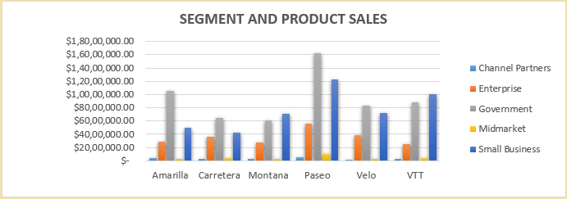
SEGMENT AND PRODUCT SALES
Analysis: "This graph shows that the Paseo product has highest sales in Government Segment and Velo product is lowest sales in Channel Partners segment.”

Slide 7
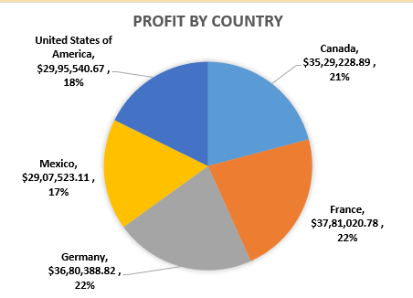
Profit by Country
Analysis: "This graph shows that the France is the highest profitable country.”

Slide 8
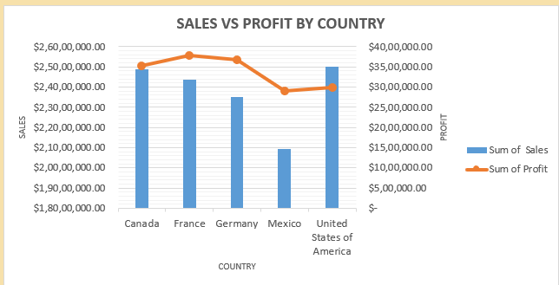
SALES VS PROFIT BY COUNTRY
Analysis: "This graph shows that the United states of America country has the highest sales and France Country has highest profit. Mexico is lowest country for both sales and profit.”

Slide 9
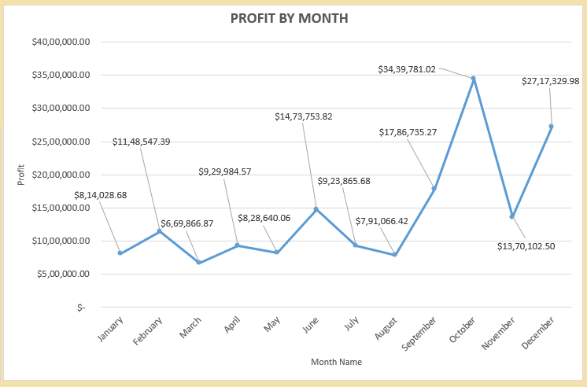
Profit By Month
Analysis: "This graph shows that the October month has the Highest profit and March month has the lowest profit”

Slide 10
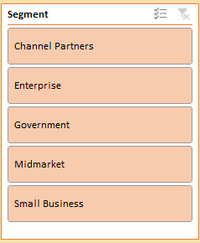
The Segment Filter Slicer
The Segment filter slicer is used to analyze sales Segment wise which helps to identify highest/lowest sales Segment.

Slide 11
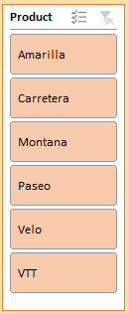
The Product Filter Slicer
The Product filter slicer helps to analyze sales Product wise which helps to identify highest/lowest sales Product.

Slide 12
The Country Sales Filter
The Country filter slicer helps to analyze Sales and Profit by Country which helps to identify highest/lowest Country value.

Slide 13

The Year Filter Slicer
The Year filter slicer helps to analyze profit over year.

Slide 14
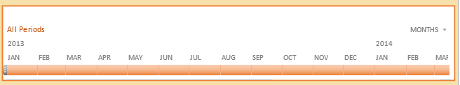
Date filter by Timeline
By analyzing the data, we can identify patterns and trends in customer behavior, such as :-
➢ Seasonal fluctuations- Identifying seasonal patterns in sales data
➢ Year-over-year growth- Analyzing sales data over time to assess growth and trends
➢ Peak periods- Identify peak periods when orders are highest. Used to optimize inventory management, staffing, and marketing strategies.
➢ Low periods- Identify low periods when orders are scarce. Help us to plan for slow periods, adjust our pricing strategy, or implement targeted marketing campaigns to boost sales

Slide 15
Conclusion
The sample superstore dashboard provides a valuable tool for businesses to analyze sales data, identify trends, and optimize strategies.
By leveraging data visualization and analytics, businesses can gain insights into customer behavior, sales performance, and profit margins, ultimately driving growth and improvement.
The dashboard's interactive features and drill-down capabilities enable users to explore data in detail, making it an essential resource for data-driven decision-making

Slide 16
RECOMMENDATIONS
Focus on Paseo product in the Government segment.
Invest in the France country customers to maximize the Profit.
Target on United States of America country customers which has Highest Sales.
Analyze and replicate strategies from October, which recorded the highest monthly profit of ₹3.44 Cr.
Revise sales strategies to improve sales and profit.

Slide 17


